Slide 1
Issues in Creativity
Veljko Milutinovic, vm@etf.rs

Slide 2
Ten Idea Generation Methods*

Slide 3
Mendeleyevization: Inductor versus Catalyst
(M1 vs M2)
Definition: If one of the classification class includes no examples, it first has to be checked why is that so. If it is so because it makes no sense, an appropriate explanation is in place. If it is so because the technology or the applications are not yet ready for such an approach, one can act in the same way as the famous chemists Mendeleyev: Empty positions in any classification are potential avenues leading to new inventions. We refer to such an approach as: Mendeleyevization.
Examples: As far as M1/M2, the famous classification of computer systems by Mike Flynn (SISD, SIMD, MISD, MIMD) initially included no examples of the MISD type. Later on, a DFT machine (generated using the M1 method) was categorized as an MISD machine [Milutinovic86A], as well as one pipelined machine (generated using the M2 method), namely [Milutinovic87C]; the DFT served as an inductor, and pipeline as a catalyst. Other popular examples are related to various signal processors and process accelerators.
A: Mendeleyevization (Inductor versus Catalyst) – M1 vs M2
Notes:
3

Slide 4
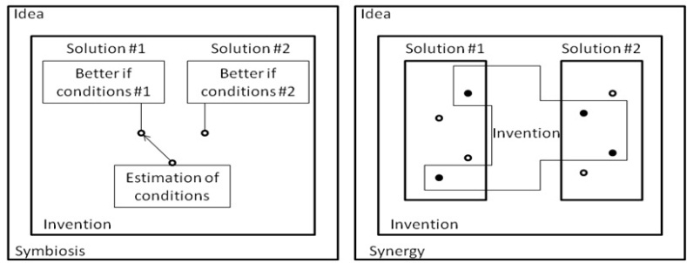
Hybridization: Symbiosis versus Synergy
(H1 vs H2)
Definition: Sometimes two classification classes can be combined, in order to obtain a hybrid solution (hybridization). Hybrid solutions can be symbiotic (measuring the conditions in the environment and switching from one approach to the other, so that each approach is active all the time, while the conditions are such that it provides better performance compared to the other approach) or synergistic (creating a new approach, which, for each particular solution element takes the better solution element of two different approaches).
Examples: As far as H1/H2, the essence of [Milutinovic85] is that two algorithms are combined into one on the either-one-or-the-other basis (using the H1 method), and on a combine-inherent-details basis (using the H2 method) in [Milutinovic87B]. Other popular examples include hybrid computers or computers that use special purpose accelerators, when appropriate data/process patterns are located.
B: Hybridization (Symbiosis versus Synergy) – H1 vs H2

Slide 5
Transdisciplinarization: Modifications versus Mutations (T1 vs T2)
Definition: Often times, good new ideas get generated if algorithms, procedures, ways of thinking, re ported from one field to another field, along the lines of transdisciplinary research methodologies (transdisciplinarization).
Examples: As far as T1/T2, [Milutinovic86B] ports algorithms from Silicon to GaAs (using the T1 method), and introduces appropriate modifications along the process, while [Milutinovic87A] creates a proposal for a novel computer architecture (using the T2 method), along the analogies with a biological honeycomb. Other popular examples include porting of the FFT from seismic signal processing to speech signal processing (modification), or introduction of mathematical neural networks inspired by biological neural networks (mutation).
C: Transdisciplinarization (Modification versus Mutation) – T1 vs T2

Slide 6
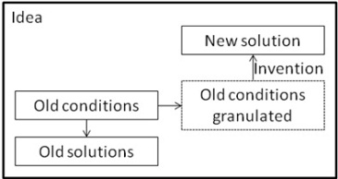
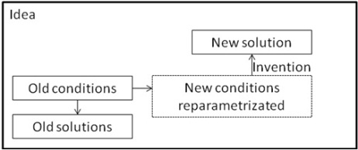
Remodelling: Granularization versus Reparametrization (R1 vs R2)
Definition: Sometimes it is simply the best to take a research direction different (even opposite) compared to what others take (retrajectorization using remodeling). The different (opposite) research direction makes sense either if a more detailed set of parameters is in place (granularization, due to model changes because of application changes), or because parameters of the environment have changed permanently (reparametrization, due to model changes because of technology changes). The two alternatives are referred to as granularization and reparametrization.
Examples: As far as R1/R2, [Milutinovic88] offers a new algorithm (using the R1 method) that makes sense if an environment is represented with a more detailed model, while [Milutinovic89] offers a new solution in a changed environment (using the R2 method), when a design has to be ported from Silicon to GaAs (from the performance/price point of view, the best adder design for Silicon, the carry-lookahead adder, is among the worst ones for GaAs, and the opposite: the worst adder for Silicon, the ripple-carry adder, is among the best ones for GaAs; this is because GaAs gate delays depend on fan-out and ripple-carry adders are characterized with only the minimal fan-out, while the fan-out of the carry-lookahead adders depends on the word size, and can grow infinitely). Other popular examples are related to concept modeling in AI based on graphical representation with icons (in a model with fewer icons, one can make a conclusion which is different, and often times even opposite, compared to a conclusion made from a model with a much larger number of icons); also, when the environment changes (for example, the ratio of processing speed to communication speed changes), a different type of supercomputing network becomes optimal.
D: Remodeling (Granularization versus Reparametrization) – R1 vs R2

Slide 7
Unorthodoxization: ViewFromAbove versus ViewFromInside (U1 vs U2)
Definition:
This category encompasses the approaches that are difficult to classify: Sometimes one sees something that others did not see for decades or centuries (ViewFromAbove) or one gets stroked by an idea of a genius with no ground in existing research (ViewFromInside).
Examples: As far as U1/U2, [Milutinovic2000] generated an innovation after trying to make a holistic view (U1), and [Milutinovic2001] introduces an idea after an effort is made to understand the intrinsic details of the problem (U2). Other popular examples include the contributions of Nobel Laureates Martin Perl and Jerome Friedman.
E: Unorthodoxization (ViewFromAbove versus ViewFromInside) – U1 vs U2

Slide 11
Experiences with PhD Students of the Authors of this Research
Researcher | Research domain | Method
Drazen Draskovic | mutation algorithms for genetic search [Draskovic2012] | H1
Bojan Furlan | opinion mining for social networks [Furlan2011] | H1
Nemanja Kojic | data mining for wireless sensor networks [Kojic2012] | U1
Marko Misic | interconnection networks for multiprocessor systems [Misic2011] | R2
Milos Cvetanovic | system software for wireless sensor networks [Cvetanovic2008] | H1
Zaharije Radivojevic | application software for wireless sensor networks [Radivojevic2008] | H1
Zarko Stanisavljevic | computing infrastructure for distant education [Stanisavljevic2011] | H1
Zivojin Sustran | cache management for multiprocessor systems [Sustran2012] | T2
Djordje Djurdjevic | of computer graphics for mission applications [Djurdjevic2011] | R1
Sasa Stojanovic | hybrid computing for supercomputer architecture [Stojanovic2012] | H1

Slide 12
Classified References Used in the Educational Process
M1: Mendeleyevization/Inductor [Milutinovic86a] Milutinovic, V., Fortes, J., Jamieson, L.,A Multiprocessor Architecture for Real-Time Computation of a Class of DFT Algorithm,IEEE Transactions on Acoustics, Speech, and signal Processing, Aol. ASSP-34, No. 5, October 1986, pp. 1301-1309.(impact factor 1.463/1992).
M2: Mendeleyevization/Catalyst [Milutinovic87c] Milutinovic, V.,A Simulation Study of the Vertical-Migration Microprocessor Architecture,IEEE Transactions on Software Engineering, Vol. SE-13, No. 12, December 1987, pp. 1265-1277.
H1: Hybridization/Symbiosis [Milutinovic85] Milutinovic, V.,A Microprocessor-Oriented Algorithm for Adaptive Equalization,IEEE Transactions on Communications, Vol COM-33, No 6, June 1985, pp. 522-526.(impact factor 1.512/2010).
H2: Hybridization/Synergy [Milutinovic87b] Milutinovic, V., Lopez-Benitez, N., Hwang, K.,A GaAs-Based Microprocessor Architecture for Real-Time Applications,IEEE Transactions on Computer, VolC-36, No 6, June 1987, pp. 714-727.(impact factor 1.822/2010).
T1: Transdisciplinarization/Modification [Milutinovic86b] Milutinovic, V.,GaAs Microprocessor Technology,IEEE Computer, Vol 19, No. 10, October 1986 (Invited, Guest Editor's Introduction), pp. 10-15.(impact factor 2.205/2010).
T2: Transdisciplinarization/Mutation [Milutinovic87a] Milutinovic, D., Milutinovic, V., Soucek, B.,The Honeycomb Architecture,IEEE Computer, Vol. 20, No. 4, April 1987 (Open Channel), pp. 81-83.(impact factor 2.205/2010).
R1: Remodeling/Granularization [Milutinovic88] Milutinovic, V., A Comparison of Suboptimal Detection Algorithms Applied to the Additive Mix of Orthogonal Sinusoidal Signals, IEEE Transactions on Communicatiions, Vol. COM-36, No. 5, May 1988, pp. 538-543.
R2: Remodeling /Reparametrization [Milutinovic89] Milutinovic, V., Bettinger, M., Helbig, W.,Multiplier/Shifter Design Trade-offs in a 32-bit Microprocessor,IEEE Transactions on Computers, Vol. 38, No. 6, June 1989, pp. 847-880.(impact factor 1.822/2010).
U1: Unorthodoxization/ViewFromAbove [Milutinovic2000] Milutinovic, V., Cvetkovic, D., Mirkovic, J., “Genetic Search Based on Multiple Mutation Approaches,” IEEE Computer, 2000. (impact factor 1.822/2010).
U2: Unorthodoxization/ViewFromInside [Milutinovic2001] Milutinovic, V., Ngom, P., Stojmenovic, I., “STRIP --- A Strip Based Neural Network Growth Algorithm for Learning Multiple-Valued Functions,” IEEE Transactions on Computers, 2001. (impact factor 1.822/2010).

Slide 13
.ppt Presentations: Condicios Since Qua Non
n/N
7
Semantic Breaks (One Line - One Thought)

Slide 14
Semantic Breaks: An Example (Bad)
Research Issues of Importance for Distributed
Shared Memory
Hardware Issues (those to be fully
implemented in hardware)
Software Issues (those to be fully
implemented in software)
Hybrid Issues (those to be partially implemented in
hardware and partially in software)

Slide 15
Semantic Breaks: An Example (Good)
Research Issues of Importance
for Distributed Shared Memory
Hardware Issues
(those to be fully implemented in hardware)
Software Issues
(those to be fully implemented in software)
Hybrid Issues
(those to be partially implemented in hardware
and partially in software)

Slide 16
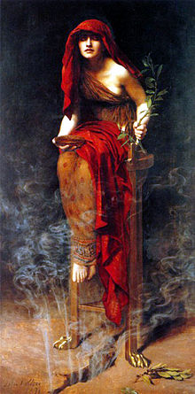
Priestess of Delphi: Pythia
Ibis, redibis nunquam,
in belo peribis
Ibis, redibis,
nunquam in belo peribis

Slide 17
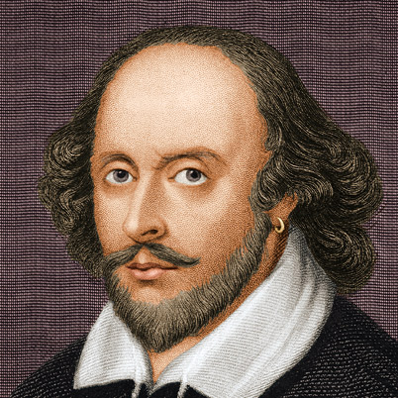
Romeo and Juliet: Prologue
Two households, both alike in dignity, In fair Verona, where we lay our scene, From ancient grudge break to new mutiny, Where civil blood makes civil hands unclean. From forth the fatal loins of these two foes A pair of star-cross'd lovers take their life; Whose misadventured piteous overthrows Do with their death bury their parents' strife. The fearful passage of their death-mark'd love, And the continuance of their parents' rage, Which, but their children's end, nought could remove, Is now the two hours' traffic of our stage; The which if you with patient ears attend, What here shall miss, our toil shall strive to mend.

Slide 18
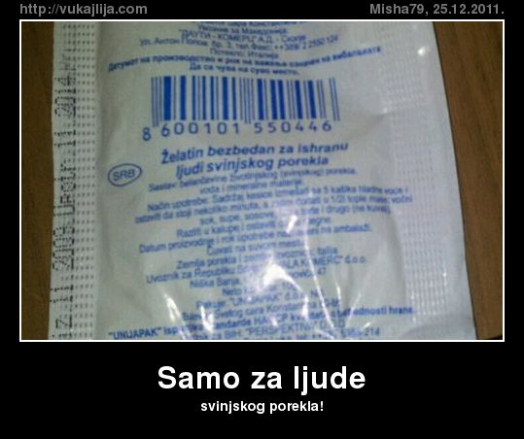

Slide 19
What is Better?
function DayOfWeek(day, month, year) {
var a = Math.floor((14 - month) / 12);
var y = year - a;
var m = month + 12 * a - 2;
var d = (day + y + Math.floor(y / 4) - Math.floor(y / 100) +
Math.floor(y / 400) + Math.floor((31 * m) / 12)) % 7;
return d;
}

Slide 20
What is Better?
function DayOfWeek(day, month, year) {
var a = Math.floor((14 - month) / 12);
var y = year - a;
var m = month + 12 * a - 2;
var d = (day + y + Math.floor(y / 4) - Math.floor(y / 100) +
Math.floor(y / 400) + Math.floor((31 * m) / 12)) % 7;
return d;
}
function DayOfWeek(day, month, year) { var a = Math.floor((14 - month) / 12); var y = year - a; var m = month + 12 * a - 2; var d = (day + y + Math.floor(y / 4) - Math.floor(y / 100) + Math.floor(y / 400) + Math.floor((31 * m) / 12)) % 7; return d;}

Slide 21
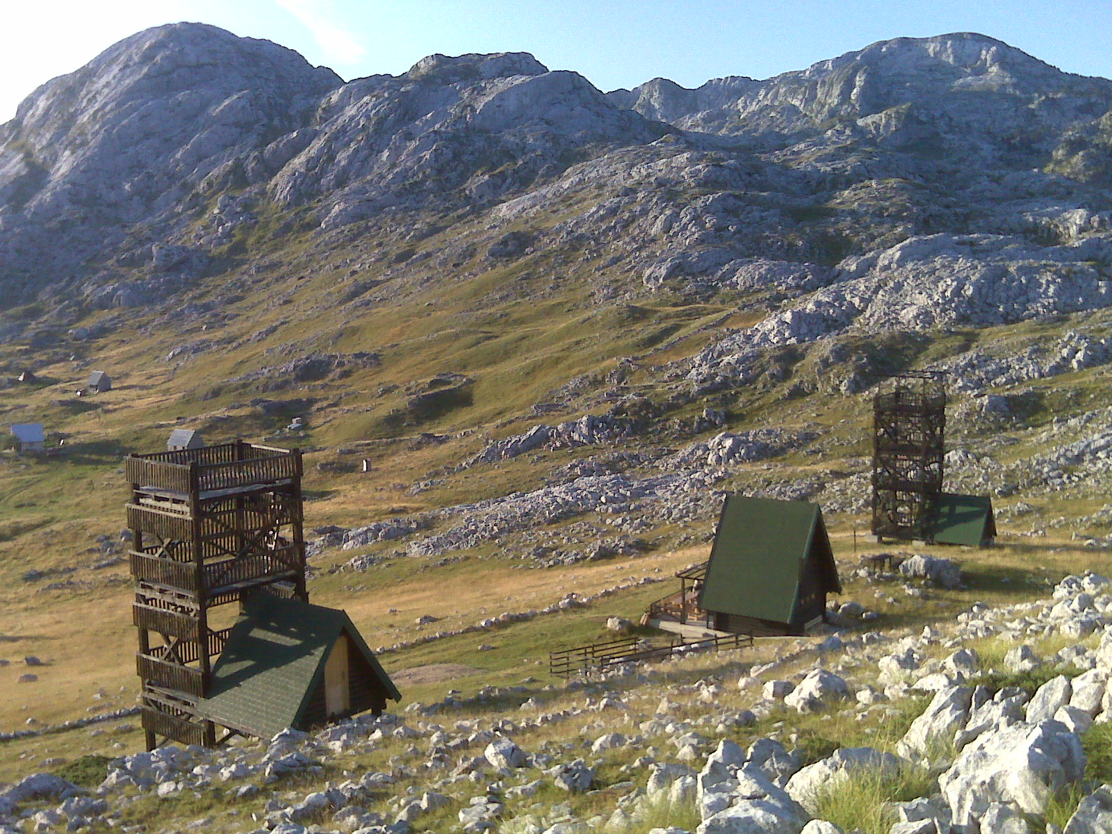
21

Slide 22
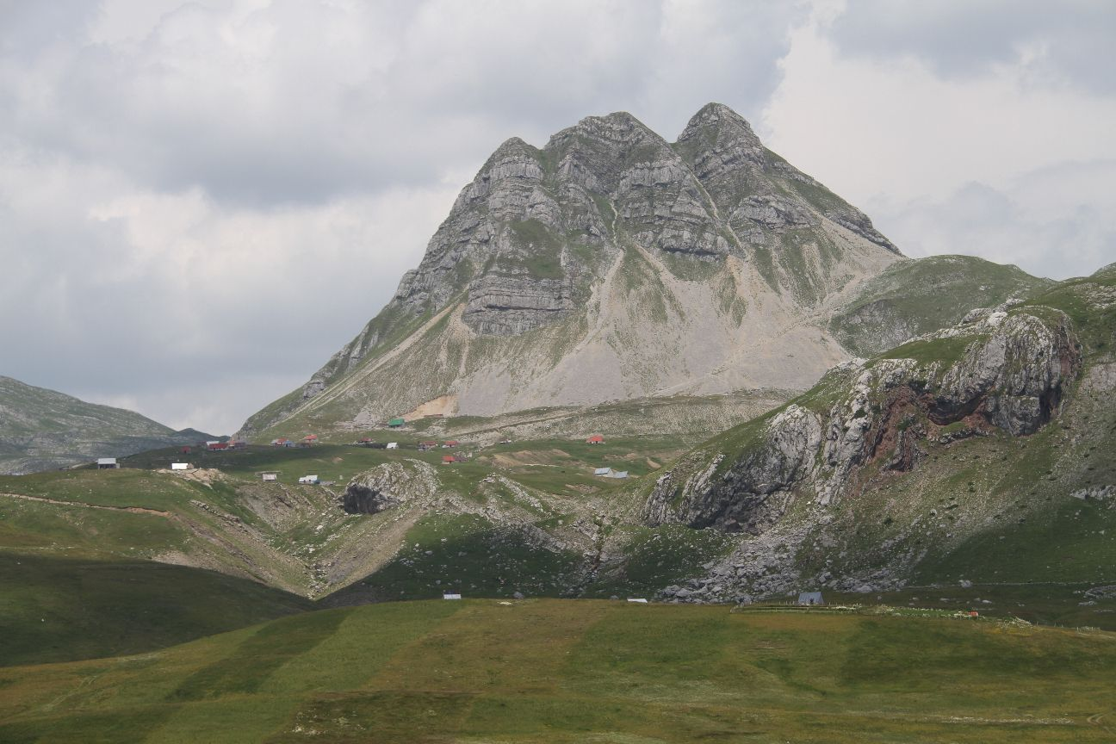
Q&A
vm@etf.rs
22
© H. Maurer

