Slide 1

Faculty of Electrical Engineering
University of Belgrade
Ant-Miner
Data Mining with an
Ant Colony Optimization Algorithm
(Parpinelli R., Lopes H., Freitas A.)
Marko Jovanović | Sonja Veljković
genije.jovanovic@gmail.com | sonja.veljkovic@gmail.com

Slide 2
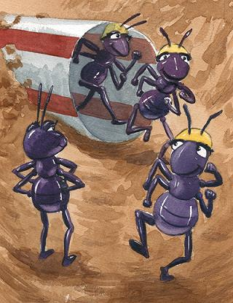
Outline
Introduction
Problem Statement
Real Ant Colonies
Ant Colony Optimization
Existing Solutions
Ant-Miner
Example
Proof of Concept
Trends and Variations
Future work
Marko Jovanović |  | Sonja Veljković
genije.jovanovic@gmail.com | 2/36 | sonja.veljkovic@gmail.com

Slide 3
Introduction
The goal of data mining:
extract (comprehensible) knowledge from data
Comprehensibility is important when knowledge
will be used for supporting a decision made by a human
Algorithm for data mining called Ant-Miner
(Ant Colony-based Data Miner)
Discover classification rules in data sets
Based on the behavior of real ant colonies
and on data mining concepts
Marko Jovanović |  | Sonja Veljković
genije.jovanovic@gmail.com | 3/36 | sonja.veljkovic@gmail.com

Slide 4
Problem Statement
Rule Induction for classification using ACO
Given: training set
Goal: (simple) rules to classify data
Output: ordered decision list
Marko Jovanović |  | Sonja Veljković
genije.jovanovic@gmail.com | 4/36 | sonja.veljkovic@gmail.com

Slide 5
Real Ant Colonies
Different insects perform related tasks
colony is capable of solving complex problems
Find the shortest path between a food source
and the nest without using visual information
Communication by means of pheromone trails
As ants move, a certain amount of pheromone is
dropped on the ground, marking the path
The more ants follow a given trail, the more attractive
this trail becomes (loop of positive feedback)
Marko Jovanović |  | Sonja Veljković
genije.jovanovic@gmail.com | 5/36 | sonja.veljkovic@gmail.com

Slide 6
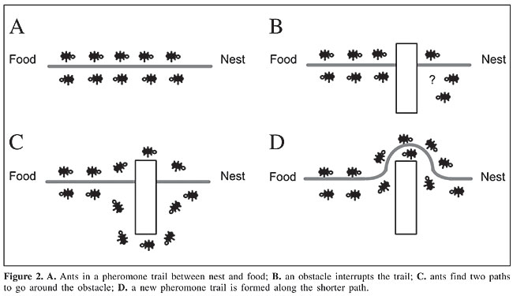
Obstacle on the Trail?
Marko Jovanović |  | Sonja Veljković
genije.jovanovic@gmail.com | 6/36 | sonja.veljkovic@gmail.com

Slide 7
Ant Colony Optimization
ACO algorithm for the classification task
Assign each case to one class, out of a set of predefined
classes
Discovered knowledge is expressed
in the form of IF-THEN rules:
IF <conditions> THEN <class>
The rule antecedent (IF) contains a set of conditions,
connected by AND operator
The rule consequent (THEN) specifies the class predicted for cases
whose predictor attributes satisfy all the terms specified in IF part
Marko Jovanović |  | Sonja Veljković
genije.jovanovic@gmail.com | 7/36 | sonja.veljkovic@gmail.com

Slide 8
Basic Ideas of ACO
Each path followed by an ant is associated
with a candidate solution
Ant follows a path
the amount of pheromone on that path is proportional
to the quality of the corresponding candidate solution
Ant choose between paths
the path(s) with a larger amount of pheromone
have a greater probability of being chosen
Marko Jovanović |  | Sonja Veljković
genije.jovanovic@gmail.com | 8/36 | sonja.veljkovic@gmail.com

Slide 9
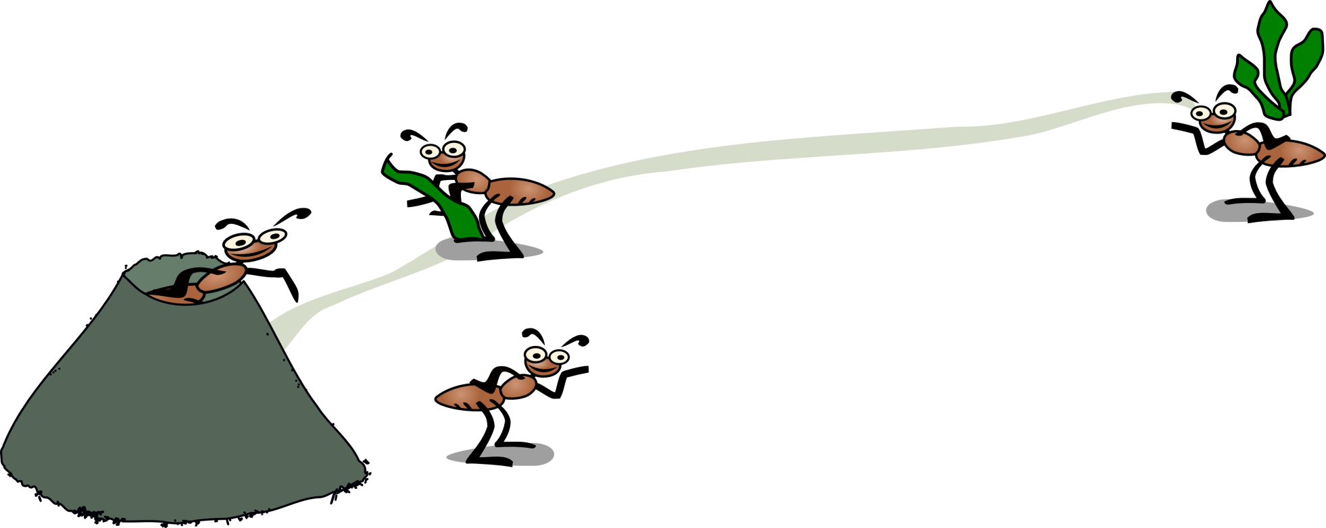
Result
Ants usually converge to the optimum
or near-optimum solution!
Marko Jovanović |  | Sonja Veljković
genije.jovanovic@gmail.com | 9/36 | sonja.veljkovic@gmail.com

Slide 10
Importance of ACO
Why are important for Data Mining?
Algorithms involve simple agents (ants)
that cooperate to achieve an unified
behavior for the system as a whole!
System finds a high-quality solution
for problems with a large search space
Rule discovery:
search for a good combination of terms
involving values of the predictor attributes
Marko Jovanović |  | Sonja Veljković
genije.jovanovic@gmail.com | 10/36 | sonja.veljkovic@gmail.com

Slide 11
Existing Solutions
Rule Induction Using a Sequential Covering Algorithm
CN2
AQ
Ripper
Marko Jovanović |  | Sonja Veljković
genije.jovanovic@gmail.com | 11/36 | sonja.veljkovic@gmail.com

Slide 12
CN2
Discovers one rule at a time
New rule to the end of the list of discovered rules
list is ordered!
Removes covered cases from the training set
Calls again the procedure to discover another rule
for the remaining training cases
Beam search for rule construction
At each iteration adds all possible terms
to the current partial rules
Retains only the best b partial rules (b - beam width)
Repeated until a stopping criterion is met
Returns the best of b rules currently kept by the beam search
Marko Jovanović |  | Sonja Veljković
genije.jovanovic@gmail.com | 12/36 | sonja.veljkovic@gmail.com

Slide 13
AQ
Builds a set of rules from the set of examples
for the collection of classes
Given positive examples p and negative examples n
Randomly select example from p
Search for set of rules that cover description
of every element in p set and none in n set
Remove all examples from p that are covered by the rule
Algorithm stops when p is empty
Dependence on specific training examples during
search!
Marko Jovanović |  | Sonja Veljković
genije.jovanovic@gmail.com | 13/36 | sonja.veljkovic@gmail.com

Slide 14
Ripper
Inductive rule learner
Search method to search through the hypothesis
There are two kinds of loop in Ripper algorithm
Outer loop: adding one rule at a time to the rule base
Inner loop: adding one condition at a time
to the current rule
Conditions are added to the rule to maximize an information gain
measure
Conditions are added to the rule until it covers no negative example
Uses FOIL gain (First Order Inductive Learner)
Disadvantage: conditions selected based only
on the values of the statistical measure!
Marko Jovanović |  | Sonja Veljković
genije.jovanovic@gmail.com | 14/36 | sonja.veljkovic@gmail.com

Slide 15
Ant-Miner
Algorithm consists of several steps
Rule construction
Rule pruning
Pheromone updating
Marko Jovanović |  | Sonja Veljković
genije.jovanovic@gmail.com | 15/36 | sonja.veljkovic@gmail.com

Slide 16
Rule Construction
Ant starts with empty rule
Ant adds one term at a time to rule
Choice depends on two factors:
Heuristic function (problem dependent)
η
Pheromone associated with term τ
Marko Jovanović |  | Sonja Veljković
genije.jovanovic@gmail.com | 16/36 | sonja.veljkovic@gmail.com

Slide 17
Rule Pruning
Some irrelevant terms may be added during previous phase
Imperfect heuristic function
Ignores attribute interactions
Marko Jovanović |  | Sonja Veljković
genije.jovanovic@gmail.com | 17/36 | sonja.veljkovic@gmail.com

Slide 18
Pheromone Updating
Increase pheromone in trail followed by current ant
According to quality of found rule
Decrease pheromone in other trails
Simulate pheromone evaporation
New ant starts with rule construction
Uses new pheromone data!
Marko Jovanović |  | Sonja Veljković
genije.jovanovic@gmail.com | 18/36 | sonja.veljkovic@gmail.com

Slide 19
Stopping Criteria
Num. of rules >= Num. of ants
Convergence is met
Last k ants found exactly the same rule, k = No_rules_converg
List of discovered rules is updated
Pheromones reset for all trails
Marko Jovanović |  | Sonja Veljković
genije.jovanovic@gmail.com | 19/36 | sonja.veljkovic@gmail.com

Slide 20
Algorithm Pseudocode
TrainingSet = {all training cases};
DiscoveredRuleList = [ ]; /* rule list is initialized with an empty list */
WHILE (TrainingSet > Max_uncovered_cases)
t = 1; /* ant index */
j = 1; /* convergence test index */
Initialize all trails with the same amount of pheromone;
REPEAT
Ant_{t} starts with an empty rule and incrementally constructs a classification rule Rt by adding
one term at a time to the current rule;
Prune rule R_{t};
Update the pheromone of all trails by increasing pheromone in the trail followed by Ant_{t}
(proportional to the quality of R_{t})
and decreasing pheromone in the other trails
(simulating pheromone evaporation);
IF (R_{t} is equal to R_{t-1}) /* update convergence test */
THEN j = j + 1;
ELSE j = 1;
END IF
t = t + 1;
UNTIL (i ≥ No_of_ants) OR (j ≥ No_rules_converg)
Choose the best rule R_{best} among all rules R_{t} constructed by all the ants;
Add rule R_{best} to DiscoveredRuleList;
TrainingSet = TrainingSet - {set of cases correctly covered by R_{best}};
END WHILE
Marko Jovanović |  | Sonja Veljković
genije.jovanovic@gmail.com | 20/36 | sonja.veljkovic@gmail.com

Slide 21
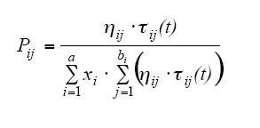
How Terms Are Chosen?
Heuristic function η_{ij} and pheromone amount τ_{ij}(t)
Probability function:
Heuristic function acts similar as proximity function in TSP
Limitations!
Marko Jovanović |  | Sonja Veljković
genije.jovanovic@gmail.com | 21/36 | sonja.veljkovic@gmail.com

Slide 22
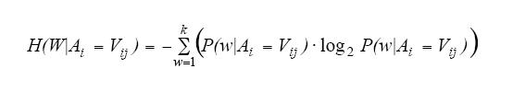
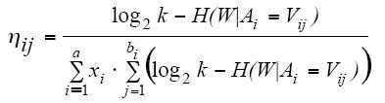
Heuristic Function η_{ij}
Based on information theory
In information theory, entropy is a measure of the uncertainty associated with a random variable – “amount of information”
Entropy for each term_{ij} is calculated as:
Final heuristic function defined as:
Marko Jovanović |  | Sonja Veljković
genije.jovanovic@gmail.com | 22/36 | sonja.veljkovic@gmail.com

Slide 23
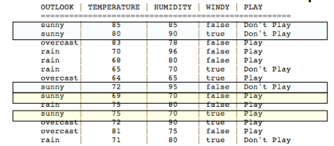
Heuristic Function η_{ij}
P(play|outlook=sunny) = 2/14 = 0.143
P(don’t play|outlook=sunny) = 3/14 = 0.214
H(W,outlook=sunny)=-0.143*log(0.143)-0.214*log(0.214) = 0.877
η_{sunny} =logk-H(W,outlook=sunny) = 1-0.877 = 0.123
Marko Jovanović |  | Sonja Veljković
genije.jovanovic@gmail.com | 23/36 | sonja.veljkovic@gmail.com

Slide 24
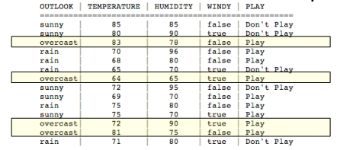
Heuristic Function η_{ij}
P(play|outlook=overcast) = 4/14 = 0.286
P(don’t play|outlook=overcast) = 0/14 = 0
H(W,outlook=overcast)=-0.286*log(0.286) = 0.516
η_{overcast} =logk-H(W,outlook=overcast) = 1-0.516 = 0.484
Marko Jovanović |  | Sonja Veljković
genije.jovanovic@gmail.com | 24/36 | sonja.veljkovic@gmail.com

Slide 25
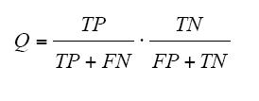
Rule Pruning
Remove irrelevant, unduly included terms in rule
Thus, improving simplicity of rule
Iteratively remove one-term-at-a-time
Test new rule against rule-quality function:
Process repeated until further removals no more improve quality of the rule
Marko Jovanović |  | Sonja Veljković
genije.jovanovic@gmail.com | 25/36 | sonja.veljkovic@gmail.com

Slide 26

Pheromone Updating
Increase probability term_{ij} will be chosen by other ants in future
In proportion to rule quality Q
0 <= Q <= 1
Updating:
Pheromone evaporation
Marko Jovanović |  | Sonja Veljković
genije.jovanovic@gmail.com | 26/36 | sonja.veljkovic@gmail.com

Slide 27
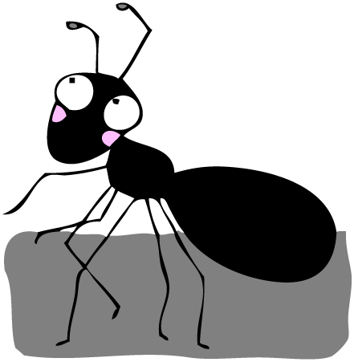
Ant-Miner example
TP=1, FN=8, TN=5, FP=0
Q=0.111
w/o outlook=overcast
Q=0.111
w/o temp=81
w/o humid=75……
w/o temp=81 and humid=75
TP=2, FN=7, TN=5, FP=0
Q=0.222 – better!
w/o outlook=overcast
TP=6, FN=3,TN=3, FP=2
Q=0.4 – even better!
w/o windy=false
TP=4, FN=5, TN=5, FP=0
Q=0.444 – BEST!
Pheromone update:
τ_{overcast}(2)=(1+0.444)* τ_{overcast}(1)
τ_{overcast}(2)=0.481
Normalization:
τ _{overcast}(2)=0.419
τ _{sunny}(2)=0.29
τ _{rain}(2)=0.29
DiscoveredRuleList=[IF overcast THEN play]
DiscoveredRuleList=[]
Rule=IF (outlook=overcast)
AND (temp=81)
AND (humid=75)
AND (windy=false)
THEN ???
THEN PLAY
η₇₂ = 0.456,
η₇₅ = 0.599,
η₇₁= η₈₁= η₆₉= η₆₄= η₆₅= η₆₈= η₇₀= η₈₃= η₈₀= η₈₅= 0.728
τ_{all}(1) = 1/12
81
η_{rain} = 0.124,
η_{sunny} = 0.123,
η_{overcast} = 0.484
τ_{rain}(1) = τ_{sunny}(1) = τ_{overcast}(1) = 1/3
overcast
η₇₅ = η₉₅ = η₆₅ =
η₉₆ = η₇₈ = η₈₅ = 0.728,
η₉₀ = 0.456,
η₇₀= η₈₀= 0.327
τ_{all}(1) = 1/12
75
η_{f} = 0.075,
η_{t} = 0.048,
τ_{all}(1) = 1/2
false
sunny overcast rain false true 85 80 83 70 68…..
Marko Jovanović |  | Sonja Veljković
genije.jovanovic@gmail.com | 27/36 | sonja.veljkovic@gmail.com

Slide 28
Proof of Concept
Compared against well-known Rule-based classification algorithms based on sequential covering, like CN2
Essence of every algorithm is the same
Rules learned one-at-a-time
Each time new rule found, tuples which are covered are removed from training set
Marko Jovanović |  | Sonja Veljković
genije.jovanovic@gmail.com | 28/36 | sonja.veljkovic@gmail.com

Slide 29
Proof of Concept
Ant-Miner is better, because:
Uses feedback (pheromone mechanism)
Stochastic search, instead of deterministic
End effect: shorter rules
Downside: sometimes worse predictive accuracy
But acceptable!
Marko Jovanović |  | Sonja Veljković
genije.jovanovic@gmail.com | 29/36 | sonja.veljkovic@gmail.com

Slide 30
Proof of Concept
Well known data sets used for comparison
Data set | #Cases | #Categorical attributes | #Continuous attributes | #Classes
Ljubljana breast cancer | 282 | 9 | - | 2
Wisconsin breast cancer | 683 | - | 9 | 2
Tic tac toe | 958 | 9 | - | 2
Dermatology | 366 | 33 | 1 | 6
Hepatitis | 155 | 13 | 6 | 2
Cleveland heart disease | 303 | 8 | 5 | 5
Marko Jovanović |  | Sonja Veljković
genije.jovanovic@gmail.com | 30/36 | sonja.veljkovic@gmail.com

Slide 31
Proof of Concept
Predictive accuracy
Data set | Ant-Miner’s predictive accuracy (%) | CN2’s predictive accuracy (%) | Conclusion
Ljubljana breast cancer | 75.25 ± 2.24 | 67.69 ± 3.59
Wisconsin breast cancer | 96.04 ± 0.93 | 94.88 ± 0.88 | ☺
Tic tac toe | 73.04 ± 2.53 | 97.38 ± 0.52 | ☹
Dermatology | 94.29 ± 1.20 | 90.38 ± 1.66
Hepatitis | 90.00 ± 3.11 | 90.00 ± 2.50 | 😐
Cleveland heart disease | 59.67 ± 2.50 | 57.48 ± 1.78 | ☺
Marko Jovanović |  | Sonja Veljković
genije.jovanovic@gmail.com | 31/36 | sonja.veljkovic@gmail.com

Slide 32
Proof of Concept
Simplicity of rule lists
 | Number of rules found |  | Average number of terms in rule
Data set | Ant-Miner | CN2 | Ant-Miner | CN2
Ljubljana breast cancer | 7.10 ± 0.31 | 55.40 ± 2.07 | 1.28 | 2.21
Wisconsin breast cancer | 6.20 ± 0.25 | 18.60 ± 0.45 | 1.97 | 2.39
Tic tac toe | 8.50 ± 0.62 | 39.70 ± 2.52 | 1.18 | 2.90
Dermatology | 7.30 ± 0.15 | 18.50 ± 0.47 | 3.16 | 2.47
Hepatitis | 3.40 ± 0.16 | 7.20 ± 0.25 | 2.41 | 1.58
Cleveland heart disease | 9.50 ± 0.92 | 42.40 ± 0.71 | 1.71 | 2.79
Marko Jovanović |  | Sonja Veljković
genije.jovanovic@gmail.com | 32/36 | sonja.veljkovic@gmail.com

Slide 33
Trends and Variations
Specialized types of classification problems:
Development of more sophisticated Ant-Miner variations
Modification for Multi–Label Classification
Hierarchical classification
Discovery of fuzzy classification rules
Marko Jovanović |  | Sonja Veljković
genije.jovanovic@gmail.com | 33/36 | sonja.veljkovic@gmail.com

Slide 34
Future Work
Extend Ant-Miner to cope with continuous attributes
this kind of attribute is required to be discretized in a preprocessing step
Investigate the performance
of other kinds of heuristic function
and pheromone updating strategy
Marko Jovanović |  | Sonja Veljković
genije.jovanovic@gmail.com | 34/36 | sonja.veljkovic@gmail.com

Slide 35
References
Parpinelli R., Lopes H., Freitas A.: Data Mining with an Ant Colony Optimization Algorithm
Han J., Kamber M.: Data Mining – Concepts and Techniques
Wikipedia article on Ant colony optimization http://en.wikipedia.org/wiki/Ant_colony_optimization
Singler J., Atkinson B.: Data Mining using Ant Colony Optimization
Marko Jovanović |  | Sonja Veljković
genije.jovanovic@gmail.com | 35/36 | sonja.veljkovic@gmail.com

Slide 36
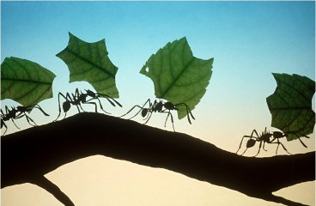
Thank you for your attention!
Marko Jovanović |  | Sonja Veljković
genije.jovanovic@gmail.com | 36/36 | sonja.veljkovic@gmail.com

