Slide 1
CHAMELEON : A Hierarchical Clustering Algorithm Using Dynamic Modeling
Faculty of Electrical Engineering
University of Belgrade
Student: Lazović Marko, 3170/11

Slide 2
Introduction :
Clustering in data mining is a discovery process that groups a set of data
The applications of clustering include :
categorization of documents on the World Wide Web
grouping of genes and proteins that have similar functionality
characterization of different customer groups
Clustering algorithm
Using static modeling
Using dynamic modeling

Slide 3
Limitations of static modeling :
Algorithms:
K-means, PAM,CLARANS, DBSCAN, CURE, and ROCK
Merging decisions are based upon static modeling of the clusters to be merged
Fail to take into account special characteristics of individual clusters
Incorrect merging decisions when the underlying data does not follow the assumed model
Two major limitations:
Schemes do not make use of information about the nature of individual clusters
ignore the information about the aggregate interconnectivity or closeness

Slide 4
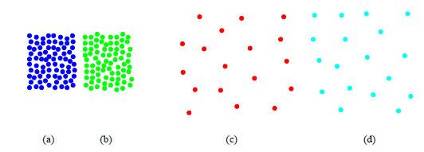
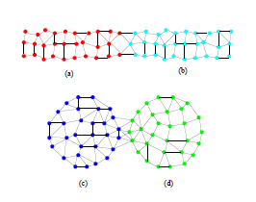
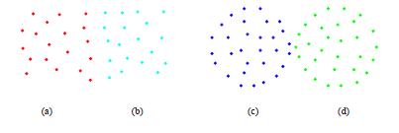
Limitations:
Cure
Rock

Slide 5
Overview:
CHEMELEON finds the clusters in the data set by using a two phase algorithm.
use a graph partitioning algorithm to cluster the data items into a large number of relatively small sub-clusters
use an agglomerative hierarchical clustering algorithm to find the genuine clusters by repeatedly combining together these sub-clusters
overcomes the limitations

Slide 6
Gene Clustering:
genes are given as input to the system
the system searches the online biomedical literature
biomedical literature contain information about these genes
performs text mining in the abstracts to retrieve useful keywords that describe functions of these genes
does statistical analysis on these keywords to find their relevance
clusters the genes based on the functional keyword associations
The input to the clustering system is the (keyword x gene) matrix or the (gene x gene) matrix
Based on the clustering results, the genes can be classified as having different functional relationships
CHAMELEON algorithm for keyword based clustering of large number of genes
CHAMELEON algorithm correctly identified all the 26 Genes in right clusters

Slide 7
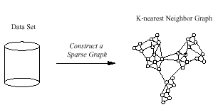
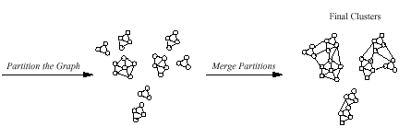
Two phase algorithm:

Slide 8
Key Feature:
CHEMELEON determines the pair of most similar sub-clusters
taking into account both the inter-connectivity as well as the closeness of the clusters.
CHEMELEON uses a novel approach to model the degree of inter-connectivity and closeness between each pair of clusters
takes into account the internal characteristics of the clusters themselves.

Slide 9
Modeling the Data
CHEMELEON’s sparse graph representation of the data items is based on the commonly used k-nearest neighbor graph approach.
Figure - k-nearest graphs from an original data in 2D

Slide 10
K-nearest neighbor graph Gk
Advantages of using a k-nearest neighbor graph G_{k}
Data points that are far apart are completely disconnected in the G_{k}
G_{k} captures the concept of neighborhood dynamically.
The density of the region is recorded as the weights of the edges.
G_{k} provides a computational advantage over a full graph in many algorithms operating on graphs.

Slide 11
Modeling the Cluster Similarity
Relative Inter-Connectivity
the relative-connectivity between a pair of clusters Ci and Cj is defined as the absolute inter-connectivity between Ci and Cj normalized with respect to the internal inter-connectivity of the two clusters Ci and Cj
The absolute inter-connectivity between a pair of clusters Ci and Cj is defined as the sum of the weight of the edges that connect vertices in Ci to vertices in Cj
The internal inter-connectivity of a cluster Ci can be easily captured by the size of its min-cut bisector

Slide 12
Modeling the Cluster Similarity
Relative Closeness
CHEMELEON measures the closeness of two clusters
connecting the average similarity between the point in Ci that are connected to points in Cj
average similarity between the points from the two clusters is equal to the average weight of the edges connecting vertices in Ci to vertices in Cj

Slide 13
Modeling the Cluster Similarity
Relative Inter-Connectivity
The internal closeness of each cluster Ci can be measured in a number of different ways
One approach is to look at all the edges connecting vertices in Ci
compute the internal closeness of a cluster as the average weight of these edges.
Other approach is to look also at the average weights of the edges that belong in the min-cut bisector of clusters Ci and Cj
overcome the limitations of existing algorithms that look only at the absolute closeness

Slide 14
CHAMELEON: A Two-phase Clustering Algorithm
Phase I: Finding Initial Sub-clusters
finds the initial sub-clusters using a graph partitioning algorithm
partition the k-nearest neighbor graph of the data set into a large number of partitions such edge-cut
edge-cut, i.e., the sum of the weight of the edges that straddle partitions, is minimized
links within clusters will be stronger and more plentiful than links across clusters
graph partitioning algorithms are very effective in capturing the global structure of the graph
graph partitioning algorithms are capable of computing partitionings that have a very small edge-cut
CHAMELEON utilizes such multilevel graph partitioning algorithms to find the initial sub-clusters
hMETIS algorithm

Slide 15
CHAMELEON: A Two-phase Clustering Algorithm
hMETIS
quickly produce high-quality partitionings for a wide range of unstructured graphs and hypergraphs
In CHAMELEON we primarily use hMETIS to split a cluster Ci into two sub-clusters
the edge-cut between clusters is minimized and each one of these sub-clusters contains at least 25% of the nodes in Ci
initially starts with all the points
selects the largest sub-cluster among the current set of sub-clusters and uses hMETIS to bisect
terminates when the larger sub-cluster contains fewer than a specified number of vertices, MINSIZE
MINSIZE should be sufficiently large, 1% to 5% of the overall number of data points

Slide 16
CHAMELEON: A Two-phase Clustering Algorithm
Phase II: Merging Sub-Clusters using a Dynamic Framework
CHAMELEON’s agglomerative hierarchical clustering algorithm
select the most similar pairs of clusters by looking both at their relative inter-connectivity and their relative closeness
Two different schemes

Slide 17
CHAMELEON: A Two-phase Clustering Algorithm
First Scheme:
merges pairs of clusters
relative inter-connectivity and relative closeness are both above some user specified threshold TRI and TRC
If more than one - the highest absolute inter-connectivity between these two clusters
TRI and TRC can be used to control the characteristics of the desired clusters
TRI - degree of inter-connectivity
TRC - uniformity of the similarity

Slide 18
CHAMELEON: A Two-phase Clustering Algorithm
Second scheme:
uses a function to combine the relative inter-connectivity and relative closeness
merge the pair of clusters that maximizes this function
α is a user specified parameter
α> 1, then CHAMELEON gives a higher importance to the relative closeness
α< 1, it gives a higher importance on the relative inter-connectivity

Slide 19
Performance Analysis(1)
n : the number of data items
m : the number of initial sub-clusters produced by the graph partitioning algorithm
each initial sub-cluster has the same number of nodes n/m
compute the k-nearest neighbor graph
low-dimensional data sets : O(n log n)
high-dimensional data : O(n²)
graph partitioning algorithm : O(|V|+|E|)
since using k-nearest neighbor graph, |E| = O(|V|)

Slide 20
Performance Analysis(2)
first phase : O(n log(n/m))
bisect each one of the initial m clusters is O(n/m), leading to an overall complexity of O(n)
during each merging step : O(nm)
find the most similar pair of cluster : O(m²logm)
overall complexity O(nm + nlogn + m²logm)

Slide 21
Experimental Results
experimental evaluation of CHAMELEON
compare its performance with DBSCAN and CURE
Data sets (6000 – 10000 points):
DS1, has five clusters that are of different size, shape, and density, and contains noise points as well as special artifacts
DS2, contains two clusters that are close to each other and different regions of the clusters have different densities
DS3, has six clusters of different size, shape, and orientation, noise points and special artifacts
DS4 contains random noise and special artifacts, such as a collection of points forming vertical streaks
DS5, has eight clusters of different shape, size, density, and orientation, as well as random noise

Slide 22
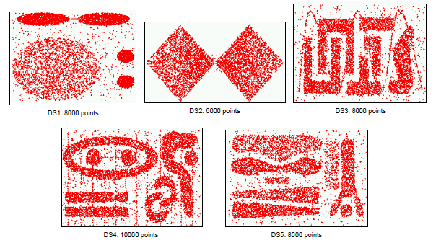
Data sets

Slide 23
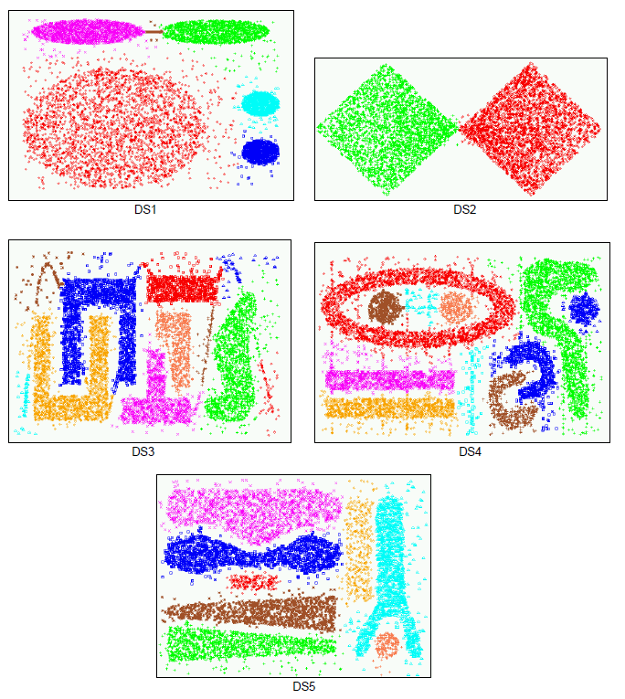
Chameleon

Slide 24
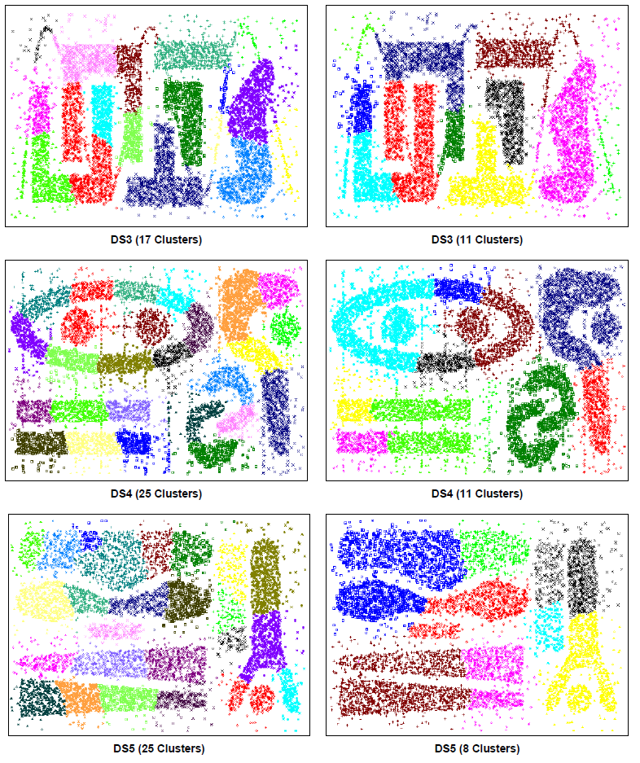
Cure

Slide 25
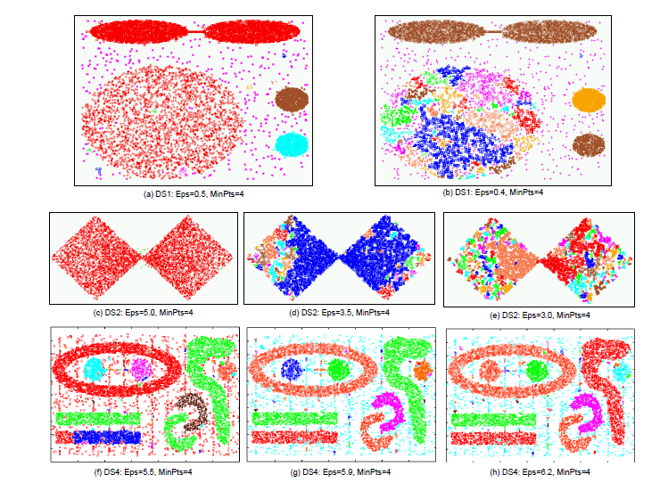
DBSCAN

Slide 26
Conclusion
CHAMELEON can discover natural clusters of different shapes and sizes
merging decision dynamically adapts to the different clustering model characterized by the clusters in consideration
The methodology of dynamic modeling of clusters in agglomerative hierarchical methods is applicable to all types of data

