Slide 1
Horizontal Segmentation and MindGenomics
Veljko Milutinovic, Jakob Salom, Zoran Markovic, Zoran Ognjanovic, Nenad Korolija, Jasna Matic
and
Howard Moskowitz

Slide 2
Essence
HorizontalSegmentation = A method to increase ScientificEffectiveness, etc.
MindGenomics = A method to implement HorizontalSegmentation
Applications = EducationalEffects + ScientificOutput, etc.
Unique = A 2-stage approach synergizing general and individual

Slide 3
One Example is Worth 1000 Words
The simpler – the better!
Example: Sales boosting in restaurant business
Stage#1: Mining (compile-time)
Stage#2: Typing (run-time)
Note! Can be used:
To maximize technologic development
To bring peace

Slide 4
MindGenomics in a NutShell
Compile-time effort: e.g., Bringing people to a restaurant

Slide 5
MindGenomics in a NutShell
4. Generation of a Marketing Slogan
3. Analysis
2. Market Polling
1. Building the MicroScience
Compile-time effort: e.g., Bringing people to a restaurant

Slide 6
MindGenomics in a NutShell
4. Generation of a Marketing Slogan
3. Analysis
2. Market Polling
1. Building the MicroScience
Compile-time effort: e.g., Bringing people to a restaurant

Slide 7
MindGenomics in a NutShell
Run-time effort: e.g., Treating people at arrival to the restaurant
4. Generation of a Marketing Slogan
3. Analysis
2. Market Polling
1. Building the MicroScience
Compile-time effort: e.g., Bringing people to a restaurant

Slide 8
MindGenomics in a NutShell
8. Building the Experience Base
7. Profit Analysis
6. Targeted Action
5. Customer Typing
Run-time effort: e.g., Treating people at arrival to the restaurant
4. Generation of a Marketing Slogan
3. Analysis
2. Market Polling
1. Building the MicroScience
Compile-time effort: e.g., Bringing people to a restaurant

Slide 9
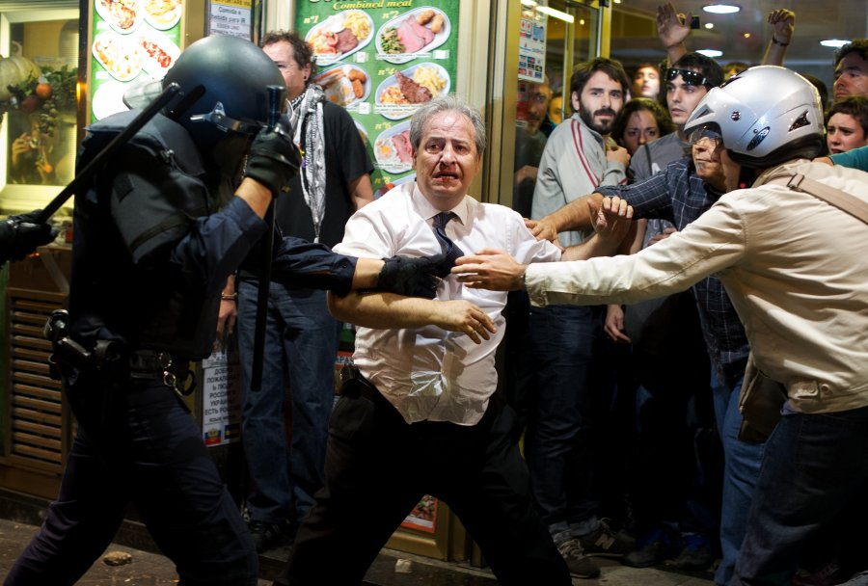
MindGenomics in a NutShell
8. Building the Experience Base
7. Profit Analysis
6. Targeted Action
5. Customer Typing
Run-time effort: e.g., Treating people at arrival to the restaurant
4. Generation of a Marketing Slogan
3. Analysis
2. Market Polling
1. Building the MicroScience
Compile-time effort: e.g., Bringing people to a restaurant

Slide 10
MindGenomics in a NutShell
8. Building the Experience Base
7. Profit Analysis
6. Targeted Action
5. Customer Typing
Run-time effort: e.g., Treating people at arrival to the restaurant
4. Generation of a Marketing Slogan
3. Analysis
2. Market Polling
1. Building the MicroScience
Compile-time effort: e.g., e.g., Bringing people to a restaurant

Slide 11
1. Building the MicroScience
Music
Food
Wines
Smiles
Silos (6)
Elements (6)
Jazz
Rock
Rap
Funk
Country
Metal
Veggie
Turkey
Chicken
Seafood
Eggs
Fruits
White
Red
Rosé
Sparkling
Dessert
Fortified
Sweet
I am in Love
Most Beautiful
Happy
Thoughtful
I know It All
Combining one Silo and two Elements: 216. Optimal: 40 questions to answer! The MoskovitzJacobs software helps in the process!

Slide 12
2. Market Polling
a. Internet: $2 -> $5 (max = 300)
b. NeuroEconomy: Prelec Helmet (MIT)
c. Text/Media-Mining: Future Research (ACM iASC-2013)
d. Computer/Network-Acceleration: Future Research (ACM ISCA-2013)

Slide 13
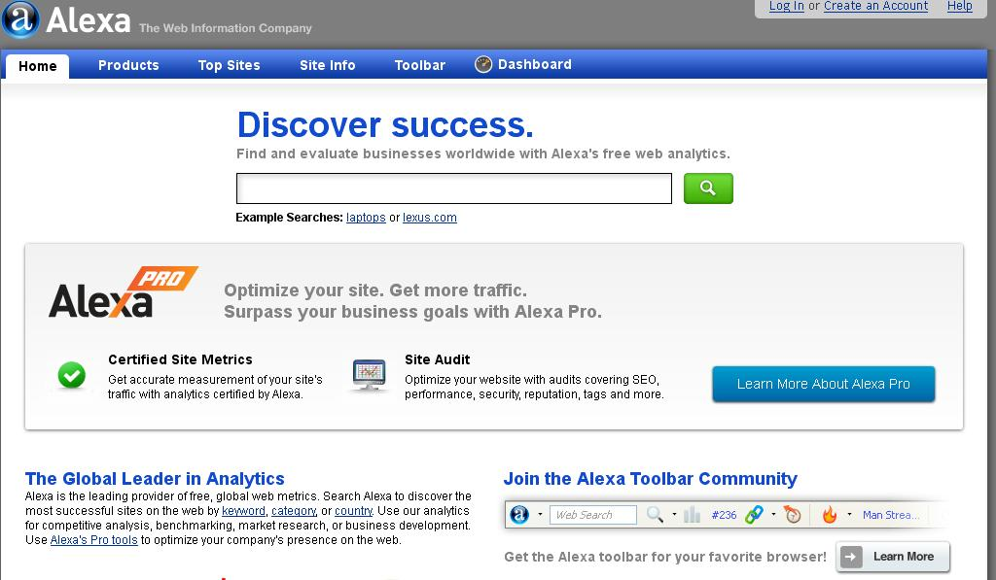
High-Tech Polling

Slide 14
The Brain Marked with Economically Relevant Areas

Slide 15
Mining from Social Networks

Slide 16
3. Analysis: Linear Regression

Slide 17
3. Analysis: Linear Regression

Slide 18
3. Analysis: Linear Regression

Slide 19
4. Slogans
Slogan #1
Slogan #2
Slogan #3

Slide 20
4. Slogans
Slogan #1
Blackened Louisiana
Shrimps
Slogan #2
AFLA
LongLife
Vaccine
Slogan #3 Special
Music
Wish

Slide 21
4. Slogans
Slogan #1
Blackened Louisiana
Shrimps
Slogan #2
AFLA
LongLife
Vaccine
Slogan #3 Special
Music
Wish
The slogans will bring people to the restaurant!

Slide 22
5. Customer Typing
Classifying each just-arrived customer to a cluster!
?
The Major Tradeoff: Likelihood Maximization versus Cluster Count

Slide 23
5. Customer Typing
Classifying each customer to a cluster!
38%
20%
42%
The Major Tradeoff: Likelihood Maximization versus Cluster Count

Slide 24
5. Customer Typing
Classifying each customer to a cluster!
38%
24%
20%
12%
42%
64%
The Major Tradeoff: Likelihood Maximization versus Cluster Count

Slide 25
5. Customer Typing
Classifying each customer to a cluster!
38%
24%
6%
20%
12%
6%
42%
64%
88%
The Major Tradeoff: Likelihood Maximization versus Cluster Count

Slide 26
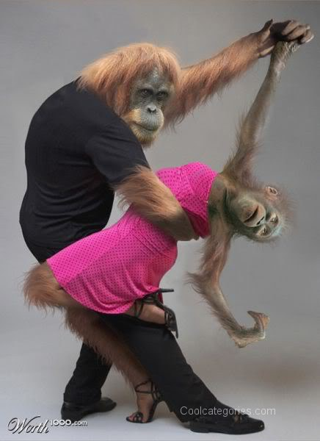
6. Targeted Actions
What is your music wish?
Music with the smell of garlic ☺ ?
88%

Slide 27
7. Profit Analysis
1.
2.
e.g., LittleBay@London 3.
4.

Slide 28
8. Machine Learning
Finding
missing
puzzle
elements:
For
better
future
estimate

Slide 29
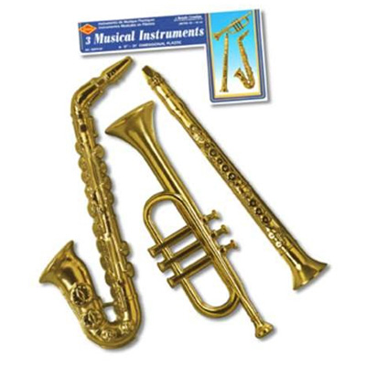
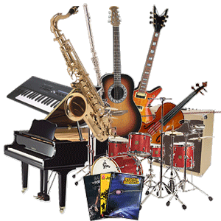
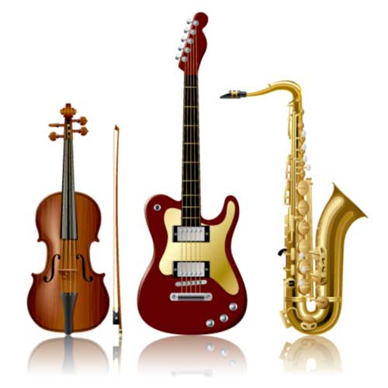
Horizontal Segmentation
So far: N_{S} = 1
How about: N_{S} > 1
One cluster ⬄ One Segment!

Slide 30
Horizontal Segmentation: Example
Before: Yogurt - 1000pcs@$1

Slide 31
Horizontal Segmentation: Example
Before: Yogurt - 1000pcs@$1
After:
Cherry - 1000pcs@$2
Bicycle - 1000pcs@$2
AFLA - 1000pcs@$2
? - 1000pcs@$2 Typing?

Slide 32
Horizontal Segmentation: Example
Before: Yogurt - 1000pcs@$1
After:
Cherry - 1000pcs@$2
Bicycle - 1000pcs@$2
AFLA - 1000pcs@$2
? - 1000pcs@$2 Typing? Self-typing while the customer is at shelves!

Slide 33
Horizontal Segmentation: Example
Before: Yogurt - 1000pcs@$1
After:
Cherry - 1000pcs@$2
Bicycle - 1000pcs@$2
AFLA - 1000pcs@$2
Yni - 1000pcs@$2 Typing? MG-typing while the customer is at entry!

Slide 34
MindGenomics: Revisited

Slide 35
The Ice Point of View: What is MindGenomics? (1)
Why?
A method based on industrial psychology, mathematics, and DataMining,
which can be used to promote products, services, ideas, opinions ...
What is the essence?
If one wants to sell, one has to listen to the needs of the prospect!

Slide 36
What is MindGenomics? (2)
Company assessment!
1. A company with potentials is approached,
and their capabilities are estimated,
using methods from company auditing
and financial engineering.
2. A product is selected with potentials for horizontal segmentation; the question is, how to figure out what the market needs!

Slide 37
What is MindGenomics? (3)
Data gathering!
3. Based on the principles of industrial psychology,
a set of N questions is generated,
which penetrate deep into the needs
of the target group of individuals.
4. A polling partner is engaged
to approach the target audience,
and to bring back the form filled in,
which assumes the existing of a small motivation item.

Slide 38
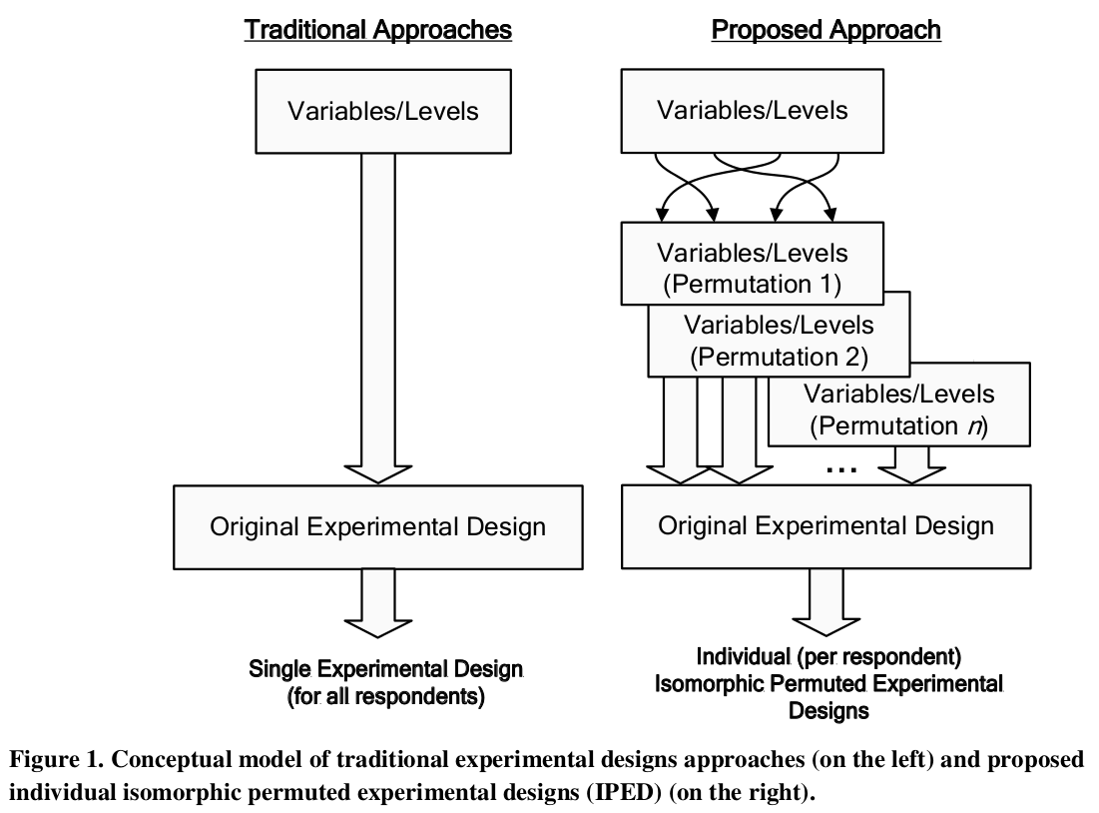

Slide 39
What is MindGenomics? (4)
Data analysis!
5. The results of the poll are analyzed,
using a proprietary datamining software,
based on sophisticated math,
and recommendations are made (for the essence and the form)
6. Crucial Step: Analysis!

Slide 40
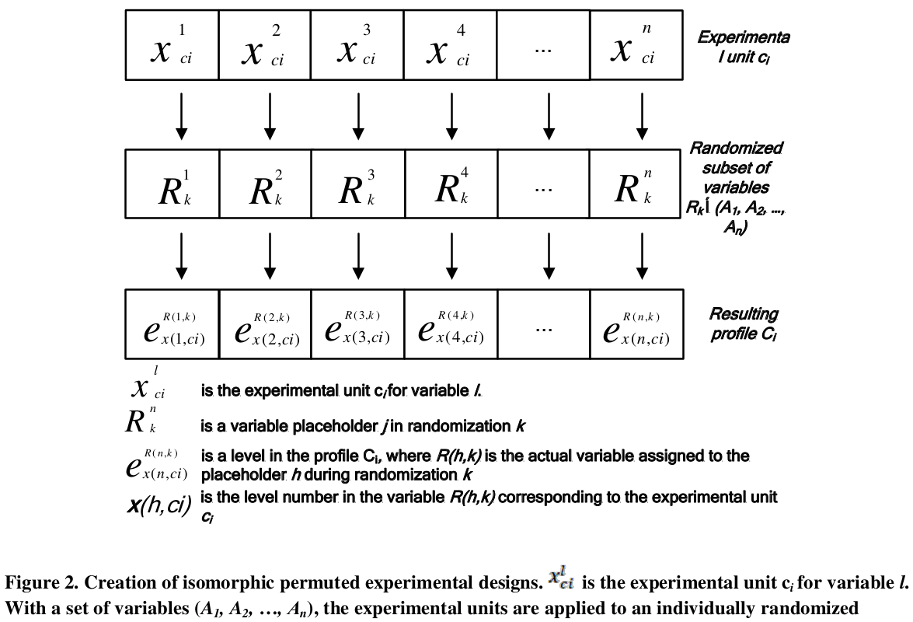

Slide 41
An Introduction to Linear Regression
Given a data set of n statistical units, a linear regression model assumes that the relationship between the dependent variable y_{i} and the p-vector of regressors x_{i} is linear. This relationship is modelled through a disturbance term or error variable ε_{i} — an unobserved random variable that adds noise to the linear relationship between the dependent variable and regressors. Thus the model takes the form:
where ^{T} denotes the transpose, so that x_{i}^{T}β is the inner product between vectors x_{i} and β. Often these n equations are stacked together and written in vector form:
where:

Slide 42
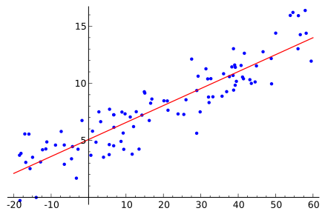
Example
Figure 3: Example of simple linear regression, which has one independent variable!

Slide 43
What is MindGenomics? (5)
Process analysis!
7. The life time monitoring of the process is absolutely mandatory.
8. Applications span from science and engineering
to humanities and arts!
What are the alternatives to polling?
9. SocialNetworksDataMining
10. NeuroEconomyMindGenomics

Slide 44
The best ideas are coming from nature!

Slide 45
H2020: ICEs of Europe MindMining = MediaMining + AlgorithmicPlethora
MoskowitzJacobs@HCNY

