Slide 1

Serbia ..Looking Ahead to 2015
Mind Genomics and The Serbia Institute of Competitive Excellence
Presented by
Howard Moskowitz, Ph.D.

Slide 2
Imagine if…
Serbia’s youth become smarter
than everyone else
Serbia’s brainpower is harnessed
to achieve competitive strength
Serbia’s academics maintain world-class status
Serbia leads Europe

Slide 3
This is all possible
It means adopting new ideas
Empowered by technology
With immediate results
Embraced by youth
And used

Slide 4
The science that will make this possible – mind genomics

Slide 5
Mind Genomics
What is it?
The experimental science of the everyday
Which means…
  Understand the mind of the typical person
  Focus on the simple ‘touch-points’ of experience
  Create wonderful experiences…
  and become the leader

Slide 6
Great literature deals with the great ideas
And science?
By knowing the everyday ..
you understand the world
Education: Your students learn to think
in a disciplined fashion ..
mathematics and practice
Economics: You create products and services that people want
End Product: You create new sciences
based upon the genomes of the mind

Slide 7
Why is the every day so important?
Shouldn’t science focus on issues having ‘real’ gravitas
What’s the gravitas of the mathematics classroom for a ninth grade student?
  Or even the preferences of a person for slivovitz (HRM’s favorite alcoholic product) !!
Very simply .. We live in the everyday!
Profoundly understand the everyday for anyone … and you are many steps ahead of everyone
Make the every day a science and you create
a microscope/telescope of our world

Slide 8
How does mind genomics work?

Slide 9


Process: Develop the microscience …
Identify topic area
Raw Materials – Silos & Elements
INTERNET
IdeaMap™
SURVEY
Target Customers
- Impact on Customer Experience
ANALYZED SURVEY RESULTS → Mind Genomics
MARKETING PHRASES
MARKET SEGMENTATION
TYPING ENGINE
Notes:
9
also talk about speed and low cost. The reason marketers were overly reliant on focus groups is because of the speed and relatively low cost
Survey Statements – words, ideas, product features, services, attributes, etc

Slide 10
How Mind Genomics Works
Select specific messages relevant to the topic …
a person’s touch-points in life
(Education? Product? Ethics? Aesthetics)
Present vignettes (combos of messages) to target survey audience.
Use regression statistics to link messages to degree of persuasion
Discover new groups of people who resonate to similar messages... these new segments transcend traditional demographics
and psychographics.
These identifiable and predictable new segments
are defined by the person’s own mind-set, not a surrogate marker
Create typing tool to assign a new person to a segment

Slide 11
Why is this new science important to serbia? Or ..really .. To anyone?

Slide 12
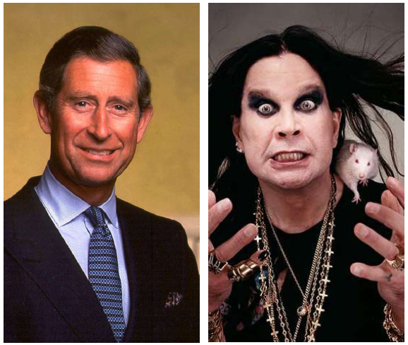
Because knowing the mind of a person helps you create a world for that person
Who is this person ..and what world should we create?
Sex: Male
Age: 50+
Height: 5’10.5”
Nationality: British
Family Status: Married
Annual Income: $10M+
Hobbies: Music, Art, Philanthropy
Notes:
Does Age, Gender and Income...really matter???

Slide 13
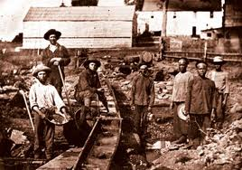
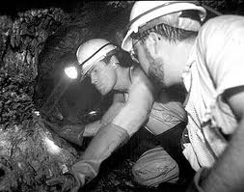
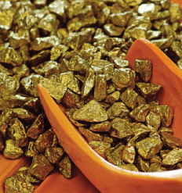
Well ..if WHO is important..then… data mining is the common (but not the best) answer… It’s experiments, not data mining which really work
Today’s predictive analytics attempt to segment or classify people through:
  General demographics – age, gender, marital status, family size, education…
  Occupation – Lawyer, Salesman, Specialist . . .
  Lifestyle Segmentation
  Psychographic Segmentation
  Behavior patterns –prescribing behavior, publishing behavior . . .
  (Amazon.com – “people who bought this, also bought this . . . “)
  There’s an assumption (generally misleading that shared attributes predict shared attitudes.
Notes:
Predictive analytics vs. Mind Genomics
PA - who Shows up
Are you likely to be in a particular action state?
Data mining – Historical, retrospective, “Language of likelihoods”
MG Given my ability to test you with words, product features, services, experiences, attributes, ideas, etc,…will motivate you to action
Predictive granularity
There is NO data I can buy that will tell me how you will specifically respond when purchasing a car choosing a hotel, donate to a charity, purchase insurance, select a bank, a medical practice or legal practice…
However…given my ability to test you with words, product features, experiences, attributes, ideas, etc,…will motivate you to action…

Slide 14
What makes Mind Genomics new?
The traditional thinking…
  Demographics makes the assumption that people of certain age, gender, race, income will act in the same way. Example: 55+ white male making $1M a year would give you Prince Charles and Ozzy Osbourne
  Social Analytics gives you insight into behavior: the sites that are visited, purchases etc but it is still a guessing game as to what they think about your product and how you should communicate with them
Mind Genomics breaks new ground
  Focus on creating an empirical science about… how customers THINK ..and then apply that science… marketing and sales statements/messaging
  This is different from applications/science based on profiling

Slide 15
Now let’s talk about serbia

Slide 16
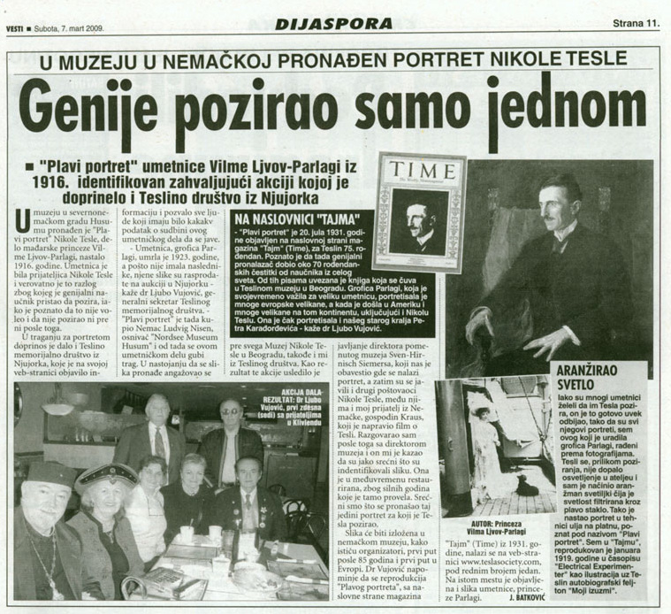
First Nicholas Tesla .. Now SICE

Slide 17


Identify the particular mind-set to which a person belongs: in 5 to 10 seconds by asking a few simple questions
That everyone in Serbia can know exactly what to create or what to say at every customer contact point…
What products and services can Serbia provide to EU & the World!!!
Imagine… if a national strategic strength of Serbia is knowing and applying Mind Genomics
© 2011 iNovum LLC
17
Notes:
Imagine having the ability to meet a client/customer for the first time and within seconds identify and understand them as a consumer of your specific product/service/idea better than they understand or communicate themselves. This sounds almost impossible doesn’t it, but we have scientific and empirical evidence proving this in the marketplace.

Slide 18
Three case histories For Serbia

Slide 19
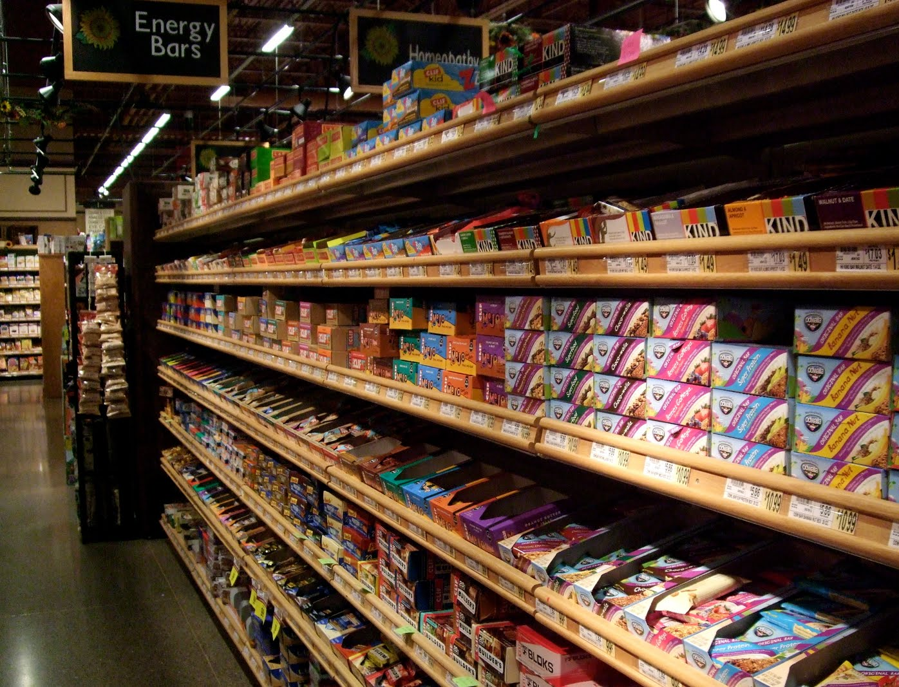
Project #1
Creating a cereal bar product for Europe

Slide 20
SICE Project #1 – A cereal-based export
Serbia sells its products to the world
Goal – export a cereal product to the EU
  Strategy – use Mind Genomics
  to understand how people respond to cereal
  Understand what Europeans want in a cereal-based product
  Create a cereal-based product, from grains grown in Serbia,
  Finally –the key messages to make EU customers
  want to buy the cereal-based product
**Product = Magdalena Cereal Bars ..
A line of cereal bars designed for the modern taste… product designed by Serbia..
taste created for the world

Slide 21
The business background
It became clear that the world cereal market
was moving towards whole grains
  But what would consumers want
The staff at SICE used Mind Genomics to discover what features of cereal bars would be desired
  The study involved consumers from UK, France and Germany
SICE (Food and Agri-business Department) discovered the new segments,
and thus the Serbian opportunity

Slide 22
Serbia understands customer preferences for Europe Cereal Bars using Mind Genomics
(Serbia production opportunity – Segment 2)
 |  | Avg | UK | Fr | Ger | Seg1 | Seg2
 | Base Size | 287 | 73 | 126 | 88 | 42 | 31
 | Constant | 21 | 8 | 32 | 16 | 12 | 3
A7 | Cereal bar with dried fruits and honey, no sugar added | 8 | 7 | 8 | 9 | -4 | 26
A8 | Soft and crispy cereal bar, dried fruits, seeds and nuts | 11 | 9 | 13 | 9 | 4 | 22
A1 | Crispy cereal bar | 5 | 5 | 5 | 6 | -1 | 14
A9 | Premium bar, soft and crunchy with a lot of fruit and chocolate chunks | 16 | 23 | 14 | 13 | 19 | 13
B3 | Cereals from organic production | 3 | 3 | 1 | 7 | -2 | 12
A6 | Cereal bar with a soft fruit-yogurt filling | 3 | 7 | -7 | 13 | -3 | 12
A3 | Crispy cereal bar with milk-chocolate coating | 16 | 18 | 14 | 19 | 21 | 11
A4 | Chocolate bar with a filling of full grain biscuits and raisins | 7 | 9 | 5 | 9 | 7 | 8
A2 | Crispy cereal bar with dried fruits | 1 | 7 | -2 | 1 | -3 | 7

Slide 23

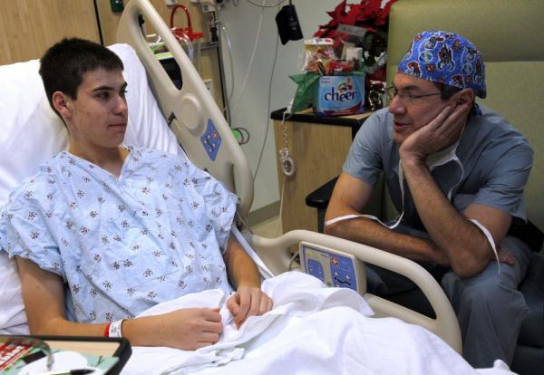

Project #2
Mind typing the health touch-points

Slide 24
SICE Project #2
Mind-Typing the Health Experience
Serbia provides a state-of-the-art service
Goal – sequence the ‘health mind’
of the world
Strategy – use Mind Genomics to understand how people respond health touch points
Work product – create a knowledge system (the total mind genome) for the health experience …sell to health organizations

Slide 25
Business background
User benefit … medical service ‘customers’ world-wide can be treated according to their mind-type (in experience, in compliance)
Opportunity brings revenue to Serbia
  Start off with the US, mind-type 100mm people, at $100/year $10bn
  Finally – offer this mind-typing sequencing
  as a service world wide to 2 bn people,
  at $50/person/year - $100 bn/yr

Slide 26
What SICE did
Identified 20 ‘health touch-points’
  For each touchpoint, did Mind Genomics for the US population ….Identified the mind-set segments
  Created a ‘typing wizard’ of 3-4 simple questions
  which assigns a person to the segment
Created a set of 20 such 3-4 question typing wizards
  Used that to sequence the health-mind of the US customer
Now that sequenced health-mind is part of a patient’s electronic health record
  Any doctor or hospital know show to make the experience exceptionally positive for that individual

Slide 27
Let’s look at one touch-point:
Teen facing the hospital

Slide 28
Mind Genomics revealed three mind-set segments for teens facing hospital
 | Seg1 | Seg2 | Seg3
Base Size | 43 | 55 | 59
Constant | 42 | 56 | 71
Seg 1
Medical staff always have a smile on their face | 18 | -8 | -3
Medical staff constantly checks up on teenage patients and insure their comfort | 18 | 8 | -4
Medical staff genuinely tries to help patients which makes teenage patients feel special | 16 | -1 | -7
Seg2
Medical staff always speaks the truth to the teenage patient no matter how traumatizing as it will help in the long run | 5 | 15 | -5
Wittiness helps medical staff seem more human | 2 | 15 | -4
Medical staff communicates and gives advice to teenage patients for their present and future lives | 3 | 15 | -4
Seg 3
Medical staff develop a teacher-student bond and help teenage patients who want to be medical staff themselves | 3 | -8 | 25
Medical staff develops bond with teenage patient to make it easy for them to vent | 7 | 0 | 14
Medical staff develop a permanent friendship with teenage patient that carries on even after their release | -3 | -7 | 14

Slide 29
The three mind-set segments (Mind Genomics)
Personal Attention
27%
Permanent Bond/Mentorship
38%
Honest/Open communication
35%
  What appeals to one teen mind-set doesn’t appeal to the other…

Slide 30

The Mind-Typing ‘wizard’ for teen going into the hospital
Welcome to the PATIENT ENHANCEMENT Tool
On the following screens, we're going to give you 3 simple questions to ask YOUR patients.
Ask each question, type in the answer...that's all you have to do.
Then... the PATIENT ENHANCEMENT TOOL will suggest what you should FOCUS ON…and of course...what you should AVOID!

Slide 31

How satisfied are you in the bedside manner if the
medical staff become friends with teenage patients through humor?
What to say to / do for Segment 1:
Medical staff always have a smile on their face
Medical staff constantly checks up on teenage patients and insure their comfort
Medical staff genuinely tries to help patients which makes teenage patients feel special
Medical personal are assigned to one or two teenage patients at a time
What to avoid saying to / doing for Segment 1:
Medical staff shows patience in trying to break the teenage patient’s wall of
apathy Medical staff develop a permanent friendship with teenage patient that carries on even after their release
Medical staff are patient in trying to understand teenage patient’s generation
Medical staff become temporary father/mother -figure to teenage patient

Slide 32



SICE Project #3
Revolution in education:
Teaching math to high school students

Slide 33
SICE Project #3
Teaching math ‘better’ to the students of Serbia
Serbia advances the potential of its students
Goal – teach Serbian students ‘faster and better’
  Strategy – use Mind Genomics to understand how students need to learn …and set up school that way
  Implemtation - teach mathematics and an application (RDE = Rule developing experimentation, the science behind Mind Genomics)
Benefit … Teach each student the way the student learns best… plus ..math with a new application
  Give the Serbian student a ‘leg up’ on every other student in the world

Slide 34
The business background
It was becoming obvious that students around the world were getting better education than before
  How could Serbian students compete far more efficiently
Teach them mathematics and a skill
  But understand how they learn, and adjust the teaching to the student
Create a nation of much better, more competitive students …who could ‘run rings’ around students in other countries

Slide 35
What SICE did
Identified 15 education touch-points
  For each touch-point, did Mind Genomics among students
  Created a ‘typing wizard’ of 3-4 simple questions which assigns a person to the segment
  Created a set of 15 such typing wizards, one for each education touch-point
Sequenced each student, to know how to best teach that student
  Assigned students to different classes, fitting the best teacher with the student
Added RDE (Rule Developing Experimentation) to the curriculum, giving the student a competitive advantage vs the rest of Europe and the world

Slide 36
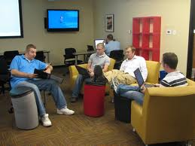
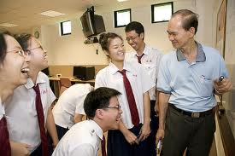
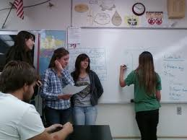
The three student mind-sets for math
Learning Environment
28%
Fun Seekers
32%
Peer Support
40%
  Students do best when you teach them in their style

Slide 37
Application: The student enters the class …
But which math class, which style
You meet a high school student in a class. How do you find the right teaching approach to that student?
How to uncover mind-set to correctly classify a person who you’ve never met before?
Knowing the specifics guides you…what to say and do

Slide 38
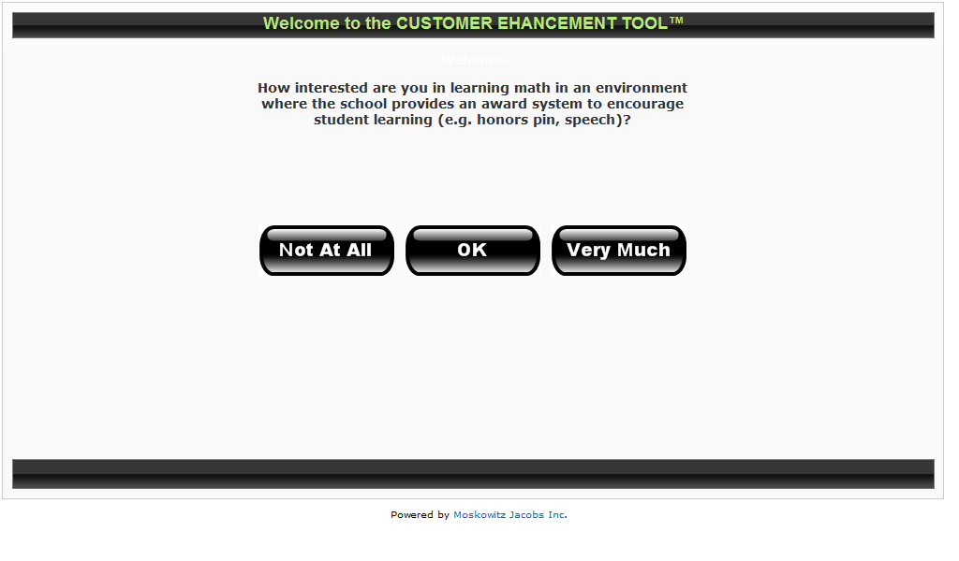
The Serbia Math Typing Tool
(One of the three questions)

Slide 39
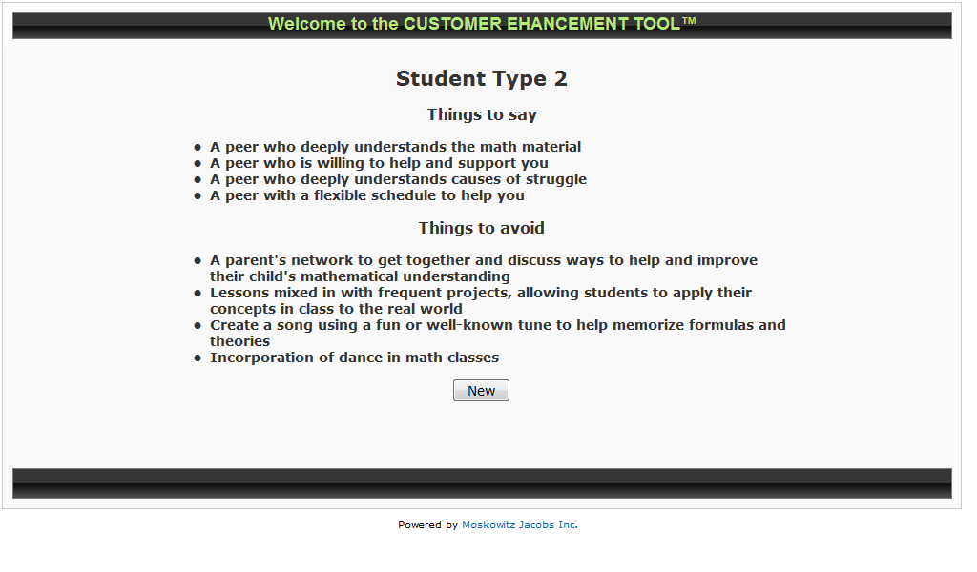
This student ‘types’ as Segment 2
How should you teach this student?

Slide 40
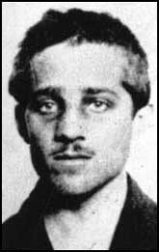
It is now almost 100 years since WWI
It is time for Serbia to shine
All of the foregoing represent what Serbia can accomplish within the next 1-2 years
What is available – science, technology, support staff
What is needed – vision, and willpower
Born: July 25, 1894, Obljaj Died: April 28, 1918, Terezín

Slide 41

Dr. Howard Moskowitz.
Developer of Mind Genomics
  President of Moskowitz Jacobs, Inc. Chairman of
  iNovum, a graduate of Queens College, holds a Ph.D. in
  Experimental Psychology from Harvard University.
  Three prestigious science awards
  2005 Charles Coolidge Parlin Marketing Research
  Award
  The “Nobel Prize” of Market Research, received only by
  the pioneers of market research.
  Recipients include Arthur Nielsen, George Gallup, Michael Porter, David Ogilvy and Philip Kotler.
  2010 Walston Chubb Award for Innovation across all sciences, Sigma Xi, The Scientific Research Society, international Awarded for Mind Genomics: The science underlying the technology used in this Math 110 course.
  2012 Edison Award for innovation in science and its
  application

