Slide 1

MIND GENOMICS
APPLIED TO ANDROID APP DISTRIBUTION
Filip Petrović
email: filip-petrovic@hotmail.com
Bojan Cvetojević
email: bojancvetojevic989@gmail.com
Mentor: Veljko Milutinović
1/6

Slide 2
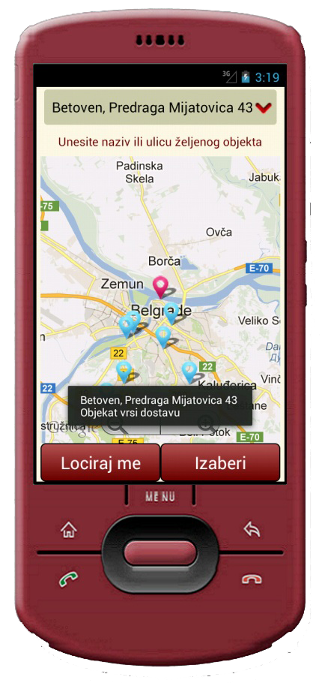
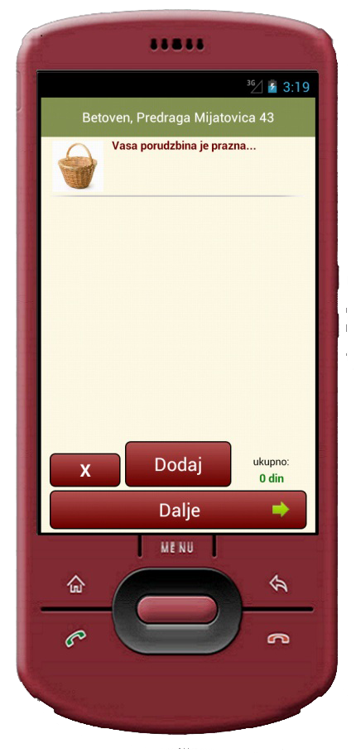
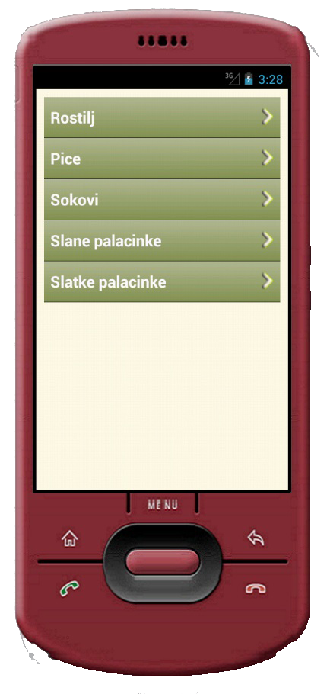
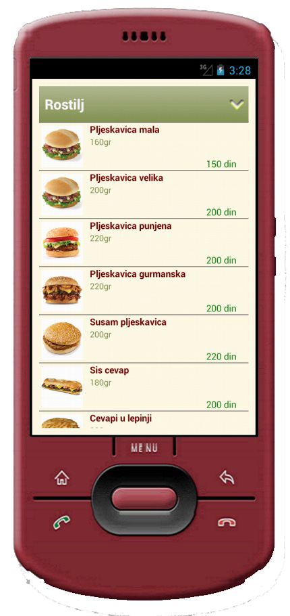
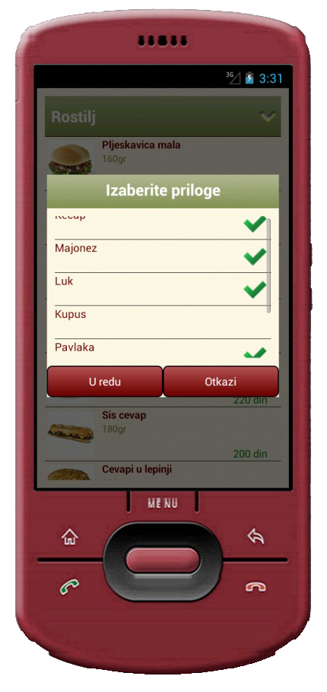
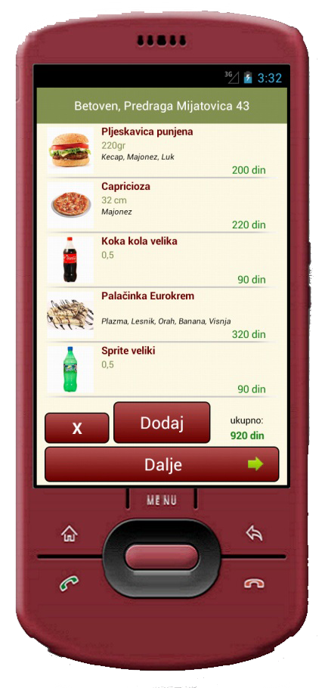
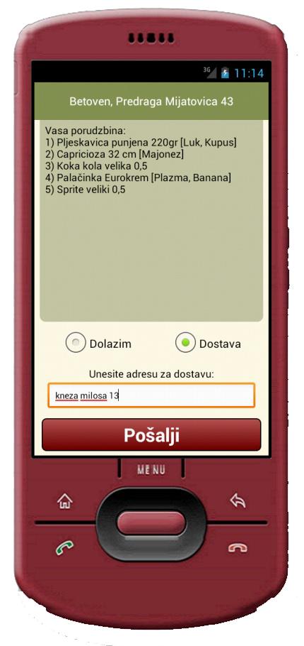
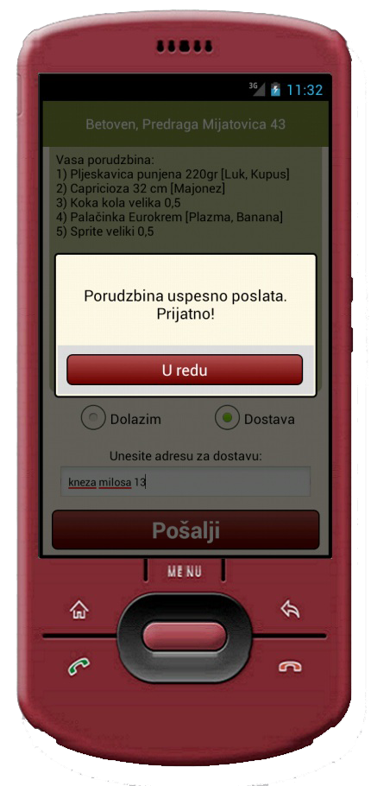
What is “Poruči Bre”?
Embedded database of fast food restaurants
- easy data access
- search restaurant by name or geo-location
Insight into the selected restaurant’s menu
- optional comparing of different fast food restaurants
- no haste and no pressure
Easy to create and send orders
- just a few clicks away from your meal
- no need to call, search for phone numbers or wait due to busy lines
- solved problem of potential inconvenience
Internet independent
- your order is sent via sms
- the receiver side only needs a regular cell-phone
2/6

Slide 3





How to distribute?
WHO WILL BENEFIT?
Powerful corporation
MIND GENOMICS
- Do you want to increase your reputation?
- Do you want to follow new trends?
- Do you want a cheap and effective advertisement?
-Classify target groups
-Determine the right approach
Find and classify target groups
Raw Materials – Silos & Elements
Fast food owner
Hungry customer
INTERNET
IdeaMap™
Target Customers
Target Distributers
Impact on Customer Experience
ANALYZED SURVEY RESULTS → Mind Genomics
- Do you want to increase your profit?
- Do you want to reach new customers?
- Do you want to speed up the ordering process?
- Do you want to be ahead of your competition?
MARKETING PHRASES
MARKET SEGMENTATION
TYPING ENGINE
- Do you want to be able to order food anytime, anywhere?
- Do you want to avoid waiting for your meal?
- Do you want to feel comfortable while ordering?
3/6

Slide 4
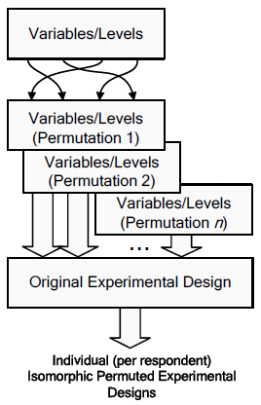
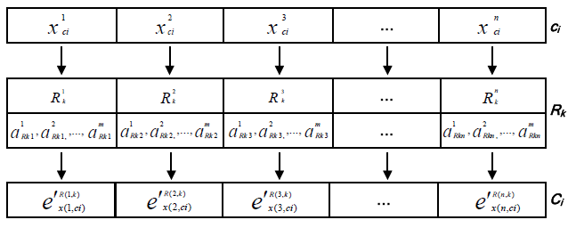
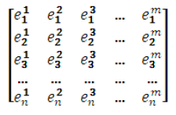
How to ask the right questions?
Mathematics will help - IPAD
- Isomorphic Permuted Experimental Designs
- helps us create distinct designs for each respondent
Multiple permutations of the variables/levels
This is done before the experimental design is applied
Creation of augmented isomorphic permuted experimental
designs that includes permutation of the levels and the variables.
Example of the creation of augmented isomorphic permuted experimental designs
With a set of variables (A1, A2, …, An),
the experimental units are applied to an
individually randomized array of variables
Rk ⊆ (A1, A2, …, An)
The experimental unit ci is applied to three
randomizations (Rk) of the variables
(A, B, C, D, E) to create profiles Ci.
Xj is level j of variable X.
Goal - Proper questions designed for each target group
4/6

Slide 5





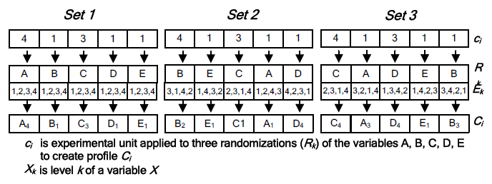
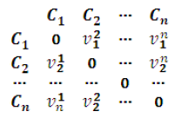
How to ask the right questions?
- The approach creates isomorphic designs that are statistically equivalent
- This in turn creates a diverse contextual environment for concept testing
- This produces less biased results
Final result
- Unique set of questions specifically designed for the target group
- They will be most effective when used with Mind Genomics
5/6

Slide 6
Contact Info
Filip Petrović
email: filip-petrovic@hotmail.com
+381642916852
Bojan Cvetojević
email: bojancvetojevic989@gmail.com
+381693028769
6/6

