Slide 1
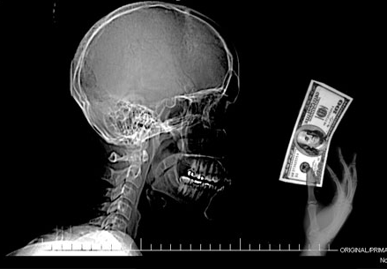
NeuroEconomics
The Brain & Decision Making
Viktorija Filipovic University of Belgrade

Slide 2
NeuroEconomics
Table of content
INTRODUCTION – What is NeuroEconomics?
PROBLEM STATEMENT – NeuroEconomics vs. Behavioral Economics
METHODOLOGY – How to collect data?
BASIC LESSONS FROM NEUROSCIENCE
SPECIFIC ECONOMIC APPLICATIONS
CONCLUSION
REFERENCES
Q & A

Slide 3
1. Introduction
NeuroEconomics is an interdisciplinary field that seeks to explain human decision making.

Slide 4
1. Research fields
Economics Psychology
NeuroScience
Biology Computer Science Mathematics
NeuroEconomics

Slide 5
2. Problem statement
NeuroEconomics vs. Behavioral Economics
Economic decisions = ?
Behavioral Economics: social, cognitive, and emotional factors
NeuroEconomics: + neuroscientific methods
Why NeuroEconomics is important?

Slide 6
2. NeuroEconomics & NeuroScience in literature
“How NeuroScience can inform Economics?”
COLIN CAMERER, GEORGE LOEWENSTEIN, and DRAZEN PRELEC
Journal of Economic Literature
Vol. XLIII (March 2005), pp. 9–64

Slide 7
3. Methodology
Diversity of tools NeuroScience use: mathematical, econometric, psychological, and simulation methods
Six basic NeuroScience methods
Problems with resulting datasets –
Insufficiently precise data (technical limitations)
Best methods – small datasets (fRMI)
Data Mining algorithms

Slide 8
3. Neuroscience methods
Brain Imaging
Single Neuron Measurement
Electrical Brain Stimulation
Psychopathology & Brain Damage
Psychophysical Measurement
Diffusion tensor imaging (DTI)

Slide 9
3.1. Brain Imaging
Most popular Neuroscience tool
Neural processes: 0.1mm in 100msec typical scanner: 3mm in several seconds
Best method -> hybrid techniques
Three basic imaging method:
Electro-Encephalogram (EEG)
Positron Emission Topography (PET)
Functional Magnetic Resonance Imaging (fMRI)

Slide 10
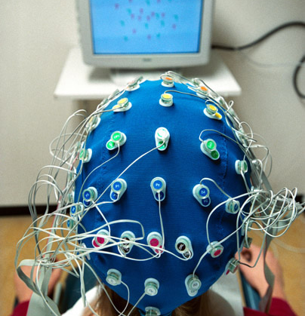
3.1. Brain Imaging – Electro-Encephalogram (EEG)
Electrodes attached to the scalp to measure electrical activity of brain.
The oldest method
Pros:
excellent temporal resolution ( 1 millisecond)
Portability
Cons :
Poor spatial resolution (only measures activities in the outer part of the brain)

Slide 11
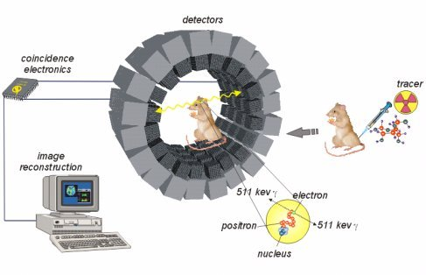
3.1. Brain Imaging – Positron Emission Topography(PET)
Measures blood flow in the brain.
Also an old method
Pros:
Good spatial resolution
Cons:
Poor temporal resolution (up to the minute)
Toxical injections

Slide 12
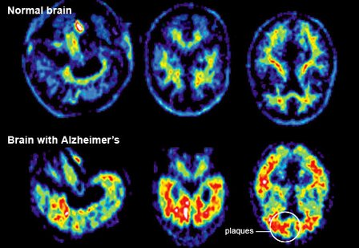
3.1. Brain Imaging – Positron Emission Topography (PET)

Slide 13
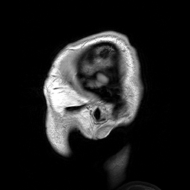
3.1. Brain Imaging – Functional Magnetic Resonance Imaging (fMRI)
Tracks blood flow in the brain using changes in magnetic properties due to blood oxygenation (the “BOLD” signal)
New method
Pros: Good spatial resolution
Cons: Poor temporal resolution (few seconds)
Right: Parasagittal MRI of the head of a patient with benign familial macrocephaly

Slide 14
3.1. Brain Imaging – Functional Magnetic Resonance Imaging (fMRI)

Slide 15
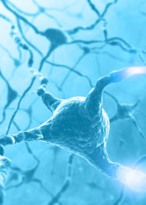
3.2. Single Neuron Measurement
Wires inserted in brain measures changes in brain
Very precise method
Insertion damage neurons -> Animals only
Based on basic emotional and motivational processes that humans share with mammals

Slide 16
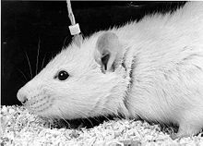
3.3. Electrical Brain Stimulation (EBS)
Rats would learn and execute new and uncommon behaviors if rewarded by brief pulses of EBS to certain sites in the brain
Obvious application in Economics, but only a few studies have explored substitutability of EBS and other reinforces.

Slide 17
3.4. Psychopathology & Brain damage
Interesting new insights while observing humans with schizophrenia, autism, degenerative diseases of neural system…
Transcranial Magnetic Stimulation (TMS)
Pulses magnetic fields to temporary disrupt brain function in specific regions
Pros: brain region <-> neural function
Cons: limited on cortex; bad long-term effects

Slide 18
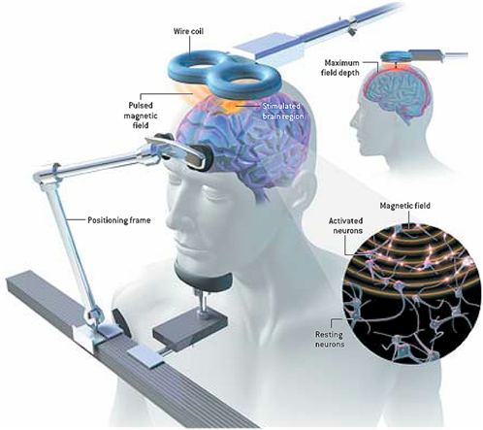
3.4. Transcranial Magnetic Stimulation (TMS)

Slide 19
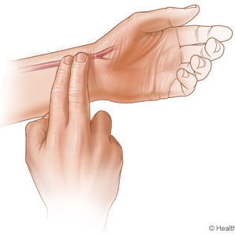
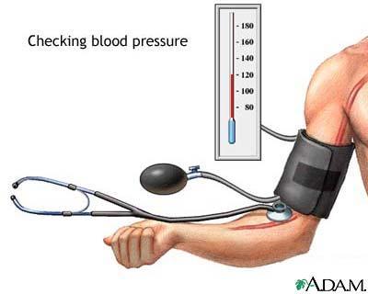
3.5. Psychophysical measurements
Old and simple technique
Measures indicators like:
Heart rate
Blood pressure
Galvanic skin response
Pupil dilatation …

Slide 20
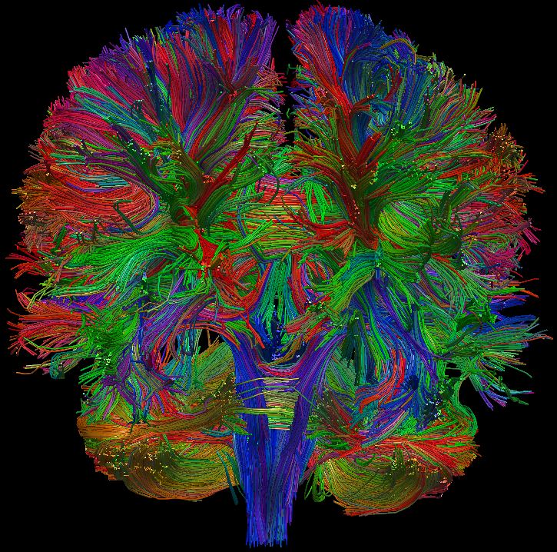
3.6. Diffusion Tensor Imaging (DTI)
Water flows rapidly through myelinated neural axons
New technique
The trajectories that project connections from one neural region to others
Can be used after autopsies

Slide 21
3. Data-Mining in NeuroScience
Multi-voxel pattern analysis (MVPA)
Beyond mind-reading: multi-voxel pattern analysis of fMRI data
Researchers use powerful algorithms, applied to multi-voxel patterns of activity, to decode the information that is represented in that pattern of activity
Kenneth A. Norman et al., Beyond mind-reading: multi-voxel pattern analysis of fMRI data, TRENDS in Cognitive Sciences (2006)

Slide 22
3. Multi-Voxel Pattern Analysis of fMRI data - MVPA
MVPA is Data Mining in Neuroscience
Brain voxel = brain pixels

Slide 23
4. Basic Lessons from NeuroScience
Two-dimensional framework

Slide 24
4. The Brain marked with some economically relevant areas

Slide 25
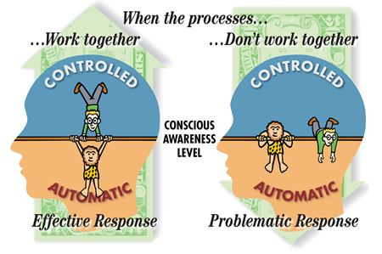
4. Automatic vs. Controlled
Automatic:
Fear
Dreaming
Controlled:
Solve math problem
Choose a new car

Slide 26
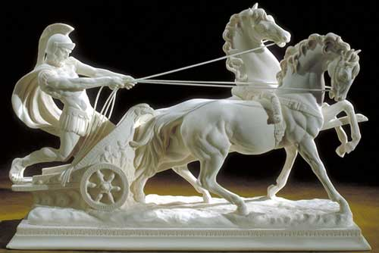
4. Affective vs. Cognitive
Plato described people as driving a chariot drawn by two horses: reason and passion

Slide 27
4. New Implications from Neuroscience
Activates the same reward areas in brain:
Food, Drugs, Money

Slide 28
4. Economic Constructs
Economist classify individuals as:
Time preference
Risk preference
Altruism
Self-control
Conscientiousness

Slide 29
4. Domain-Specific Expertise
People will perform equivalently on problems that have similar structure
“Mentalizing” (or “theory of mind”) module
fMRI - normal adults are given pairs of closely matching judgment problems, differing only in whether they do or do not require mentalizing, the mentalizing problems lead to greater activation in the left medial prefrontal cortex
People ->
genius in one task,
flat-footed in superficially different task

Slide 30
4. Utility of Money
Standard economics : the pleasure from food or cocaine and the “pleasure” from obtaining money as two totally different phenomena
NeuroScience: the same dopaminergic reward circuitry of the brain in the midbrain is activated for a wide variety of reinforces, including attractive faces, funny cartoons, cultural objects - like sports cars, drugs, and money!

Slide 31
4. Wanting and Liking
Economists: behavior as a search for pleasure
Neuroscience & Psychology: not always hedonic
“wanting” without “liking”:
later stages of many drug addictions
seek out information, even when you are sure that it will make you miserable

Slide 32
5. Specific Economic Applications
Research areas for specific topics in economics:
Intertemporal choice & Self control
Decision making under risk & uncertainty
Game theory
Labor-market discrimination

Slide 33
5.1. Intertemporal choice & Self control
Trade-off utility at different points in time
Humans appear to be unique among animals in terms of caring about future consequences
Affective system
Choosing earlier rewards more often
Lateral prefrontal cortex
Later rewards
More cognitive actions

Slide 34
5.1. Intertemporal choice & Self control
Experiment: 1 chocolate today or 2 chocolates tomorrow?
NeuroScience (fMRI): stimulation of limbic system associated with the midbrain dopamine system
Low serotonin, high cortisol -> immediate reward

Slide 35
5.2. Decision making under risk & uncertainty
Expected Utility
Behavioral Economics:
Rational Agents
Risk-reverse or Risk-seeking
Prospect Theory

Slide 36
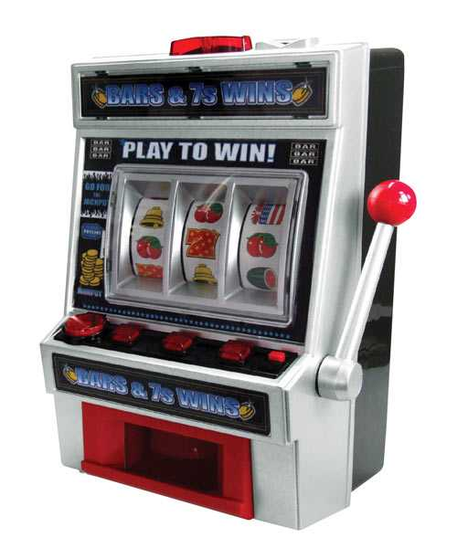
5.2. Decision making under risk & uncertainty
NeuroScience:
Increased activity
BA8 front median cortex
Prefrontal cortex
Amygdala
DOPAMINE
High dopamine -> Risky behavior
Gambling
Good for experiments
“Take it or leave it!”

Slide 37
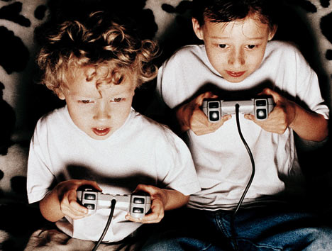
5.3. Game theory
Game theory – social decision making
Prisoner’s dilemma
Cooperate or defect against?
Trust
Oxytocin rises during social bonding
Loss Aversion – stressfully experience

Slide 38
5.4. Labor-market discrimination
Prejudice
Minority workers are less productive?
Experiment with employees and names
Neuroscience: experiment with pictures
Amygdala high activity for pictures of people of other race
Exception – familiar faces, celebrities

Slide 39
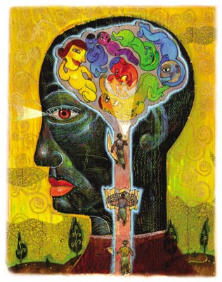
6. Conclusion
Economics about Neuroscience
Curious about psychology
Skeptical
Can Neuroscience save rational choice Economics?

Slide 40
7. References
NeuroEconomics: How Neuroscience Can Inform Economics COLIN CAMERER, GEORGE LOEWENSTEIN, and DRAZEN PRELEC Journal of Economic Literature Vol. XLIII (March 2005), pp. 9–64
Kenneth A. Norman et al., Beyond mind-reading: multi-voxel pattern analysis of fMRI data, TRENDS in Cognitive Sciences (2006), doi:10.1016/j.tics.2006.07.005.
http://en.wikipedia.org/wiki/Neuroeconomics http://en.wikipedia.org/wiki/Neuroscience
http://www.neuroeconomics.org/
http://www.scholarpedia.org/article/Neuroeconomics

Slide 41
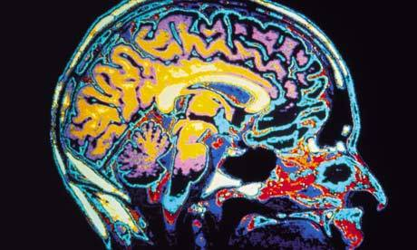
8. Q&A ?

