Slide 1
Current DARPA projects based on data mining

Slide 2
Contents
What is DARPA?
Projects
ADAMS – Anomaly Detection at Multiple Scales
SMISC – Social Media in Strategic Communication
Biochronicity
H1N1 Acceleration (Blue Angel)
DEFT – Deep Exploration and Filtering of Text
Mind’s Eye
AAA – Assured Arctic Awareness
Q & A

Slide 3
DARPA
The Defense Advanced Research Projects Agency (DARPA) is an agency of the US Department of Defense responsible for the development of new technologies for use by the military.
Established in 1958, after the Soviet launch of the Sputnik.
DARPA’s mission is to prevent technological surprise.
Their projects rarely succeed, but when they do, they revolutionize the industry (early Internet, research in artificial intelligence, integrated circuits etc.)

Slide 4
ADAMS
Each time we see an incident like a soldier becoming homicidal or suicidal or an innocent insider becoming malicious we wonder why we didn’t see it coming.
Why can’t we see the clues before the fact?
Because we generally need to look through an enormous amount of data and don’t know where and what to look for.

Slide 5
ADAMS
The Anomaly Detection at Multiple Scales (ADAMS) program creates, adapts and applies technology to anomaly characterization and detection in massive data sets.
The initial application domain is insider threat detection in which malevolent actions by a trusted individual are detected against a background of everyday network activity.

Slide 6
SMISC
Through the Social Media in Strategic Communication (SMISC) program, DARPA seeks to develop tools to support the efforts of human operators to counter misinformation or deception campaigns in social media.
Researchers will attempt to:
Track ideas and concepts
Model emergent communities
Detect generation of automated content (such as by bots)

Slide 7
SMISC
To accomplish this, SMISC will focus research on:
Linguistic cues
Patterns of information flow
Detection of sentiment or opinion
SMISC researchers will create a closed and controlled environment where large amounts of data are collected (e.g. , a closed social media network of 2000 to 5000 people)

Slide 8
DEFT
The goal of the Deep Exploration and Filtering of Text (DEFT) program is to enable analysts to discover implicitly-expressed, actionable information.
DEFT is expected to:
Provide the capability to identify and interpret explicit and implicit information from highly ambiguous and vague narrative text
Integrate individual facts into large domain models for assessment, planning and prediction.
Support the initial stages of report writing

Slide 9
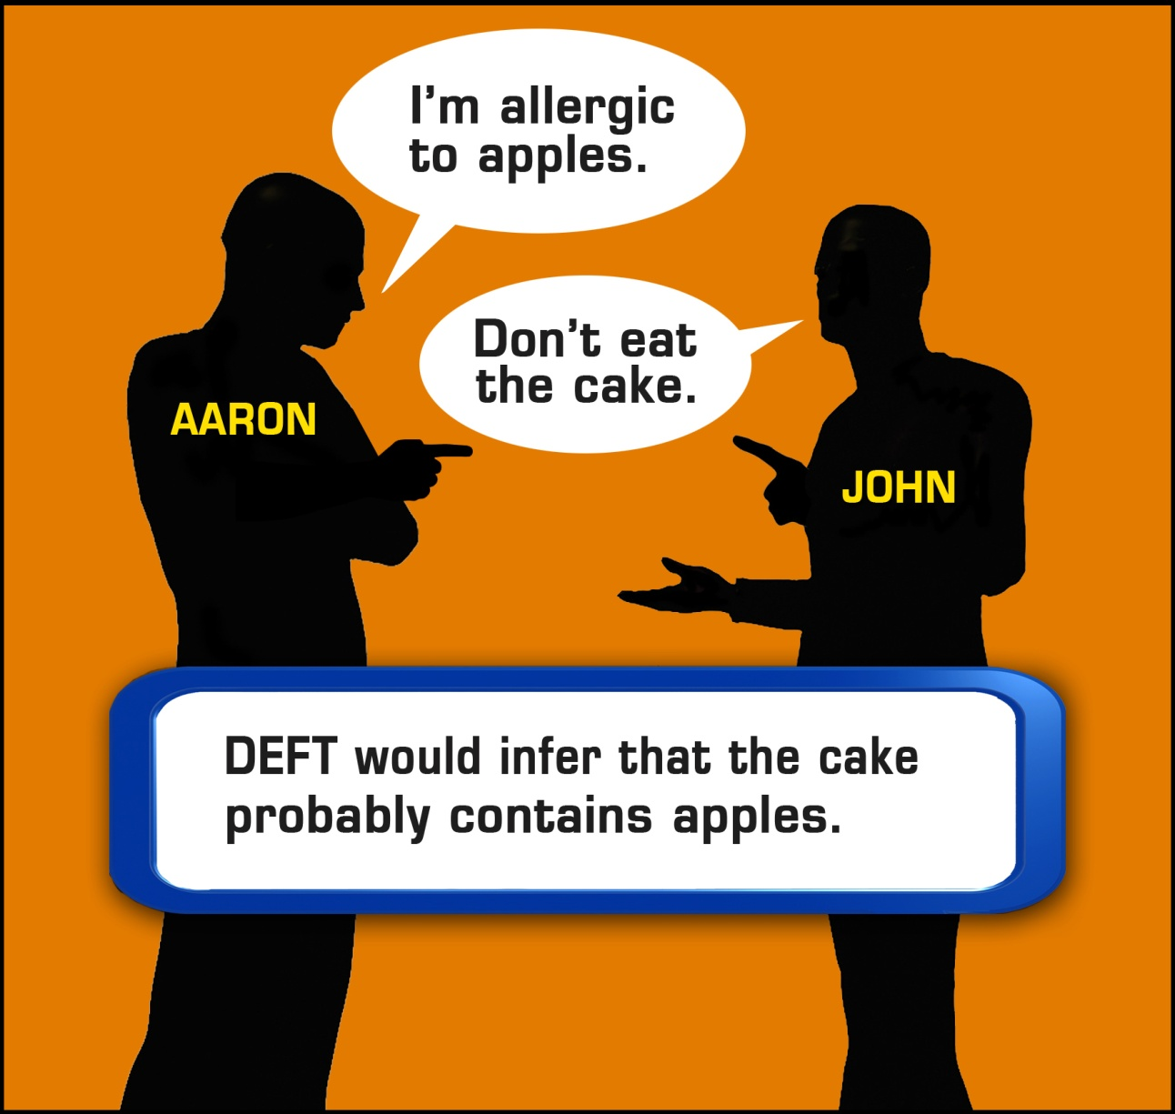
DEFT

Slide 10
Biochronicity
Currently, multiple “clock genes” have been uncovered, but none have been identified as the master regulator of cell lifecycle.
Proposed research should investigate approaches that increase the understanding of time in biological systems.
In phase 1, empirically derived data, bioinformatic and data mining techniques will be used to build a large library of factors that regulate cell lifecycle.

Slide 11
Biochronicity
If successful, this program could contribute to:
Enhancing human combat performance
Improving trauma care on the battlefield
Understanding the mechanisms behind disease and managing their effects

Slide 12
H1N1 Acceleration – Blue Angel
The Blue Angel program is an effort to deliver effective interventions for pandemic influenza.
Blue Angel brings together the following technologies:
Predicting Health and Disease (PHD)
Modular IMmune In vitro Constructs (MIMIC)
Accelerated Manufacture of Pharmaceuticals (AMP)

Slide 13
Blue Angel - PHD
PHD has developed a method for determining who will or will not become sick after exposure to a virus many days before symptoms appear.
High accuracy of detection enables prevention, prediction of disease propagation, and appropriate early treatment of infected individuals.

Slide 14
Mind’s Eye
The Mind’s Eye program seeks to develop in machines a capability that currently exists only in animals: visual intelligence.
One of the desired military uses of this is in a smart camera mounted on an unmanned ground vehicle.
It would have sufficient visual intelligence that is can report on activity in an area of observation.

Slide 15
Mind’s Eye

Slide 16
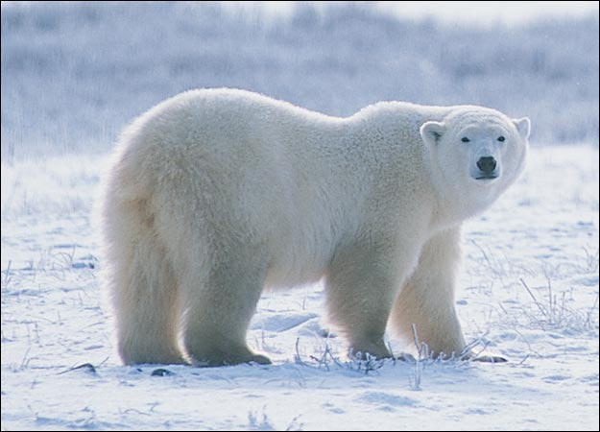
AAA
Due to anticipated retreating Arctic ice in the coming decades, shipping is expected to increase during summer months.
This growth in activity will increase the strategic significance of the region and will drive a need for effective regional monitoring.
The extreme environmental conditions of the Arctic challenge the ability of conventional technology to provide such monitoring.

Slide 17
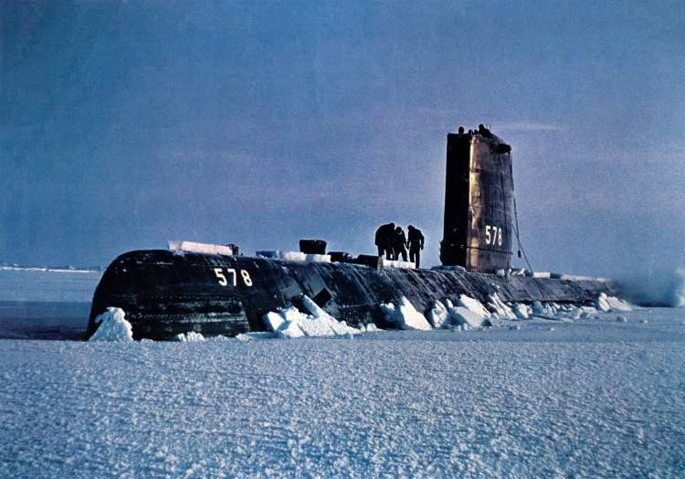
AAA
The Assured Arctic Awareness (AAA) program plans to develop new technologies for an advanced distributed sensor system to monitor the Arctic both below and above the ice.
Developers will need to overcome the challenges of:
Persistence
Survivability
Energy management
Sensing
Mobility
Delivery
Communications

Slide 18
Questions?

