Slide 1
DataFlow SuperComputing for ExaScale Applications: Revisiting the Algorithms
V. Milutinović, G. Rakocevic, S. Stojanović, and Z. Sustran
University of Belgrade
Oskar Mencer
Imperial College, London
Oliver Pell Maxeler Technologies, London and Palo Alto
Michael Flynn
Stanford University, Palo Alto

Slide 2
Essence of the Paradigm:
For Big Data algorithms and for the same hardware price as before, achieving:
a) speed-up, 20-200
b) monthly electricity bills, reduced 20 times
c) size, 20 times smaller
2/40

Slide 3
European Dimension of the Paradigm:
Absolutely all results achieved with:
a) all hardware produced in Europe,
specifically UK
b) all software generated by programmers of EU and WB
3/5

Slide 4
ControlFlow vs. DataFlow:
ControlFlow (MultiFlow and ManyFlow):
Top500 ranks using Linpack (Japanese K,…)
DataFlow:
Coarse Grain (HEP) vs. Fine Grain (Maxeler)
4/40

Slide 5
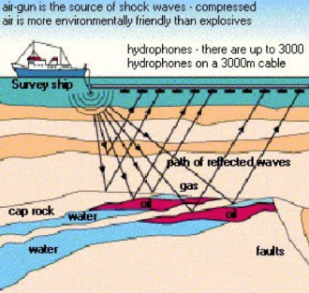
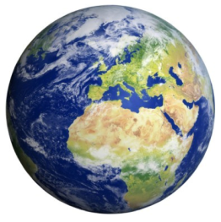
Essence of the DataFlow Approach!
Compiling below the machine code level brings speedups;
also a smaller power, size, and cost.
The price to pay:
The machine is more difficult to program.
Consequently:
Ideal for WORM applications :)
Examples using Maxeler:
GeoPhysics (20-40), Banking (200-1000, with JP Morgan 20%), M&C (New York City), Datamining (Google), …
5/40

Slide 7
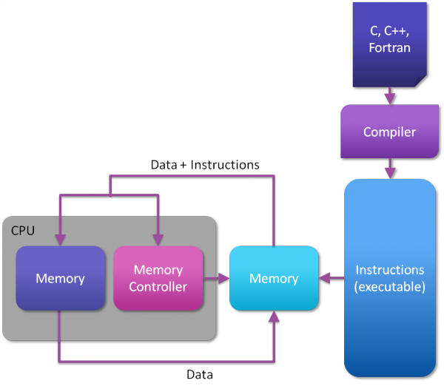
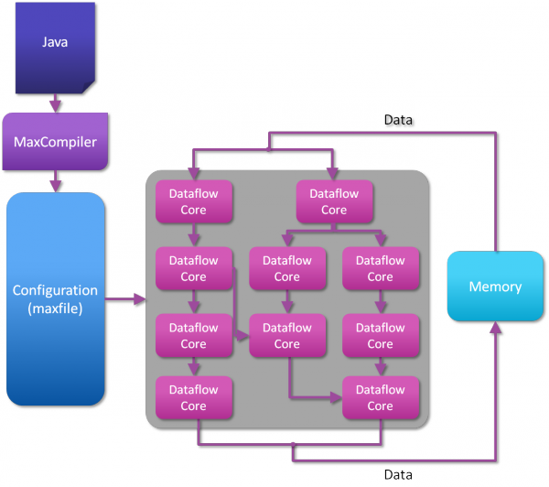
ControlFlow vs. DataFlow

Slide 8
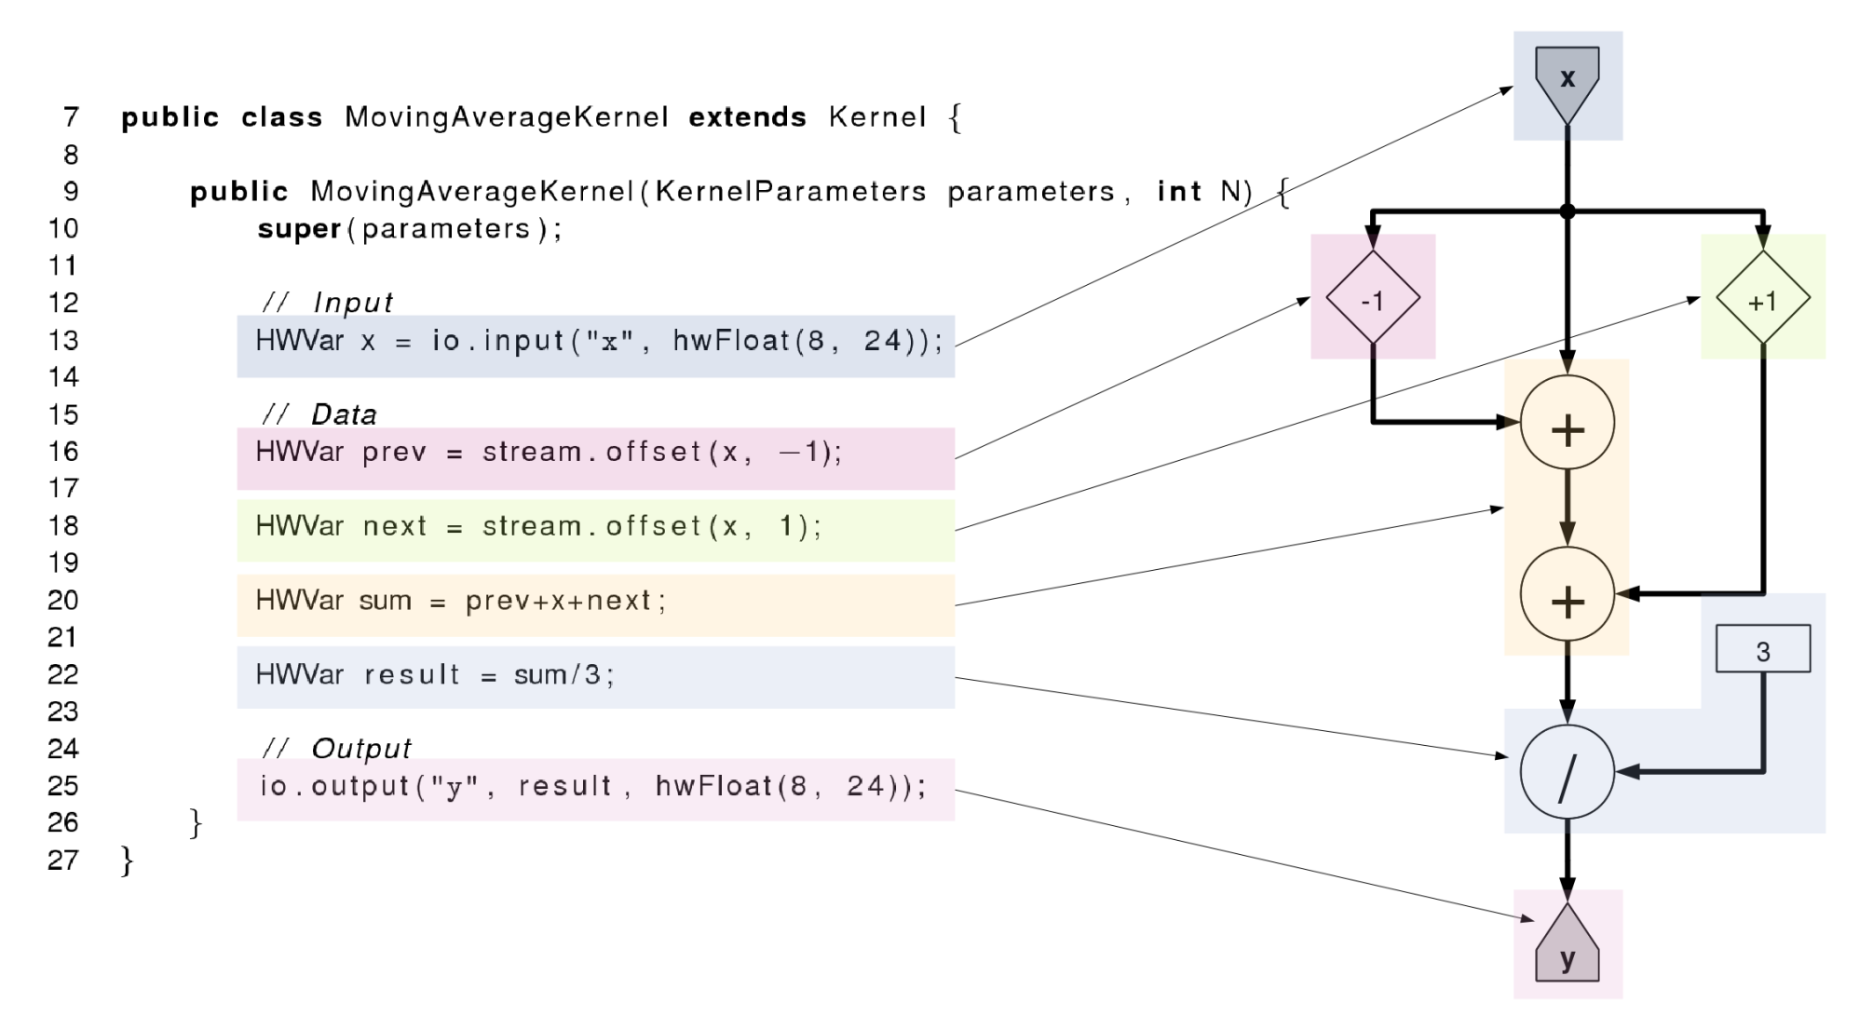
DataFlow Programming (1C +5Java)

Slide 9
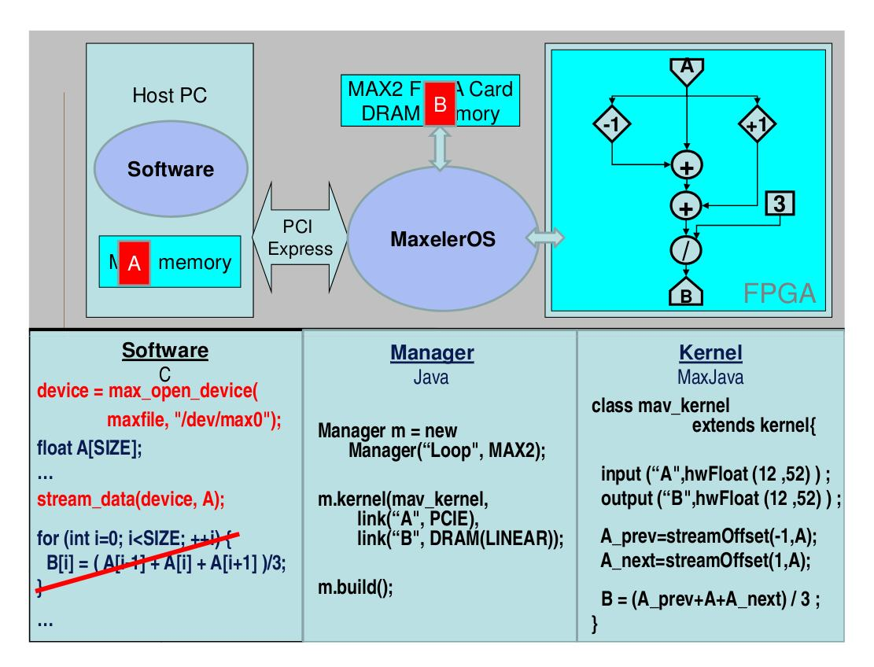

Slide 11
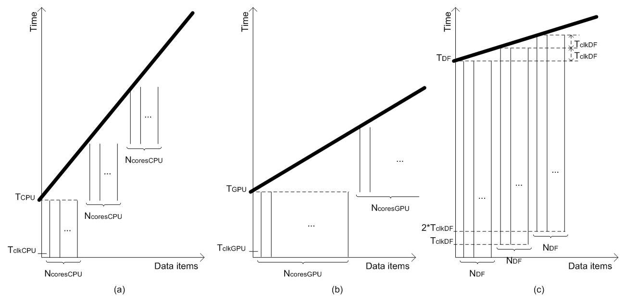
Essence: Our Paper in IEEE Computer
tCPU =
N * NOPS * CCPU*TclkCPU /NcoresCPU
tGPU =
N * NOPS * CGPU*TclkGPU / NcoresGPU
tDF = NOPS * CDF * TclkDF +
(N – 1) * TclkDF / NDF
Assumptions:
1. Software includes enough parallelism to keep all cores busy
2. The only limiting factor is the number of cores.

Slide 12
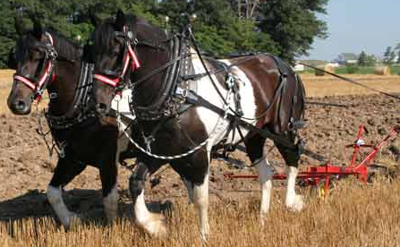
MultiCore
Which way are the horses going?
DualCore?

Slide 13
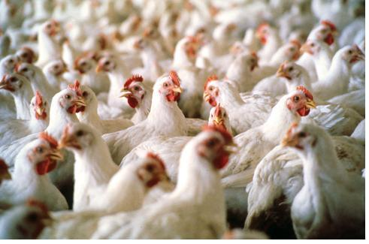
ManyCore
Is it possible to use 2000 chicken instead of two horses?
?
==
What is better, real and anecdotic?

Slide 14
ManyCore
2 x 1000 chickens (CUDA and rCUDA)

Slide 15
DataFlow
Data
How about 2 000 000 ants?

Slide 16
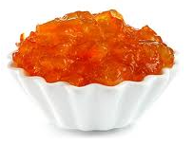
DataFlow
Big Data Input
Results
Marmalade

Slide 17
Why is DataFlow so Much Faster?
Factor: 20 to 200
MultiCore/ManyCore
Dataflow
Machine Level Code
Gate Transfer Level

Slide 18
Why are Electricity Bills so Small?
Factor: 20
MultiCore/ManyCore
Dataflow
P = kfU²

Slide 19
Why is the Cubic Foot so Small?
Factor: 20
MultiCore/ManyCore
DataFlow
Data Processing
Data Processing
Process Control
Process Control

Slide 20
Required Programming Effort?
MultiCore:
Explain what to do, to the driver
Caches, instruction buffers, and predictors needed
ManyCore:
Explain what to do, to many sub-drivers
Reduced caches and instruction buffers needed
DataFlow:
Make a field of processing gates: 1C+2nJava+3Java
No caches, etc. (300 students/year: BGD, BCN, LjU, ICL,…)

Slide 21
Required Debug Effort?
MultiCore:
Business as usual
ManyCore:
More difficult
DataFlow:
Much more difficult
Debugging both, application and configuration code

Slide 22
Required Compilation Effort?
MultiCore/ManyCore:
Several minutes
DataFlow:
Several hours for the real hardware
Fortunately, only several minutes for the simulator
The simulator supports both the large JPMorgan machine as well as the smallest “University Support” machine
Good news:
Tabula@2GHz

Slide 23
Now the Fun Part

Slide 24
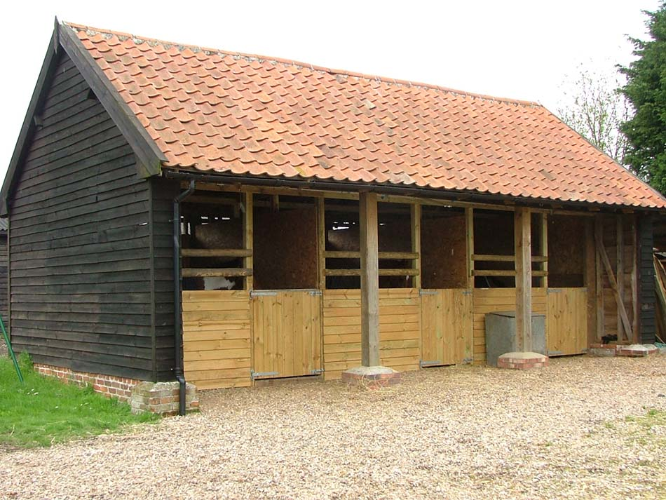
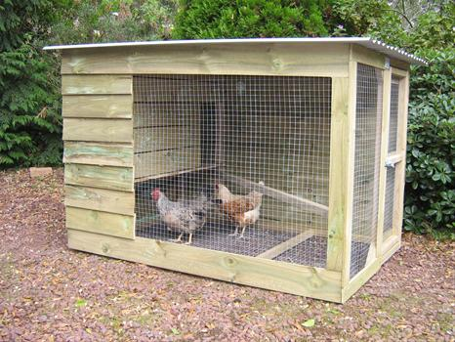
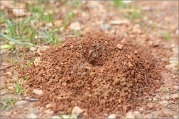
Required Space?
MultiCore:
Horse stable
ManyCore:
Chicken house
DataFlow:
Ant hole

Slide 25
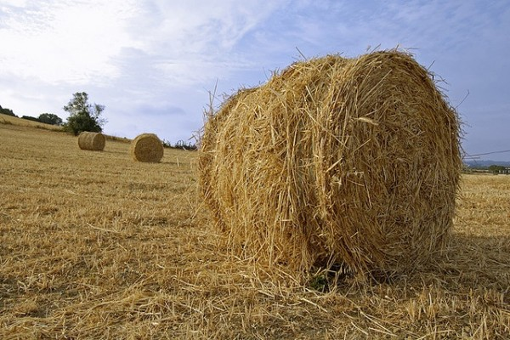
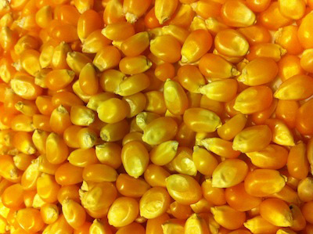
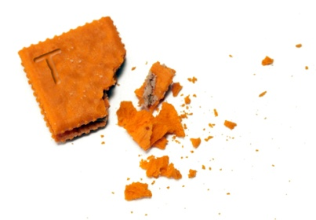
Required Energy?
MultiCore:
Haystack
ManyCore:
Cornbits
DataFlow:
Crumbs

Slide 26
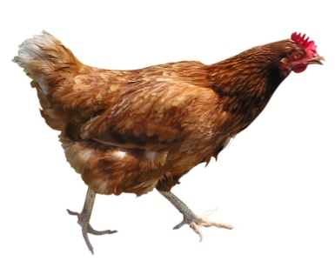
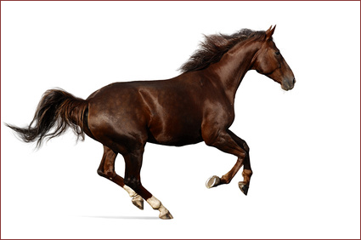
Why Faster?
Small Data: Toy Benchmarks (e.g., Linpack)

Slide 27
Why Faster?
Medium Data (benchmarks favorising NVidia,
compared to Intel,…)

Slide 28
Why Faster?
Big Data

Slide 29
DataFlow for ExaScale DM
Revisiting the Top 500 SuperComputer Benchmarks
Our paper in Communications of the ACM
Revisiting all major Big Data DM algorithms
Massive static parallelism at low clock frequencies
Concurrency and communication
Concurrency between millions of tiny cores difficult, “jitter” between cores will harm performance at synchronization points
Reliability and fault tolerance
10-100x fewer nodes, failures much less often
Memory bandwidth and FLOP/byte ratio
Optimize data choreography, data movement, and the algorithmic computation

Slide 30
Conclusion: Nota Bene
This is about algorithmic changes, to maximize the algorithm to architecture match:
Data choreography, process modifications,
and
decision precision.
The winning paradigm of Big Data ExaScale?

Slide 31
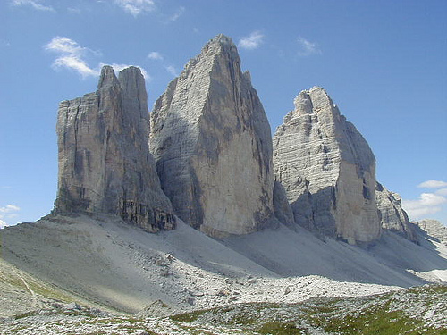
The TriPeak
Siena
+ BSC
+ Imperial College + Maxeler
+ Belgrade
31/40

Slide 32
The TriPeak
MontBlanc = A ManyCore (NVidia) + a MultiCore (ARM)
Maxeler = A FineGrain DataFlow (FPGA)
How about a happy marriage?
MontBlanc (ompSS) and Maxeler (an accelerator)
In each happy marriage,
it is known who does what :)
The Big Data DM algorithms:
What part goes to MontBlanc and what to Maxeler?
32/40

Slide 33
Core of the Symbiotic Success
An intelligent DM algorithmic scheduler,
partially implemented for compile time,
and partially for run time.
At compile time:
Checking what part of code fits where
(MontBlanc or Maxeler): LoC 1M vs 2K vs 20K
At run time:
Rechecking the compile time decision,
based on the current data values.
33/40

Slide 34
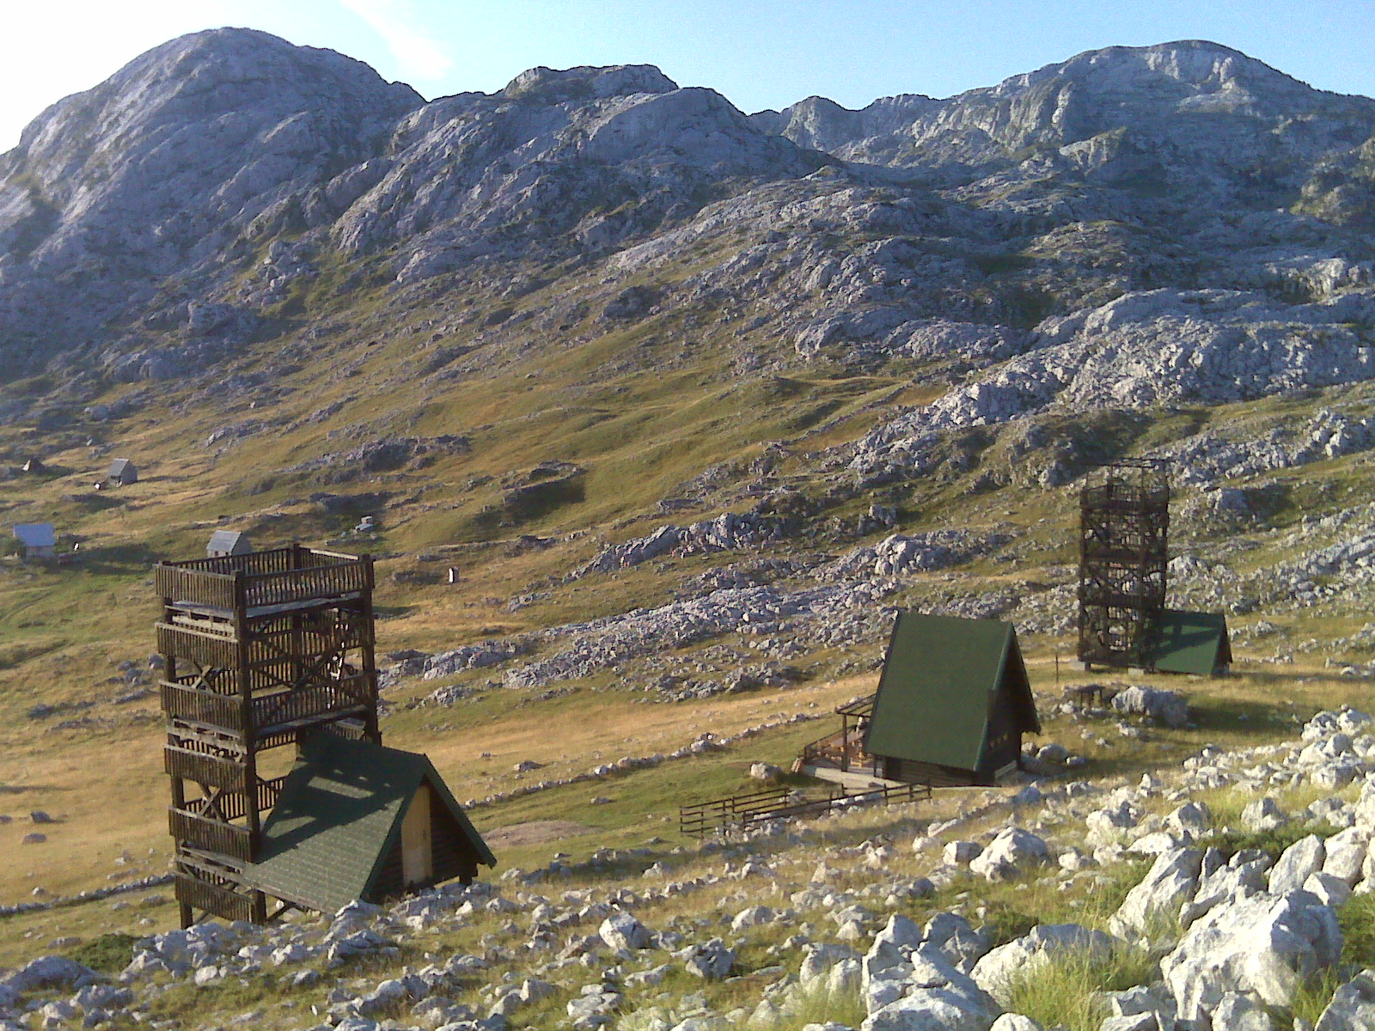
34

Slide 35
Maxeler: Teaching (Google: prof vm)
TEACHING, VLSI, PowerPoints, Maxeler:
Maxeler Veljko Explanations, August 2012
Maxeler Veljko Anegdotic,
Maxeler Oskar Talk, August 2012
Maxeler Forbes Article
Flyer by JP Morgan
Flyer by Maxeler HPC
Tutorial Slides by Sasha and Veljko: Practice (Current Update)
Paper, unconditionally accepted for Advances in Computers by Elsevier
Paper, unconditionally accepted for Communications of the ACM
Tutorial Slides by Oskar: Theory (7 parts)
Slides by Jacob, New York
Slides by Jacob, Alabama
Slides by Sasha: Practice (Current Update)
Maxeler in Meteorology
Maxeler in Mathematics
Examples generated in Belgrade and Worldwide
THE COURSE ALSO INCLUDES DARPA METHODOLOGY FOR MICROPROCESSOR DESIGN, with an example
35/40

Slide 36
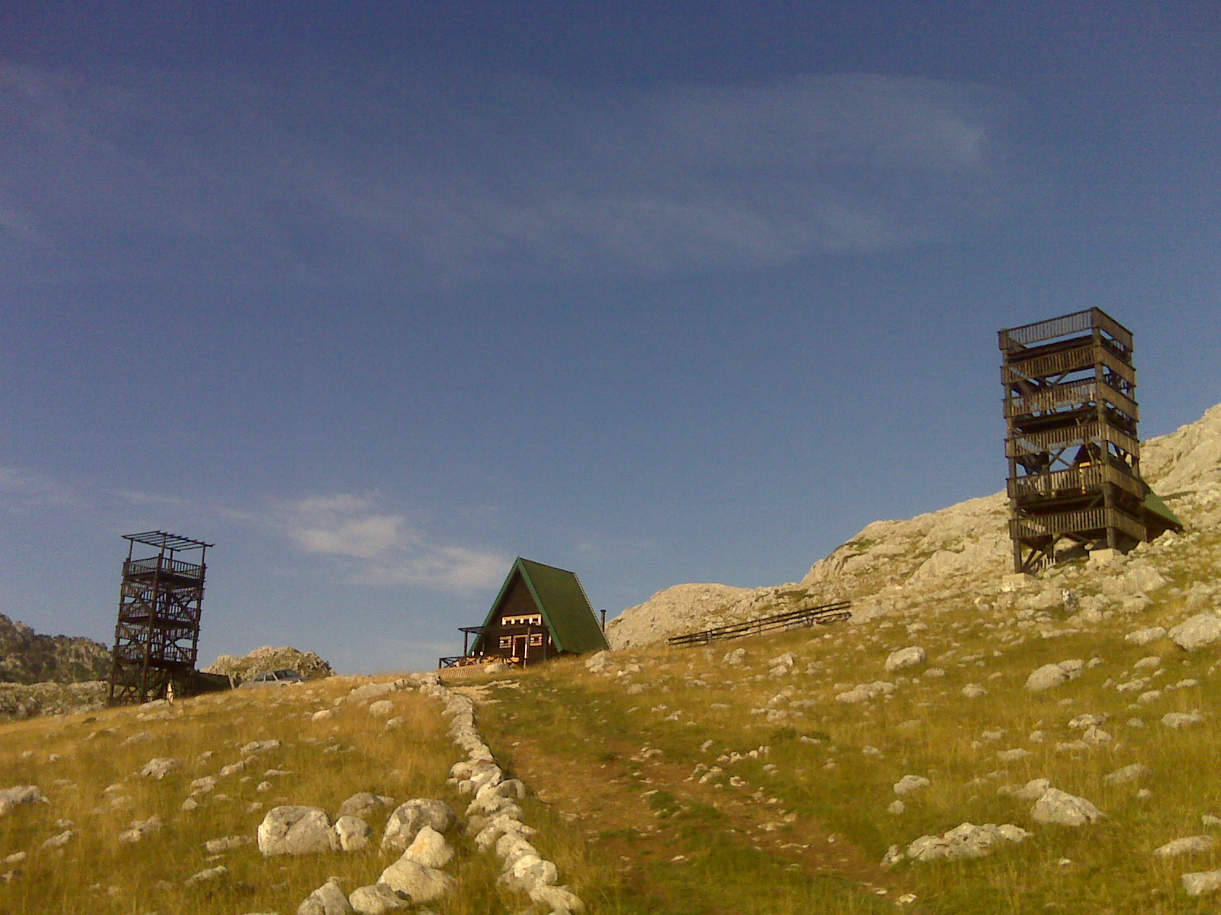
36
© H. Maurer

Slide 37
Maxeler: Research (Google: good method)
Structure of a Typical Research Paper: Scenario #1
[Comparison of Platforms for One Algorithm]
Curve A: MultiCore of approximately the same PurchasePrice
Curve B: ManyCore of approximately the same PurchasePrice
Curve C: Maxeler after a direct algorithm migration
Curve D: Maxeler after algorithmic improvements
Curve E: Maxeler after data choreography
Curve F: Maxeler after precision modifications
Structure of a Typical Research Paper: Scenario #2
[Ranking of Algorithms for One Application]
CurveSet A: Comparison of Algorithms on a MultiCore
CurveSet B: Comparison of Algorithms on a ManyCore
CurveSet C: Comparison on Maxeler, after a direct algorithm migration
CurveSet D: Comparison on Maxeler, after algorithmic improvements
CurveSet E: Comparison on Maxeler, after data choreography
CurveSet F: Comparison on Maxeler, after precision modifications
37/40

Slide 38
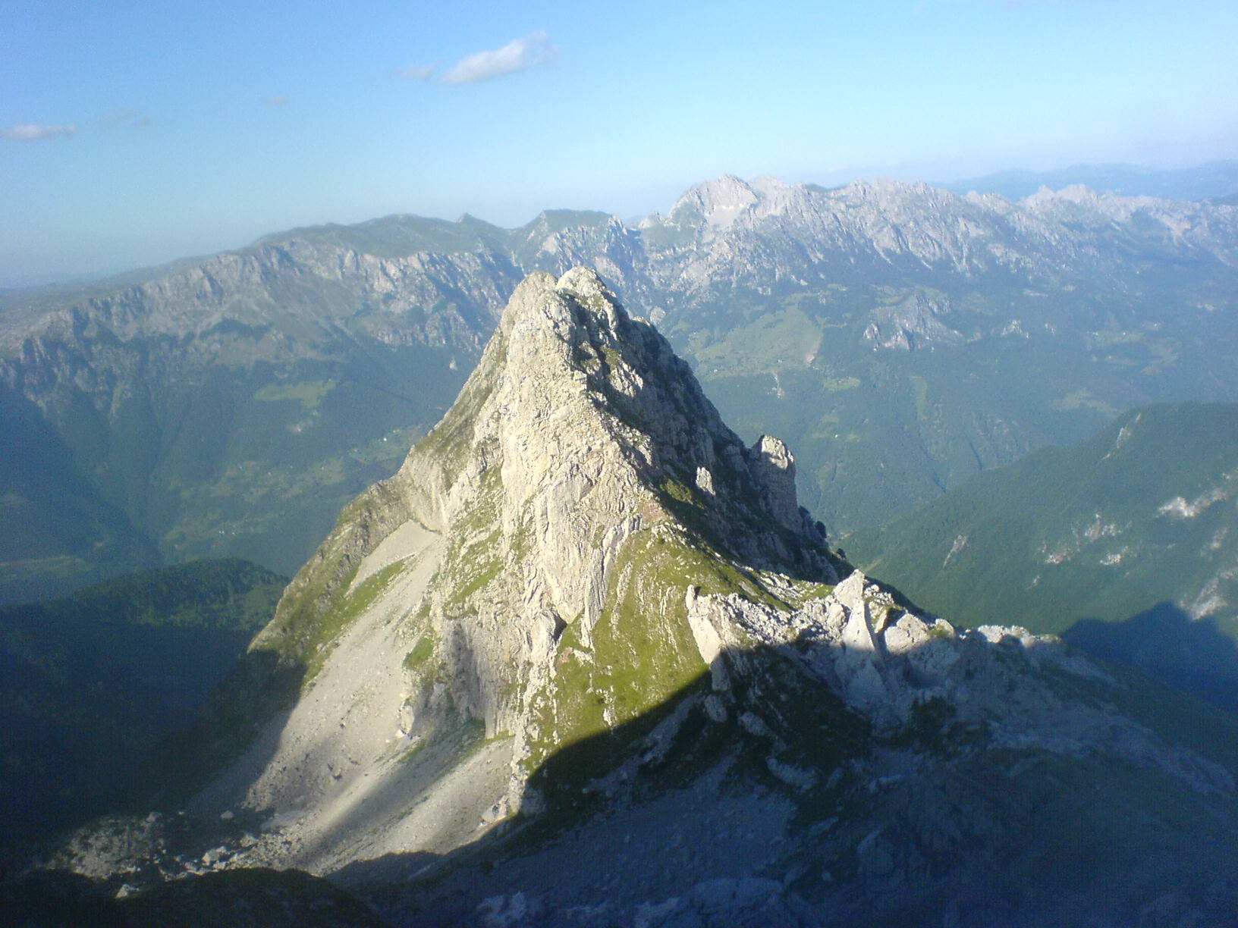
38
© H. Maurer

Slide 39
Maxeler: Topics (Google: HiPeac Berlin)
SRB (TR):
KG: Blood Flow
NS: Combinatorial Math
BG1: MiSANU Math
BG2: Meteos Meteorology
BG3: Physics (Gross Pitaevskii 3D real)
BG4: Physics (Gross Pitaevskii 3D imaginary)
(reusability with MPI/OpenMP vs effort to accelerate)
FP7 (Call 11):
University of Siena, Italy,
ICL, UK,
BSC, Spain,
QPLAN, Greece,
ETF, Serbia,
IJS, Slovenia, …
39/40

Slide 40
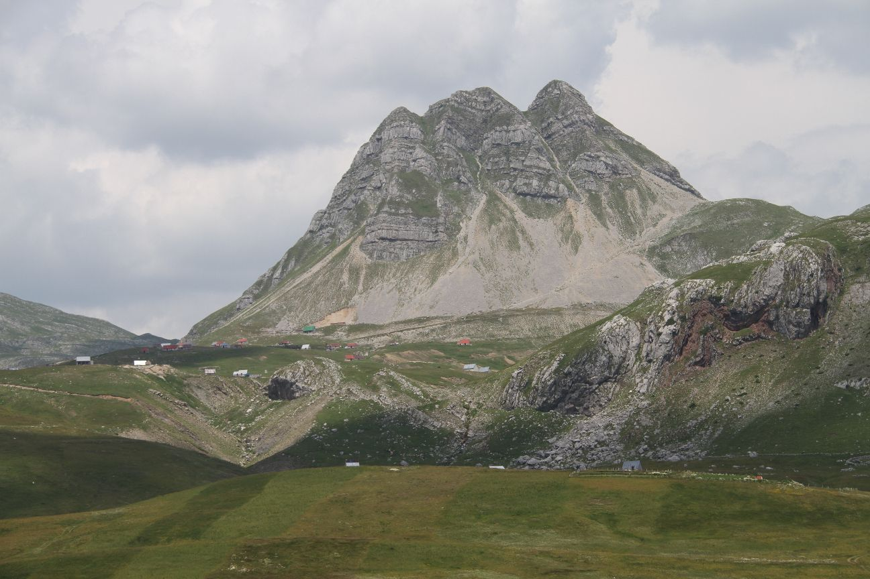
Q&A
vm@etf.rs
40
© H. Maurer

