Slide 1
Intelligent Question Routing Systems - A Tutorial
Bojan Furlan, Bosko Nikolic, Veljko Milutinovic, Fellow of the IEEE
{bojan.furlan, bosko.nikolic, veljko.milutinovic}@etf.bg.ac.rs
School of Electrical Engineering, University of Belgrade, Serbia

Slide 2
Content
Introduction
Generalization
of the Analyzed Approaches
Presentation and Comparison
of the Analyzed Approaches
Ideas for Future Research
Conclusion
Notes:
I will give a brief introduction …

Slide 3
Introduction

Slide 4



What is IQRS –
Intelligent Question Routing System?
Type a question
Understand “information need”
Find a right person
Forward the question
Understand the question
Give an answer
User
IQRS Service
User

Slide 5
Where IQRS Can Be Used?
Everywhere where intensive communication between users is required; for example:
Public or enterprise services
University
Technical support
Notes:
where intensive communication between users is required (e.g., large enterprises, e-government agencies, health care system, army, etc.) Other applications can involve a support in educational and collaboration processes, where IQRS facilitates an efficient and effective knowledge exchange between scientists, researchers, university staff, and students. The benefit coming from deployment of such systems includes: (a) reducing stress on experts and (b) increasing the system owners' (enterprise, government, university) quality of service.

Slide 6
The Benefits of Using IQRS
Reduces unnecessary “pinging” of experts
Experts are a valuable resource;
we don’t want to waste their time.
b) Increases the quality of service
Users are more satisfied with answers;
their questions are answered by the right persons.

Slide 7
Generalization of the Analyzed Approaches
Notes:
Hopefully now I convinced you that IQRS is an interesting research topic ☺

Slide 8
Issues
#1: How to identify “information need”
from a question?
#2: How to find competent users
for a particular question?
#3: How to accurately profile user knowledge from various information sources?
Notes:
The first, the second, the third

Slide 9
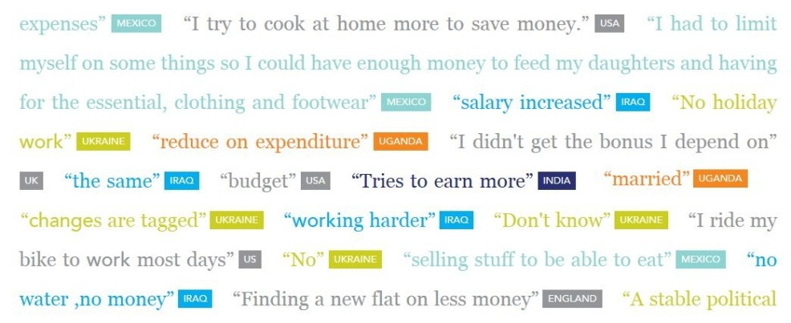
#1: How to identify information need from a question?
In IQRS, the human answerer
has to understand the question
  Human intelligence is well-suited for this task
Question analysis task is simpler,
we “only” have to understand the question sufficiently enough
to route it to a competent answerer.
  to identify “information need:”
  in a form of topics or terms related to the question
Notes:
Aj!dentifaj ☺

Slide 10
Criteria of Interest for Question#1:
User interaction type:
  with question annotation (tags, categories)
  without question annotation
Algorithm extraction type:
  Natural Language Processing (NLP) techniques: stemming, synonym lookup,
  Part Of Speech (POS) filtering, etc.
  Data Mining/Machine Learning techniques:
  DM (trained topic classifiers) or ML (topic modeling)
Notes:
Criteria … are (mnozina, ne is)
E!notation

Slide 11
#2: How to find competent users for a particular question?
recognized “information need” from the question
match
similarity
available knowledge profiles
ordered list of users (or “candidate answerers”)
who should be contacted to answer the question

Slide 12
Criteria of Interest for Question#2:
Model organization
  Centralized
  Distributed
Similarity calculation
  With exact matching
  With semantic matching
Notes:
i.e. - id est

Slide 13
#3: How to accurately profile user knowledge from various information sources?
Knowledge can be classified broadly as [1,2]:
  Explicit knowledge (facts, rules, relationships, policies)
  - it is explicitly expressed
  - it can be codified in a paper or electronic form.
  Tacit knowledge (or intuition) relates to personal skills,
  - it is influenced by beliefs, perspectives, and values
  - it requires interaction
Individual knowledge is learned (internalized) into the human brain:
We have to use the psychological approach:
  To observe the subject’s characteristics from the performed behavior.
  Here, the behavior is represented by the content that a user generates:
  User is modeled as a content generator.
This content to some extent maps to the previous classification:
  explicit knowledge is mostly expressed within the published documents (papers, books, articles, or blogs)
  email communication and content from the question-answering process
  can identify the tacit knowledge
Both sorts of information are valuable – we have to integrate this!
Notes:
i!xsplicitly

Slide 14
Criteria of Interest for Question#3
User profiling methodology by source of information:
Text (posts on forums, blogs, articles, etc.):
  NLP (stemming, ad-hoc named entity extractor, etc.)
  DM (classification, clustering) or ML (topic modeling)
  Recommender System (RS) models
Other (social network linkage graph, response rate,…)
  Ad-hoc (AH) models
  Recommender System (RS) models
  DM (e.g., PageRank or HITS)

Slide 15
An Anatomy of IQRS
Notes:
Pro!cesing

Slide 16
Presentation and Comparison of the Analyzed Approaches

Slide 17
Analyzed Approaches
iLink [3]
Davitz et al (2007)
Probabilistic Latent Semantic Analysis in Community Question Answering
Qu et al (2009) [4] (PLSA in CQA)
Question Routing Framework [5]
Li and King (2010)
Aardvark [6]
Horowitz and Kamvar (2010)
Yahoo! Answers Recommender System [7]
Dror et al (2011)
Social Query Model (SQM) [8]
Banerjee and Basu (2008)

Slide 18
iLink
  A model for social search and message routing

Slide 19
PLSA in CQA
  A question recommendation technique based on PLSA

Slide 20
Question Routing Framework
  Considers both user’s expertise and user’s availability

Slide 21
Aardvark
  A social search engine in user’s extended social networks

Slide 22
Yahoo! Answers Recommender System
  A multi-channel recommender system:
  fuses social and content signals

Slide 23
Social Query Model (SQM)
  A model for decentralized search

Slide 24
Comparison of the Analyzed Approaches
 | 1. Question Processing |  | 2. Matching & Ranking |  | 3. User Knowledge Profiling |  | 4. Addition. Info.
 | Annotation | Analysis | Model Organization | Semantic Matching | Text | Other
iLink | Tagging | NLP | Centralized (or Distributed) | No | DM | Response Score | Referral Rank
PLSA in CQA | No | ML | Centralized | No | ML | No | No
Question Routing Framework | No | No | Centralized | No | RS model | No | Availability
Aardvark | Tagging | DM | Centralized | Yes | DM & NLP | RS Model | Connectedness, Availability
Yahoo! Answers Recommender System | Categories | NLP | Centralized | No | RS model | RS model | Group of user attributes
SQM | No | No | Distributed | No | No | Expertise Score | Response Rate

Slide 25
Ideas for Future Research

Slide 26
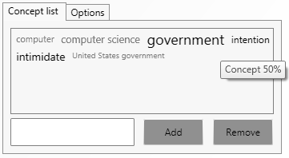
Question Visualization
Problems with automated question processing:
  Questions are often ambiguous
  Tools can be insufficiently precise and can omit information
Possible improvements:
  An interactive user interface [9] – automatic text processing
  and manual correction of results
  TagCloud visualization:
  “the more significant the concept, the bigger its font size”
Notes:
This approach combines fully automatic text processing and manual correction of the results, giving the user a possibility to increase the accuracy of the output. On the other hand, automated processing can produce more results that would be usually forgotten.
that allows communication between the question-processing module and a user that posed the question.

Slide 27
Semantic and String Similarity Incorporation
Questions or profiles can include:
  typos
  different forms of infrequent proper nouns
recognized “information need” from the question
match
Bag of words approach [10] ->
Semantic &String similarity
available knowledge profiles
ordered list of users (or “candidate answerers”) who should be contacted to answer the question
Notes:
Along semantic use string similarity

Slide 28
Profile Integration
Bayesian approach (used in analyzed solutions)
does not have an adequate expressiveness [11], e.g.:
  User A answered 100 questions about a topic c
  and the quality of the answers rated by other users was 0.5
  User A did not answer any question about topic c
  In both cases trust in A’s knowledge about the topic c is:
  p(trust)=0.5, p(distrust)=0.5.
Possible improvements - generalization of Bayesian probability
that can handle ignorance; trust model based on:
  The Dempster-Shafer theory (DST)
  The Dezert-Smarandache theory (DSmT) [11]
Notes:
Distinguish between ignorance and uncertainty
Shejfer!!!

Slide 29
Conclusion
Notes:
Et the end I will give the conclusion

Slide 30
What We Did?
Since IQRSs are about questions and answers,
our attitude in this paper was:
  "Half of science is asking the right questions," Aristotle (384 BC – 322 BC).
  We asked three fundamental questions
  and on their basis we built a presentation paradigm.
We established common characteristics of IQRSs to allow their uniform analysis
Future research - to implement a prototype
of the proposed ideas
and to evaluate their performance

Slide 31
Selected References
I. Rus and M. Lindvall, “Knowledge management in software engineering,” IEEE Software, vol. 19, no. 3, pp. 26-38, May 2002.
S. Frameworks, “Management of explicit and tacit knowledge,” Journal of the Royal Society of Medicine, vol. 94, pp. 6-9, 2001.
J. Davitz, J. Yu, S. Basu, D. Gutelius, and A, “iLink: search and routing in social networks,” in WWW, 2007.
M. Qu, G. Qiu, X. He, and C. Zhang, “Probabilistic question recommendation for question answering communities,” in WWW, pp. 1229-1230, 2009.
B. Li, and I. King, “Routing questions to appropriate answerers in community question answering services,” in CIKM, pp. 1585-1588, 2010.
D. Horowitz and S. D. Kamvar, “The anatomy of a large-scale social search engine,” in WWW, 2010.
G. Dror, Y. Koren, Y. Maarek, and I. Szpektor, “I want to answer; who has a question?: Yahoo! answers recommender system,” in KDD, pp. 1109-1117, 2011.
A. Banerjee and S. Basu, “A social query model for decentralized search,” in SNAKDD, 2008.
E. Varga, B. Furlan, and V. Milutinovic, "Document Filter Based on Extracted Concepts," Transactions on Internet Research, vol. 6, no. 1, pp. 5-9, January 2010.
A. Islam and D. Inkpen, “Semantic text similarity using corpus-based word similarity and string similarity,” ACM Transactions on Knowledge Discovery from Data, vol. 2, no. 2, pp. 1-25, Jul. 2008.
J. Wang and H.-J. Sun, “A new evidential trust model for open communities,” Computer Standards & Interfaces, vol. 31, no. 5, pp. 994-1001, Sep. 2009.

Slide 32
Questions?
Thank You!
bojan.furlan@etf.rs

