Slide 1
Probabilistic Graphical Models For Text Mining: A Topic Modeling Survey
V. Jelisavčić*, B. Furlan **, J. Protić**, V. Milutinović**
* Mathematical Institute of the Serbian Academy of Sciences and Arts/11000, Belgrade, Serbia
** Department of Computer Engineering, School of Electrical Engineering,
University of Belgrade/11000, Belgrade, Serbia
vladisavj@mi.sanu.ac.rs, {bojan.furlan, jeca, vm}@etf.rs

Slide 2
Summary
Introduction to topic models
Theoretical introduction
Probabilistic graphical models: basics
Inference in graphical models
Finding topics with PGM
Classification of topic models
Classification method
Examples and applications
Conclusion and ideas for future research

Slide 3
Introduction to topic models
How do we define “topic”?
Group of words that frequently co-occur together
Context
Semantics?
Why modeling topics?
Soft clustering of text
Similar documents -> similar topics
Machine learning from text: where to start?
What features to use?
Dimensionality of a million (or billion) words corpus
How to use additional features alongside pure text

Slide 4
Introduction to topic models
How to deal with uncertainty in natural language:
Probabilistic approach
Comparison with language models:
Short distance vs long distance dependence
Local vs Global
Sequence vs Bag

Slide 5
Introduction to topic models
Topic modeling in a nutshell: Text + (PG Model + Inference algorithm) -> Topics

Slide 6
Probabilistic graphical models: basics
Modeling the problem: Start with the variable space
Uncertainty through probability
Basic elements:
Observed variables
Latent variables
Priors
Parameters

Slide 7
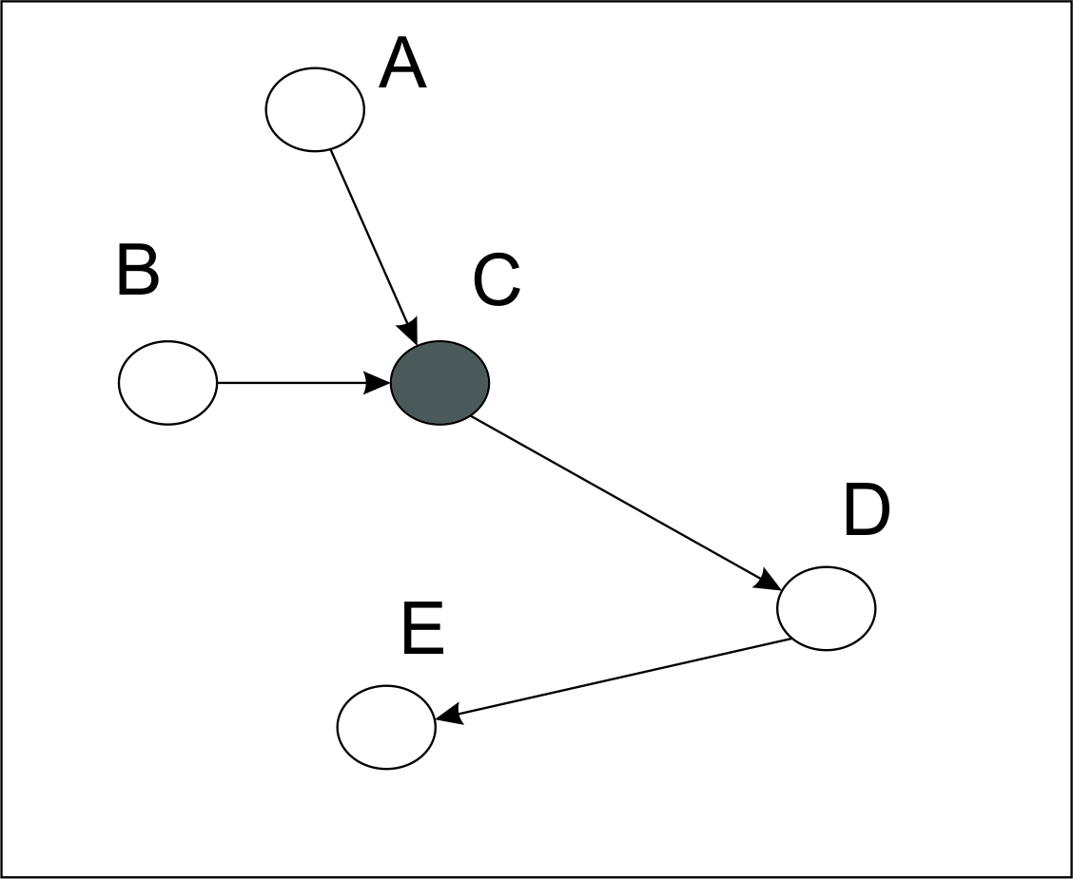
Probabilistic graphical models: basics
Too many variables -> Too many dimensions in variable space
Dimension reduction through independence assumption
Representing independencies using graphs
$$p\left(A,B,C,D,E\right)=p\left(A\right)p\left(B\right)p\left(C | A,B\right)p\left(D | C\right)p(E|D)$$

Slide 8
Probabilistic graphical models: basics
Marginal & Conditional independence: knowing the difference
Goals:
Learn full probability distribution from observed data
Find marginal distribution over some subset of variables
Find most likely value of a specific variable

Slide 9
Inference and learning in graphical models
Likelihood:
Max likelihood estimation
Max a posteriori estimation
Max margin estimation

Slide 10
Inference and learning in graphical models
Goal: Learn the value of the latent variables using the given data (observed variables):
What are the most probable values of latent variables? Values with highest likelihood given the evidence!
Going step further (full bayesian approach): What are the most probable distributions of lat. var.? Use prior distributions!

Slide 11
Inference and learning in graphical models
If there are no latent variables, learning is simple
Likelihood is concave function, finding max is trivial
If there are latent variable, things tend to get more complicated
Sometimes learning is intractable
To calculate the normalizing const for the likelihood, sum (or integration) over all possible values must be done
Approximation algorithms are required

Slide 12
Inference and learning in graphical models
Expectation Maximization
Markov Chain Monte Carlo (Gibbs sampling)
Variational Inference
Kalman Filtering

Slide 13
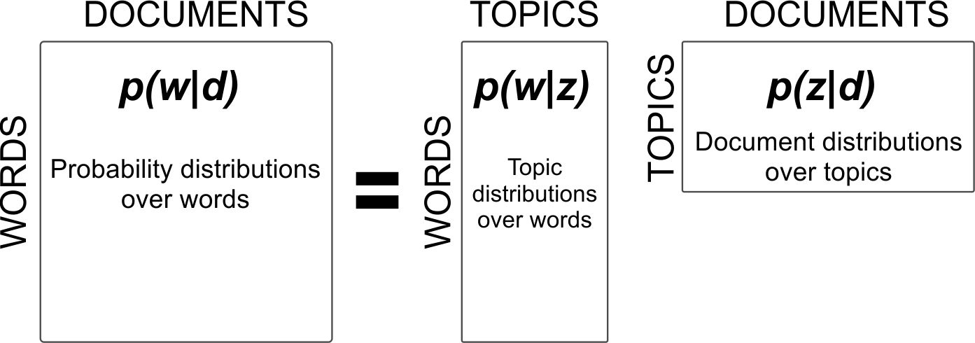
Finding topics with PGM
I.I.D. – Bag of words (de Finetti theorem)
Representing semantics using probability: dimensionality reduction

Slide 14
Finding topics with PGM
Variables: documents, words, topics
Observed: words, documents
Latent: topics, topic assignment to words
Documents contain words
Topics are sets of words that frequently co-occur together (context)

Slide 15
Finding topics with PGM
Soft clustering:
Documents contain multiple topics
Each topic can be found in multiple documents
Each document has its own distribution over topics
Topics contain multiple word types
Each word type can be found in multiple topics (with different probability)
Each topic has its own distribution over word types

Slide 16
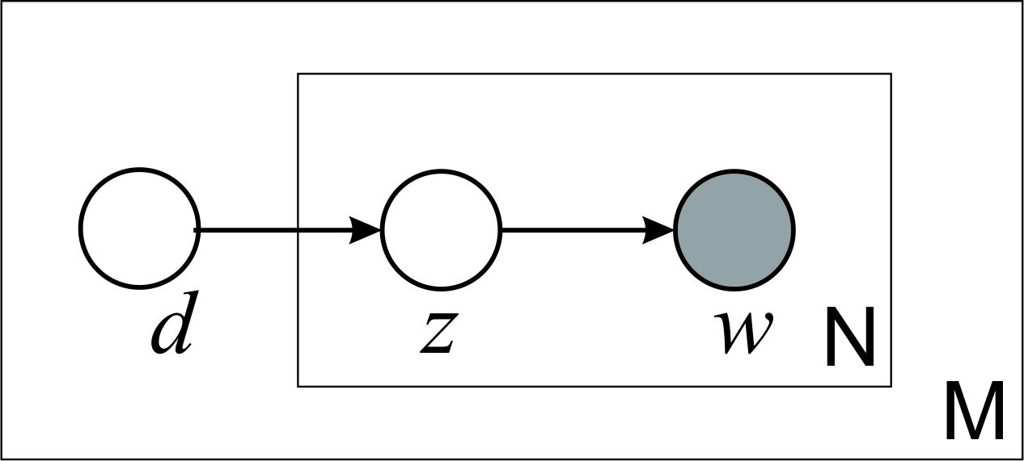
Finding topics with PGM
Probabilistic semantic indexing:

Slide 17
Finding topics with PGM
Soft clustering:
Documents contain multiple topics
Each topic can be found in multiple documents
Each document has its own distribution over topics
Topics contain multiple word types
Each word type can be found in multiple topics (with different prob.)
Each topic has its own distribution over word types
Number of parameters to learn should be independent of the total document number
Avoid overfitting
Solution: using priors!
Each word token in document comes from a specific topic
Each word token should have its own topic identifier assigned

Slide 18
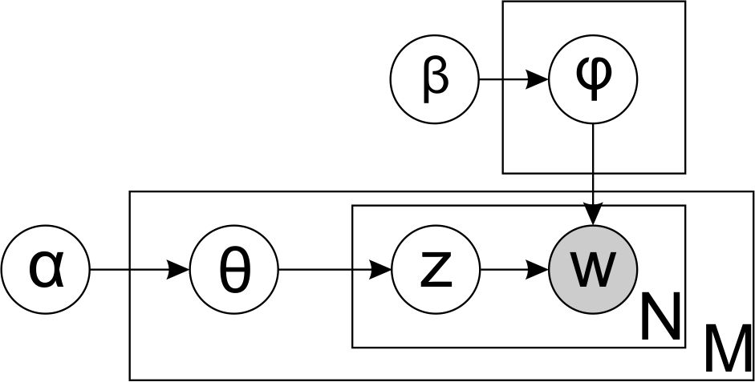
Finding topics with PGM
Adding the priors: LDA

Slide 19
Finding topics with PGM
Advantages of using PGMs:
Extendable
Add more features to the model easily
Use different prior distributions
Incorporate other forms of knowledge alongside text
Modular
Lessons learned in one model can easily be adopted by the other
Widely applicable
Topics can be used to augment solutions to various existing problems

Slide 20
Classification
Relaxing the exchangeability assumption:
Document relations
Time
Links
Topic relations
Correlations
Sequence
Word relations
Intra-document (Sequentiality)
Inter-document (Entity recognition)

Slide 21
Classification
Modeling with additional data:
Document features
Sentiment
Authors
Topic features
Labels
Word features
Concepts

Slide 22
Classification

Slide 23
Examples and applications: Document relations
In base model (LDA) documents are exchangeable (document exchangeability assumption)
By removing this assumption, we can build more complex model
More complex model -> New (more specific) applications
Two types of document relations:
Sequential (time)
Networked (links, citations, references…)

Slide 24
Examples and applications
Modeling time: topic detection and tracking
Trend detection: What was popular? What will be popular?
Event detection: Something important has happened
Topic tracking: Evolution of a specific topic

Slide 25
Examples and applications
Modeling time: two approaches
Markov dependency
Short-distance
Dynamic Topic Model
Time as additional feature
Long-distance
Topics-Over-Time

Slide 26
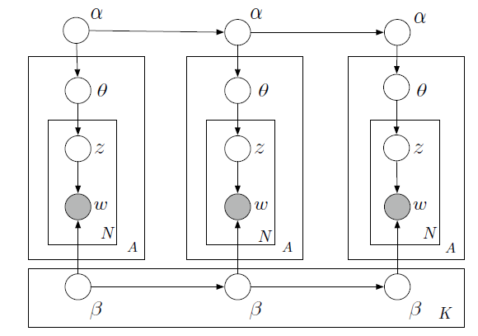
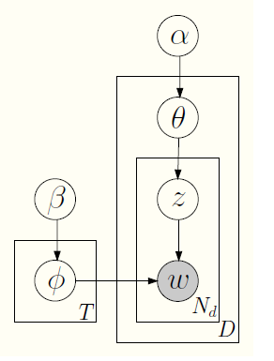
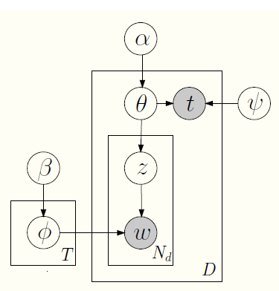
Examples and applications

Slide 27
Examples and applications
Modeling document networks:
Web (documents with hyperlinks)
Messages (documents with senders and recipients)
Scientific papers (documents and citations)

Slide 28
Examples and applications: Topic relations
In base model (LDA) topics are “exchangeable” (topic exchangeability assumption)
By removing this assumption, we can build more complex model
More complex model -> New (more specific) applications
Two types of topic relations:
Correlations (topic hierarchy, similarity,…)
Sequence (linear structure of text)

Slide 29
Examples and applications
Topic correlations:
Instead of finding “flat” topic structure:
Topic hierarchy: super-topics and sub-topics
Topic correlation matrix
Arbitrary DAG structure
Topic sequence:
Sequential nature of the human language:
Text is written from beginning to the end
Topics in latter chapters of the text tend to depend on previous
Markov property

Slide 30
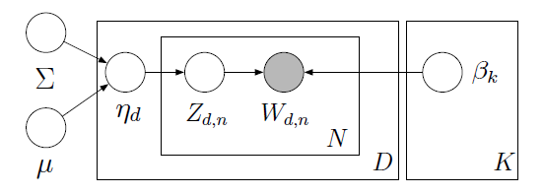
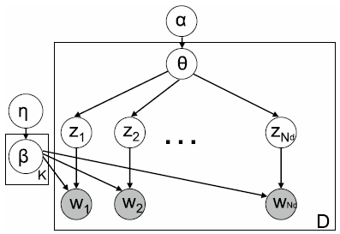
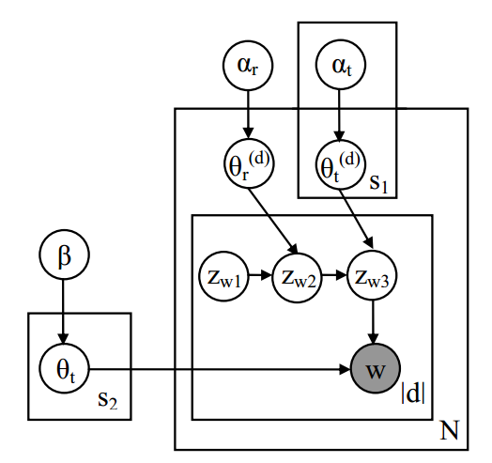
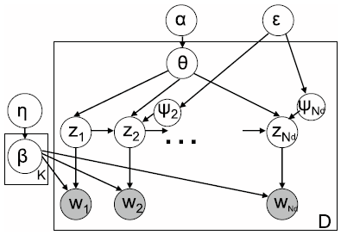
Examples and applications

Slide 31
Examples and applications: Word relations
In base model (LDA) words are “exchangeable” (word exchangeability assumption)
By removing this assumption, we can build more complex model
More complex model -> New (more specific) applications
Two types of word relations:
Intra-document (word sequence)
Inter-document (entity recognition, multilinguality…)

Slide 32
Examples and applications
Intra-document word relations:
Sequential nature of text:
Modeling phrases and n-grams
Markov property
Inter-document word relations:
Some words can be treated as special entities
Not sufficiently investigated
Multilingual models
Harnessing multiple languages
Bridging the language gap

Slide 33
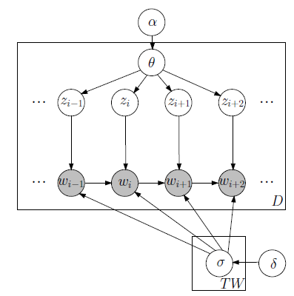
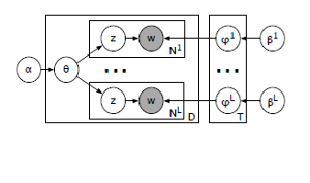
Examples and applications

Slide 34
Examples and applications
Relieving the aforementioned exchangeability assumptions is not the only way to extend the LDA model to new problems and more complex domains
Extension can be made by utilizing additional features on any of the three levels (document, topic, word)
Combining different features from different domains can solve new compound problems (eg. time-evolution of topic hierarchies)

Slide 35
Examples and applications
Examples of models with additional features on document level:
Author topic models
Group topic models
Sentiment topic models
Opinion topic models

Slide 36
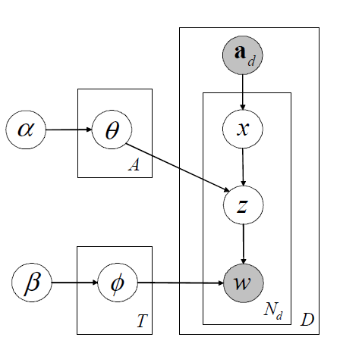
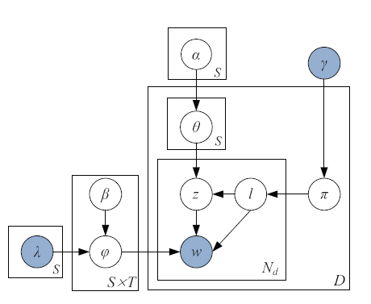
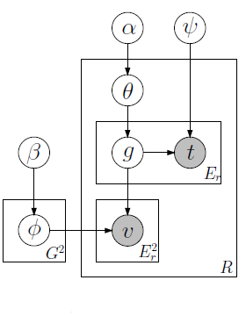
Examples and applications

Slide 37
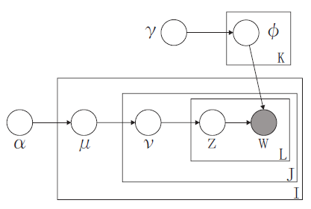
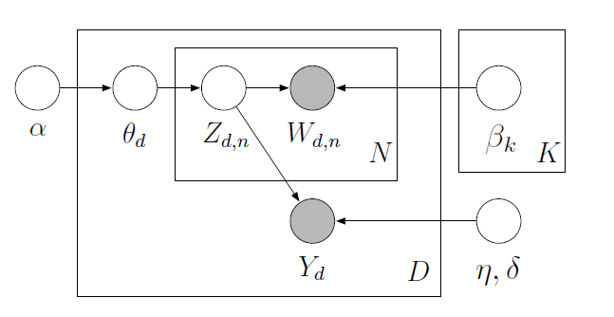
Examples and applications
Examples of models with additional features on topic level:
Supervised topic models
Segmentation topic models

Slide 38
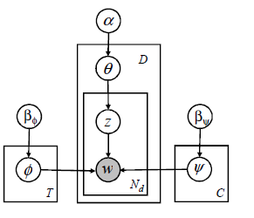
Examples and applications
Examples of models with additional features on word level:
Concept topic models
Entity disambiguation topic models

Slide 39
Examples and applications
Using simple additional features sometimes is not enough:
How to implement knowledge?
Complex set of features (with their dependencies)
Markov logic networks?
Incorporate knowledge through priors
Room for improvement!
Number of parameters is often not known in advance:
How many topics are there in a corpus?
Solution: non-parametric distributions
Dirichlet process (Chinese restaurant process, Stick-breaking process, Pitman-Yor process, Indian buffet process….)

Slide 40
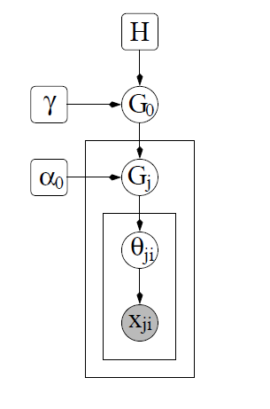
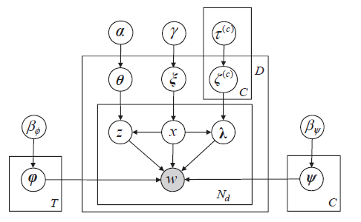
Examples and applications

Slide 41
Conclusion and Ideas for Future Research
Extending the “word” side of topic models (e.g., harnessing morphology): Stem LDA
Combining existing topic modeling paradigms on new problems
New topic representations (using ontology triplets instead of simple terms)

Slide 42
THE END
THANK YOU FOR YOUR TIME.
Probabilistic Graphical Models For Text Mining: A Topic Modeling Survey
vladisav@mi.sanu.ac.rs, {bojan.furlan, jeca, vm}@etf.rs

