Slide 1
Genetic Algorithms
Authors:
Aleksandra Popovic,
Drazen Draskovic,
Veljko Milutinovic, vm@etf.rs

Slide 2
What You Will Learn From This Tutorial?
Part I
What is a genetic algorithm?
Principles of genetic algorithms.
How to design an algorithm?
Comparison of gas and conventional algorithms.
Applications of GA
  GA and the internet
  GA and image segmentation
  GA and system design
Genetic programming
Part II
Part III

Slide 3
Part I: GA Theory
What are genetic algorithms?
How to design a genetic algorithm?

Slide 4
Genetic Algorithm Is Not...
...Gene coding

Slide 5
Genetic Algorithm Is...
… Computer algorithm
That resides on principles of genetics and evolution

Slide 6
Instead of Introduction...
Hill climbing
global
local

Slide 7
Instead of Introduction…(2)
Multi-climbers

Slide 8
Instead of Introduction…(3)
Genetic algorithm
I am not at the top.
My high is better!
I am at the top
Height is ...
I will continue

Slide 9
Instead of Introduction…(3)
Genetic algorithm - few microseconds after

Slide 10
The GA Concept
Genetic algorithm (GA) introduces the principle of evolution
and genetics into search among possible solutions
to a given problem.
The idea is to simulate the process in natural systems.
This is done by the creation within a machine
of a population of individuals represented by chromosomes,
in essence a set of character strings,
that are analogous to the DNA,
that we have in our own chromosomes.

Slide 11

Survival of the Fittest
The main principle of evolution used in GA
is “survival of the fittest”.
The good solution survive, while bad ones die.

Slide 12
Nature and GA...
Nature reality
Genetic algorithm
Chromosome
String
Gene
Character
Locus
String position
Genotype
Population
Phenotype
Decoded structure

Slide 13
The History of GA
Cellular automata
  John Holland, university of Michigan, 1975.
Until the early 80s, the concept was studied theoretically.
In 80s, the first “real world” GAs were designed.

Slide 14
Algorithmic Phases
Initialize the population
Select individuals for the mating pool
Perform crossover
Perform mutation
Insert offspring into the population
Stop?
no
yes
The End

Slide 15

Designing GA...
    How to represent genomes?
    How to define the crossover operator?
    How to define the mutation operator?
    How to define fitness function?
    How to generate next generation?
    How to define stopping criteria?

Slide 16
Representing Genomes...
Representation
Example
string
1 0 1 1 1 0 0 1
array of strings
http avala yubc net ~apopovic
or
>
c
tree - genetic programming
xor
b
a
b

Slide 17
Crossover
Crossover is concept from genetics.
Crossover is sexual reproduction.
Crossover combines genetic material from two parents,
in order to produce superior offspring.
Few types of crossover:
  One-point
  Multiple point.

Slide 18
One-point Crossover
0
7
1
6
2
5
3
4
4
3
5
2
6
1
7
0
Parent #2
Parent #1

Slide 19
One-point Crossover
0
7
1
6
5
2
3
4
4
3
5
2
6
1
7
0
Parent #2
Parent #1

Slide 20
Mutation
Mutation introduces randomness into the population.
Mutation is asexual reproduction.
The idea of mutation
is to reintroduce divergence
into a converging population.
Mutation is performed
on small part of population,
in order to avoid entering unstable state.

Slide 21
Mutation...
Parent
1
1
1
0
1
0
0
0
0
1
0
0
1
0
1
0
1
Child
1
0
1

Slide 22
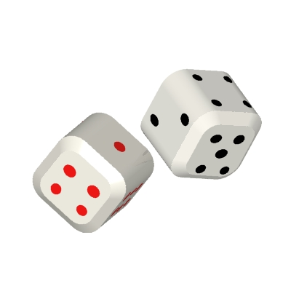
About Probabilities...
Average probability for individual to crossover
is, in most cases, about 80%.
Average probability for individual to mutate
is about 1-2%.
Probability of genetic operators
follow the probability in natural systems.
The better solutions reproduce more often.

Slide 23
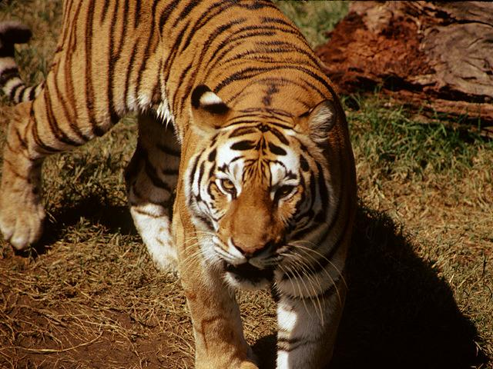
Fitness Function
Fitness function is evaluation function,
that determines what solutions are better than others.
Fitness is computed for each individual.
Fitness function is application depended.

Slide 24
Selection
The selection operation copies a single individual, probabilistically selected based on fitness,
into the next generation of the population.
There are few possible ways to implement selection:
  “Only the strongest survive”
    Choose the individuals with the highest fitness
    for next generation
  “Some weak solutions survive”
    Assign a probability that a particular individual
    will be selected for the next generation
    More diversity
    Some bad solutions might have good parts!

Slide 25
Selection - Survival of The Strongest
Previous generation
0.93
0.51
0.72
0.31
0.12
0.64
Next generation
0.93
0.72
0.64

Slide 26
Selection - Some Weak Solutions Survive
Previous generation
0.93
0.51
0.72
0.31
0.12
0.12
0.64
Next generation
0.93
0.72
0.64
0.12

Slide 27
Mutation and Selection...
D
D
Phenotype
D
Solution distribution
Phenotype
Phenotype
Selection
Mutation

Slide 28

Stopping Criteria
Final problem is to decide
when to stop execution of algorithm.
There are two possible solutions
to this problem:
  First approach:
    Stop after production
    of definite number of generations
  Second approach:
    Stop when the improvement in average fitness
    over two generations is below a threshold

Slide 29
GA vs. Ad-hoc Algorithms
Genetic Algorithm
Ad-hoc Algorithms
Speed
Slow *
Generally fast
Human work
Minimal
Long and exhaustive
There are problems
that cannot be solved analytically
Applicability
General
Performance
Excellent
Depends
* Not necessary!

Slide 30

Problems With GAs
Sometimes GA is extremely slow,
and much slower than usual algorithms

Slide 31
Advantages of GAs
Concept is easy to understand.
Minimum human involvement.
Computer is not learned how to use existing solution,
but to find new solution!
Modular, separate from application
Supports multi-objective optimization
Always an answer; answer gets better with time !!!
Inherently parallel; easily distributed
Many ways to speed up and improve a GA-based application as knowledge about problem domain is gained
Easy to exploit previous or alternate solutions

Slide 32
GA: An Example - Diophantine Equations
Diophantine equation (n=4):
A*x + b*y + c*z + d*q = s
For given a, b, c, d, and s - find x, y, z, q
Genome:
(X, y, z, p) =
x
y
z
q

Slide 33
GA: An Example - Diophantine Equations(2)
Crossover
Mutation
( 1, 2, 3, 4 )
( 1, 6, 3, 4 )
( 5, 6, 7, 8 )
( 5, 2, 7, 8 )
( 1, 2, 3, 4 )
( 1, 2, 3, 9 )

Slide 34
GA: An Example - Diophantine Equations(3)
First generation is randomly generated of numbers
lower than sum (s).
Fitness is defined as absolute value of difference
between total and given sum:
Fitness = abs (total - sum) ,
Algorithm enters a loop in which operators are performed
on genomes: crossover, mutation, selection.
After number of generation a solution is reached.

Slide 35
Some Applications of GAs
Control systems design
Software guided circuit design
Optimization
Internet search
search
GA
Path finding
Mobile robots
Data mining
Trend spotting
Stock prize prediction

Slide 36
Part II: Applications of GAs
GA and the Internet
GA and image segmentation
GA and system design

Slide 37
Genetic Algorithm and the Internet
School of Electrical Engineering,
University of Belgrade

Slide 38
Introduction
GA can be used for intelligent internet search.
GA is used in cases when search space
is relatively large.
GA is adoptive search.
GA is a heuristic search method.

Slide 39
Algorithm Phases
Process set of URLs given by user
Select all links from input set
Evaluate fitness function for all genomes
Perform crossover, mutation, and reproduction
Satisfactory
solution
obtained?
The End

Slide 40
A System for the GA Internet Search
Essence:
If “desperate,” do database mutation
If “happy,” do locality based mutation
Input set
C
O
N
T
R
O
L
P
R
O
G
R
A
M
Generator
Agent
Spider
Topic
Top data
Current set
Space
Time
Net data
Output set

Slide 41
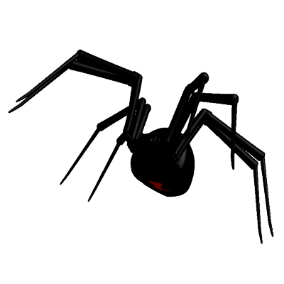
Spider
Spider is software packages,
that picks up internet documents
from user supplied input with depth specified by user.
Spider takes one URL, fetches all links,
and documents thy contain with predefined depth.
The fetched documents are stored on local hard disk with same structure as on the original location.
Spider’s task is to produce the first generation.
Spider is used during crossover and mutation.

Slide 42

Agent
Agent takes as an input a set of urls,
and calls spider, for every one of them, with depth 1.
Then, agent performs extraction of keywords
from each document, and stores it in local hard disk.

Slide 43
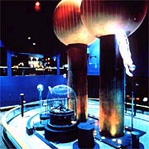
Generator
Generator generates a set of urls from given keywords,
using some conventional search engine.
It takes as input the desired topic, calls yahoo search engine,
and submits a query looking for all documents
covering the specific topic.
Generator stores URL and topic of given web page
in database called topdata.

Slide 44

Topic
It uses topdata DB in
order to insert random urls
from database into current set.
Topic performs mutation.

Slide 45
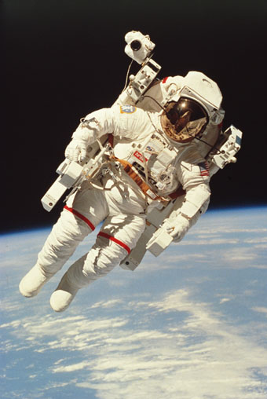
Space
Space takes as input the current set
from the agent application
and injects into it those urls
from the database netdata
that appeared with the greatest frequency
in the output set of previous searches.

Slide 46
Time
Time takes set of urls from agent
and inserts ones with greatest frequency into DB netdata.
The netdata DB contains of three fields: URL, topic,
and count number.
The DB is updated in each algorithm iteration.

Slide 47
How Does the System Work?
command flow
Input set
data flow
C
O
N
T
R
O
L
P
R
O
G
R
A
M
Generator
Agent
Spider
Topic
Top data
Current set
Space
Time
Net data
Output set

Slide 48
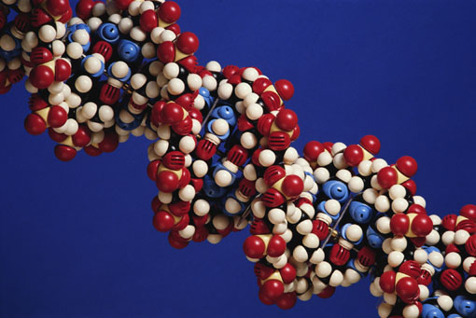
GA and the Internet: Conclusion
GA for internet search, on contrary to other gas,
is much faster and more efficient that conventional solutions,
such as standard internet search engines.
INTERNET

Slide 49
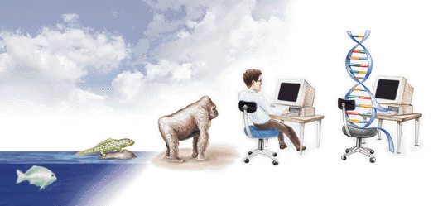
Conclusion: Evolution of Future Research

