Slide 1

CLASSIFICATION
AND THE SURVIVAL ANALYSES
IN THE ARTREAT PROJECT
Goran Rakocevic
Zoran Babovic
Marko Novakovic
Nenad Korolija
Veljko Milutinovic
Tuesday, August 21, 12

Slide 2
THE ARTREAT PROJECT
• ARTreat targets at providing a computational model
of the cardiovascular system, to improve prediction
for the atherosclerosis progression
and propagation into life-threatening events.
• An FP7 Large-scale Integrating Project (IP)
• 16 partners
• Funding: 10,000,000 €
Tuesday, August 21, 12

Slide 3
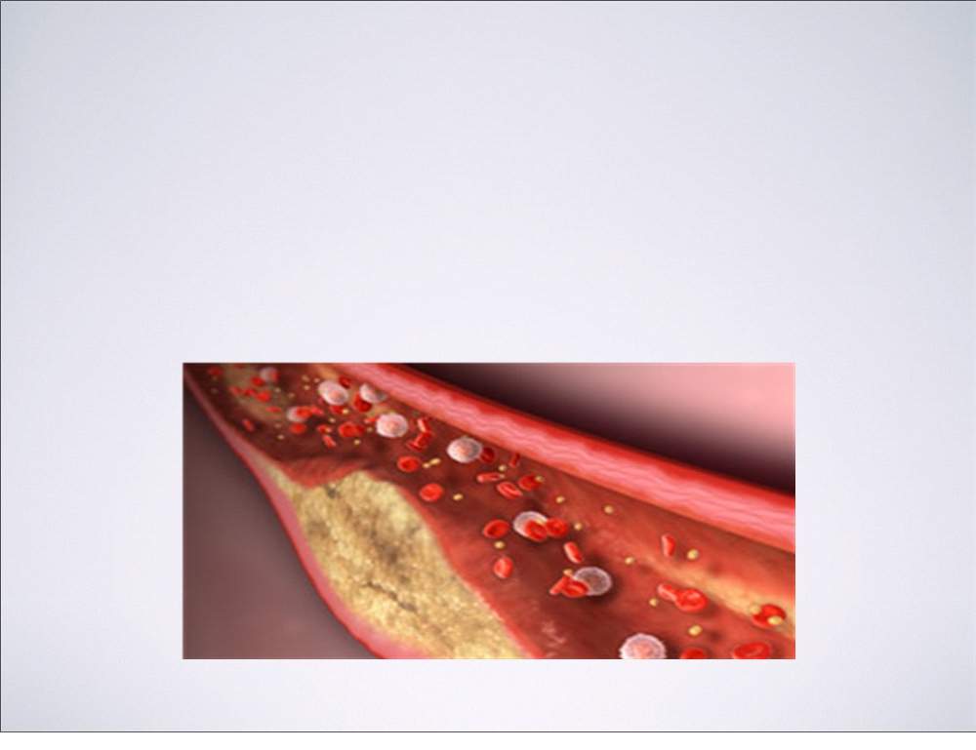
ATHEROSCLEROSIS
• Atherosclerosis is the condition
in which an artery wall thickens as the result
of a build-up of fatty materials such as cholesterol
Tuesday, August 21, 12

Slide 4
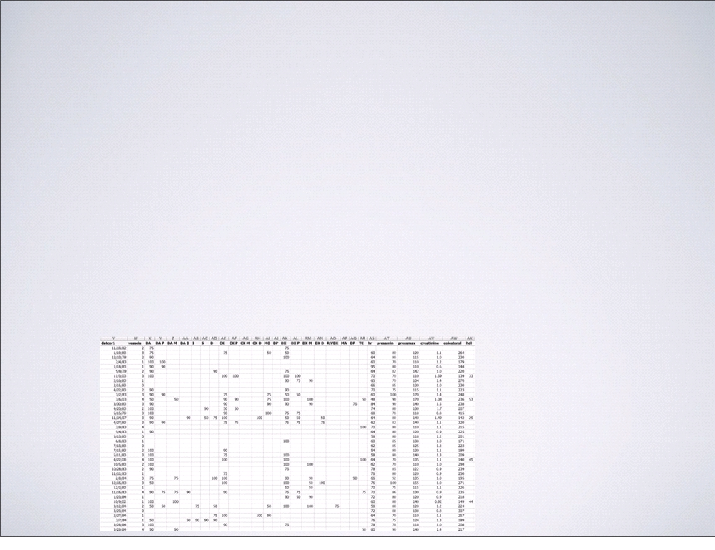
THE DATA
• 3000 patients with 97 attributes
• 450 patients with genetic profiles
• 400 patients with repeated angiographies
• 600 patients with scintigraphies
Tuesday, August 21, 12

Slide 5
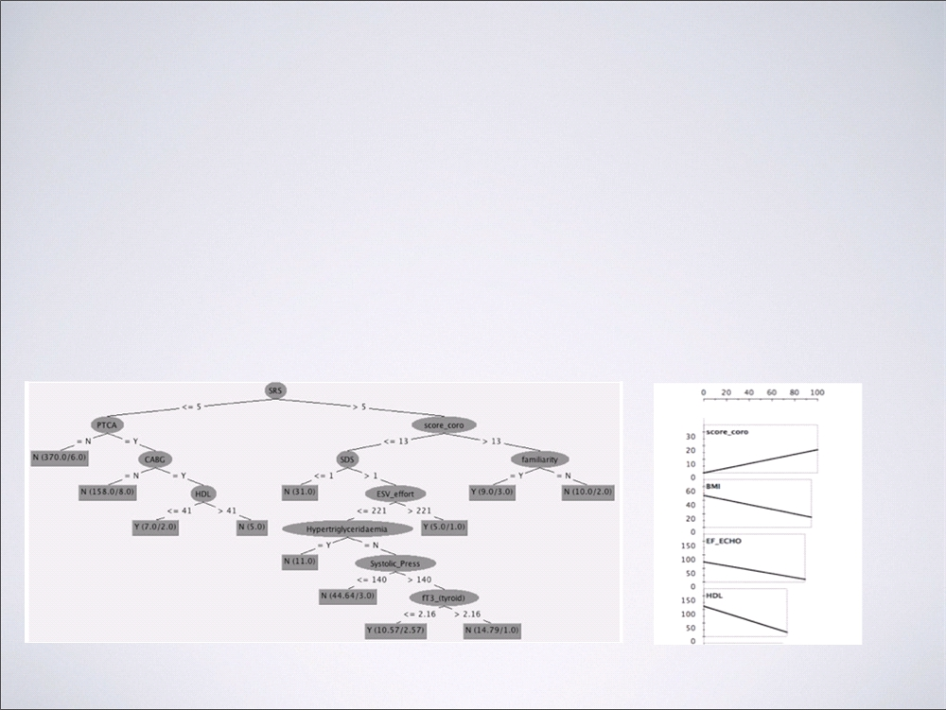
CLASSIFICATION:
HARD EVENTS
• Divide patients into:
those who had an event vs. those who did not
Tuesday, August 21, 12

Slide 6
CLASSIFICATION:
HARD EVENTS
• Interventions in most severe cases
change patient characteristics
• Hard event classification became meaningless
• A MACE study (Major Adverse Cardiac Events)
• Better results, still not sufficient
Tuesday, August 21, 12

Slide 7
SURVIVAL ANALYSES
• Type of problems:
• Study over a period of time
• In the course of study and event either happens or not
• Not just about if, but also when
Tuesday, August 21, 12

Slide 8
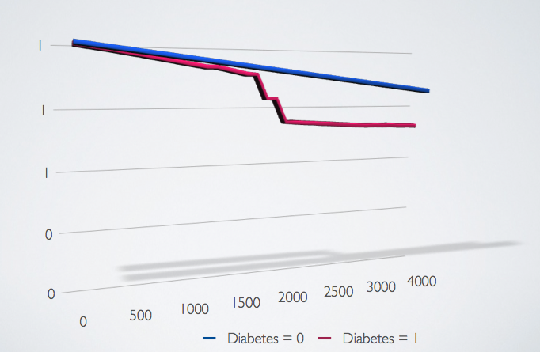
THE KAPLAN-MEIER ESTIMATOR
Tuesday, August 21, 12

Slide 9
COX REGRESSION
• Proportional Hazards assumption
• Omits the underlying hazard function
• Gives only a Hazard Ratio
• Relatively Simple, and often sufficient
• Easy to add time varying predictors and covarities
Tuesday, August 21, 12

