Slide 1

Efficient Algorithms for Imputation of Missing SNP Genotype Data
Mihajlović, ambiz2005@gmail.com
V. Milutinović, vm@etf.rs

Slide 2
Definitions
Imputation
  Given a relevant data set with missing values
  Discover hidden knowledge
  between the known values
  Use this knowledge to best guess the values
  of the missing data
  Knowledge is usually probabilistic
  (probabilistic imputation)
    Implement probabilistic model
    for modeling the data
    Select values for the missing data
    that best fit the model
2

Slide 3
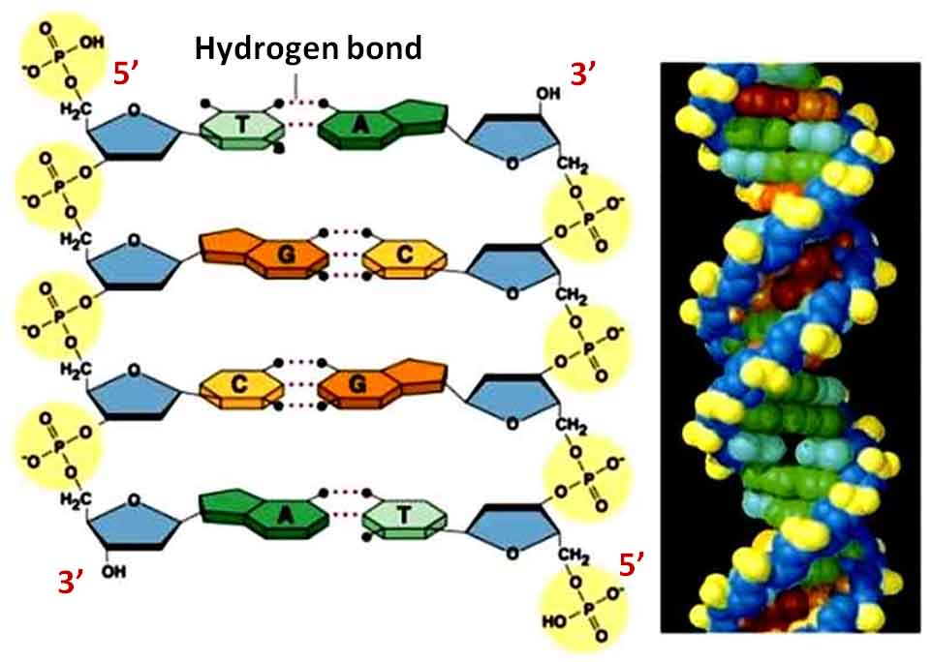
Definitions
DNA

Slide 4
Definitions
SNP
  Single Nucleotide Polymorphism
  Located along DNA chain
  i.e. at exactly the same location
  along every chromatid of a chromosome pair
    Its positional consistency makes it a marker
  Single base pair change
  One SNP every 100-1000 bases
  Biallelic
    Each SNP can assume one of two
    possible base pair values
    Other bases assume only one base pair value and are the same among all humans

Slide 5
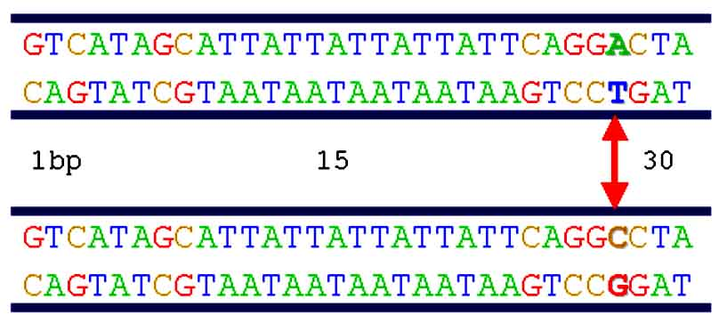
Definitions

Slide 6
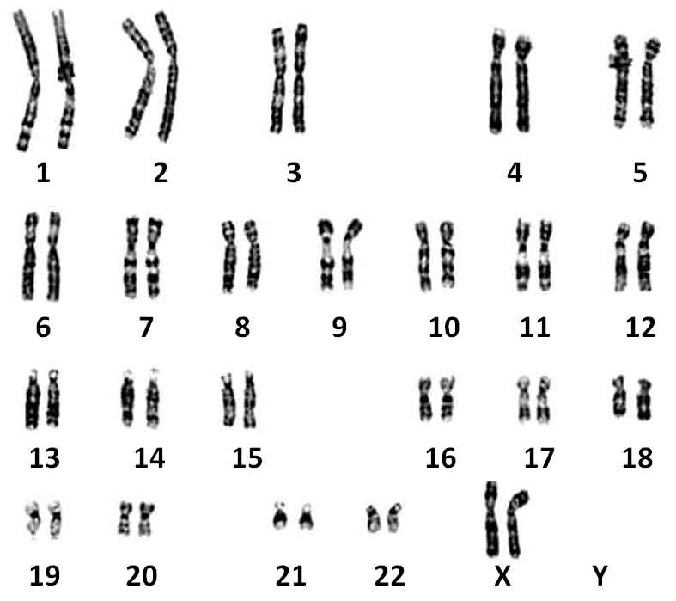
Definitions
SNP Genotypes

Slide 7
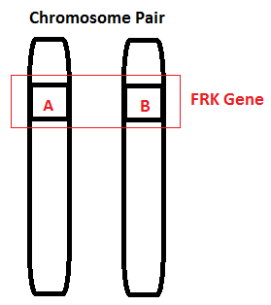
Definitions
SNP Genotype
Genotype in this case is AB
  A is one base pair value
  B is the other possible base pair value

Slide 8
Definitions
SNP Genotype
Genotype in this case is AB
  A=AT or for short A
  B=CG or for short C

Slide 9
Definitions
SNP Genotype
Genotype in this case is AB
  A=AT or for short A
  B=CG or for short C
  GENOTYPE = AC

Slide 10
Definitions
SNP Genotype data sets
  Generally used in GWAS studies
 | Marker 1 | Marker 2 | Marker 3 | Marker 4 | Marker 5
Line 1 | AG | AT | AA | AG | TT
Line 2 | AG | AT | AA | AG | AT
Line 3 | AA | TT | GG | AA | TT
Line 4 | AG | AT | GG | AG | AT

Slide 11
Definitions
GWAS
  Genome Wide Association Studies
  Goal
    Statistical analysis of SNP genotype data
      Locating SNP genotypes associated with disease
        Find the nearest gene to the SNP
          Suspected gene that is expressing the disease
  Problem
    Most input data sets prior to being used for GWAS
    must be cleaned of missing genotype values
      These values must be IMPUTED

Slide 12
State of the Art Solutions
fastPHASE
  Based on fitting probabilistic HMM
  model onto the data set
  Testing value for best fit
KNNimpute
  Based on agreement of k nearest neighbors
  Distance metric measured by matching markers
Goal of imputation algorithms
  To increase accuracy and speed of imputation
The goal of this work
  To reach better or similar error rates
  than fastPHASE and/or KNNimpute

Slide 13
Hypothesis
  Possibly similar error rates to fastPHASE
  and KNNimpute could be achieved using CPDs
  as a model of dependency between SNPs i.e. markers
    This was tested both randomly
    and using maximum likelihood i.e. maximum selection
  Programmed and used a WOLAP
  (web on line analytical processing)
  data set analysis tool (SNP Browser)
    Analyzed the joint probabilities
    and conditional probabilities of adjacent markers

Slide 14
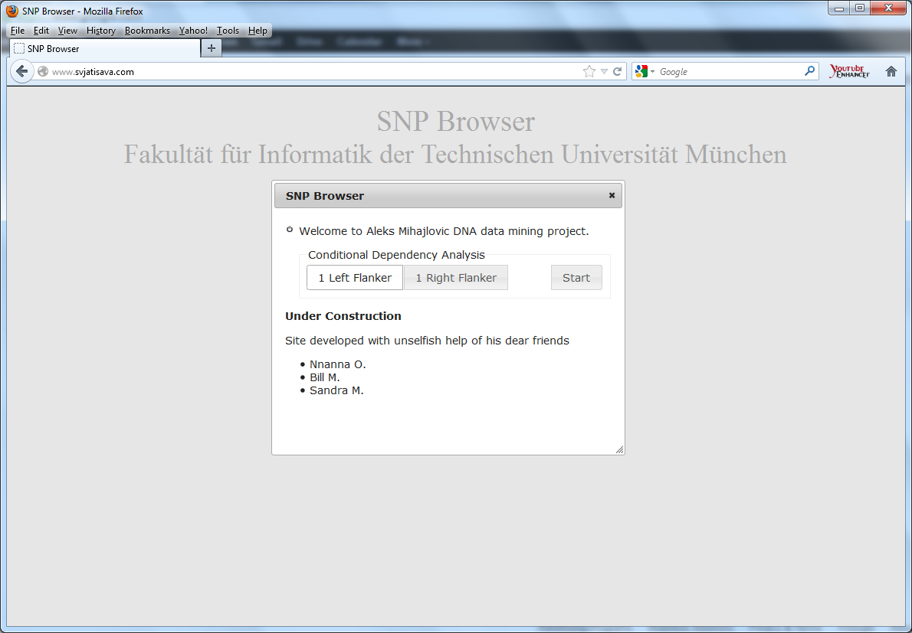
SNP Browser v.1.0

Slide 15
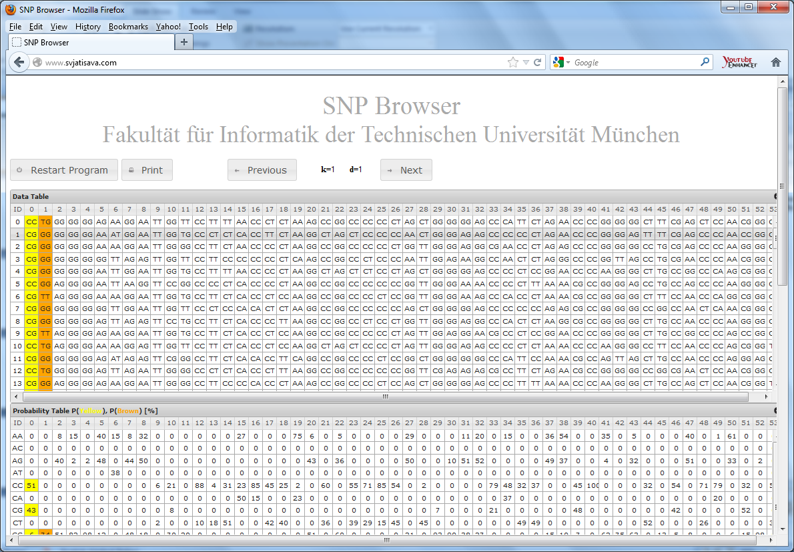
SNP Browser v.1.0

Slide 16
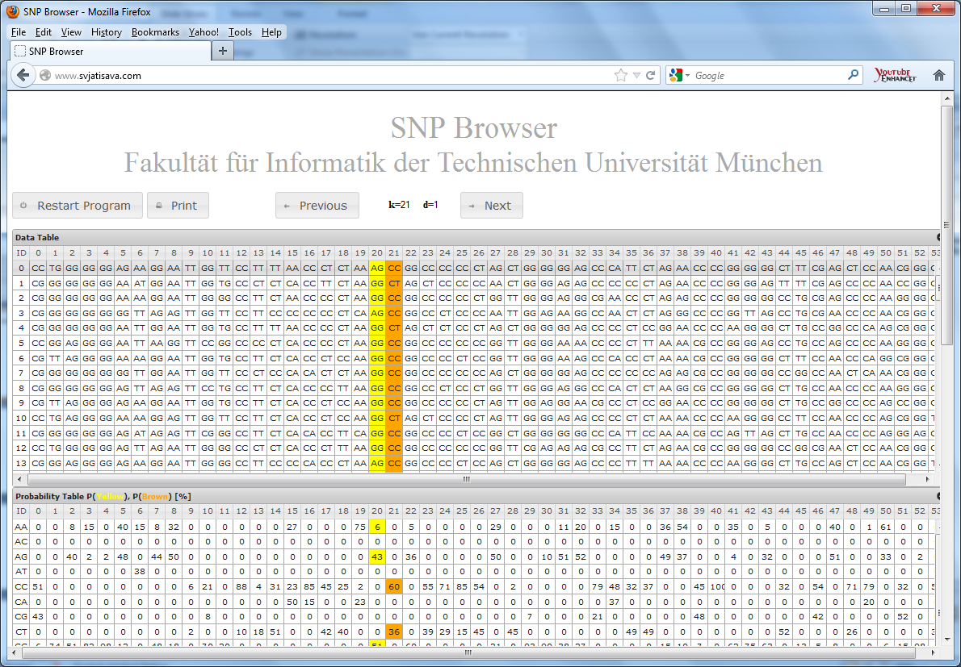
Random Select/Click on Any Column

Slide 17
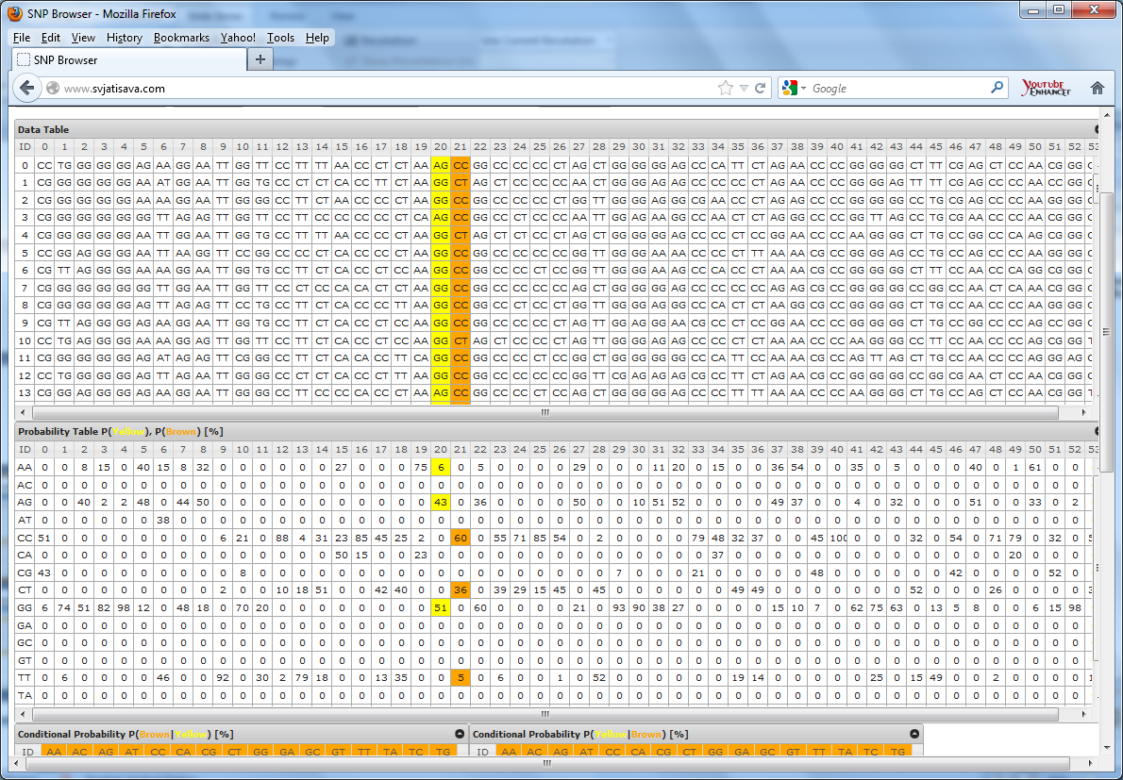
Inspect Independent & Conditional Probabilities

Slide 18
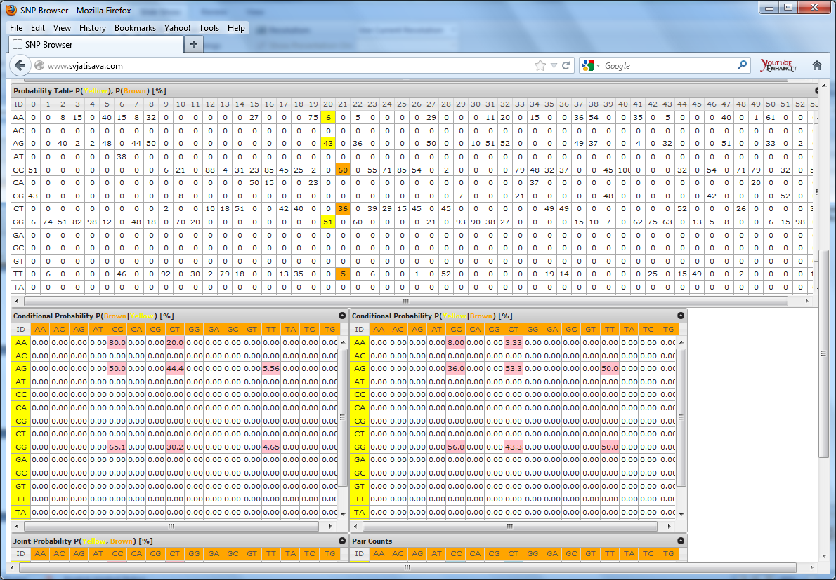
Inspect Conditional

Slide 19
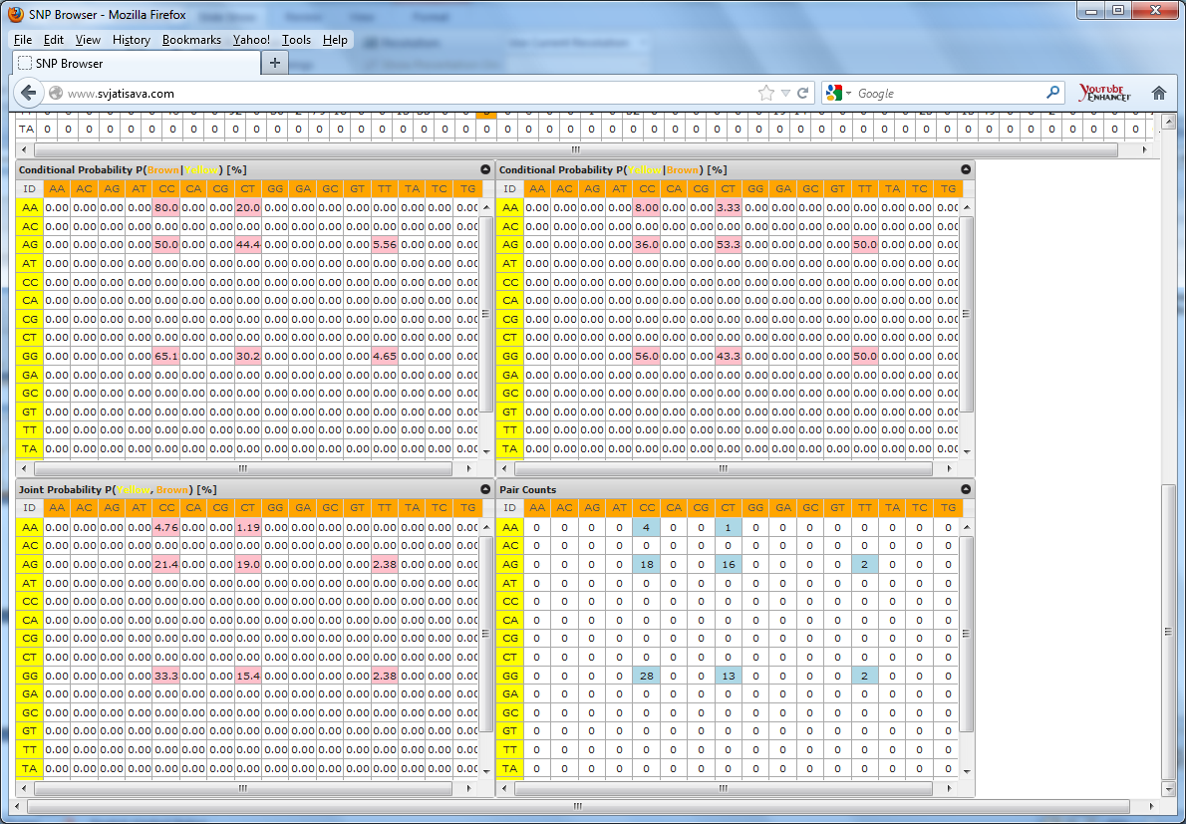
Inspect Conditional & Joint Probabilities

Slide 20
Work Performed
In order to test the hypothesis, four algorithms
known as the Quick Pick series of algorithms
have been designed and developed into programs.
  Quick Pick v. 1
  Quick Pick v. 2
  Quick Pick v. 3
  Quick Pick v. 4

Slide 21
Quick Pick version 1
What does it do??
It treats each column of the data set
as an independent random variable
P(Marker 1) P(Marker 2) P(Marker 3) P(Marker 4) P(Marker 5)
It exploits the PMF
i.e. the probabilistic distribution of each random variable during imputation
Randomly imputes from corresponding independent dist.
 | Marker 1 | Marker 2 | Marker 3 | Marker 4 | Marker 5
Line 1 | AG | AT | AA | AG | AT
Line 2 | AG | AT | AA | AG | AT
Line 3 | AA | TT | GG | AA | TT
Line 4 | AG | AT | GG | AG | TT
21

Slide 22
Quick Pick version 1
 | Marker 1 | Marker 2 | Marker 3 | Marker 4 | Marker 5
Line 1 | AG | AT | AA | AG | AT
Line 2 | AG | AT | AA | AG | AT
Line 3 | AA | TT | GG | AA | TT
Line 4 | AG | AT | GG | AG | TT
We are presented with a hypothetical data set without any missing values
22

Slide 23
Quick Pick version 1
 | Marker 1 | Marker 2 | Marker 3 | Marker 4 | Marker 5
Line 1 | AG | AT | AA | AG | AT
Line 2 | AG | AT | ?? | AG | AT
Line 3 | AA | TT | GG | AA | TT
Line 4 | AG | AT | GG | AG | TT
We are presented with a missing value
?? at Marker 3, Line 2.
23

Slide 24
Quick Pick version 1
 | Marker 1 | Marker 2 | Marker 3 | Marker 4 | Marker 5
Line 1 | AG | AT | AA | AG | AT
Line 2 | AG | AT | ?? | AG | AT
Line 3 | AA | TT | GG | AA | TT
Line 4 | AG | AT | GG | AG | TT
The algorithm begins traversing the data set
column by column searching for missing values “??”
24

Slide 25
Quick Pick version 1
 | Marker 1 | Marker 2 | Marker 3 | Marker 4 | Marker 5
Line 1 | AG | AT | AA | AG | AT
Line 2 | AG | AT | ?? | AG | AT
Line 3 | AA | TT | GG | AA | TT
Line 4 | AG | AT | GG | AG | TT
25

Slide 26
Quick Pick version 1
 | Marker 1 | Marker 2 | Marker 3 | Marker 4 | Marker 5
Line 1 | AG | AT | AA | AG | AT
Line 2 | AG | AT | ?? | AG | AT
Line 3 | AA | TT | GG | AA | TT
Line 4 | AG | AT | GG | AG | TT
26

Slide 27
Quick Pick version 1
 | Marker 1 | Marker 2 | Marker 3 | Marker 4 | Marker 5
Line 1 | AG | AT | AA | AG | AT
Line 2 | AG | AT | ?? | AG | AT
Line 3 | AA | TT | GG | AA | TT
Line 4 | AG | AT | GG | AG | TT
27

Slide 28
Quick Pick version 1
 | Marker 1 | Marker 2 | Marker 3 | Marker 4 | Marker 5
Line 1 | AG | AT | AA | AG | AT
Line 2 | AG | AT | ?? | AG | AT
Line 3 | AA | TT | GG | AA | TT
Line 4 | AG | AT | GG | AG | TT
28

Slide 29
Quick Pick version 1
 | Marker 1 | Marker 2 | Marker 3 | Marker 4 | Marker 5
Line 1 | AG | AT | AA | AG | AT
Line 2 | AG | AT | ?? | AG | AT
Line 3 | AA | TT | GG | AA | TT
Line 4 | AG | AT | GG | AG | TT
29

Slide 30
Quick Pick version 1
 | Marker 1 | Marker 2 | Marker 3 | Marker 4 | Marker 5
Line 1 | AG | AT | AA | AG | AT
Line 2 | AG | AT | ?? | AG | AT
Line 3 | AA | TT | GG | AA | TT
Line 4 | AG | AT | GG | AG | TT
30

Slide 31
Quick Pick version 1
 | Marker 1 | Marker 2 | Marker 3 | Marker 4 | Marker 5
Line 1 | AG | AT | AA | AG | AT
Line 2 | AG | AT | ?? | AG | AT
Line 3 | AA | TT | GG | AA | TT
Line 4 | AG | AT | GG | AG | TT
31

Slide 32
Quick Pick version 1
 | Marker 1 | Marker 2 | Marker 3 | Marker 4 | Marker 5
Line 1 | AG | AT | AA | AG | AT
Line 2 | AG | AT | ?? | AG | AT
Line 3 | AA | TT | GG | AA | TT
Line 4 | AG | AT | GG | AG | TT
32

Slide 33
Quick Pick version 1
 | Marker 1 | Marker 2 | Marker 3 | Marker 4 | Marker 5
Line 1 | AG | AT | AA | AG | AT
Line 2 | AG | AT | ?? | AG | AT
Line 3 | AA | TT | GG | AA | TT
Line 4 | AG | AT | GG | AG | TT
QP v.1 detects missing value ??
at Marker 3, Line 2
33

Slide 34
Quick Pick version 1
Random Number Generator Selects No. 3
 | Marker 3
1 | AA
2 | ??
3 | GG
4 | GG
Random Number Generator picks a line number from 1 to 4. Each number corresponds to a row i.e. line within the column
34

Slide 35
Quick Pick version 1
 | Marker 3
1 | AA
2 | ??=GG
3 | GG
4 | GG
The value in the “Marker 3’s”
3rd row is taken and substituted for ??.
35

Slide 36
Quick Pick version 1
 | Marker 1 | Marker 2 | Marker 3 | Marker 4 | Marker 5
Line 1 | AG | AT | AA | AG | AT
Line 2 | AG | AT | GG | AG | AT
Line 3 | AA | TT | GG | AA | TT
Line 4 | AG | AT | GG | AG | TT
QP v.1 imputed GG.
And continues traversing the data set searching for more missing values
36

Slide 37
Quick Pick version 1
 | Marker 1 | Marker 2 | Marker 3 | Marker 4 | Marker 5
Line 1 | AG | AT | AA | AG | AT
Line 2 | AG | AT | GG | AG | AT
Line 3 | AA | TT | GG | AA | TT
Line 4 | AG | AT | GG | AG | TT
QP v.1 imputed GG.
Is GG correct?
37

Slide 38
Quick Pick version 1
 | Marker 1 | Marker 2 | Marker 3 | Marker 4 | Marker 5
Line 1 | AG | AT | AA | AG | AT
Line 2 | AG | AT | GG | AG | AT
Line 3 | AA | TT | GG | AA | TT
Line 4 | AG | AT | GG | AG | TT
QP v.1 imputed GG.
Is GG correct?
NO!!!!
38

Slide 39
Quick Pick version 1
 | Marker 1 | Marker 2 | Marker 3 | Marker 4 | Marker 5
Line 1 | AG | AT | AA | AG | AT
Line 2 | AG | AT | GG | AG | AT
Line 3 | AA | TT | GG | AA | TT
Line 4 | AG | AT | GG | AG | TT
Genotypes along a row are associated.
We need to exploit associations between genotype,
such as adjacent genotypes
39

Slide 40
Quick Pick version 1
 | Marker 1 | Marker 2 | Marker 3 | Marker 4 | Marker 5
Line 1 | AG | AT | AA | AG | AT
Line 2 | AG | AT | GG | AG | AT
Line 3 | AA | TT | GG | AA | TT
Line 4 | AG | AT | GG | AG | TT
Q: How do we do this??
40

Slide 41
Quick Pick version 1
 | Marker 1 | Marker 2 | Marker 3 | Marker 4 | Marker 5
Line 1 | AG | AT | AA | AG | AT
Line 2 | AG | AT | GG | AG | AT
Line 3 | AA | TT | GG | AA | TT
Line 4 | AG | AT | GG | AG | TT
Q: How do we do this??
A: Probabilistic dependency measure between adjacent genotypes using CPDs
41

Slide 42
Quick Pick version 2
What does it do??
It treats adjacent markers as dependent random variables.
Dependency between adjacent markers,
in this case two to three adjacent markers is established, and evaluated using a CPD.
Given a marker genotype is missing,
QP v.2 establishes dependency
between the missing value genotype
and its immediate left and right flanking genotypes
42

Slide 43
Quick Pick version 2
M2
M4
M3
 | Marker 1 | Marker 2 | Marker 3 | Marker 4 | Marker 5
Line 1 | AG | AT | AA | AG | AT
Line 2 | AG | AT | ?? | AG | AT
Line 3 | AA | TT | GG | AA | TT
Line 4 | AG | AT | GG | AG | TT
43

Slide 44
Quick Pick version 2
It then builds a cluster with the M3 or middle values from a CPD where the left M2 and the right flanking M4 genotypes
are observed i.e. give:
P(Marker 3| Marker 2 = AT, Marker 4 = AG )
This cluster is a normalized distribution,
(normalized CPD distribution)
The algorithm than selects the imputation estimate
at random from this distribution
44

Slide 45
Quick Pick version 2
 | Marker 1 | Marker 2 | Marker 3 | Marker 4 | Marker 5
Line 1 | AG | AT | AA | AG | AT
Line 2 | AG | AT | ?? | AG | AT
Line 3 | AA | TT | GG | AA | TT
Line 4 | AG | AT | GG | AG | TT
QP v.2 uses traverses the data set
the same way QP v.1 does.
It detects missing value ??
at Marker 3, Line 2
45

Slide 46
Quick Pick version 2
 | Marker 1 | Marker 2 | Marker 3 | Marker 4 | Marker 5
Line 1 | AG | AT | AA | AG | AT
Line 2 | AG | AT | ?? | AG | AT
Line 3 | AA | TT | GG | AA | TT
Line 4 | AG | AT | GG | AG | TT
QP v.2 reads the left and right flanking markers of genotype Marker 3, Line 2
46

Slide 47
Quick Pick version 2
 | Marker 1 | Marker 2 | Marker 3 | Marker 4 | Marker 5
Line 1 | AG | AT | AA | AG | AT
Line 2 | AG | AT | ?? | AG | AT
Line 3 | AA | TT | GG | AA | TT
Line 4 | AG | AT | GG | AG | TT
QP v.2 begins searching the Marker 3 column
for values that have the same flanking markers.
47

Slide 48
Quick Pick version 2
 | Marker 1 | Marker 2 | Marker 3 | Marker 4 | Marker 5
Line 1 | AG | AT | AA | AG | AT
Line 2 | AG | AT | ?? | AG | AT
Line 3 | AA | TT | GG | AA | TT
Line 4 | AG | AT | GG | AG | TT
If Marker 2, Line 1 = Marker 2, Line 2
&
If Marker 4, Line 1 = Marker 2, Line 2
then place Marker 3, Line 1 into a cluster as follows…….
48

Slide 49
Quick Pick version 2
 | Marker 1 | Marker 2 | Marker 3 | Marker 4 | Marker 5
Line 1 | AG | AT | AA | AG | AT
Line 2 | AG | AT | ?? | AG | AT
Line 3 | AA | TT | GG | AA | TT
Line 4 | AG | AT | GG | AG | TT
AA
.
.
.
Continue traversing the rows of the column: Marker 3
49

Slide 50
Quick Pick version 2
 | Marker 1 | Marker 2 | Marker 3 | Marker 4 | Marker 5
Line 1 | AG | AT | AA | AG | AT
Line 2 | AG | AT | ?? | AG | AT
Line 3 | AA | TT | GG | AA | TT
Line 4 | AG | AT | GG | AG | TT
AA
.
.
.
Continue traversing the rows of the column: Marker 3
50

Slide 51
Quick Pick version 2
 | Marker 1 | Marker 2 | Marker 3 | Marker 4 | Marker 5
Line 1 | AG | AT | AA | AG | AT
Line 2 | AG | AT | ?? | AG | AT
Line 3 | AA | TT | GG | AA | TT
Line 4 | AG | AT | GG | AG | TT
Flanking markers don’t match!!!!
AA
.
.
.
51

Slide 52
Quick Pick version 2
 | Marker 1 | Marker 2 | Marker 3 | Marker 4 | Marker 5
Line 1 | AG | AT | AA | AG | AT
Line 2 | AG | AT | ?? | AG | AT
Line 3 | AA | TT | GG | AA | TT
Line 4 | AG | AT | GG | AG | TT
Flanking markers don’t match!!!!
AA
.
.
.
52

Slide 53
Quick Pick version 2
 | Marker 1 | Marker 2 | Marker 3 | Marker 4 | Marker 5
Line 1 | AG | AT | AA | AG | AT
Line 2 | AG | AT | ?? | AG | AT
Line 3 | AA | TT | GG | AA | TT
Line 4 | AG | AT | GG | AG | TT
Continue traversing the rows of the column: Marker 3
AA
.
.
.
53

Slide 54
Quick Pick version 2
 | Marker 1 | Marker 2 | Marker 3 | Marker 4 | Marker 5
Line 1 | AG | AT | AA | AG | AT
Line 2 | AG | AT | ?? | AG | AT
Line 3 | AA | TT | GG | AA | TT
Line 4 | AG | AT | GG | AG | TT
Continue traversing the rows of the column: Marker 3
AA
.
.
.
54

Slide 55
Quick Pick version 2
 | Marker 1 | Marker 2 | Marker 3 | Marker 4 | Marker 5
Line 1 | AG | AT | AA | AG | AT
Line 2 | AG | AT | ?? | AG | AT
Line 3 | AA | TT | GG | AA | TT
Line 4 | AG | AT | GG | AG | TT
Flanking markers match!!!
AA
.
.
.
55

Slide 56
Quick Pick version 2
 | Marker 1 | Marker 2 | Marker 3 | Marker 4 | Marker 5
Line 1 | AG | AT | AA | AG | AT
Line 2 | AG | AT | ?? | AG | AT
Line 3 | AA | TT | GG | AA | TT
Line 4 | AG | AT | GG | AG | TT
Place Marker 3, Line 4 into cluster
AA
GG
.
.
56

Slide 57
Quick Pick version 2
 | Marker 1 | Marker 2 | Marker 3 | Marker 4 | Marker 5
Line 1 | AG | AT | AA | AG | AT
Line 2 | AG | AT | ?? | AG | AT
Line 3 | AA | TT | GG | AA | TT
Line 4 | AG | AT | GG | AG | TT
Readjust cluster size
AA
GG
57

Slide 58
Quick Pick version 2
 | Marker 1 | Marker 2 | Marker 3 | Marker 4 | Marker 5
Line 1 | AG | AT | AA | AG | AT
Line 2 | AG | AT | ?? | AG | AT
Line 3 | AA | TT | GG | AA | TT
Line 4 | AG | AT | GG | AG | TT
Q: What does the cluster tell us?
AA
GG
58

Slide 59
Quick Pick version 2
A: P(Marker 3| Marker 2 = AT, Marker 4 = AG)
The CPD of Marker 3 given Markers 2 and 4
 | Marker 1 | Marker 2 | Marker 3 | Marker 4 | Marker 5
Line 1 | AG | AT | AA | AG | AT
Line 2 | AG | AT | ?? | AG | AT
Line 3 | AA | TT | GG | AA | TT
Line 4 | AG | AT | GG | AG | TT
Q: What does the cluster tell us?
AA
GG
59

Slide 60
Quick Pick version 2
 | Marker 1 | Marker 2 | Marker 3 | Marker 4 | Marker 5
Line 1 | AG | AT | AA | AG | AT
Line 2 | AG | AT | ?? | AG | AT
Line 3 | AA | TT | GG | AA | TT
Line 4 | AG | AT | GG | AG | TT
The next step is to randomly select a value from this distribution using a random number generator
1 | AA
2 | GG
60

Slide 61
Quick Pick version 2
 | Marker 1 | Marker 2 | Marker 3 | Marker 4 | Marker 5
Line 1 | AG | AT | AA | AG | AT
Line 2 | AG | AT | ?? | AG | AT
Line 3 | AA | TT | GG | AA | TT
Line 4 | AG | AT | GG | AG | TT
The next step is to randomly select a value from this distribution using a random number generator
1 | AA
2 | GG
Random Number Generator Selects No. 1
61

Slide 62
Quick Pick version 2
 | Marker 1 | Marker 2 | Marker 3 | Marker 4 | Marker 5
Line 1 | AG | AT | AA | AG | AT
Line 2 | AG | AT | ??=AA | AG | AT
Line 3 | AA | TT | GG | AA | TT
Line 4 | AG | AT | GG | AG | TT
Use selected value to substitute missing value ??
1 | AA
2 | GG
62

Slide 63
Quick Pick version 2
 | Marker 1 | Marker 2 | Marker 3 | Marker 4 | Marker 5
Line 1 | AG | AT | AA | AG | AT
Line 2 | AG | AT | AA | AG | AT
Line 3 | AA | TT | GG | AA | TT
Line 4 | AG | AT | GG | AG | TT
QP v.2 imputed AA.
And continues traversing the data set searching for more missing values
63

Slide 64
Quick Pick version 2
 | Marker 1 | Marker 2 | Marker 3 | Marker 4 | Marker 5
Line 1 | AG | AT | AA | AG | AT
Line 2 | AG | AT | AA | AG | AT
Line 3 | AA | TT | GG | AA | TT
Line 4 | AG | AT | GG | AG | TT
QP v.2 imputed AA.
Is AA correct?
64

Slide 65
Quick Pick version 2
 | Marker 1 | Marker 2 | Marker 3 | Marker 4 | Marker 5
Line 1 | AG | AT | AA | AG | AT
Line 2 | AG | AT | AA | AG | AT
Line 3 | AA | TT | GG | AA | TT
Line 4 | AG | AT | GG | AG | TT
QP v.2 imputed AA.
Is AA correct?
YES!!!!
65

Slide 66
Quick Pick version 2
 | Marker 1 | Marker 2 | Marker 3 | Marker 4 | Marker 5
Line 1 | AG | AT | AA | AG | AT
Line 2 | AG | AT | AA | AG | AT
Line 3 | AA | TT | GG | AA | TT
Line 4 | AG | AT | GG | AG | TT
Q: How can we further improve
the exploitation of association knowledge of adjacent genotypes??
66

Slide 67
Quick Pick version 2
 | Marker 1 | Marker 2 | Marker 3 | Marker 4 | Marker 5
Line 1 | AG | AT | AA | AG | AT
Line 2 | AG | AT | AA | AG | AT
Line 3 | AA | TT | GG | AA | TT
Line 4 | AG | AT | GG | AG | TT
A: Take into consideration
more flanking markers!!!
67

Slide 68
Quick Pick version 3
What does it do??
  It decreases the size of the distribution
  by taking more parameters i.e. flanking markers into consideration
M1
M2
M4
CVCV
M5
CVCV
M3
 | Marker 1 | Marker 2 | Marker 3 | Marker 4 | Marker 5
Line 1 | AG | AT | AA | AG | AT
Line 2 | AG | AT | ?? | AG | AT
Line 3 | AA | TT | GG | AA | TT
Line 4 | AG | AT | GG | AG | TT
68

Slide 69
Quick Pick version 3
It then builds a cluster with the M3 or middle values from a CPD where the far left M1, left M2, right M4 and far right M5 flanking genotypes are observed
i.e. give:
P(Marker 3| Marker 1 = AG, Marker 2 = AT, Marker 4 = AG, M5 = AT )
This cluster is a normalized distribution,
(normalized CPD distribution)
The algorithm than selects the imputation estimate at random from this distribution
69

Slide 70
Quick Pick version 3
 | Marker 1 | Marker 2 | Marker 3 | Marker 4 | Marker 5
Line 1 | AG | AT | AA | AG | AT
Line 2 | AG | AT | ?? | AG | AT
Line 3 | AA | TT | GG | AA | TT
Line 4 | AG | AT | GG | AG | TT
QP v.3 traverses the data set
the same way QP v.1 and v.2 do.
It detects missing value ?? at Marker 3, Line 2
70

Slide 71
Quick Pick version 3
 | Marker 1 | Marker 2 | Marker 3 | Marker 4 | Marker 5
Line 1 | AG | AT | AA | AG | AT
Line 2 | AG | AT | ?? | AG | AT
Line 3 | AA | TT | GG | AA | TT
Line 4 | AG | AT | GG | AG | TT
QP v. 3 reads the double flanking genotype pairs
71

Slide 72
Quick Pick version 3
 | Marker 1 | Marker 2 | Marker 3 | Marker 4 | Marker 5
Line 1 | AG | AT | AA | AG | AT
Line 2 | AG | AT | ?? | AG | AT
Line 3 | AA | TT | GG | AA | TT
Line 4 | AG | AT | GG | AG | TT
QP v.3 finds only one value possible value with matching double flanking genotype pairs
72

Slide 73
Quick Pick version 3
 | Marker 1 | Marker 2 | Marker 3 | Marker 4 | Marker 5
Line 1 | AG | AT | AA | AG | AT
Line 2 | AG | AT | ?? | AG | AT
Line 3 | AA | TT | GG | AA | TT
Line 4 | AG | AT | GG | AG | TT
The value at Marker 3, Line 1 is placed into a cluster
73

Slide 74
Quick Pick version 3
 | Marker 1 | Marker 2 | Marker 3 | Marker 4 | Marker 5
Line 1 | AG | AT | AA | AG | AT
Line 2 | AG | AT | ?? | AG | AT
Line 3 | AA | TT | GG | AA | TT
Line 4 | AG | AT | GG | AG | TT
The value at Marker 3, Line 1 is placed into a cluster
AA
.
.
.
74

Slide 75
Quick Pick version 3
 | Marker 1 | Marker 2 | Marker 3 | Marker 4 | Marker 5
Line 1 | AG | AT | AA | AG | AT
Line 2 | AG | AT | ?? | AG | AT
Line 3 | AA | TT | GG | AA | TT
Line 4 | AG | AT | GG | AG | TT
The value at Marker 3, Line 1 is placed into a cluster
AA
.
.
.
75

Slide 76
Quick Pick version 3
 | Marker 1 | Marker 2 | Marker 3 | Marker 4 | Marker 5
Line 1 | AG | AT | AA | AG | AT
Line 2 | AG | AT | ?? | AG | AT
Line 3 | AA | TT | GG | AA | TT
Line 4 | AG | AT | GG | AG | TT
AA
Cluster is reduced
76

Slide 77
Quick Pick version 3
 | Marker 1 | Marker 2 | Marker 3 | Marker 4 | Marker 5
Line 1 | AG | AT | AA | AG | AT
Line 2 | AG | AT | ?? | AG | AT
Line 3 | AA | TT | GG | AA | TT
Line 4 | AG | AT | GG | AG | TT
Random number generator has a 100% chance of selecting the correct genotype
AA
Random Number Generator Selects No.1
77

Slide 78
Quick Pick version 3
 | Marker 1 | Marker 2 | Marker 3 | Marker 4 | Marker 5
Line 1 | AG | AT | AA | AG | AT
Line 2 | AG | AT | ??=AA | AG | AT
Line 3 | AA | TT | GG | AA | TT
Line 4 | AG | AT | GG | AG | TT
The selected value is imputed
AA
78

Slide 79
Quick Pick version 2
 | Marker 1 | Marker 2 | Marker 3 | Marker 4 | Marker 5
Line 1 | AG | AT | AA | AG | AT
Line 2 | AG | AT | AA | AG | AT
Line 3 | AA | TT | GG | AA | TT
Line 4 | AG | AT | GG | AG | TT
QP v.3 imputed AA.
Is AA correct?
YES!!!!
79

Slide 80
Quick Pick v. 1 – 3 Logic
Given all genotypes along a row are associated
  The strengths of their associations are exploited
  through dependency measures
  Dependency is measured using a CPD
  Genotypes with high associativity are also highly dependent
    Highly dependent means occurrence
    of probabilistically outstanding genotype(s)
      The probability of a certain genotype occuring
      given flanking genotypes is higher
      than any of the other possible genotypes
      By randomly selecting a value from a cluster
      made from such a distribution,
      we exploit the natural tendency of a missing value
      to assume a particular outstanding genotype with probability p or to assume a non-outstanding genotype with probability 1 – p.
        Delivers a degree of selective fairness in terms of probability
  How are they associated with maximum likelihood selection
80

Slide 81
Quick Pick v. 1 – 3 Logic
compare the probability distributions:
P(M3)
P(M3|M2, M4)
P(M3|M1, M2, M4, M5)
81

Slide 82
Quick Pick v. 1 – 3 Logic
compare the probability distributions:
P(M3)
P(M3|M2, M4)
P(M3|M1, M2, M4, M5)
  How are they associated in terms of accuracy of random selection
82

Slide 83
Quick Pick v. 1 – 3 Logic
compare the probability distributions:
P(M3)
P(M3|M2, M4)
P(M3|M1, M2, M4, M5)
  How are they associated in terms of accuracy of random selection
M3 | P
AA
GG
83

Slide 84
Quick Pick v. 1 – 3 Logic
compare the probability distributions given M3, Line 2 = ??:
P(M3)
P(M3|M2, M4)
P(M3|M1, M2, M4, M5)
  How are they associated in terms of accuracy of random selection
M3 | P
AA | 0.25
GG | 0.75
84

Slide 85
Quick Pick v. 1 – 3 Logic
compare the probability distributions given M3, Line 2 = ??:
P(M3)
P(M3|M2, M4)
P(M3|M1, M2, M4, M5)
  How are they associated in terms of accuracy of random selection
    The probability of getting the correct AA answer
    from this distribution is 0.25 or 25%
M3 | P
AA | 0.25
GG | 0.75
85

Slide 86
Quick Pick v. 1 – 3 Logic
compare the probability distributions given M3, Line 2 = ??:
P(M3)
P(M3|M2, M4)
P(M3|M1, M2, M4, M5)
  How are they associated in terms of accuracy of random selection
M3 | P
AA
GG
86

Slide 87
Quick Pick v. 1 – 3 Logic
compare the probability distributions given M3, Line 2 = ??:
P(M3)
P(M3|M2, M4)
P(M3|M1, M2, M4, M5)
  How are they associated in terms of accuracy of random selection
M3 | P
AA | 0.5
GG | 0.5
87

Slide 88
Quick Pick v. 1 – 3 Logic
compare the probability distributions given M3, Line 2 = ??:
P(M3)
P(M3|M2, M4)
P(M3|M1, M2, M4, M5)
  How are they associated in terms of accuracy of random selection
    The probability of getting the correct AA answer
    from this distribution is 0.5 or 50%
M3 | P
AA | 0.5
GG | 0.5
88

Slide 89
Quick Pick v. 1 – 3 Logic
compare the probability distributions given M3, Line 2 = ??:
P(M3)
P(M3|M2, M4)
P(M3|M1, M2, M4, M5)
  How are they associated in terms of accuracy of random selection
M3 | P
AA
GG
89

Slide 90
Quick Pick v. 1 – 3 Logic
compare the probability distributions given M3, Line 2 = ??:
P(M3)
P(M3|M2, M4)
P(M3|M1, M2, M4, M5)
  How are they associated in terms of accuracy of random selection
M3 | P
AA | 1.0
GG | 0.0
90

Slide 91
Quick Pick v. 1 – 3 Logic
compare the probability distributions given M3, Line 2 = ??:
P(M3)
P(M3|M2, M4)
P(M3|M1, M2, M4, M5)
  How are they associated in terms of accuracy of random selection
    The probability of getting the correct AA answer
    from this distribution is 1.0 or 100%
M3 | P
AA | 1.0
GG | 0.0
91

Slide 92
Quick Pick version 4
Traverses the data set just like all of the randomized approaches
Utilizes the creation of clusters just like in QP v. 2
  Only one flanking genotype pair
Only difference between QP v. 2 and QP v. 4
is that QP v. 4 is does not select it’s imputation estimate randomly
  The most dominant genotype
  i.e. the genotype with maximum probability of occurring
  within a cluster is selected as the imputation estimate
92

Slide 93
Quick Pick version 4
 | Marker 1 | Marker 2 | Marker 3 | Marker 4 | Marker 5
Line 1 | AG | AT | AA | AG | AT
Line 2 | AG | AT | ?? | AG | AT
Line 3 | AA | TT | GG | AA | TT
Line 4 | AG | AT | GG | AG | TT
QP v.4 detects missing value ??
at Marker 3, Line 2
93

Slide 94
Quick Pick version 4
 | Marker 1 | Marker 2 | Marker 3 | Marker 4 | Marker 5
Line 1 | AG | AT | AA | AG | AT
Line 2 | AG | AT | ?? | AG | AT
Line 3 | AA | TT | GG | AA | TT
Line 4 | AG | AT | GG | AG | TT
QP v.4 reads the left and right flanking markers of genotype Marker 3, Line 2
94

Slide 95
Quick Pick version 4
 | Marker 1 | Marker 2 | Marker 3 | Marker 4 | Marker 5
Line 1 | AG | AT | AA | AG | AT
Line 2 | AG | AT | ?? | AG | AT
Line 3 | AA | TT | GG | AA | TT
Line 4 | AG | AT | GG | AG | TT
QP v.4 begins searching the Marker 3 column for values that have the same flanking markers.
95

Slide 96
Quick Pick version 4
 | Marker 1 | Marker 2 | Marker 3 | Marker 4 | Marker 5
Line 1 | AG | AT | AA | AG | AT
Line 2 | AG | AT | ?? | AG | AT
Line 3 | AA | TT | GG | AA | TT
Line 4 | AG | AT | GG | AG | TT
If Marker 2, Line 1 = Marker 2, Line 2
&
If Marker 4, Line 1 = Marker 2, Line 2
then place Marker 3, Line 1 into a cluster as follows…….
96

Slide 97
Quick Pick version 4
 | Marker 1 | Marker 2 | Marker 3 | Marker 4 | Marker 5
Line 1 | AG | AT | AA | AG | AT
Line 2 | AG | AT | ?? | AG | AT
Line 3 | AA | TT | GG | AA | TT
Line 4 | AG | AT | GG | AG | TT
AA
.
.
.
Continue traversing the rows of the column: Marker 3
97

Slide 98
Quick Pick version 4
 | Marker 1 | Marker 2 | Marker 3 | Marker 4 | Marker 5
Line 1 | AG | AT | AA | AG | AT
Line 2 | AG | AT | ?? | AG | AT
Line 3 | AA | TT | GG | AA | TT
Line 4 | AG | AT | GG | AG | TT
AA
.
.
.
Continue traversing the rows of the column: Marker 3
98

Slide 99
Quick Pick version 4
 | Marker 1 | Marker 2 | Marker 3 | Marker 4 | Marker 5
Line 1 | AG | AT | AA | AG | AT
Line 2 | AG | AT | ?? | AG | AT
Line 3 | AA | TT | GG | AA | TT
Line 4 | AG | AT | GG | AG | TT
Flanking markers don’t match!!!!
AA
.
.
.
99

Slide 100
Quick Pick version 4
 | Marker 1 | Marker 2 | Marker 3 | Marker 4 | Marker 5
Line 1 | AG | AT | AA | AG | AT
Line 2 | AG | AT | ?? | AG | AT
Line 3 | AA | TT | GG | AA | TT
Line 4 | AG | AT | GG | AG | TT
Flanking markers don’t match!!!!
AA
.
.
.
100

Slide 101
Quick Pick version 4
 | Marker 1 | Marker 2 | Marker 3 | Marker 4 | Marker 5
Line 1 | AG | AT | AA | AG | AT
Line 2 | AG | AT | ?? | AG | AT
Line 3 | AA | TT | GG | AA | TT
Line 4 | AG | AT | GG | AG | TT
Continue traversing the rows of the column: Marker 3
AA
.
.
.
101

Slide 102
Quick Pick version 4
 | Marker 1 | Marker 2 | Marker 3 | Marker 4 | Marker 5
Line 1 | AG | AT | AA | AG | AT
Line 2 | AG | AT | ?? | AG | AT
Line 3 | AA | TT | GG | AA | TT
Line 4 | AG | AT | GG | AG | TT
Continue traversing the rows of the column: Marker 3
AA
.
.
.
102

Slide 103
Quick Pick version 4
 | Marker 1 | Marker 2 | Marker 3 | Marker 4 | Marker 5
Line 1 | AG | AT | AA | AG | AT
Line 2 | AG | AT | ?? | AG | AT
Line 3 | AA | TT | GG | AA | TT
Line 4 | AG | AT | GG | AG | TT
Flanking markers match!!!
AA
.
.
.
103

Slide 104
Quick Pick version 4
 | Marker 1 | Marker 2 | Marker 3 | Marker 4 | Marker 5
Line 1 | AG | AT | AA | AG | AT
Line 2 | AG | AT | ?? | AG | AT
Line 3 | AA | TT | GG | AA | TT
Line 4 | AG | AT | GG | AG | TT
Place Marker 3, Line 4 into cluster
AA
GG
.
.
104

Slide 105
Quick Pick version 4
 | Marker 1 | Marker 2 | Marker 3 | Marker 4 | Marker 5
Line 1 | AG | AT | AA | AG | AT
Line 2 | AG | AT | ?? | AG | AT
Line 3 | AA | TT | GG | AA | TT
Line 4 | AG | AT | GG | AG | TT
Readjust cluster size
AA
GG
105

Slide 106
Quick Pick v. 4 Logic
QP v. 4 is a maximum likelihood approach
  The fact that given a CPD, the maximum or most likely genotype i.e. the one with the greatest probability of occurring
  is selected as the imputation estimate
  Given that the markers within the data set
  are associative in nature,
  this algorithm exploits the notion of maximum associativity
    This algorithm tests the assumption
    that for every given pair of flanking genotypes,
    there is a dominant middle genotype
    rather than several fairly or equally (probabilistically) distributed genotypes.
106

Slide 107
Testing the QP series
Data
  ARTreat data with originally (449 x 57) 25.593 genotypes
  With 6.8% or 1.747 missing genotypes
Data preparation
  Problem: Can’t use an incomplete data set
  Delete any rows with missing values
  Delete any columns with many missing values
  Original data set reduced to (84 x 54) 4.536 genotypes
Missing data generation
  7 independent missing value data sets created
  with 5,10, 20, 50, 100, 226 (5%) and 453 (10%) missing values
    Why?
      To strictly test the imputation accuracy
      independent of the pattern of missingness
107

Slide 108
Testing the QP Series
QP v. 1 – 3 were tested on each of the data sets 100x
  Average error rate determined for each set of 100 runs.
    Since they are non-deterministic averaging
    is a proper measurement for their accuracy
    Trends in standard deviation of the error rate
    were also measured
      Testing the biasness of imputation
      (whether random imputation is too dependent
      on the data provided)
  Minimum error rate determined for each of the 100 runs
    Tells us the optimum that we can expect
    from the QP random series
fastPHASE, KNNimpute and QP v.4 were run only once
on each of the seven data sets
  They are deterministic

Slide 109
Results: Average Error Rate
109

Slide 110
Results: Standard Deviation of Error Rates
110

Slide 111
Results: Minimum Error Rate
111

Slide 112
Conclusion
Was the hypothesis true?
  For the random approach the hypothesis was false
  However the error rates in strictly
  in terms of the random approaches
  showed to be better as the CPD
  took into account more flanking markers
  In terms of the maximum likelihood approach,
  QP v. 4 performed relatively better
  than fastPHASE and KNNimpute
  for smaller numbers of missing values on this data set
112

Slide 113
Conclusion
Follow up research
  Assume a missing value
  Find the CPD of all possible flanking markers individually
  For each flanking marker determine the max genotype
  Count the number of distributions
  that include each max gentoype
  The genotype covering
  the largest number of distributions,
  i.e. the most dominant one is the imputation estimate

Slide 114
END
        Questions
        Aleksandar Mihajlović
        mihajlovic@mytum.de
        +4917667341387
        or
        +38163422413
114

