Slide 1
Novel System Architectures for Semantic Based Sensor Networks Integration
The progress in the sensing and wireless technology implies proliferation and deployment of various sensor nodes devices
Sensor Web – the vision of heterogeneous sensor networks integration on the Web
Semantic Based Integration: Ability of independent systems to exchange, understand, interpret, and process data produced by other systems based on semantic data
Semantic Sensor Web is a platform that enables possibility for providing more complex services by supplying context-related information with the raw sensor data

Slide 2
Challenges of Sensor Networks Integration
Basic organization
Scalability
Sensor data sources heterogenity
Flexibility of supported sensor networks
SN capability awareness
SN management and actuation functions
Ontologies and level of applied semantics
The data representation model
Query language
Knowledge inference
Application/Service interface and data format
Service discovery
Service composition
Quality of service and information
Security

Slide 3
Clasiffication Criteria for Existing Approaches
Two main available approaches:
Bottom-up – Sensor Networks Oriented Approaches
Top-down - Application Oriented Approaches
Sensor networks oriented approaches include:
Database Centered
The Query Translation
Sensor Virtualization
Application oriented approaches include:
The Service-Oriented Architecture
Service-Composition Oriented Approach
The Rule Based Data Transformation
The Agent Based Systems

Slide 4
Sensor Virtualization Approaches
Basic Characteristics
Sensors and other devices are virtualized with an abstract data model
Applications are provided with the ability to directly interact with such abstractions using the specified interface
Multiple levels of sensor data formats might coexist depending on the user needs
Challenges:
Produced data streams must comply with the commonly accepted format that should enable interoperability
Non-Semantic Solutions
GSN (Global Sensor Network), EPFL, Switzerland in 2006
Semantic Solutions
SENSEI, EU FP7, 2010
IoT (Internet of Things), EU FP7, 2012

Slide 5
Rule Based Data Transformation Approaches
Basic Characteristics:
Mapping functions are based on the relationships between the concepts captured in the ontological representation of the domain model and sensor data observations and measurements
Data are transformed from lower level formats to semantic-based representations that enable semantic search over available data and applying of reasoning algorithms
Challenges:
An appropriate information model should be designed in order to cover various application domains and sensor devices
Semantic Based Solutions
Semantic Based Data Fusion by University of Toronto in 2007
Data Transformation by Mapping Rules by National Technical University of Athens in 2008
SWASN by Ericsson in 2008

Slide 6
Comparison
Scalability: The most scalable approach is directory based approach used in sensor virtualization architectures
Users’ flexibility: Most comfortable approaches from users’ perspective are service-composition architectures
Information model: The most comprehensive information model has been proposed in large EU FP7 Projects Sensei, IoT, and SemSor4Grid based on the W3C’s SSN Ontology
Application interface: The REST interface is the most efficient application interface implemented in many solutions

Slide 7
Authors’ Research Efforts
Traditional RDBMS fail in supporting the management of high volume of sensor data provided by multiple data providers and huge number of Internet users
NoSQL database systems offer high data availability while maintaining petabytes of data distributed over thousands of commodity machines
Column stores are widely used for Internet scale applications by Google, Facebook, Twitter and others
We have considered a column store distributed repository for keeping obtained sensor data represented through RDF, and performing search over such data using appropriate indices
This platform can be used for publishing Linked Sensor Data, following principles of Linked Data
Our prototype is based on the HBase column store built on the top of the Hadoop

Slide 8
Mapping of RDF Sensor Data to Column Store
In column stores, there is no strict schema for columns which can be dynamically added or removed
Sensor data are represented as triples <s, p, o> using RDF
How to support all triple search patterns ?
Subject Centered Indexed Table: one subject per row with multiple predicates mapped as columns
Predicate Index Table: <po_s> type of index, where predicate_object is a row key, and a subject as column key
Separate table for keeping spatial data index
Temporal information of sensor observations are coded as URI concatenation with the timestamp

Slide 9
The Architecture Based on the Column Store
Ability of applying distributed multiple processing on sensor data using MapReduce
Users are able to subscribe on either the data from the sensor data source or to complex data streams published by processing elements
Spatial-temporal search is improved using separate index structures

Slide 10
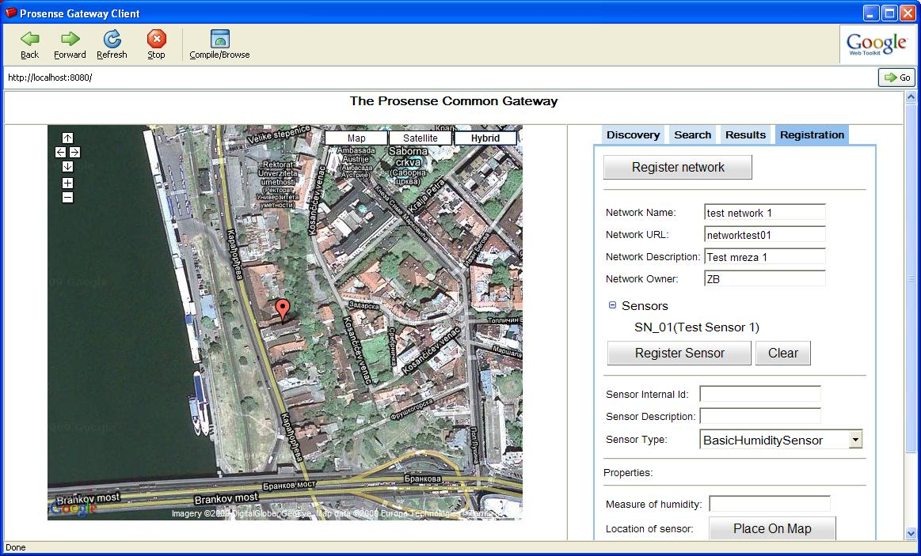
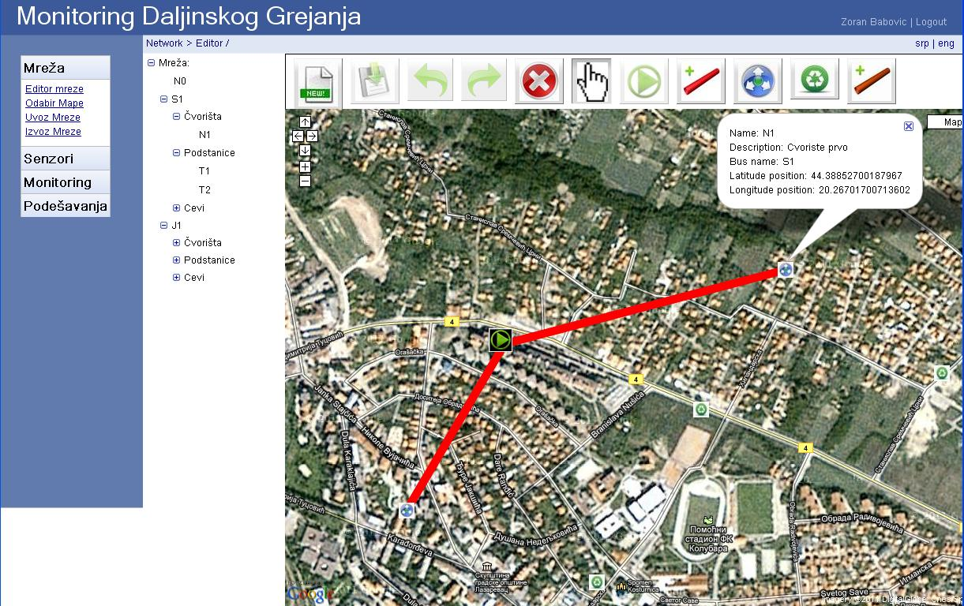
Sensor Web Applications
Public District Heating Monitoring System
Semantic Sensor Data Search

Slide 11
Future Research Directions
Publications of sensor data as linked resources using XLINK mechanism
Some researchers investigate extensions of available semantic query languages
Creation of a flexible information model that will satisfy needs of many sensor application scenarios
Investigation of efficient distributed structures suitable for managing spatial-temporal characteristic of huge sensor data volume
Data mining and processing of Big Sensor Data

