Slide 1
Mind genomics
“From tomato pieces to world peace”
Damjan Komlenac
School of Electrical Engineering Belgrade

Slide 2
Content
Dr. Howard Moskowitz
What mind genomics is
How it works
Example
Summa summarum and more

Slide 3
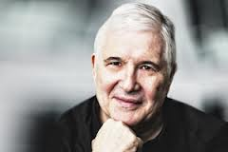
Dr. Howard Moskowitz
Clients :
Pepsi(s), Coca cola, Microsoft, HP, McDonald's, Ford, Heineken, Master Card, L’Oreal…
How it started? - Chunky spaghetti sauce
Awards:
2012 Edison Award for Innovation.
2010 Sigma Xi's Walston Chubb
Award for Innovation.
2005 Charles Coolidge Parlin Marketing Research Award
…

Slide 4
What mind genomics is
“Mind Genomics, the science of everyday experience, is the research discipline guiding our work”.
“People don’t know their true preferences or their real feelings. If they don’t know them, they can’t articulate them”.
Horizontal segmentation
There is no better, there is only different,
which suits to different kinds of people. – Democracy.

Slide 5
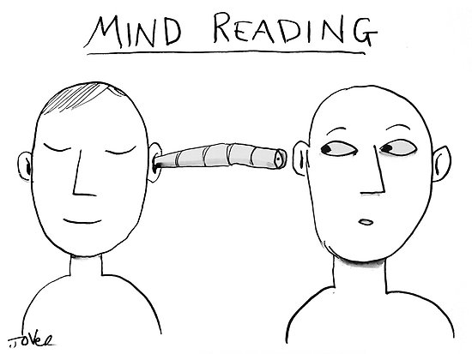
How it works
Works by presenting people with a group of ideas and getting their reactions
Reveals segments and what to tell them
Does all of this quickly..in a few days..and at very affordable costs
Has an excellent track record across disciplines

Slide 6
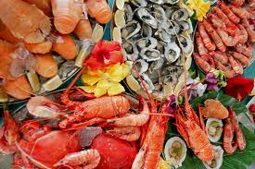
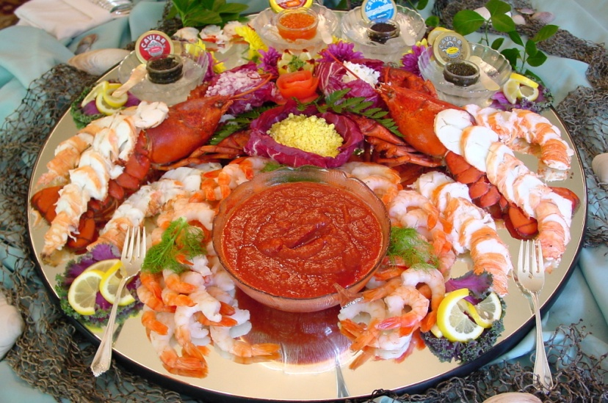
Example: How to advertise seafood that comes from the Gulf of Mexico since massive oil spill in 2010?

Slide 7
Welcome page to the interview

Slide 8
Sample test concept and rating scale

Slide 9
Sample test concept and ‘primary emotion’

Slide 10
What makes you feel like you felt last year – total panel

Slide 11
What elements drive each dominant feeling : total panel

Slide 12
Other results
Gender Differences
Age groups
Ethnic groups
Mind-Sets
Strong positive actions
Right social structures

Slide 13
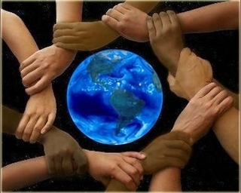
Summa summarum and more
Food industry
Marketing for all kinds of products
Weight lose
More competitive careers for students
Niger
Nominom
Making mind typing procedure popular
Find out more about yourself
Targeted advertisements
World peace
Columbia university, Peter Coleman
Three mindsets of Palestinians and Israelis

