Slide 1
New Paradigms in
Graduate Education for
Informatics and Mathematics:
The Algorithmic Approach
Veljko Milutinovic, vm@etf.rs

Slide 2
Top(USA): Business + Engineering + Science
MBA : Wharton + Dartmouth
MEng: MIT + UCB
MSc: Harvard + Stanford
Ivy: Princeton + Yale
NY: Columbia + NYU
Mid West: Purdue + Illinois
PhD

Slide 3

Math and Informatics @ Wharton

Slide 4
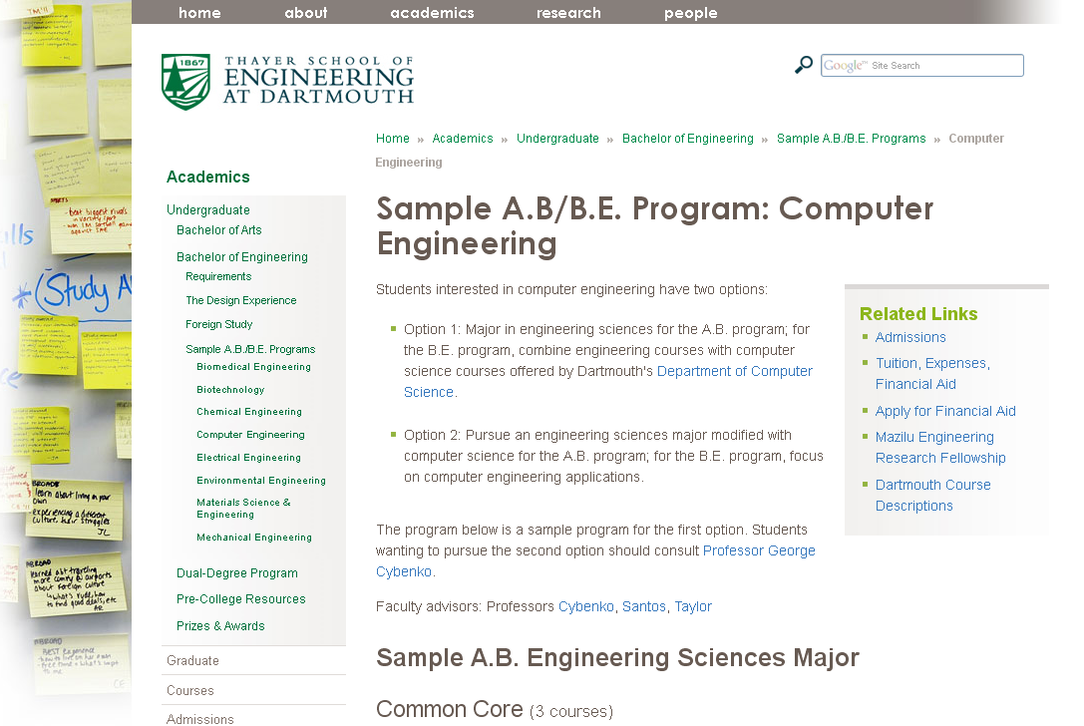
Math and Informatics @ Dartmouth

Slide 5
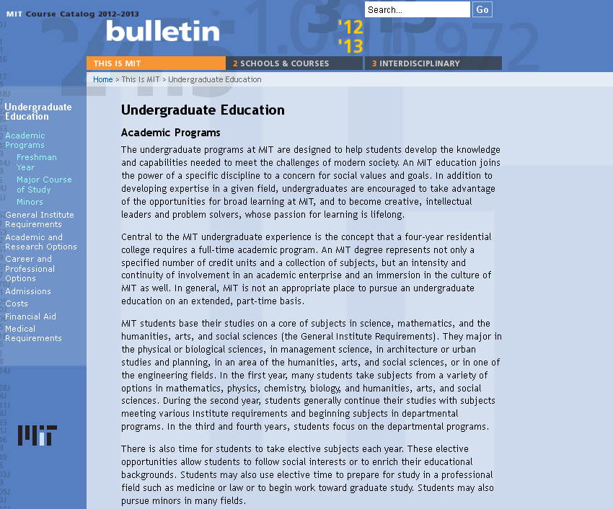
Math and Informatics @ MIT

Slide 6
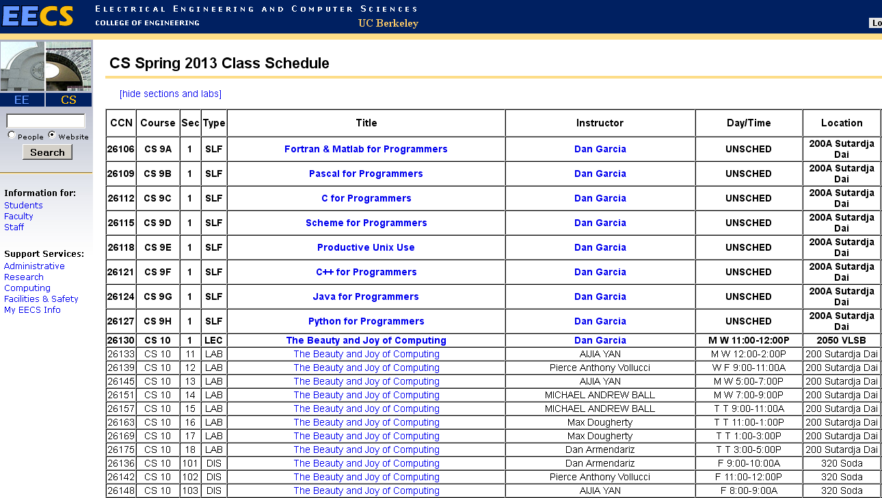
Math and Informatics @ UCB

Slide 7
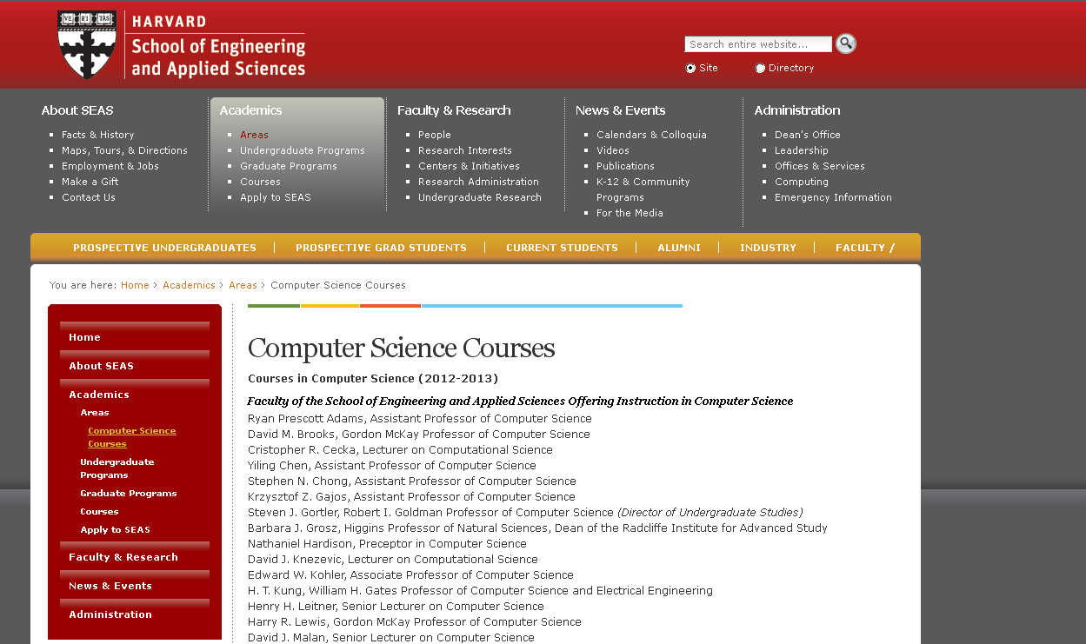
Math and Informatics @ Harvard

Slide 8
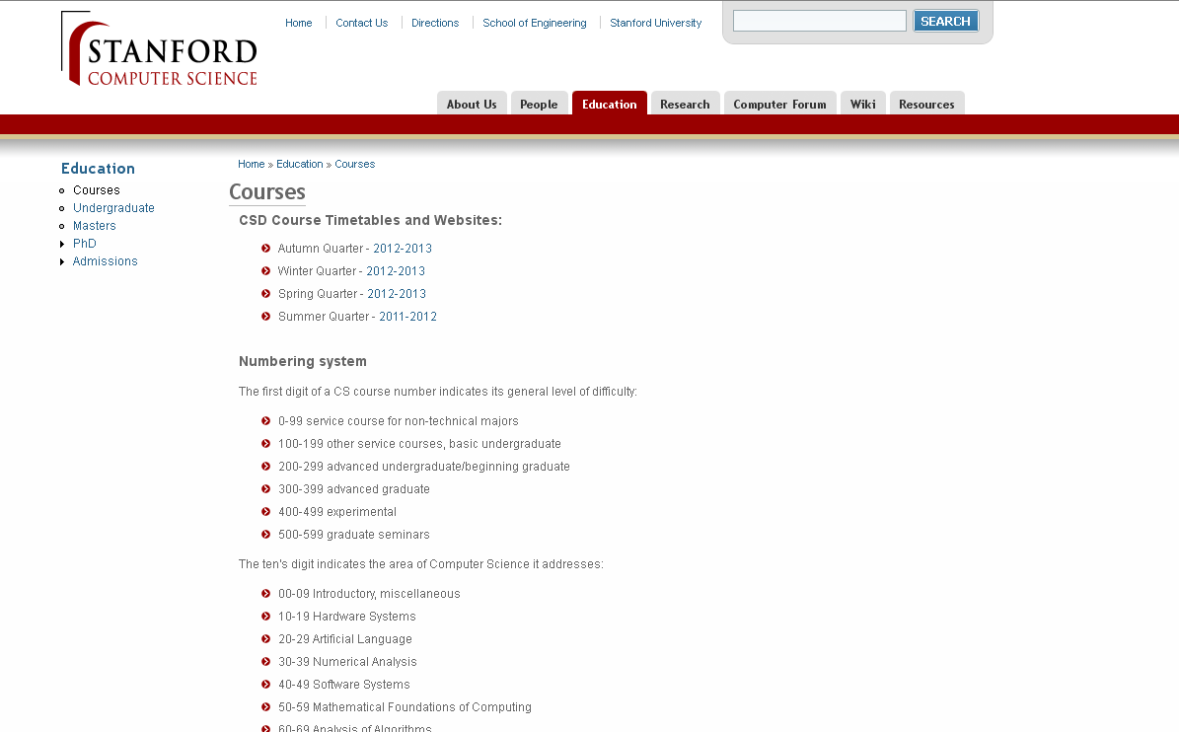
Math and Informatics @ Stanford

Slide 9

Conclusion: Synergy
Business + Engineering + Science

Slide 10
On Strategic and Tactical Issues
Related to PhD Research
with Special Emphasis
on Generation of New Ideas
and Writing of Papers
in Computer Science and Engineering:
An Analysis
Veljko Milutinovic
Notes:
10

Slide 11
Table of Contents
1. Introduction
2. The Major Strategic Issues
3. About Generation of New Ideas
4. Examples from Turing Awards (10)
5. Examples from Nobel Prizes (10)
6. Examples from the UCLA List of Top500 CS Researchers
7. Numerical Values from Google Scholar
8. Examples from University of Belgrade (10)
9. Experiences with PhD Students
10. Conclusions

Slide 12
Biranje teme se svodi na biranje problema,
za koji u otvorenoj literaturi postoji rešenje,
ali Vi želite da uvedete novo rešenje
koje je bolje od najboljeg postojećeg
pod podređenim uslovima,
tako da to rešenje može da posluži primeni
(sadašnjoj ili budućoj),
a može se implementirati u nekoj tehnologiji
(sadašnjoj ili budućoj).

Slide 13
Introduction: General Strategy
Stage #1: Survey
1. Problem selection and collection of 20-40 research papers
2. Analysis and description (7S+F1infrastructure+F2data+F3algorithm)
3. Classification criteria and classification tree/cube
4. Ideas for future research, along the lines of 10 methodological paths
5. Survey paper, in Serbian (1324)
6. Survey paper, in English, for an IEEE or an ACM conference
7. Survey paper for a journal (ACM, IEEE, SCI)
8. Springer book 50-125
9. .ppt equivalent (preconference tutorials + teaching for Bologna credit)
10. Doing an implementation and living through the incubation period
Stage #2: Research
11. Doing a research paper (1 of 10) along the lines of 10 method paths
12. Publishing (SRB.con + ENG.con + ACM/IEEE/SCI.journal)
Stage #3: Prototyping
13. Writing an EU project proposal, with appendices from the above
14. Approaching the US companies, with knowledge from the above
Stage #4: Commercialization
15. If the project was successful, prepare a business plan for a startup
16. Work on turning the EU project prototype into a market product

Slide 14
Ten
Idea Generation Methods*

Slide 15

Mendeleyevization:
Inductor versus Catalyst
(M1 vs M2)
Definition:
If one of the classification class includes no examples,
it first has to be checked why is that so.
If it is so because it makes no sense, an appropriate explanation is in place.
If it is so because the technology or the applications are not yet ready
for such an approach, one can act in the same way as the famous chemists Mendeleyev:
Empty positions in any classification are potential avenues leading to new inventions.
We refer to such an approach as: Mendeleyevization.
Examples:
As far as M1/M2, the famous classification of computer systems by Mike Flynn
(SISD, SIMD, MISD, MIMD) initially included no examples of the MISD type.
Later on, a DFT machine (generated using the M1 method)
was categorized as an MISD machine [Milutinovic86A],
as well as one pipelined machine (generated using the M2 method),
namely [Milutinovic87C];
the DFT served as an inductor, and pipeline as a catalyst.
Other popular examples are related to various signal processors and process accelerators.
A: Mendeleyevization (Inductor versus Catalyst) – M1 vs M2
Notes:
15

Slide 16
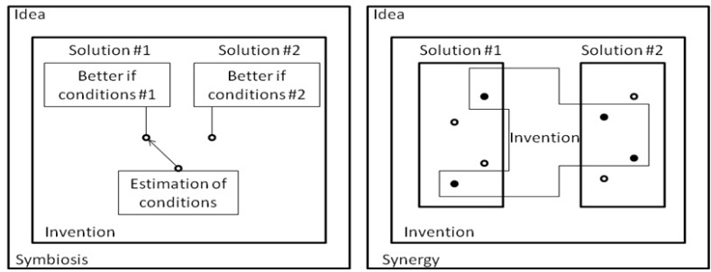
Hybridization:
Symbiosis versus Synergy
(H1 vs H2)
Definition:
Sometimes two classification classes can be combined,
in order to obtain a hybrid solution (hybridization).
Hybrid solutions can be symbiotic (measuring the conditions in the environment
and switching from one approach to the other, so that each approach is active all the time,
while the conditions are such that it provides better performance compared to the other approach)
or synergistic (creating a new approach, which, for each particular solution element
takes the better solution element of two different approaches).
Examples:
As far as H1/H2, the essence of [Milutinovic85] is that two algorithms are combined into one
on the either-one-or-the-other basis (using the H1 method),
and on a combine-inherent-details basis (using the H2 method) in [Milutinovic87B].
Other popular examples include hybrid computers
or computers that use special purpose accelerators,
when appropriate data/process patterns are located.
B: Hybridization (Symbiosis versus Synergy) – H1 vs H2

Slide 17
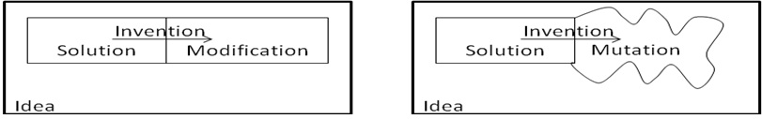
Transdisciplinarization:
Modifications versus Mutations (T1 vs T2)
Definition:
Often times, good new ideas get generated if algorithms, procedures,
ways of thinking, re ported from one field to another field,
along the lines of transdisciplinary research methodologies (transdisciplinarization).
Examples:
As far as T1/T2, [Milutinovic86B] ports algorithms from Silicon to GaAs (using the T1 method),
and introduces appropriate modifications along the process,
while [Milutinovic87A] creates a proposal for a novel computer architecture
(using the T2 method),
along the analogies with a biological honeycomb.
Other popular examples include porting of the FFT
from seismic signal processing to speech signal processing
(modification),
or introduction of mathematical neural networks inspired by biological neural networks (mutation).
C: Transdisciplinarization (Modification versus Mutation) – T1 vs T2

Slide 18
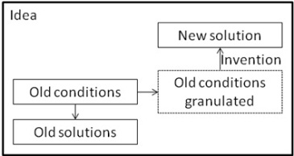
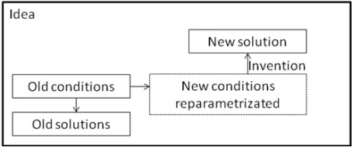
Remodelling:
Granularization versus Reparametrization (R1 vs R2)
Definition:
Sometimes it is simply the best to take a research direction different (even opposite)
compared to what others take (retrajectorization using remodeling).
The different (opposite) research direction makes sense either if a more detailed set of parameters is in place (granularization, due to model changes because of application changes),
or because parameters of the environment have changed permanently
(reparametrization, due to model changes because of technology changes).
The two alternatives are referred to as granularization and reparametrization.
Examples:
As far as R1/R2, [Milutinovic88] offers a new algorithm (using the R1 method)
that makes sense if an environment is represented with a more detailed model,
while [Milutinovic89] offers a new solution in a changed environment (using the R2 method),
when a design has to be ported from Silicon to GaAs
(from the performance/price point of view, the best adder design for Silicon, the carry-lookahead adder,
is among the worst ones for GaAs, and the opposite: the worst adder for Silicon, the ripple-carry adder,
is among the best ones for GaAs; this is because GaAs gate delays depend on fan-out
and ripple-carry adders are characterized with only the minimal fan-out,
while the fan-out of the carry-lookahead adders depends on the word size, and can grow infinitely).
Other popular examples are related to concept modeling in AI based on graphical representation with icons
(in a model with fewer icons, one can make a conclusion which is different, and often times even opposite, compared to a conclusion made from a model with a much larger number of icons);
also, when the environment changes (for example, the ratio of processing speed to communication speed changes), a different type of supercomputing network becomes optimal.
D: Remodeling (Granularization versus Reparametrization) – R1 vs R2

Slide 19

Unorthodoxization:
ViewFromAbove versus ViewFromInside (U1 vs U2)
Definition:
This category encompasses the approaches that are difficult to classify:
Sometimes one sees something that others did not see for decades or centuries (ViewFromAbove)
or one gets stroked by an idea of a genius with no ground in existing research (ViewFromInside).
Examples:
As far as U1/U2, [Milutinovic2000] generated an innovation
after trying to make a holistic view (U1),
and [Milutinovic2001] introduces an idea after an effort is made
to understand the intrinsic details of the problem (U2).
Other popular examples include the contributions
of Nobel Laureates Martin Perl and Jerome Friedman.
E: Unorthodoxization (ViewFromAbove versus ViewFromInside) – U1 vs U2

Slide 20
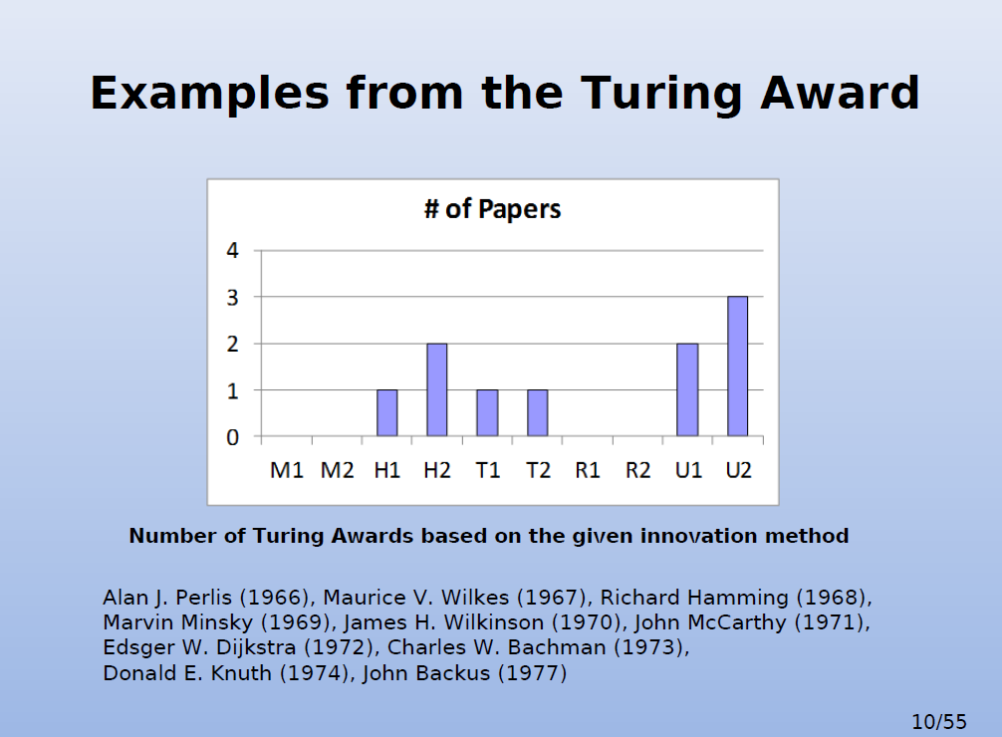

Slide 21
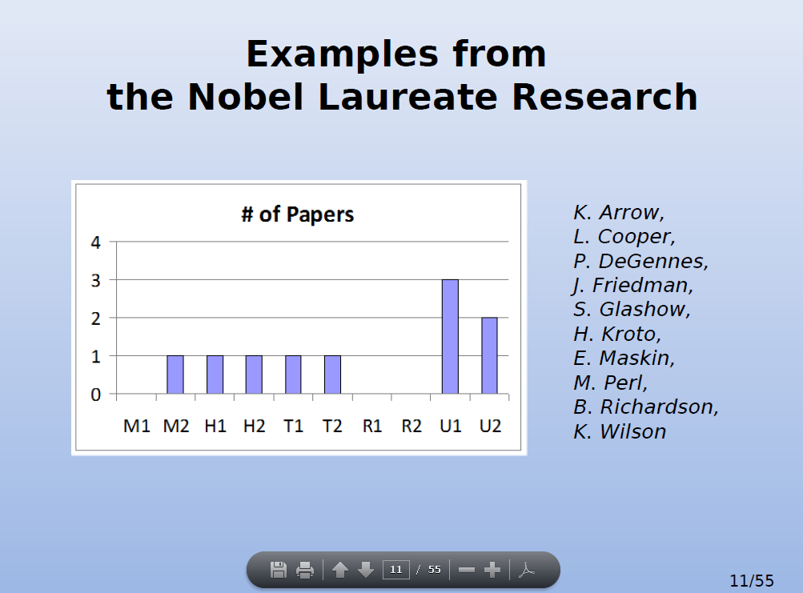

Slide 22
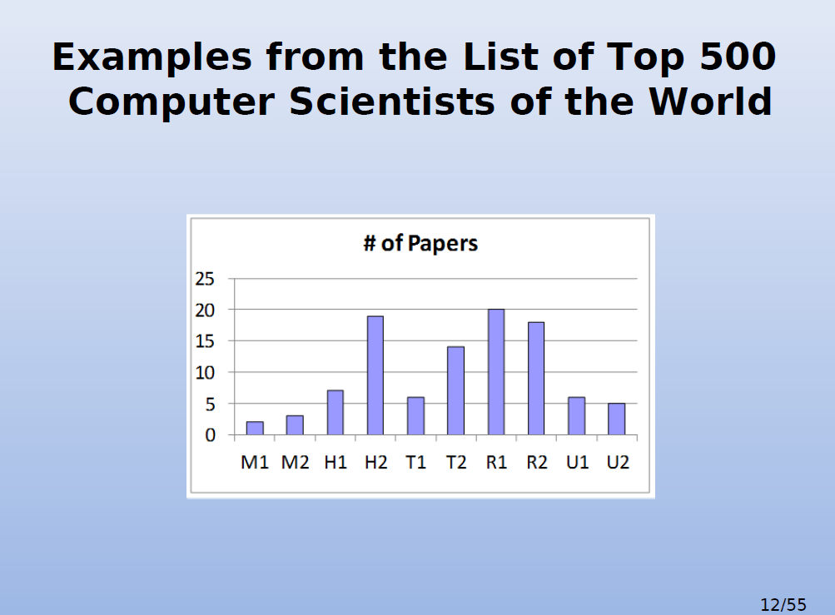

Slide 23
Experiences with PhD Students
of the Authors of this Research
Researcher | Research domain | Method
Drazen Draskovic | mutation algorithms for genetic search [Draskovic2012] | H1
Bojan Furlan | opinion mining for social networks [Furlan2011] | H1
Nemanja Kojic | data mining for wireless sensor networks [Kojic2012] | U1
Marko Misic | interconnection networks for multiprocessor systems [Misic2011] | R2
Milos Cvetanovic | system software for wireless sensor networks [Cvetanovic2008] | H1
Zaharije Radivojevic | application software for wireless sensor networks [Radivojevic2008] | H1
Zarko Stanisavljevic | computing infrastructure for distant education [Stanisavljevic2011] | H1
Zivojin Sustran | cache management for multiprocessor systems [Sustran2012] | T2
Djordje Djurdjevic | of computer graphics for mission applications [Djurdjevic2011] | R1
Sasa Stojanovic | hybrid computing for supercomputer architecture [Stojanovic2012] | H1

Slide 24
Classified References
Used in the Educational Process
M1: Mendeleyevization/Inductor
[Milutinovic86a] Milutinovic, V., Fortes, J., Jamieson, L.,A Multiprocessor Architecture for Real-Time Computation of a Class of DFT Algorithm,IEEE Transactions on Acoustics, Speech, and signal Processing, Aol. ASSP-34, No. 5, October 1986, pp. 1301-1309.(impact factor 1.463/1992).
M2: Mendeleyevization/Catalyst
[Milutinovic87c] Milutinovic, V.,A Simulation Study of the Vertical-Migration Microprocessor Architecture,IEEE Transactions on Software Engineering, Vol. SE-13, No. 12, December 1987, pp. 1265-1277.
H1: Hybridization/Symbiosis
[Milutinovic85] Milutinovic, V.,A Microprocessor-Oriented Algorithm for Adaptive Equalization,IEEE Transactions on Communications, Vol COM-33, No 6, June 1985, pp. 522-526.(impact factor 1.512/2010).
H2: Hybridization/Synergy
[Milutinovic87b] Milutinovic, V., Lopez-Benitez, N., Hwang, K.,A GaAs-Based Microprocessor Architecture for Real-Time Applications,IEEE Transactions on Computer, VolC-36, No 6, June 1987, pp. 714-727.(impact factor 1.822/2010).
T1: Transdisciplinarization/Modification
[Milutinovic86b] Milutinovic, V.,GaAs Microprocessor Technology,IEEE Computer, Vol 19, No. 10, October 1986 (Invited, Guest Editor's Introduction), pp. 10-15.(impact factor 2.205/2010).
T2: Transdisciplinarization/Mutation
[Milutinovic87a] Milutinovic, D., Milutinovic, V., Soucek, B.,The Honeycomb Architecture,IEEE Computer, Vol. 20, No. 4, April 1987 (Open Channel), pp. 81-83.(impact factor 2.205/2010).
R1: Remodeling/Granularization
[Milutinovic88] Milutinovic, V., A Comparison of Suboptimal Detection Algorithms Applied to the Additive Mix of Orthogonal Sinusoidal Signals, IEEE Transactions on Communicatiions, Vol. COM-36, No. 5, May 1988, pp. 538-543.
R2: Remodeling /Reparametrization
[Milutinovic89] Milutinovic, V., Bettinger, M., Helbig, W.,Multiplier/Shifter Design Trade-offs in a 32-bit Microprocessor,IEEE Transactions on Computers, Vol. 38, No. 6, June 1989, pp. 847-880.(impact factor 1.822/2010).
U1: Unorthodoxization/ViewFromAbove [Milutinovic2000] Milutinovic, V., Cvetkovic, D., Mirkovic, J.,
“Genetic Search Based on Multiple Mutation Approaches,” IEEE Computer, 2000. (impact factor 1.822/2010).
U2: Unorthodoxization/ViewFromInside [Milutinovic2001] Milutinovic, V., Ngom, P., Stojmenovic, I., “STRIP --- A Strip Based Neural Network Growth Algorithm for Learning Multiple-Valued Functions,” IEEE Transactions on Computers, 2001. (impact factor 1.822/2010).

Slide 25
A Short Course for PhD Students
in Science and Engineering:
”How to Write Papers for JCR Journals”
(A) survey papers
(B) research papers

Slide 26
Major Contributions
of the Two Paper Types
Major contributions of the two paper types are as follows:
a) For a survey paper:
  A novel classification of existing approaches to the problem,
  using a well thought set of classification criteria.
  Presentation of each approach using the same template
  and the same type of figures, so an easy comparison is possible.
3) Some wisdom related to future research trends.
b) For a research paper:
1) Introduction of a new original idea.
2) Comparison of that idea with the best one from the open literature,
using the previously built tools:
For how much is it better and under what conditions?
3) In addition to a performance oriented comparison,
any research paper also has to include
a complexity oriented comparison.

Slide 27
1. Survey Papers
Selection of the topic for a survey must satisfy
the following requirements:
  The field is newly emerging.
  Popularity of the field will grow over time.
  A critical number of papers with new algorithms/approaches does exist
  (at least twenty to forty).
  A survey paper does not exist.
  The PhD student worked before in a related scientific field.
  The PhD student is enthusiastic about the particular field
  of his/her tutorial paper.
  Find papers using Google Scholar,
  Citation Count for old papers and Locality Principle for new papers!

Slide 28
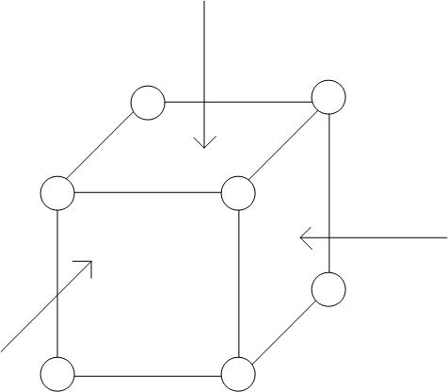
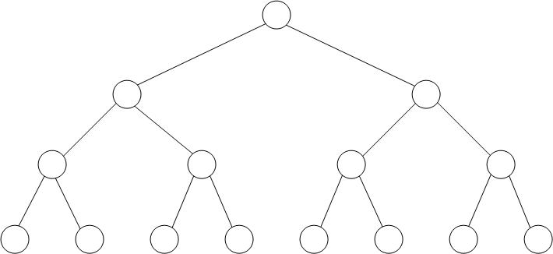
1. Survey Papers
With the binary (or n-ary) criteria, one can create either a tree-like classification
or a cube-like classification,
as indicated in Figures 1 and 2 [Vukasinovic2012].
With a tree-like classification, one can classify only the approaches that entirely belong to a specific class.
With a cube-like classification, one defines a space in which inner points include, to some extent, characteristics of all existing classes
What is useful, is to prepare a figure which includes the following:
  The classification criteria.
  The classification
  The technical mnemonics.
  The symbolic mnemonics.
  The number of selected examples per class.
  The full list of references of selected examples.
  The vector of relevant characteristics.
FIGURE 1. A tree-like classification:
Classes are only at the leaves of the tree.
FIGURE 2. A cube-like classification:
Classes can exist also at points inside the cube,
as pointed to by the three arrows.

Slide 29
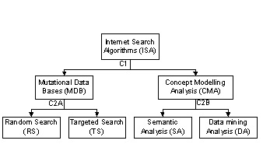
Figure 3. Classification of Internet Search Algorithms
Legend: C1 (criterion #1) = Retrieval-oriented vs Analysis-oriented
C2A (criterion #2, in the MDB path) = Random Search vs Targeted Search
C2B (criterion #2, in the CMA path) = Semantics-oriented vs Datamining-oriented

Slide 30
Technical Names | Random Search (RS or RS/MDB) | Targeted Search (TS or TS/MDB) | Semantic Analysis (SA or SA/CMA) | Data-mining Analysis (DA or DA/CMA)
Symbolic Names | Lion | Jaguar | Tiger | Panthera
Number of Surveyed Contributions | 4 | 4 | 4 | 4
References | [Nikolic2011a] Nikolic, B., “Expert Systems,” WUS Austria Educational Publishing and University of Belgrade, Classroom Textbook, June 2011. | [Milutinovic2000a] Milutinovic, V., Cvetkovic, D., Mirkovic, J., “Genetic Search Based on Multiple Mutation Approaches,” IEEE Computer, November 2000, vol. 33, issue: 9, pp. 118-119. | [Nikolic2011b] Furlan, B., Sivacki, V., Jovanovic, D., Nikolic, B., “Comparable Evaluation of Contemporary Corpus-Based and Knowledge-Bases Semantic Similarity Measures of Short Text,” JITA, vol. 1, no. 1, pp. 65-72, ISSN: 2232-962, June 2011. | [Milutinovic2000b] Milutinovic, V., Knezevic, P., Radunovic, B., Casselman, S., Schewel, J.,“Obelix Searches Internet Using Customer Data,”IEEE Computer, July 2000, vol. 33, issue: 7, pp. 104-107.
 | [Nick2001] [ ] [ ] | [Simon2009] [Mirkovic1999] [Chen1997] | [Gordon2006] [Leroy2003] [Wang2006] | [Al-Dallal2009] [Hu2007] [Freitas2001]
-ability#1 ... -ability#N
TABLE A: SUMMARY OF THE APPROACHES THAT LED TO THE CLASSIFICATION PROPOSED IN THIS PAPER

Slide 31
Survey Papers
When presenting each particular example, one can use the template presented next:
  Seven Ws about the survey example (Who, What, When, Where, Why, for Whom, hoW) - 7.
  Essence (it is extremely difficult to give entire essence in only one sentence) - k.
  Structure (at this place, one can insert a call to a figure,
  like in [Draskovic2012]) - 3.
  Some relevant infrastructure details - l.
  Algorithm (refer to a figure) - 3.
  Example (here one can call a figure that explains an example using a pseudo-code,
  like in [Draskovic2012];
  ideally, the same application case should be used for all surveyed examples) - m.
  Seven As pros and cons + trends and ideas,
  as well as Author’s opinion of this approach and its potentials
  in the domains of technology, architecture, and application - 7.
  For short surveys, each template element is a sentence.
  For long surveys, each template element is a paragraph.
  For books, each template element can be a page, or more.

Slide 32
Parts of the Figure Caption
Title
Legend
Discussion
(description + explanation + consequences)
Note: Symbols in the figure should be language independent.

Slide 33
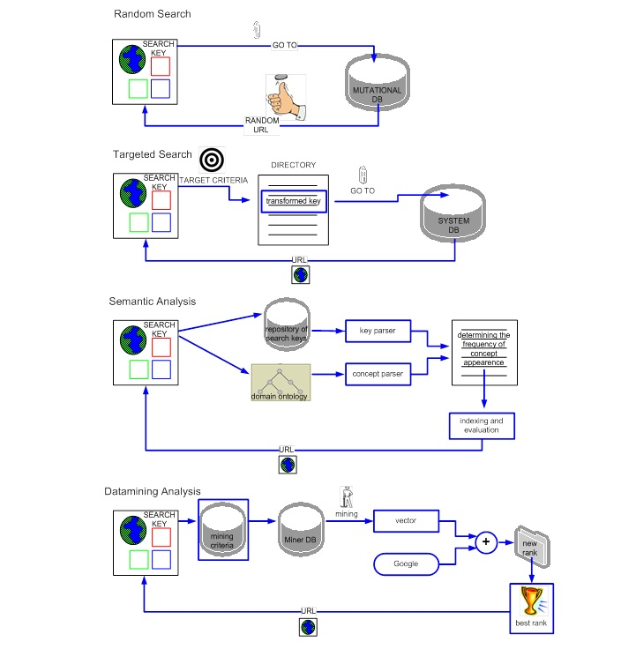
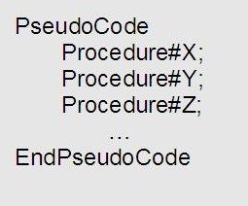
FIGURE 5: PseudoCode
that demonstrates behavior of an example,
in the case of a specific application;
it is advised that the same application is used
with all examples.
FIGURE 4: Generalized Structure of the Search Classes
Legend:
DB = Database;
URL = Type of URI that is used to describe
the location of a specific document;

Slide 34
2. Research Papers
The major purpose of the research paper is to describe an innovation
and to demonstrate that, under certain conditions,
it has a better performance and/or complexity,
compared to the best one from the open literature.
The major steps in the process are:
  To create an invention.
  To perform a rigorous analysis,
  to demonstrate that the invented solution is better
  than the best one from the open literature under a specific set of conditions,
  and to show what these conditions are
  and for how much is it better.
  To asses complexity and to write the paper using a methodologically correct template.

Slide 35
Research Papers
As far as the presentation of the research results,
the students are told that each research paper
should contain the following twelve sections:
  Introduction
  Problem statement
  Existing solutions
  The proposed solution
  Details
  Axioms, conditions, and assumptions of the analysis to follow
  Mathematical analysis
  Simulation analysis to show performance
  Implementation analysis to show complexity
  Conclusion
  Acknowledgments
  Annotated references

Slide 36
1. Introduction
The minimum introductory text
should contain the following three paragraphs:
  About the general field of this research.
  About the specific field of this research.
  About the vision (viewpoint) of this research,
  as well as the goal (battle),
  and mission (war) of this research.

Slide 37
2. Problem Statement
The following elements are obligatory:
  Problem definition.
  Why is the problem important.
  Why will the importance of the problem
  grow over time.

Slide 38
3. Existing Solutions
Existing solutions and their drawbacks,
looking from the viewpoint defined in the introduction,
and having in mind the goals defined in the introduction.
Elements of this section are:
  A brief classification of the best solution from the open literature.
  Short description of each relevant solution.
  A detailed criticism of each presented solution,
  especially in domains in which the proposed solution
  is expected to be better.

Slide 39
4. The Proposed Solution
  The proposed solution and its essence,
  and why is it supposed to be better
  compared to the best solution from the open literature;
  elements of this section are:
  Philosophical essence of the proposed solution.
  Why the proposed solution
  is without drawbacks of existing solution(s).
  What is the best methodology
  to prove the superiority of the proposed solution,
  and under what conditions that holds.

Slide 40
5. Details
This section should contain details of the best one
among the existing approaches and of the proposed solution.
The relevant details should be grouped into categories.
For example:
  Hardware details.
  System software details
  Application software details.

Slide 41
6. Axioms, Conditions, and Assumptions
of the Analysis to Follow
a) Axioms refer to axiomatic standpoints.
b) Conditions refer to realistic specifiers of the environment.
c) Assumptions refer to simplifications that make the analysis easier,
without jeopardizing on the quality of the final result.

Slide 42
7. Mathematical Analysis
Axioms, conditions, and assumptions
are described mathematically.
Closed or open form formulae are derived
for the major performance measures.
Closed or open form formulae are derived
for the major complexity measures.

Slide 43
8. Simulation Analysis
to Show Performance
Simulator, logical structure
and user interface are described.
Simulation experiments are described.
Simulation results are discussed.

Slide 44
9. Implementation Analysis
to Show Complexity
a) Implementation strategy is discussed for the chosen technology.
b) Implementation details and complexity are presented.
c) If a prototype is implemented, show some characteristic measurement.
If a prototype is not implemented, give some implementation guidelines.

Slide 45
10. Conclusion
Summary of what was done
and to what extent are the initial goals achieved
(vision + goal + mission).
To whom is that of benefit.
Newly open problem for further research.

Slide 46
11. Acknowledgments
a) To all those who patiently listened to your ideas
and especially to those who volunteered to share with you
some of their own ideas for further benefit of your research.
Also, it is obligatory to cite the relevant work
of all those who volunteered the improvement ideas.
b) To all those who helped provide the infrastructure for your research.
If this is related to one or more research project, list them.
c) To all those who suffered by taking everyday life responsibilities from you,
so you could dedicate more of your time to research.

Slide 47
12. Annotated References
The references are more useful if listed in groups.
Each topic requires different grouping.
The grouping that seems most appropriate
for this paper includes:
  References related to methodology.
  References related to examples.
  References related to success of past students.

Slide 48
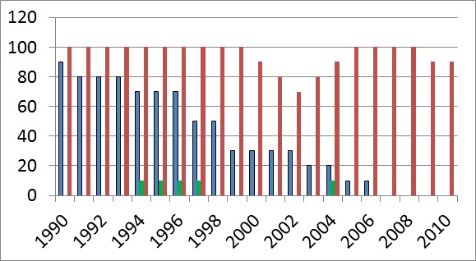
Figure 6: Success rates of paper submissions: (A) Normalized percentage of class with permission to submit.
(B) Normalized paper acceptance rate of those permitted to submit.
(C) Among the student with accepted papers, how many enrolled a PhD program later.
Explanation: Curve A is almost monotonically decreasing due to the fact that the class was not formal in the beginning
and only the best students opted to take informal lectures. After the class became formal, the student body became larger,
and consequently, not all of them were extraordinary. Curve B had ups and downs, with peeks separated about twelve years apart,
which could be a consequence of the motivation ups and downs of the teacher. Curve C is at hundred percent,
except in years characterized with an industry boom.

Slide 49
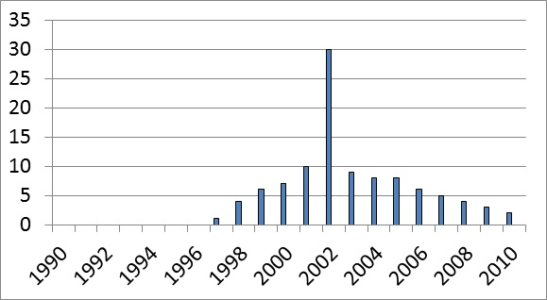
Figure 7: Citation analysis for the ten most referenced papers.
Explanation: It is clear that in some years the production was of a higher quality;
that seems to be coinciding with years in which the world’s top industry
was giving donations to the department.
The Y axis refers to the total number of citations for the top 10 papers

Slide 50
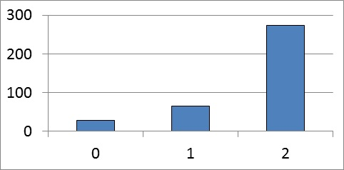
Figure 8: Impact of the existence of another survey paper.
Explanation: This figure gives a result which was absolutely unexpected.
The expectation was that existence of a survey would decrease citations of our survey,
but it happened absolutely the opposite. This means that the quality is more important
than the pre-existence of another survey paper on the same subject.
The paper with 2 preceded survey papers was the paper by Protic at al [Protic 1996].
The paper with one preceded survey was the paper by Tomasevic at al [Tomasevic1993].
The paper with no preceded survey was the paper by Jovanovic at al [Jovanovic1999].

Slide 51
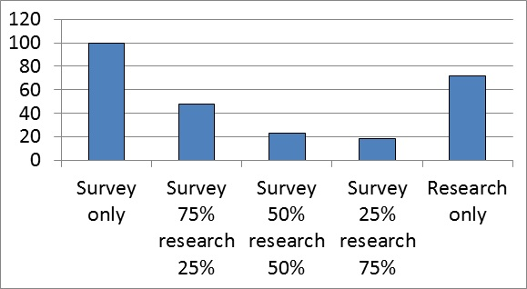
Figure 9: Survey papers versus research papers, what generates more citations? Explanation: Surveys generate more,
unless an extraordinary research paper is generated in a popular field.

Slide 52
Appendix
One possible research plan
based on the methodology
presented in this paper is elaborated here,
week by week
(between two logical weeks,
one can have one or more physical weeks)

Slide 53
SURVEY PAPER
1. Read about the general subject, to worm up.
2. Collect 20 to 40 papers,
on various approaches from the open literature.
3. For each example (covered by one or more papers),
write the main 7 sentences, as explained in this paper.
Explain why the chosen template enables easy comparison,
and therefore represents a contribution to science.
4. Decide about classification criteria generate a classification,
sort the found examples by classes,
and form Figure #1, as explained in this paper.
Explain why the proposed classification represents
a contribution to science.
5. For each example, generate two figures
(for example, one block scheme of the structure,
and one pseudo code presentation of the algorithm).
Choose the presentation form which indicates
the essence of the class that the example belongs to.
6. If the generated classification
includes a class without examples
(which is highly desirable,
since that points to possible new research avenues),
define the research strategy of interest for those
who decide to take that avenue.
Form a section with appropriate discussions.
7. Define the research strategy for those
who decide to analyze the hybrid approaches
(those consisting of elements of two different classes).
Hybrid approaches can be either a symbiosis
(the two solutions used interchangeably, as the conditions dictate),
or a synergy (the two solutions combined into one).
Discuss possible new solutions or both types (symbiosis and synergy).
Discuss other possible avenues leading to new inventions
(transdisciplinarization and retrajectorization).
8. Add the preamble and the postambule,
and create the list of annotated references.
Form the final text of the paper.
Generate a pearl of wisdom that sheds light
on the essence of the paper,
and increases the probability that the paper be referenced a lot.
9. Ask peers to review your paper,
while you look for a suitable journal to publish it.
10. Submit the paper to a journal.

Slide 54
RESEARCH PAPER
1. For the best subset of ideas from the position paper,
make appropriate simulator changes,
and run the newly generated original solutions,
comparatively with the best solution from the open literature.
Create the tables and figures with results.
2. Write the paper.
3. Bounce the paper off the peers, and submit it to a journal.

Slide 55
State of the Art Tutorials

Slide 56
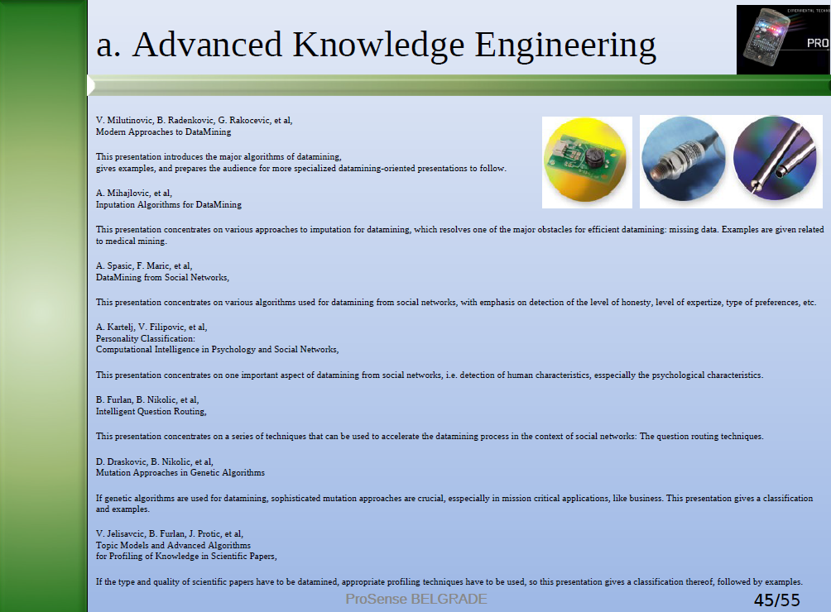

Slide 57
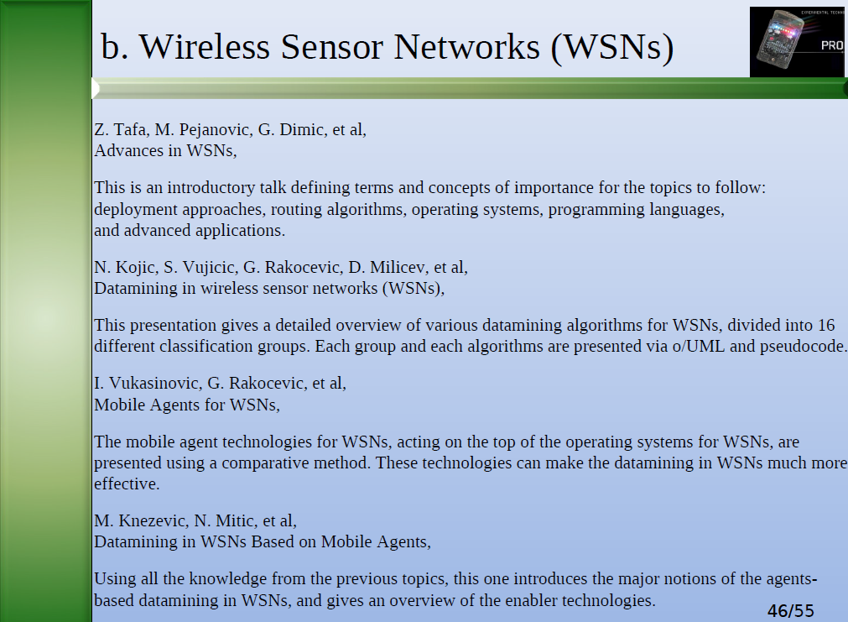

Slide 58
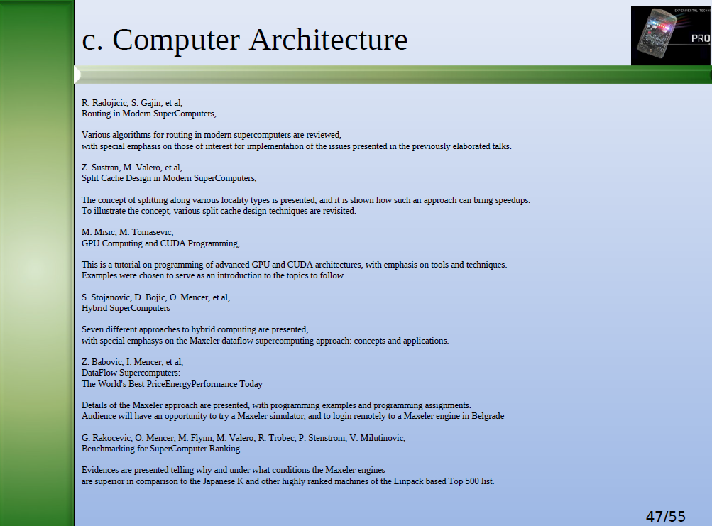

Slide 59
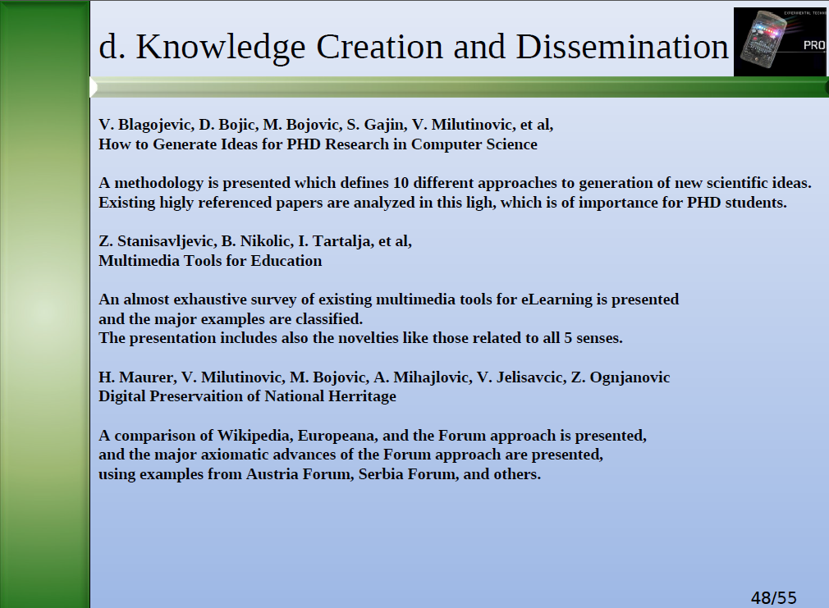

Slide 60
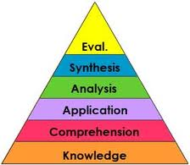
PowerPoint Presentations:
Condicios Since Qua Non
n/N (Expectations + Attention + TimeSavings)
5/7 (Tables + Plots + Figures + Graphs + Photos + Animations + Movies)
Semantic Breaks (One Line - One Thought)

Slide 61
Semantic Breaks: An Example (Bad)
Research Issues of Importance for
Distributed Shared Memory
Hardware Issues (those to be fully
implemented in hardware)
Software Issues (those to be fully
implemented in software)
Hybrid Issues (those to be partially
implemented in hardware and partially
in software)

Slide 62
Semantic Breaks: An Example (Good)
Research Issues of Importance
for Distributed Shared Memory
Hardware Issues
(those to be fully implemented in hardware)
Software Issues
(those to be fully implemented in software)
Hybrid Issues
(those to be partially implemented in hardware and partially in software)

Slide 63
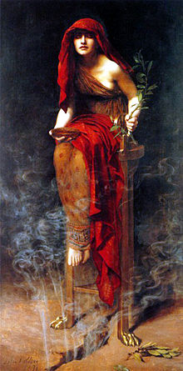
Priestess of Delphi: Pythia
Ibis, redibis nunquam,
in belo peribis
Ibis, redibis,
nunquam in belo peribis
If properly used, saves lifes.

Slide 64
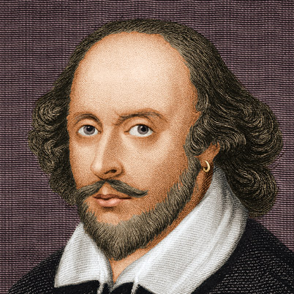
Romeo and Juliet: Prologue
Two households, both alike in dignity,
In fair Verona, where we lay our scene,
From ancient grudge break to new mutiny,
Where civil blood makes civil hands unclean.
From forth the fatal loins of these two foes
A pair of star-cross'd lovers take their life;
Whose misadventured piteous overthrows
Do with their death bury their parents' strife.
The fearful passage of their death-mark'd love,
And the continuance of their parents' rage,
Which, but their children's end, nought could remove,
Is now the two hours' traffic of our stage;
The which if you with patient ears attend,
What here shall miss, our toil shall strive to mend.
If properly used, the most sophisticated wisdom gets understood, and no misunderstandings happen.

Slide 65
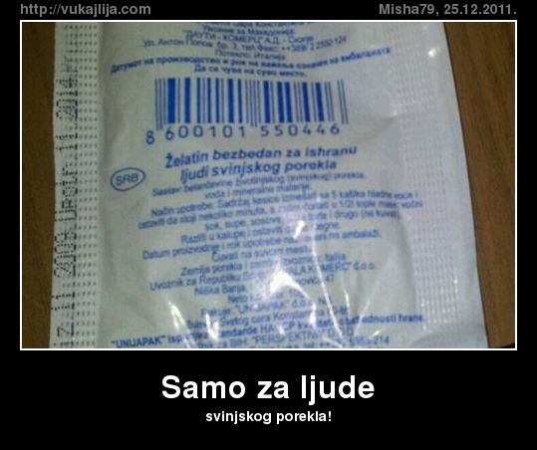
If properly used, decreases the probability that people laugh about us when we make mistakes (e.g., when the noun and the related adjective are not next to each other).

Slide 66
What is Better?
With semantic breaks:
function DayOfWeek(day, month, year) {
var a = Math.floor((14 - month) / 12);
var y = year - a;
var m = month + 12 * a - 2;
var d = (day + y + Math.floor(y / 4) - Math.floor(y / 100) +
Math.floor(y / 400) + Math.floor((31 * m) / 12)) % 7;
return d;
}
Essence: The higher the level of abstraction in the text,
the more benefit from semantic breaks
Also: The more tired the audience,
the more benefits from semantic breaks

Slide 67
What is Better?
With semantic breaks:
function DayOfWeek(day, month, year) {
var a = Math.floor((14 - month) / 12);
var y = year - a;
var m = month + 12 * a - 2;
var d = (day + y + Math.floor(y / 4) - Math.floor(y / 100) +
Math.floor(y / 400) + Math.floor((31 * m) / 12)) % 7;
return d;
}
function DayOfWeek(day, month, year) { var a = Math.floor((14 - month) / 12); var y = year - a; var m = month + 12 * a - 2; var d = (day + y + Math.floor(y / 4) - Math.floor(y / 100) + Math.floor(y / 400) + Math.floor((31 * m) / 12)) % 7; return d;}
Without semantic breaks:
Question: How long it takes to figure out the essence of the above?
Answer: BioPhysics + PsychologyAnalytics!

Slide 68
THE “USPI” COURSE
Veljko Milutinovic

Slide 69
THE “USPI” COURSE OUTLINE:
STAGES OF A COMPLEX RESEARCH/DEVELOPEMENT PROJECT
IN ACADEMIA/INDUSTRY
1. Before the project starts:
a. To ensure funding (e.g., H20); HW = FP7.doc
b. To get educated for management (e.g., MBA/PhD); HW = FP7.ppt
2. Soon after the project starts:
a. CMMI; HW = CMMI.level2global
b. Another more focused approach (e.g., Microsoft Project); HW = MP.local
3. Before the project is over:
a. To form a company (e.g., using the SBA guidelines); HW = BizPlan.sba
b. To protect the company product with a patent (e.g., using the USA patent office guidlines); HW = PatentAplication.doc
4. Immediately after the project is over:
a. To write about existing solutions to the problem (e.g., for a SCI journal); HW = SurveyPaper.doc
b. To write about obtained results (e.g., for a SCI journal); HW = ResearchPaper.doc
5. Soon after the project is over:
a. To form an Internet shop (small, medium, or large scale); HW = STORE.com
b. To apply MindGenomics (for better marketing of the result of your project); HW = MicroScienceCustomerTyping.doc
6. Long after the project is over:
a. To apply business intelligence (Data Mining and Media Mining and Lessons Learned); HW = NewAlgorithm.ppt
b. To brand yourself (Semantic Web and Internet Gallery and Serbia Forum); HW = NewDigitalization.pdf
READINGS:
7. Efficiency
8. Effectiveness
9. Inventivity
10.Creativity
CASE STUDIES:
MENCER/MAXELER
MAURER/MyFORUM
MOSKOWITZ/MingGenomics
MILLIGAN/M4

Slide 70
Course Demo
Material Set 1: FP7/H2020 and MBA/PhD
• FP7 (1 week)
• MBA/PhD (1 week)
Material Set 2: CMMI and RSPM
• Holistic approach (4 weeks)
• Specific approach (n weeks)
Material Set 3: SBA and SCI
• SBA (1 week)
• SCI (1 week)
Material Set 4: eShopping and MindGenomics
• eShopping (1 week)
• MindGenomics (1 week)
Material Set 5: DataMining and SemanticWeb/InternetGallery/SerbiaForum
• DataMining (1 week)
• SemanticWeb (1 week)

Slide 71
Readings and Homework
Material Set 6: Sales and Times
• Lloyd (1 week)
• Drucker (1 week)
Material Set 7: Inventivity and Creativity
• Friedman (0 weeks)
• Perl (0 weeks)
====================================================================
Help Set 1: HOMEWORK ASSIGNMENTS
• How to Make 100% (0 weeks)
Help Set 2: ORAL PRESENTATIONS
• How to Make 100% (0 weeks)

Slide 72
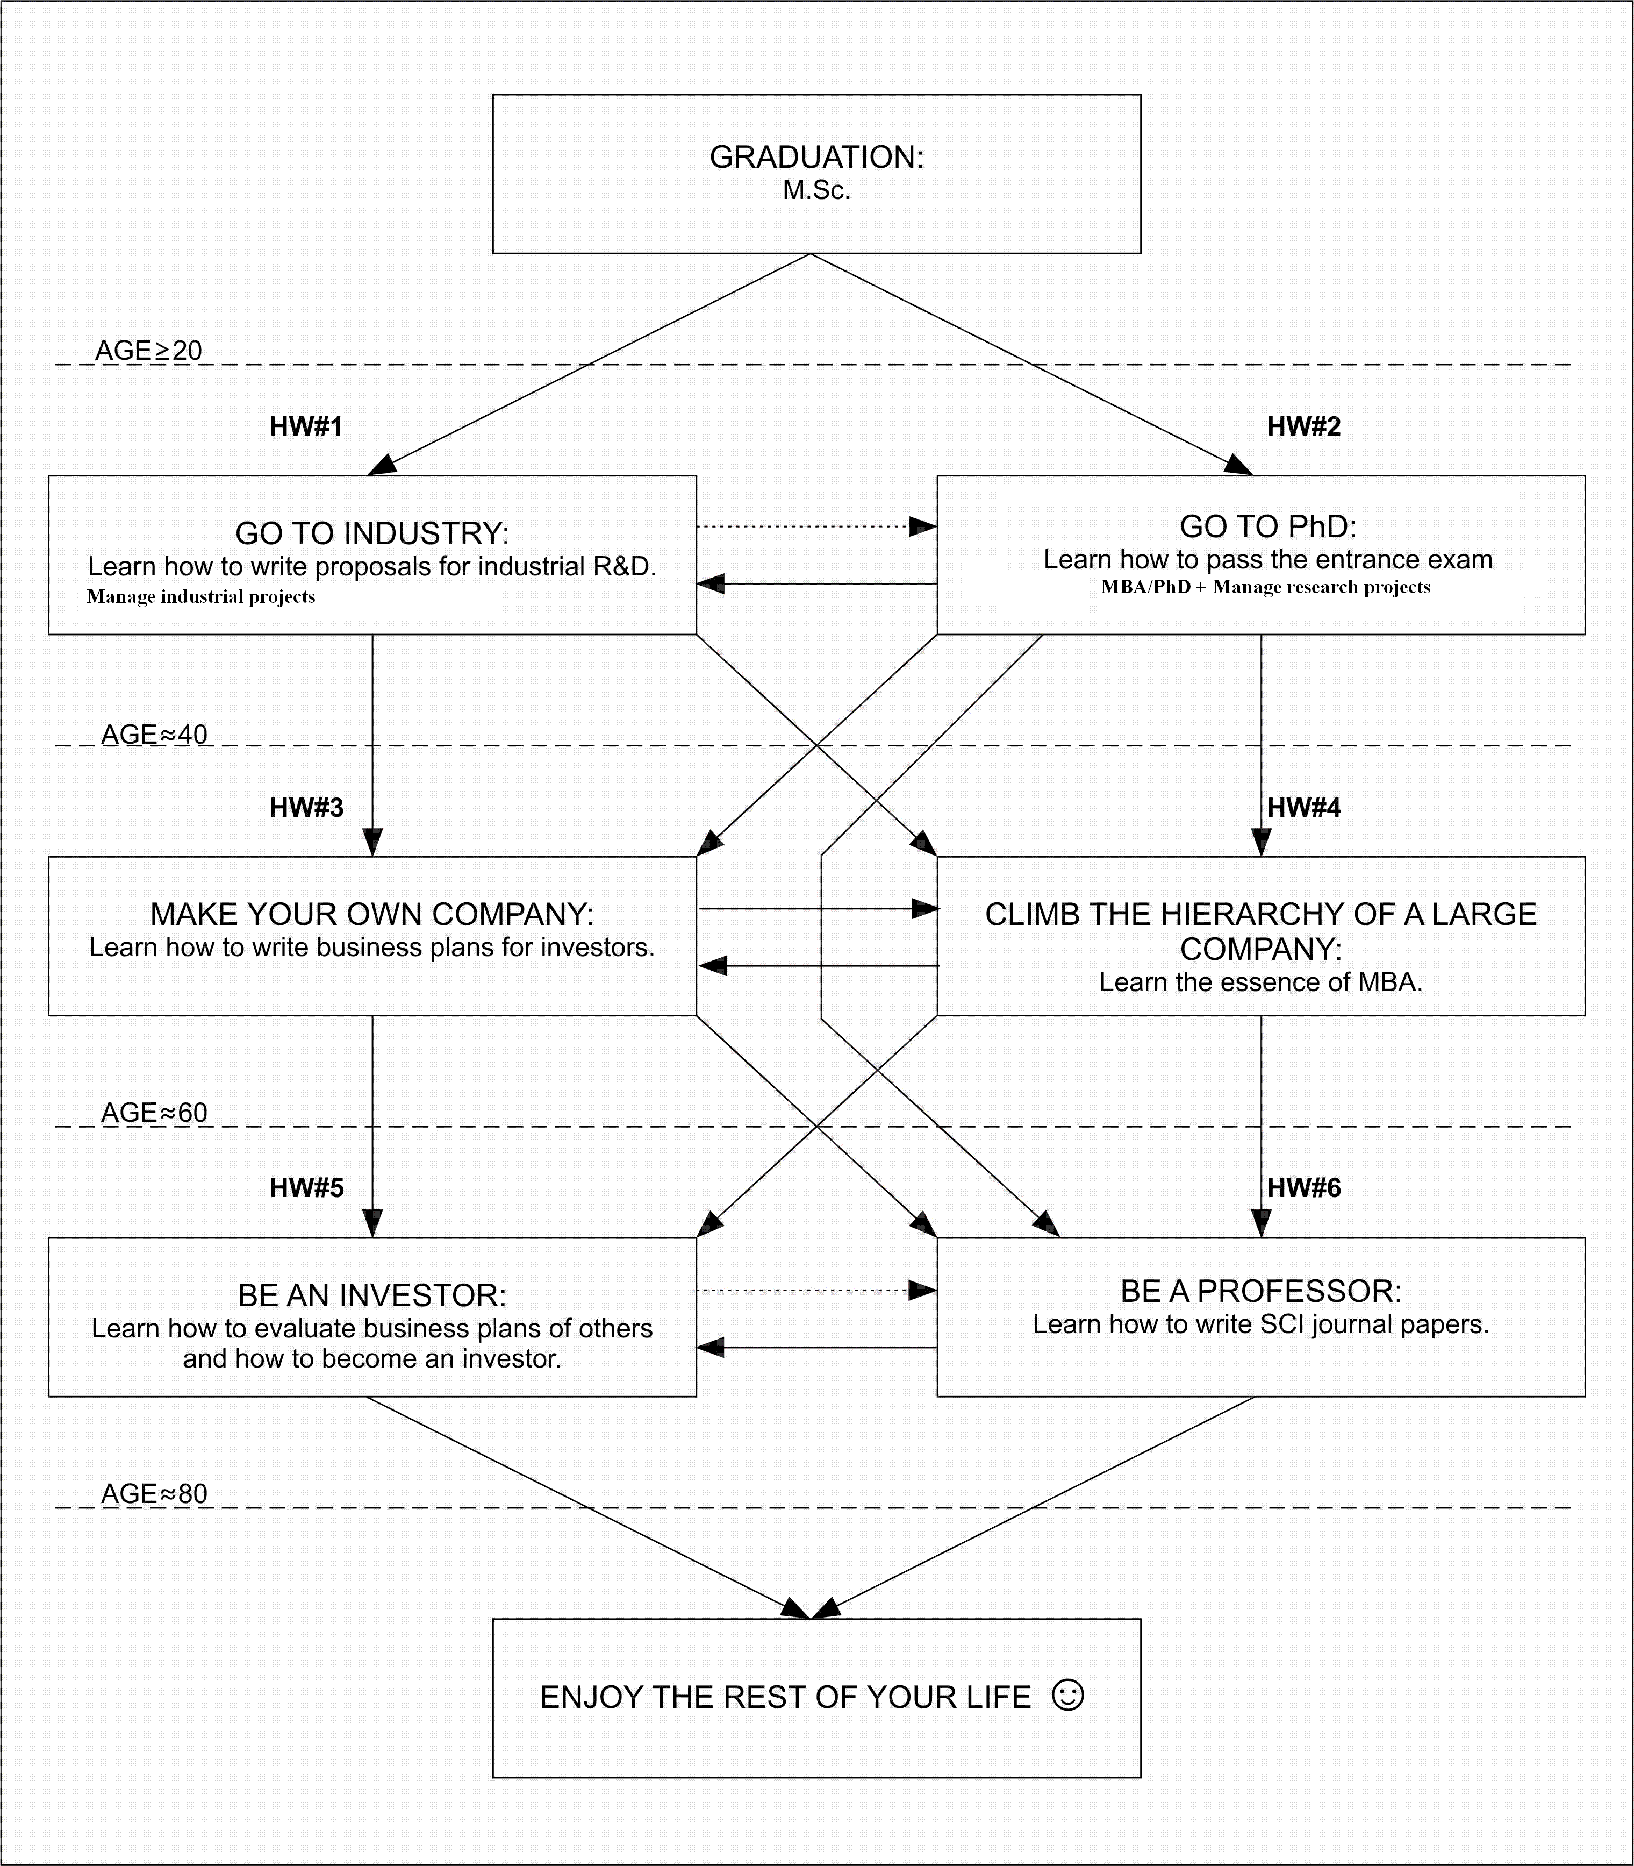
Another View: Lifetime Management

Slide 73
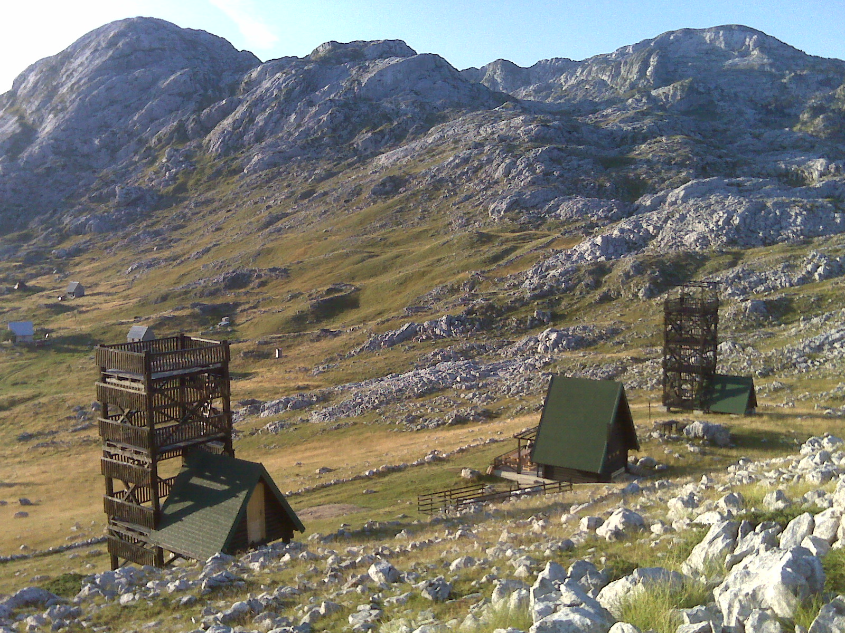
73

Slide 74
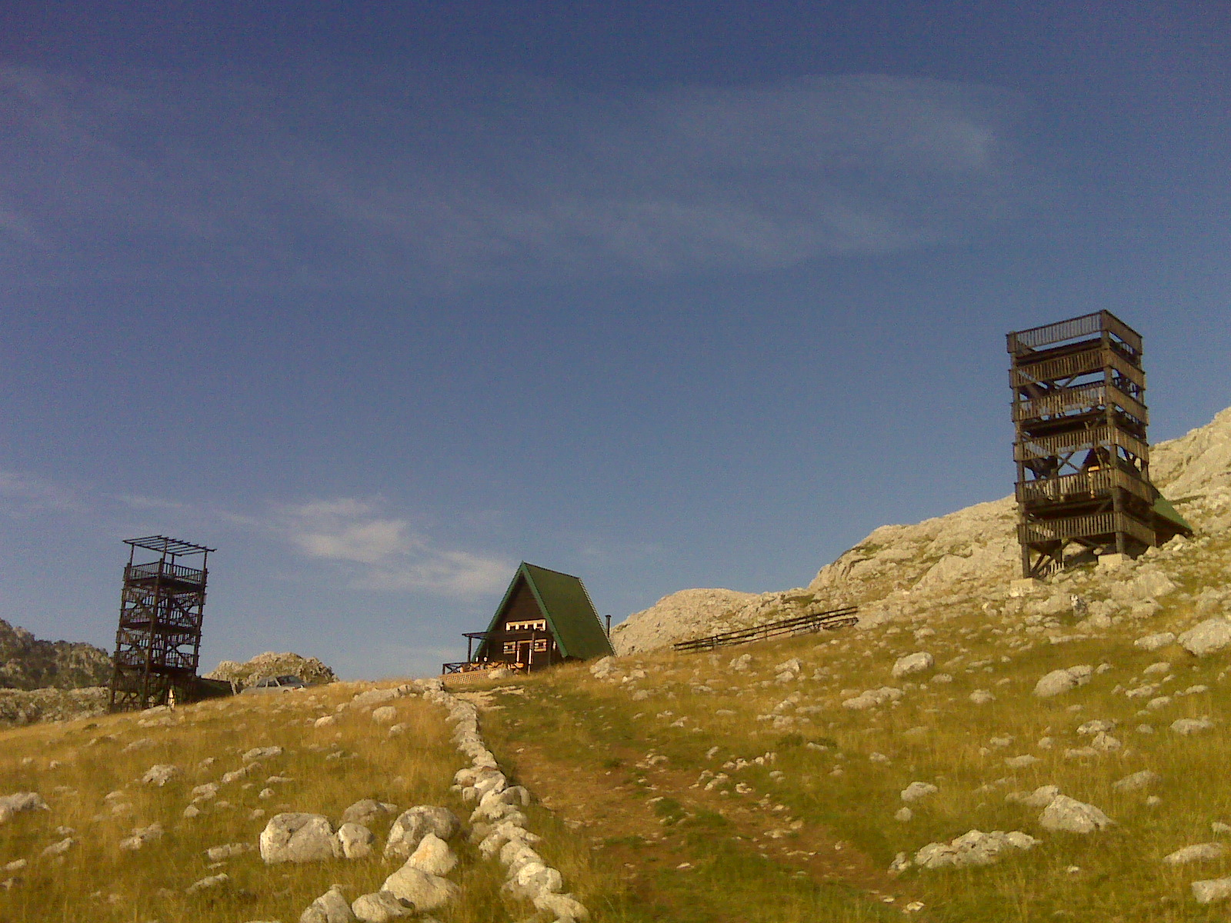
74
© H. Maurer

Slide 75
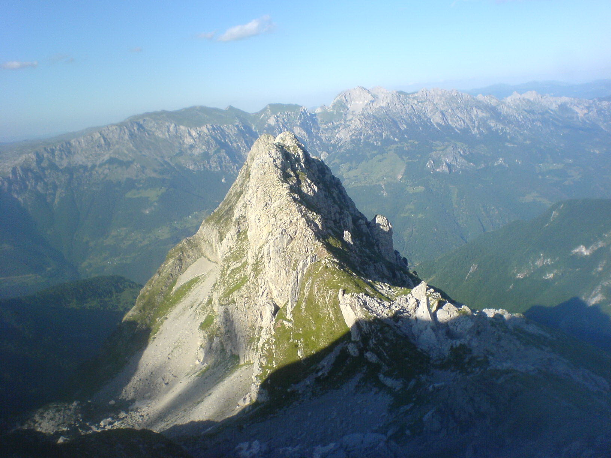
75
© H. Maurer

Slide 76
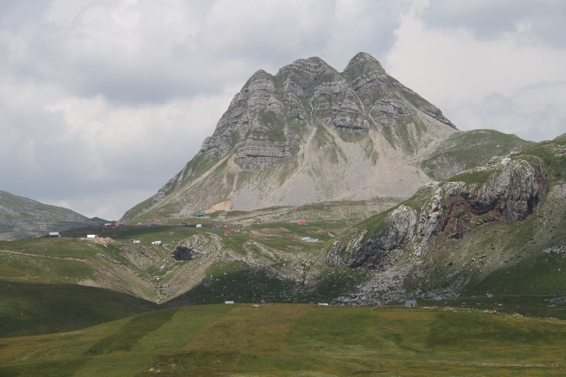
Q&A
vm@etf.rs
76
© H. Maurer

