Slide 1


Mathematical Institute
of the Serbian Academy of Sciences and Arts
Creating a project in ideamap.net - Part 2
Steve Onufrey
iNovum, LLC.

Slide 2
Agenda
1 Addressable Minds Flow – how it’s done
2 Creating a New project in Ideamap.net
New Project
Ratings
Elements
Demographics
Setup

Slide 3



Create Addressable Minds messaging for potential students
IDENTIFY TARGET MARKET
DEVELOP SURVEY QUESTIONS
INTERNET
IdeaMap™
SUY
SURVEY
Potential Students
ANALYZED SURVEY RESULTS → Addressable Minds
MARKET SEGMENTATION
MARKETING PHRASES
TYPING ENGINE
3
Notes:
3

Slide 4
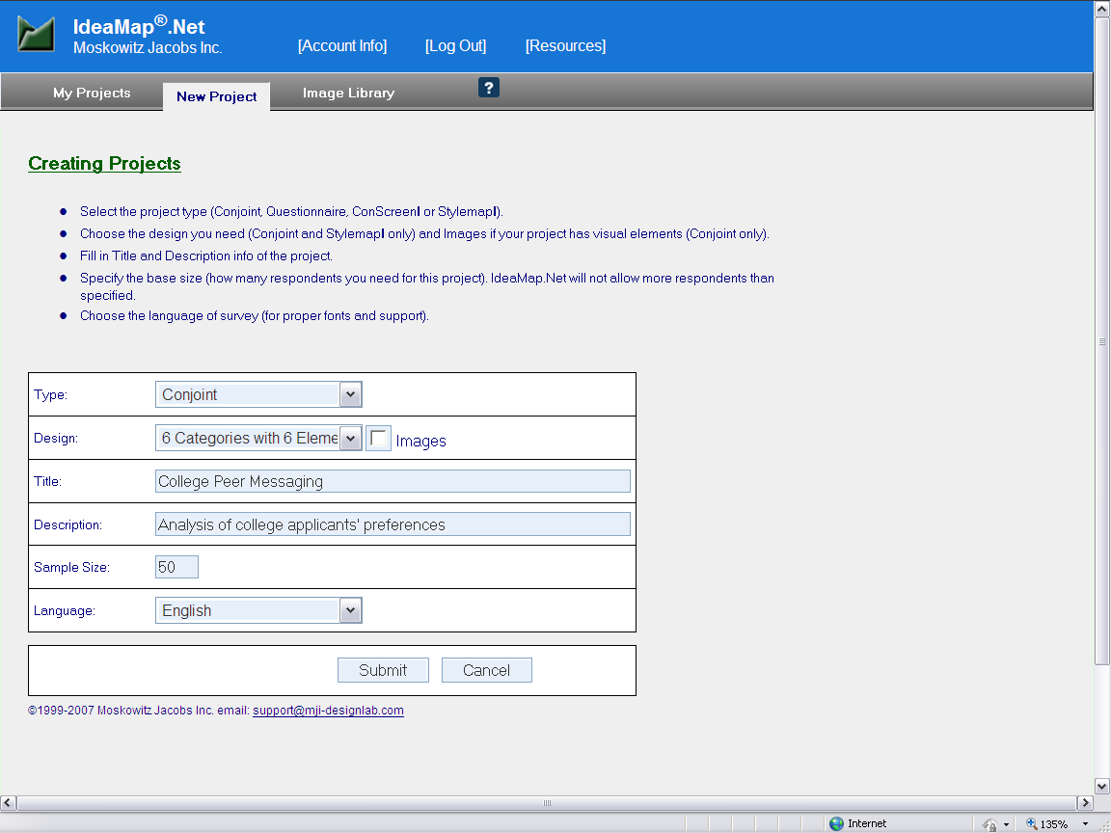
Ideamap.net – Creating a New Project
Help

Slide 5
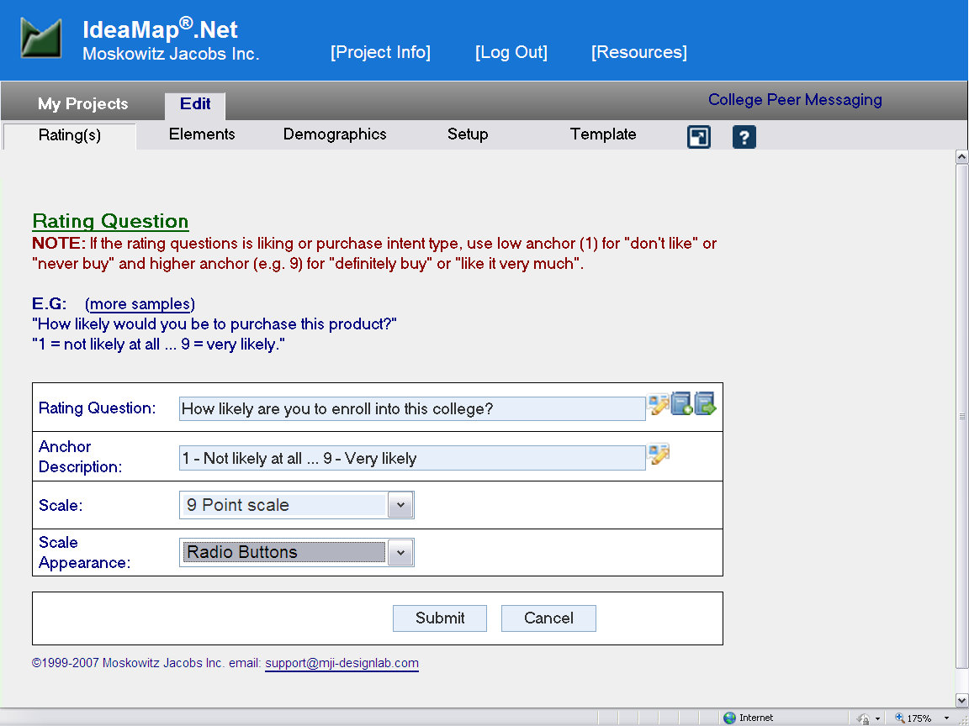
Ideamap.net – Creating Rating Questions

Slide 6
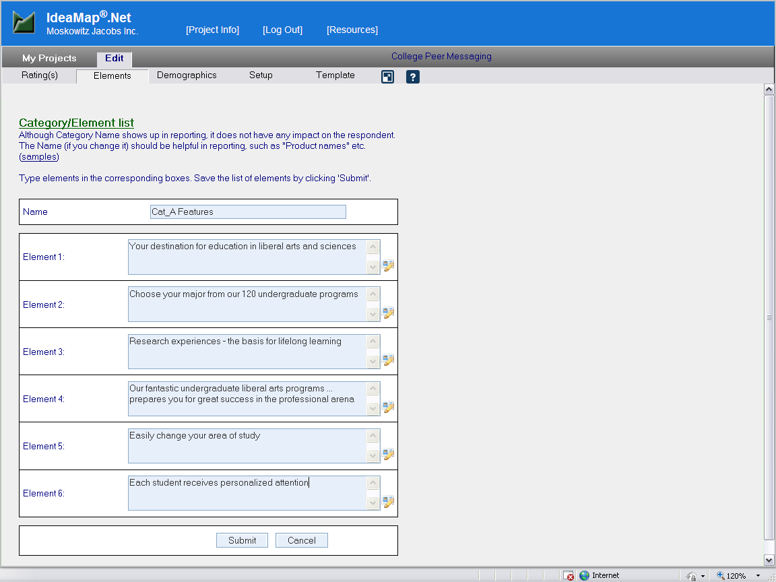
Ideamap.net – Creating Elements

Slide 7
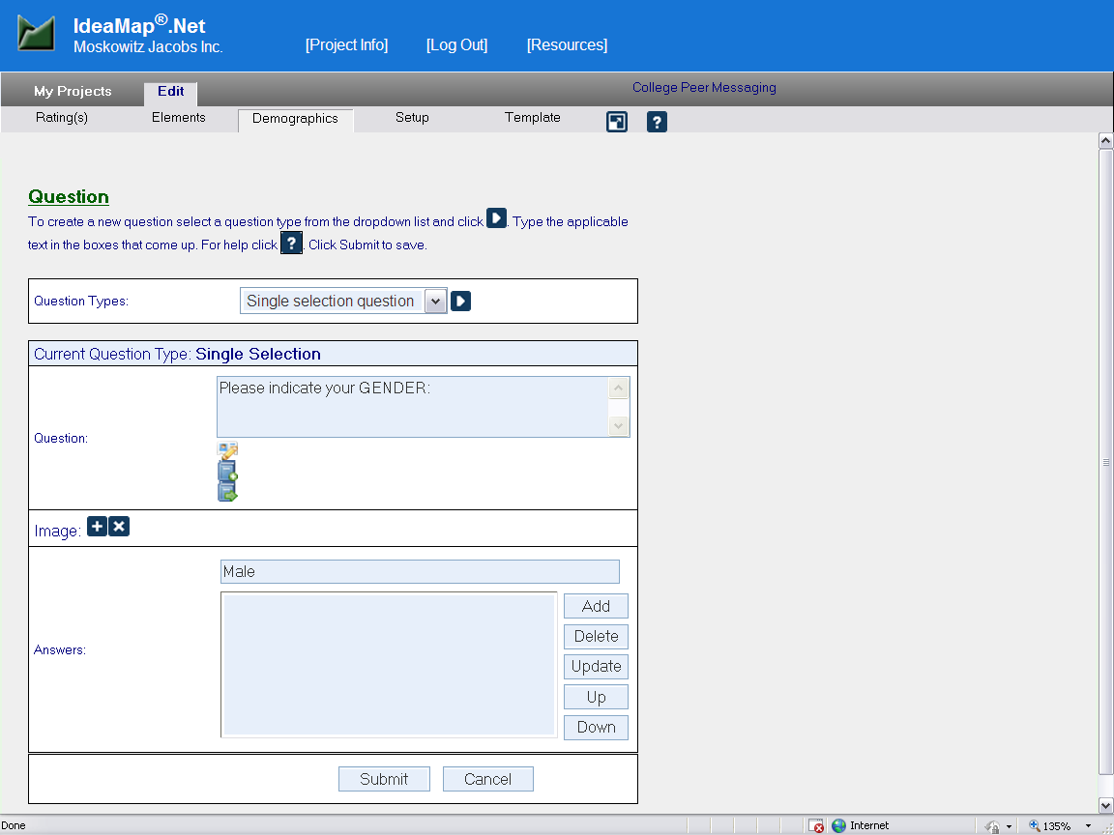
Ideamap.net – Creating Demographic Questions
Question Types:
Single selection
Multiple selection
Open ended

Slide 8
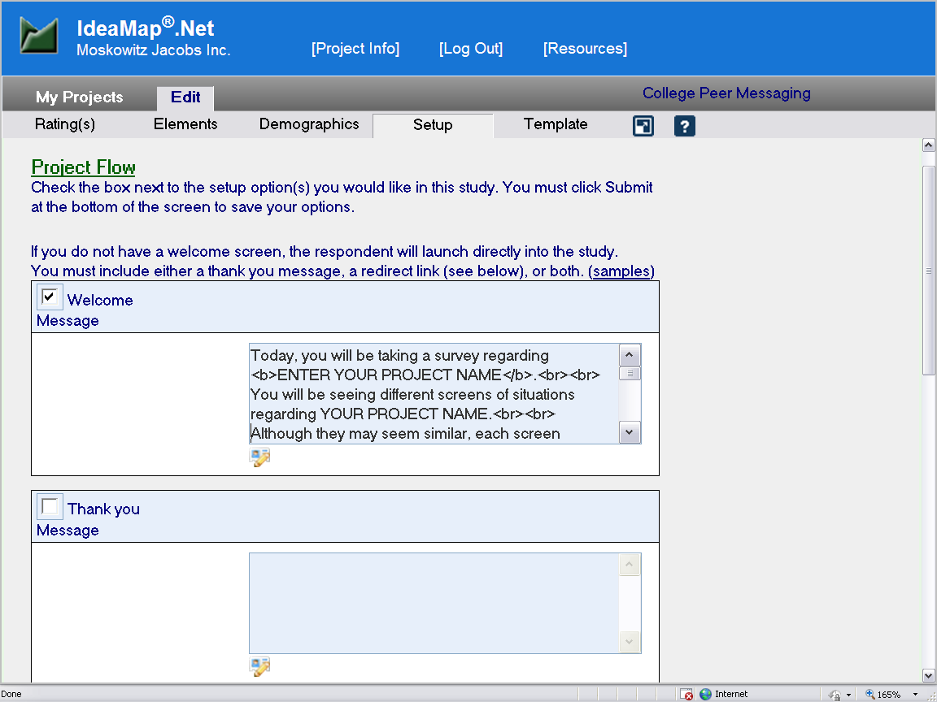
Ideamap.net – Creating Welcome Screen
Project Preview Button

