Slide 1
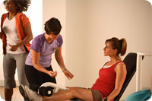

ATTRACTING NEW MEMBERS
By using Addressable Minds™
Developed by:
iNovum

Slide 2
Agenda
The business Vision
Addressable Minds… what is it
Addressable Minds results from the Curves Study
How results are used

Slide 3
Business Issues
To prosper in the present economy Curves Owners must always be on the look out for new ways to accommodate and engage their members
Curves owners need faster access to useful consumer insights in developing marketing messaging and programs, products and services.

Slide 4
Business Vision
The Vision – Increase lasting memberships at Curves
The 2-step Vision
  Step 1: Attract prospects to come in to your club by using optimum message appeal to the general marketplace through
    Web coupons
    Mailing Value Coupon packs
    Web site landing page
    E-mails
    In person
  Step 2: When the prospect comes in, lead the discussion with those Curves features that appeal most to each individual:
    Use a simple approach to tell you EXACTLY what to say to each individual

Slide 5

Dr. Howard Moskowitz.
Addressable Minds Inventor, honored by the scientific community,...
  Is the President of Moskowitz Jacobs Inc. and holds a
  Ph.D. in Experimental Psychology from Harvard
  University.
  Won two of the most prestigious awards in market
  research
  2005 Charles Coolidge Parlin Marketing Research
  Award
  The “Nobel Prize” of Market Research, received only by
  the pioneers of market research.
  Recipients include Arthur Nielsen, George Gallup, Michael Porter, David Ogilvy and Philip Kotler.
  2010 Walston Chubb Award for Innovation across all
  sciences, Sigma Xi, The Scientific Research Society, international Awarded for Mind Genomics: The science underlying the technology discussed in this presentation

Slide 6
About Addressable Minds
Addressable Minds is a scientific, actionable form of “predictive consumer intelligence” accurately defining consumer attitudes and preferences both stated and unstated.
It has been described by Malcolm Gladwell and others as discovering the “DNA of the Consumers Mind”.
This patented science created by Dr. Howard Moskowitz, author of “Selling Blue Elephants” (Wharton Press) and the Wharton Business School has achieved critical acclaim and financial success across:
  product design and development,
  consumer messaging,
  more effective consumer engagement physically and digitally.
6

Slide 7


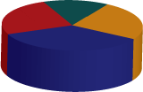

Addressable Minds
Cuts across traditional segmentation & detects hidden preferences
Behavioral Segmentation
- Product Usage
- Brand Loyalty
- Attitudinal
Psychographic Segmentation
- Social Class
- Lifestyle Type
- Personality Type
Addressable Minds
Demographic Segmentation
- Age
- Gender
- Income
Notes:
Traditional Segmentation:
- Identify segments in database by behaviors, psycho-demographics
- Create marketing messages … deliver them…hope they buy
- These segments may seem homogeneous -- but minds are not
These segments have minds that are HETEROGENEOUS
Response-Based, Addressable Mind Segmentation
- Expose customers to message vignettes by Experimental Design
- Identify profoundly different mind-sets that pervade the customer base
- Type a customer into a mind-set using ‘scratch test’ + data mining
- For a person ….RIGHT MESSAGE, RIGHT EXPERIENCE

Slide 8
What can this science of Addressable Minds deliver to curves?

Slide 9
Three Phased Approach to reach practical implementation to deliver business value
Phase I
Create Addressable Mind Segments
Phase II
Develop Use of Addressable Minds
Phase III
Implement Live Use with Customer & Prospect Interactions
The next several charts will describe what we uncovered about Addressable Minds with prospective Curves members in Phase 1

Slide 10


Create Addressable Minds messaging for potential members
IDENTIFY TARGET MARKET
DEVELOP SURVEY QUESTIONS
INTERNET
IdeaMap™
SURVEY
Potential Members
ANALYZED SURVEY RESULTS → Addressable Minds
MARKET SEGMENTATION
MARKETING PHRASES
TYPING ENGINE
Notes:
10

Slide 11
An INITIAL SURVEY was done
A survey to serve as a demonstration of the approach
Sufficient to show the power of the method
Notes:
11

Slide 12
Curves SURVEY
(1 of 2)
Survey run from December 6th 2010 to December 7th, 2010 :
  Population of women of all ages across the US
Gathered key marketing and advertising messaging from Curves website as well as from websites of peer fitness clubs:
  Butterflylife
  Contours express
  Fitnessclubforwomen
  Ladyofamerica
  Shapexpress
  Womensfitnesscenter

Slide 13
Curves SURVEY
(2 of 2)
380 Individuals responded
Assessed two major aspects of messages
  Does it convince a prospect to join Curves?
  How does it make a prospect feel?
Data reveals the mind-sets of respondents across the United States, as well as ‘what works, what doesn’t’

Slide 14
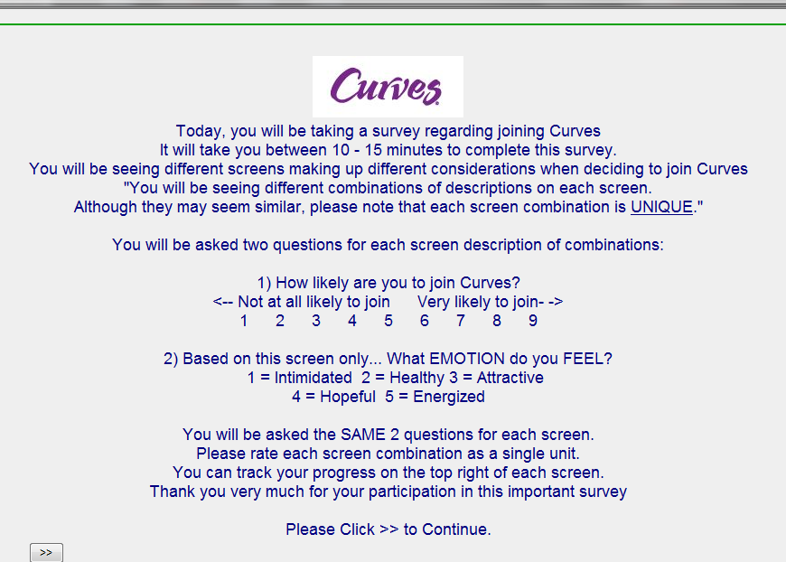
Welcome page

Slide 15
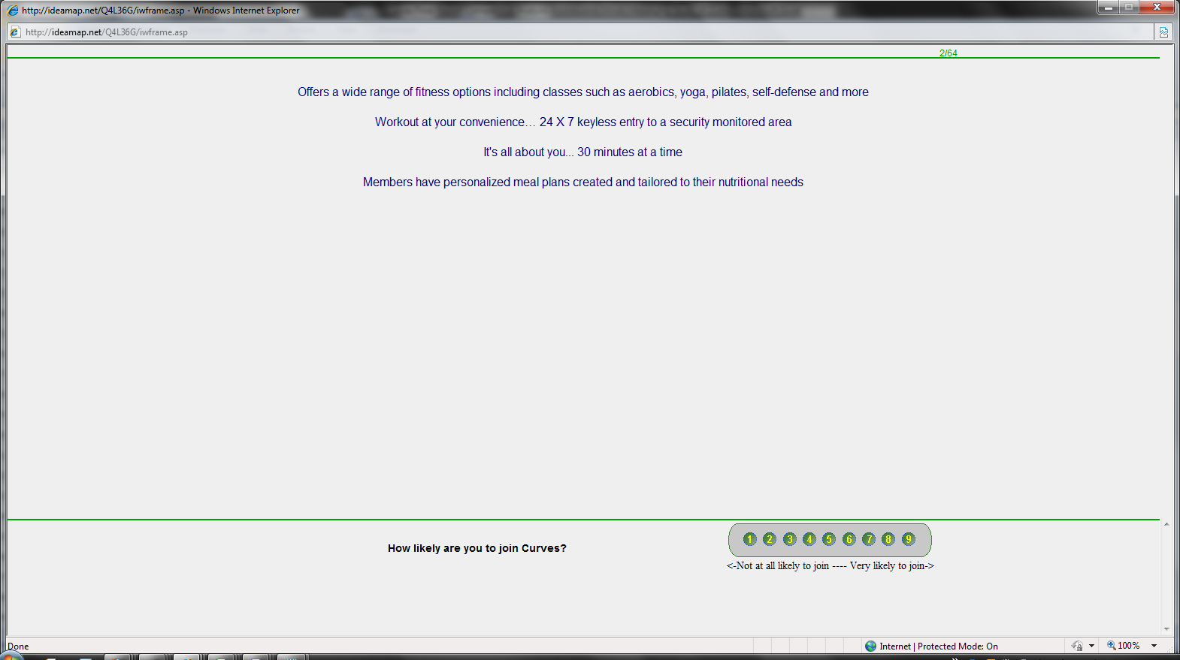
HOW LIKELY ARE YOU TO JOIN CURVES

Slide 16
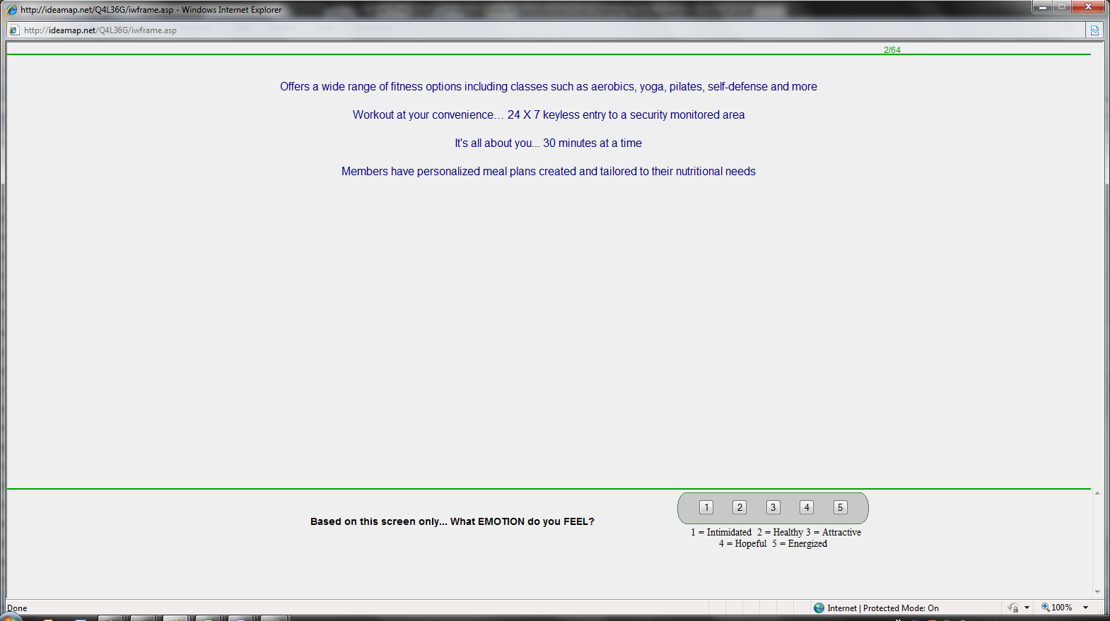
SELECT the EMOTION that you FEEL

Slide 17
Results
What convinces?
What drives feelings?

Slide 18
Total Panel: willing to join a convenient facility with friendly atmosphere after a month-long trial.
Lifestyle lectures a turnoff
Notes:
18

Slide 19
The total panel’s interest is very different from that in each of 3 identified segments
Segment
Segment
Segment
1
2
3
Conditional Formatting : Winners >+5 in green & Losers <-5 in red
Total
Busy
Just as I
am
Result-
Sample
Career
-
Oriented
Base Size
380
102
84
194
Propensity to Join
36
40
47
30
1 Month Free Trial Membership
5
-2
7
7
Workout at your convenience… 24 X 7 keyless entry to a security monitored
area
4
-4
5
8
Comfortable and friendly atmosphere for women of all ages and physical
abilities
4
-4
13
4
We compute your workout data… see progress reports with your muscle
strength, calories burned and how close you are to reaching your goals
3
2
-12
11
Burn up to 500 calories with our 30-minute workout
3
-4
9
5
We give you a full body, highly efficient workout… see how it’s worked for over 4
million women.
3
-2
-6
10
Our fitness Instructors are knowledgeable about nutrition as well, and can
recommend effective diet and supplement choices
3
-3
8
5
We offer a fun and safe place for your children while you work out
0
6
-5
-1
Online meeting spot for our members... additional support when you need it from
members around the world — 24 hours a day, 7 days a week
0
6
-8
0
Our program integrates the traditional components of weight loss, nutrition and
exercise - plus adds psychology, beauty and fashion
0
-1
-14
6
Offering a variety of classes, lectures and training, we will educate and motivate
you to exercise and maintain a healthy lifestyle
-1
-3
2
-1
1 Week Free Trial Membership for you and a friend
-1
-4
-5
3
Tune into 20-minute seminars and lectures... quickly learn simple steps to
achieving a balanced life
-2
5
-6
-3
It's not your mother's gym anymore
-3
19
10
1
-11

Slide 20

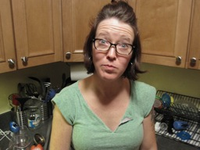
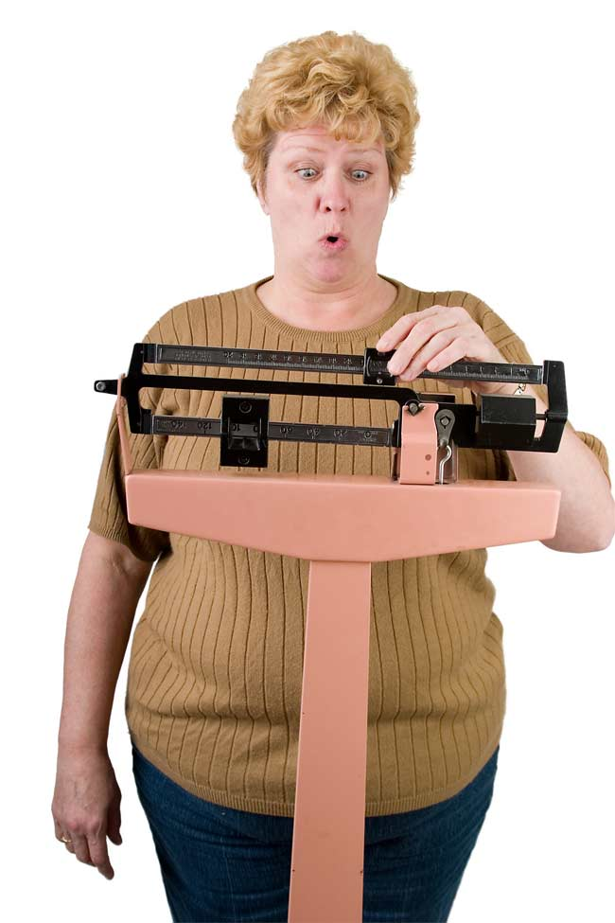
Different women – different approach
Just as I am
22%
Busy Career
27%
Results-oriented
51%
  Messaging for one isn’t necessary going to
  appeal to the other…

Slide 21
Busy career women (seg1) –interested in approach that fits their busy lifestyle. Not interested in programs beyond basic workouts.
Segment
Segment
Segment
1
2
3
Conditional Formatting : Winners >+5 in green & Losers <-5 in red
Total
Busy
Just as I
Am
Result-
Sample
Career
Oriented
Base Size
380
102
84
194
Propensity to Join
36
40
47
30
10,000 locations around the world for the busy career woman
3
10
-4
2
It's not your mother's gym anymore
-3
10
1
-11
A weight loss facility exactly for you
2
8
1
-1
All the support you need to get the results you want
3
7
4
0
We offer a fun and safe place for your children while you work out
0
6
-5
-1
The 30-minute fitness center... the smart workout
0
6
-11
2
State-of-the-art personalized coaching system gives you moment-by-moment
feedback...find your motivation and keep it
3
6
3
2
Online meeting spot for our members... additional support when you need it from
members around the world — 24 hours a day, 7 days a week
0
6
-8
0
Tune into 20-minute seminars and lectures... quickly learn simple steps to
achieving a balanced life
-2
5
-6
-3
Complete workout experience in a clean environment with no complicated
machines
3
4
-4
5
It's all about you... 30 minutes at a time
2
4
-1
2
Workout at your convenience… 24 X 7 keyless entry to a security monitored
area
4
-4
5
8
Comfortable and friendly atmosphere for women of all ages and physical
abilities
4
-4
13
4
Offers a wide range of fitness options including classes such as aerobics, yoga,
pilates, self-defense and more
2
-6
5
5
A gym that combines strength training and cardio… a workout that works your
entire body
2
-8
1
8

Slide 22
Just as I am women (seg2) – interested in nurturing personalized approach. Intimidated by competitive environment & traditional workouts.
Segment
Segment
Segment
1
2
3
Conditional Formatting : Winners >+5 in green & Losers <-5 in red
Total
Busy
Just As I
Am
Result-
Sample
Career
Oriented
Women
Women
Base Size
380
102
84
194
Propensity to Join
36
40
47
30
Comfortable and friendly atmosphere for women of all ages and physical
abilities
4
-4
13
4
Supervised circuit workouts... our instructors will make sure you have a proper
form so your time on the circuit is effective
1
-4
10
-1
Burn up to 500 calories with our 30-minute workout
3
-4
9
5
Our fitness Instructors are knowledgeable about nutrition as well, and can
recommend effective diet and supplement choices
3
-3
8
5
1 Month Free Trial Membership
5
-2
7
7
Members have personalized meal plans created and tailored to their nutritional
needs
3
0
6
3
Our active online community… find and share healthy recipes with other
members around the world
3
3
6
1
Tune into 20-minute seminars and lectures... quickly learn simple steps to
achieving a balanced life
-2
5
-6
-3
Online meeting spot for our members... additional support when you need it from
members around the world — 24 hours a day, 7 days a week
0
6
-8
0
Look Great, Loose Weight and get the results that you want with easy to use
equipment
3
-2
-9
10
Gives you results that last
1
-1
-11
7
The 30-minute fitness center... the smart workout
0
6
-11
2
We compute your workout data… see progress reports with your muscle
strength, calories burned and how close you are to reaching your goals
3
2
-12
11
Our program integrates the traditional components of weight loss, nutrition and
exercise - plus adds psychology, beauty and fashion
0
-1
-14
6

Slide 23
Result-oriented women (seg3) – interested in customized approach to reach their fitness goals. Indifferent to generalized additional info.
Segment
Segment
Segment
1
2
3
Conditional Formatting : Winners >+5 in green & Losers <-5 in red
Total
Busy
Just As I
AM
Result-
Sample
Career
Oriented
Women
Base Size
380
102
84
194
Propensity to Join
36
40
47
30
We compute your workout data… see progress reports with your muscle
strength, calories burned and how close you are to reaching your goals
3
2
-12
11
We give you a full body, highly efficient workout… see how it’s worked for over 4
million women.
3
-2
-6
10
Look Great, Loose Weight and get the results that you want with easy to use
equipment
3
-2
-9
10
A gym that combines strength training and cardio… a workout that works your
entire body
2
-8
1
8
Workout at your convenience… 24 X 7 keyless entry to a security monitored
area
4
-4
5
8
1 Month Free Trial Membership
5
-2
7
7
Gives you results that last
1
-1
-11
7
Our instructors can custom tailor an exercise routine to address any physical
limitations you may have, or to target specific "problem areas"
1
3
3
0
Offering a variety of classes, lectures and training, we will educate and motivate
you to exercise and maintain a healthy lifestyle
-1
-3
2
-1
A weight loss facility exactly for you
2
8
1
-1
We offer a fun and safe place for your children while you work out
0
6
-5
-1
Supervised circuit workouts... our instructors will make sure you have a proper
form so your time on the circuit is effective
1
-4
10
-1
Tune into 20-minute seminars and lectures... quickly learn simple steps to
achieving a balanced life
-2
5
-6
-3
It's not your mother's gym anymore
-3
10
1
-11

Slide 24
The panel’s strongest emotion is hopeful

Slide 25
Busy career (seg1) –hopeful about approach that fits their busy lifestyle. Not interested in programs beyond basic workouts.

Slide 26
Just as I am (seg2) – hopeful about nurturing personalized approach. Intimidated by competitive environment & traditional workouts.

Slide 27
Results oriented (seg3) – favor customized approach to reach their fitness goals. Indifferent to generalized additional info.

Slide 28
Using addressable minds at Curves
You meet a potential fitness club member.
How do you communicate the benefits of joining Curves?
How to uncover mind-set to correctly classify a person who you’ve never met before?
Knowing the specifics guides you…what to say and do

Slide 29
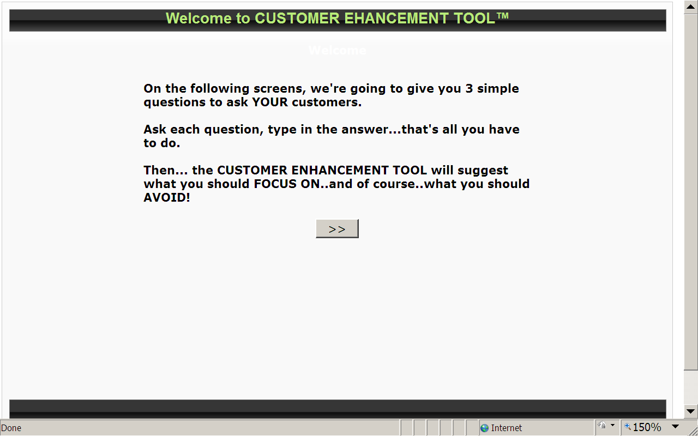
Introducing customer enhancement tool

Slide 30
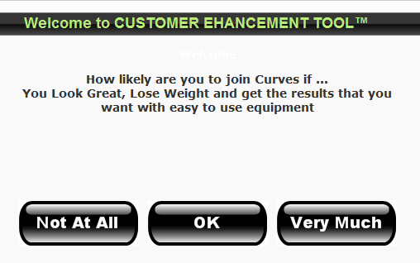
Introducing customer enhancement tool

Slide 31
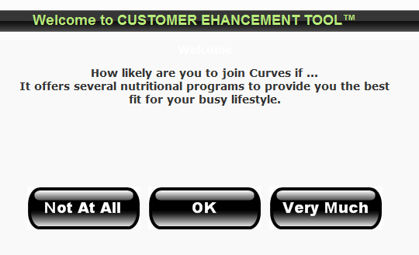
Introducing customer enhancement tool

Slide 32
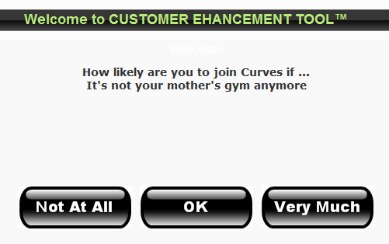
Introducing customer enhancement tool

Slide 33
sales approach to busy working women

Slide 34
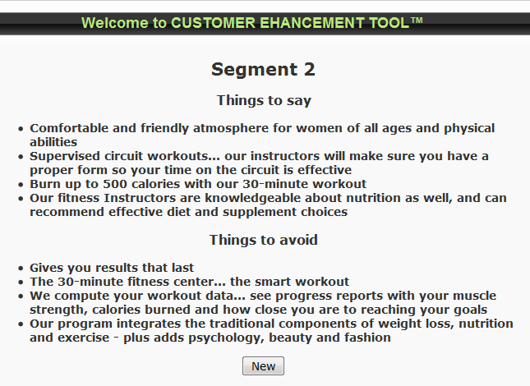
sales approach to just as I am women

Slide 35
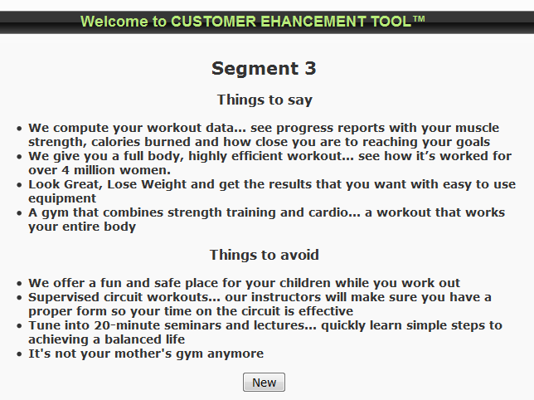
sales approach to results oriented women

Slide 36
On line example
Typing Tool Link

Slide 37


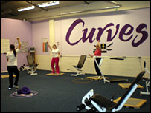
USING ADDRESSABLE MINDS
1- Identify prospect → 2-Come to Curves→ 3- Close with the right message
Staff uses the right messages with that prospect to close the sale
1 – Print customized coupon at home
Prospect at Home is identified by segment membership
3 - Right Messages to close the sale
Addressable Minds
Sales Process
Prospect comes to Curves – presents customized coupon with segment identified on coupon
2 – Come to Curves

Slide 38
Three Phased Approach to reach practical implementation to deliver business value
Phase I
Create Addressable Mind Segments
Phase II
Develop Use of Addressable Minds
Phase III
Implement Live Use with Customer & Prospect Interactions
Increase revenue by adding loyal membership

Slide 39
Conclusions
The use of Addressable Minds by Curves identifies three distinct segments with each segment having different hot buttons
Curves owners can adapt the use of this technique into their business to increase membership & improve retention
We should look at using the first study results
Additional work needs to done to do a complete Curves implementation

