Slide 1



Mind Genomics®
Scalable, Actionable Insight into
Customer Preferences
Mathematical Institute
of the Serbian Academy of Sciences and Arts
Presented By:
Steve Onufrey
Chief Implementation Officer
iNovum LLC

Slide 2
Introduction to the Week
Monday – Overview
  The Science
  The Process of running the study
  Examples
  The Institute for Competitive Excellence - Academia
Tuesday through Thursday – a detailed explanation
  Tuesday: Setting up the Survey
  Wednesday: Interpreting the results
  Thursday: Applying the results

Slide 3
What we will cover today
The Mind Genomics difference
  The Process
  Deliverables
  It is Actionable
Case Studies
  Education – How to drive application, enrollment, happier students
  Healthcare - St. Mary’s Hospital, & reducing < 30 day readmissions
The Institute for Competitive Excellence
  Education
Research
Consulting

Slide 4
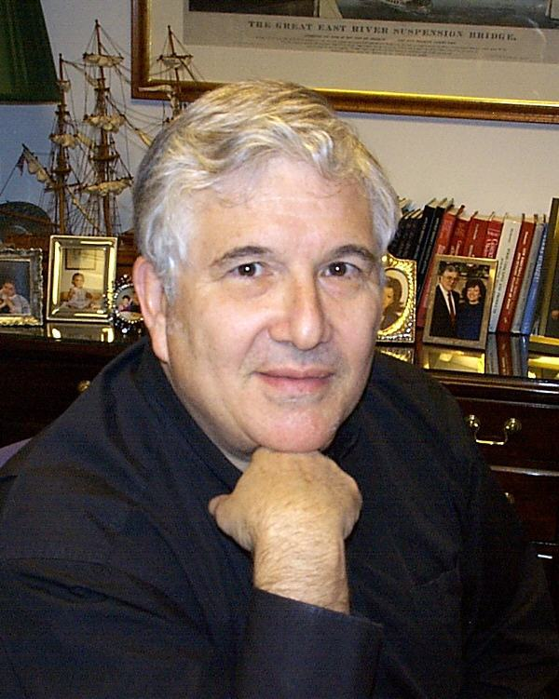
Dr. Howard Moskowitz,
an inventor honored by the scientific community.
  President of Moskowitz Jacobs Inc.
  Ph.D. in Experimental Psychology, Harvard University
  Chairman, iNovum
  Winner of three prestigious awards:
    2012 Edison Award, Bronze, for the development & commercialization of the integrative science, Mind Genomics
    2010 Walston Chubb Award for Innovation, Sigma Xi, for the creation of Mind Genomics. The award is to honor and promote creativity among scientists and engineers.
    2005 Charles Coolidge Parlin Marketing Research Award. The “Nobel Prize” of market research, received only by the pioneers of market research. Recipients include Arthur Nielsen, George Gallup, Michael Porter, Peter Drucker, David Ogilvy and Philip Kotler.
Notes:
Walston Chubb Award recognizes the most significant and impactful scientific investigation across all scientific disciplines (mathematic, biology, chemistry, physics, economics, medicine, psychology, etc., etc.,.) having the most significant impact on mankind. A very prestigious and enviable award.
Charles Coolidge Parlin Award: Please take a moment to note the prominence and brilliance of previous recipients…go to next slide…

Slide 5

Who’s using it?
© 2011 iNovum
Notes:
This is a proven methodology…Campbell’s with Prego (over 8 years added $500M to their bottom line) /
Vlasic Pickles (differentiating product line) /
HSBC + MasterCard to develop a highly successful card in Hong Kong
Now we’re moving this successful approach into the [service] sector

Slide 6

Do we really know who our customer is?
Sex: Male
Age: 50+
Height: 5’10.5”
Nationality: British
Family Status: Married
Annual Income: $10M+
Hobbies: Music, Art, Philanthropy

Slide 7




ViewPoint Messaging
Cuts across traditional segmentation & detects hidden preferences
Behavioral Segmentation
- Product Usage
- Brand Loyalty
- Attitudinal
ViewPoint
Messaging
Psychographic Segmentation
- Social Class
- Lifestyle Type
- Personality Type
Demographic Segmentation
- Age
- Gender
- Income
Notes:
Traditional Segmentation:
- Identify segments in database by behaviors, psycho-demographics
- Create marketing messages … deliver them…hope they buy
- These segments may seem homogeneous -- but minds are not
These segments have minds that are HETEROGENEOUS
Response-Based, Addressable Mind Segmentation
- Expose customers to message vignettes by Experimental Design
- Identify profoundly different mind-sets that pervade the customer base
- Type a customer into a mind-set using ‘scratch test’ + data mining
- For a person ….RIGHT MESSAGE, RIGHT EXPERIENCE

Slide 8
Value Delivered by Science + Implementation
Phase I
Create ViewPoint Mind Segments
With Mind Genomics
Phase II
Develop Use of ViewPoint Messaging
Phase III
Implement Live Use with Customer & Prospect Interactions

Slide 9


Create Addressable Minds messaging for potential students
IDENTIFY TARGET MARKET
DEVELOP SURVEY QUESTIONS
INTERNET
IdeaMap™
SUY
SURVEY
Potential Students
ANALYZED SURVEY RESULTS → ViewPoint Mind Segments
MARKET SEGMENTATION
MARKETING PHRASES
ViewPoint IDENTIFIER
9
Notes:
9

Slide 10
Addressable Minds’ underlying science
IDENTIFY TARGET MARKET
DEVELOP SURVEY QUESTIONS
Conjoint analysis
INTERNET
IdeaMap™
SUY
SURVEY
Experimental Design – Stimulus/Response
Potential Students
ANALYZED SURVEY RESULTS → ViewPoint Mind Segments
Ordinary Least Squares Regression
Cluster Analysis
Discriminant Function Analysis
10
Notes:
10

Slide 11
QUEENS COLLEGE ADMISSIONS SURVEY
  A survey was completed by potential students who checked out QC offerings and left their e-mail addresses.
    The survey was launched on Monday, April 25th and closed on Tuesday, April 26th 2011.
  Tested existing and potential Queens College messages created in conjunction with the following departments:
      Communications
      Student Life
      Enrollment
      Academics
      FYI
      Study Abroad
      Marketing Departments
11

Slide 12
QUEENS COLLEGE ADMISSIONS SURVEY
310 Individuals responded – Potential students
Assess two major aspects of messages
  Does it convince a prospect to attend?
  How does it make the prospect feel?
Data reveals the mind-sets of respondents who already were interested in applying to QC, as well as ‘what works, what doesn’t’
12

Slide 13
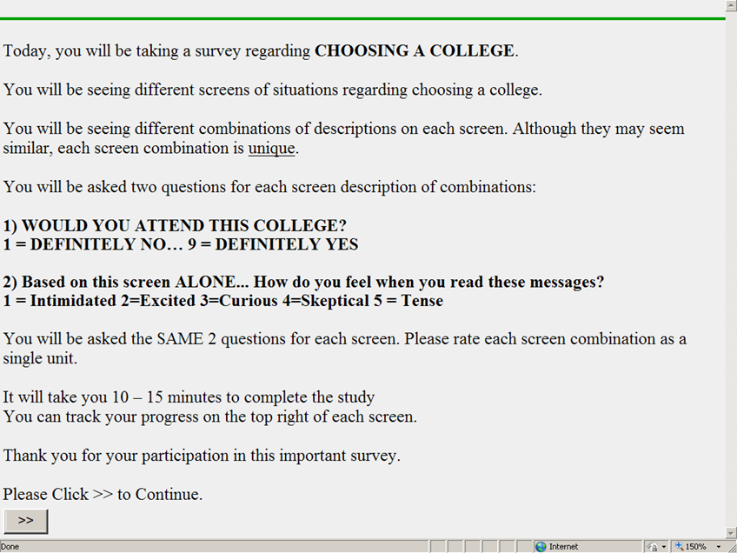
The Study begins with an orientation screen
13

Slide 14
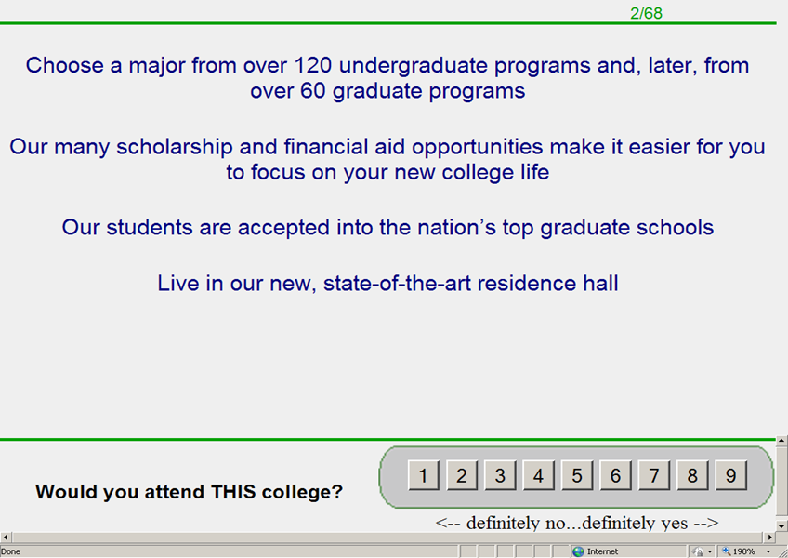
Each respondent evaluates 48 unique combinations of elements
First on overall interest
14

Slide 15
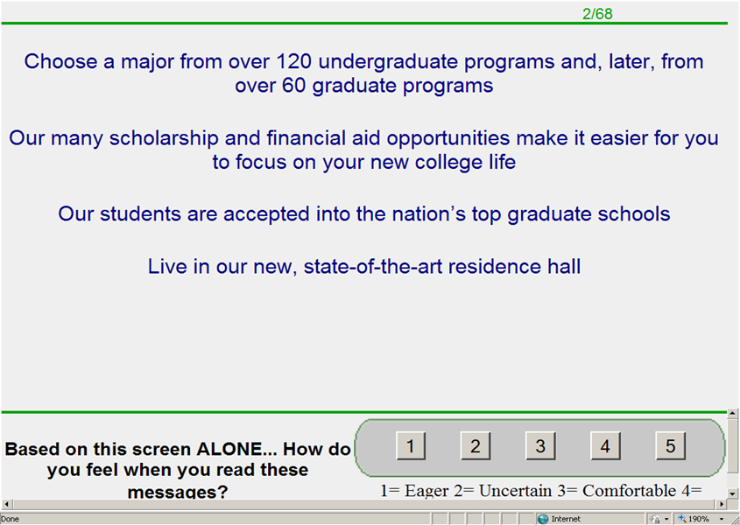
Then selects a single emotion
15
Notes:
15

Slide 16
What convinces?
What drives feelings?
RESULTS

Slide 17
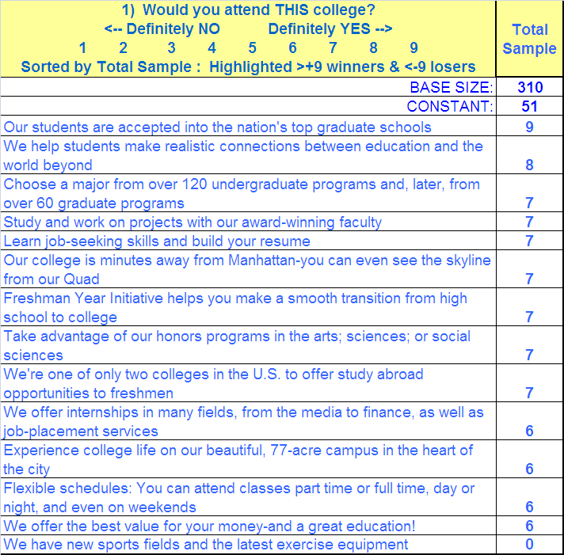
Survey was performed and showed as a whole respondents are interested in school prestige & career opportunities. Not concerned with athletic facilities.
17
Notes:
17

Slide 18
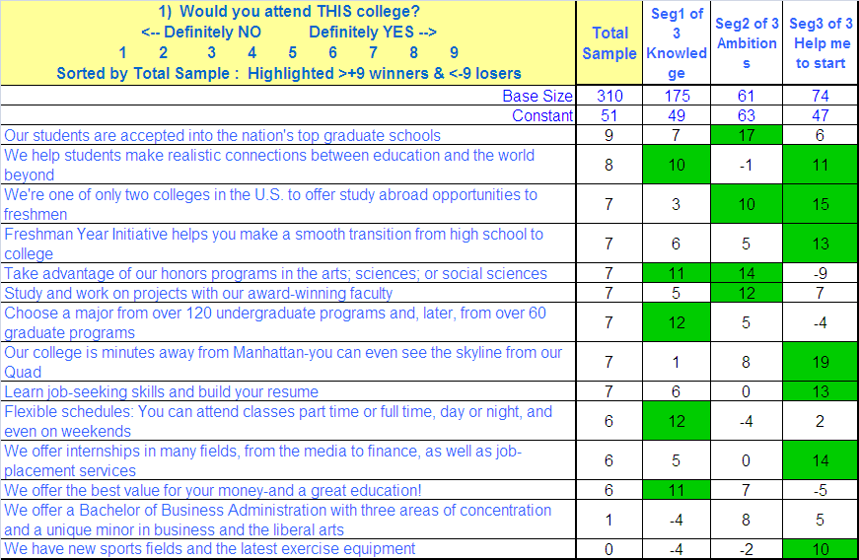
The Total Panel’s Interest is Different From That in Each of Three Identified Segments

Slide 19



Different Prospective Students – Different Approach
Opportunistic Knowledge Seekers
56%
Mentor Me
24%
Motivated Go Getters
20%
19
Notes:
19

Slide 20
Opportunistic Knowledge Seekers
(Seg1) – Interested in variety of academic programs & flexible schedules. Not concerned with athletic amenities on campus.

Slide 21

Opportunistic Knowledge Seekers –
Getting the most out of College… (Seg 1)
Turn-ons:
Interested in variety of academic programs
Prefer flexible schedules
Think about future career
Appreciate the value of reasonably priced quality education
Turn-off:
Not concerned with athletic
facilities
Campus feel

Slide 22
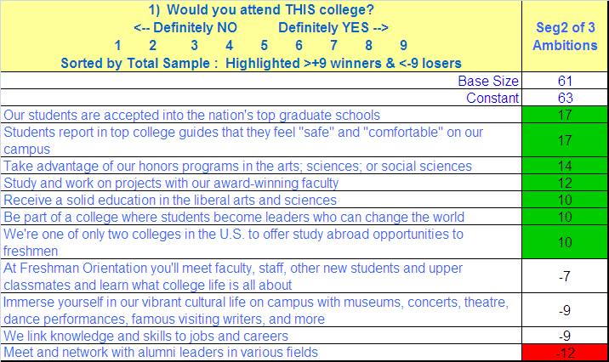
Motivated Go Getters (Seg2) – Interested in continuing education at top grad schools & award-winning faculty. Not yet concerned with career & alumni connections.

Slide 23

Motivated Go Getters (Seg 2)
Turn-ons:
Interested in continuing education on graduate level
Want to work on projects with best faculty
Care about feeling safe on campus
Would like to become leaders who change the world
Turn-offs:
Meeting alumni
Linking education & career

Slide 24
Mentor Me(Seg3) – Interested in Freshmen programs to adjust to college life. Not concerned with honors programs & other academic offerings yet.

Slide 25

Mentor Me –
Help me start, and see me through… (Seg 3)
Turn-ons:
Interested in proximity to Manhattan
Freshman Study Abroad program
Freshman Year Initiative
Internships & career-placement
Learning job-seeking skills
Enjoy campus life
Turn-offs:
Honors programs in arts & sciences
Education in liberal arts & sciences

Slide 26

Emotions: Comfortable is the strongest, followed by eager

Slide 27

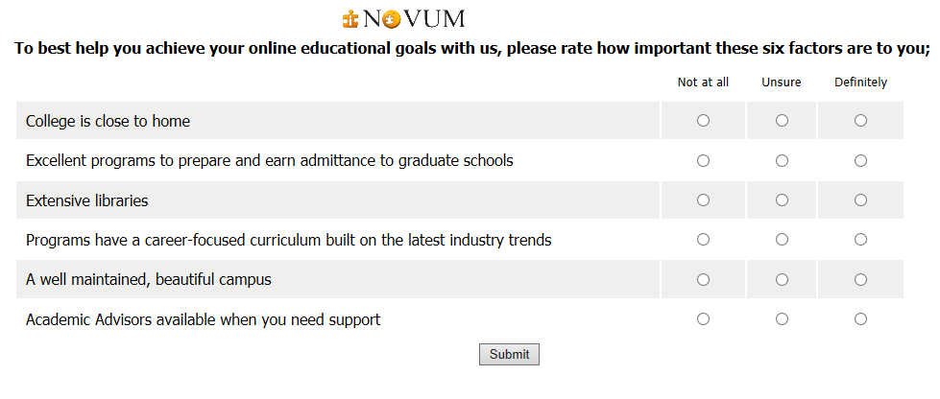
The ViewPoint Analyzer
Admissions Reps ask a few qualifying questions at the beginning of the sales conversation with the prospective student…

Slide 28

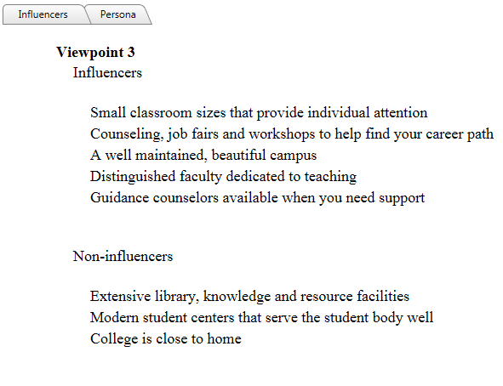
Admissions Reps then highlight those University attributes that are most appealing to the prospect’s ViewPoint

Slide 29
Phase II transitions communications use of ViewPoint Messaging as the existing budget determines
Phase I
Create ViewPoint Mind Segments
Phase II
Develop Use of ViewPoint Messaging
Phase III
Implement Live Use with Customer & Prospect Interactions
DEVELOP:
- Website
- Marketing
- Advertizing
- Applicants on telephone
- Brochures
Copywriter use ViewPoint Messaging for the story line
- Create marketing collateral
Establish & measure benefits
Test vis-à-vis control area results

Slide 30
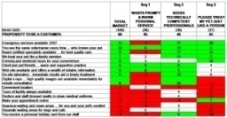
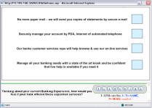
Specific Communication Uses of
ViewPoint Messaging
Reach Marketplace as a whole with total market segment messages
  Brochures
  Advertising (Broadcast – Print)
  Landing Page on Web Site
  Social Media
Blended ViewPoint and Data Mining Contacts by segment
  Direct Mail of Existing Prospective Students
  Direct Mail of prospects through purchased databases
  Call Center
One on One communications with customer or prospect typed with personal intervention
  In person at sales location
  On the internet at the web page
  Targeted Mail or e-mail to individuals
  Call Center

Slide 31
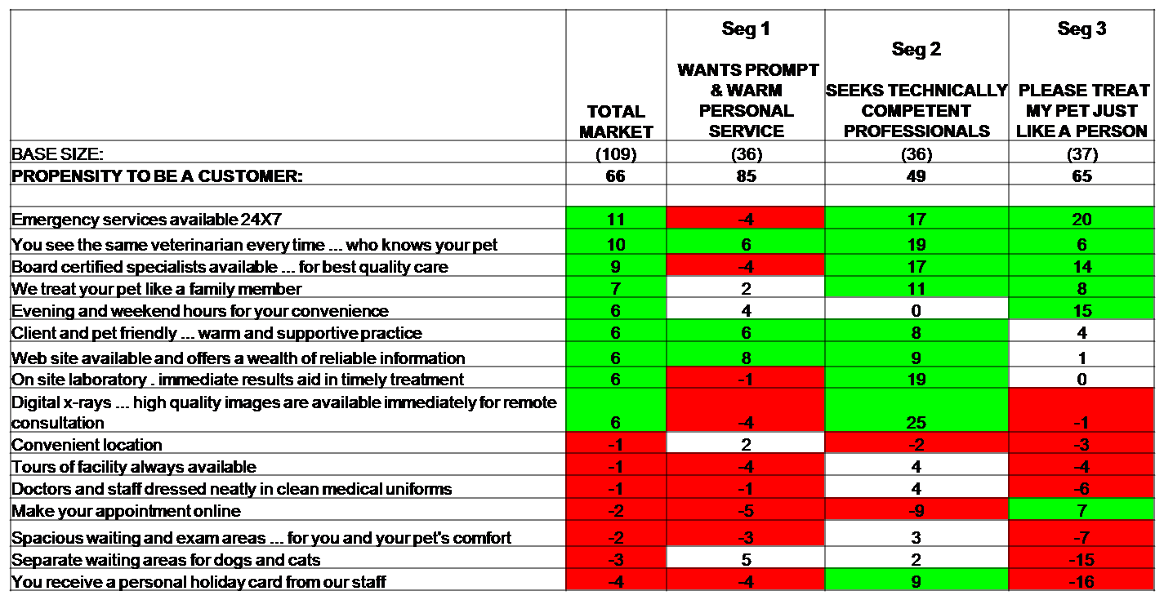
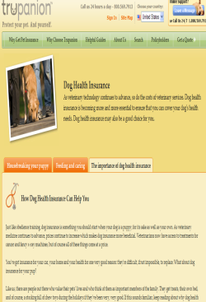
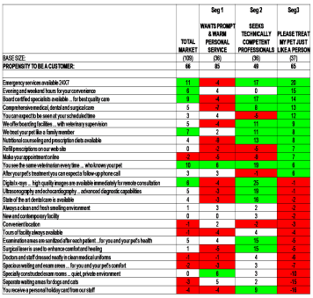
Develop Brochure Messaging based on
ViewPoints
Brochures developed
  1 for non-segment specific distribution based on total
  (Optional) 1 for each of the 3 specific segments

Slide 32
Website ViewPoint Messaging Flow
Queens College Landing Page
With
Typing Tool
Segment 1 First Screen
Segment 3 First Screen
Segment 2 First Screen

Slide 33
Next Steps – Messaging Focus
Assess Media use of existing messaging and modify with highest scoring messages for consistency at each communication point
  Broadcast : radio, TV
  Advertizing: Trains, Buses, Magazines, Newspapers
  Brochures & Posters
  Website: Use 30 second Segmentation Wizard to discover applicant segment
    Redirect each inquiry to the segment, optimal web page
  E-mails
  Contact Center: Modify scripts using highest scoring messages
  Seminars / Presentations: Reinforce other media messaging with these

Slide 34
What we will cover today
The Mind Genomics difference
  The Process
  Deliverables
  It is Actionable
Case Studies
  Education – How to drive application, enrollment, happier students
  Healthcare - St. Mary’s Hospital, & reducing < 30 day readmissions
The Institute for Competitive Excellence
  Education
Research
Consulting

Slide 35

iNovum Education
National University

Slide 36
Objectives
Deliver ViewPoint Identifier Tool To Increase Enrollment:
  Customized Tool to tell Admissions Reps what to say and what not to say
  Identify segments
  Increase enrollment
Measure: Propensity to enroll
Identify: Proper segmentation and messaging

Slide 37


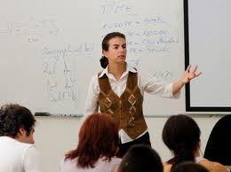
Student Segmentation
Support Segment
  33%
Financial Segment
  37%
Reputation Segment
  30%
Messaging for one isn’t necessarily going to apply to the others

Slide 38
Student Mindset Segment Personas
Support Segment
Financial Segment
Reputation Segment
  Want to feel that they are not alone.
  Seek connections with the school at all levels including but not limited to; institutional, peer, instructor and support services.
  Motivated by being part of the University community
  Need to understand the cost benefit of the programs offered to feel comfortable about the decision to enroll.
  Desiring more information and detail about anything related to the enrollment decision including but not limited to: aid, ROI, employment, special student rates. etc.
  Searching for assurance that the school is highly regarded by others and that instructors are qualified and with experience in their fields.
  Want to understand the school has the qualifications to get them where they want to go and advance if the student desires to do so.

Slide 39
‘Support’ Segment
‘Support’ Segment’s most positively impactful statements:
Technical support is accessible via e-mail or phone 24 hours a day, seven days a week.
The support of your classmates will improve your success
The University offers adequate technical support
Individual back to school transition help
Short-term programs to graduate faster
Strong sense of community encouraged between classmates to help each other succeed
Attend class when it fits your schedule…with on demand learning
Professors offer guidance and support when requested

Slide 40
‘Support’ Segment
‘Support’ Segment’s most negatively impactful statements:
Discounted computers and software purchase programs available
This University offers under graduate and graduate degree programs
Monthly payment plans are available
Earning a degree is a solid return on my investment
This University has an outstanding reputation

Slide 41
‘Financial’ Segment
‘Financial’ Segment’s most positively impactful statements:
Financial aid is available
Earning a degree is a solid return on my investment
Monthly payment plans are available
Earning a degree will improve your career opportunities
Discounted computers and software purchase programs available
Individual back to school transition help
Scholarships are available
Credits are easily transferred
Student loans are available

Slide 42
‘Financial’ Segment
‘Financial’ Segment’s most negatively impactful statements:
Academic advisors are available 24 x 7
Academic advisors available when requested
Technical support is accessible via e-mail or phone 24 hours a day, seven days a week
The University understands your individual needs
Professors offer guidance and support when requested

Slide 43
‘Reputation’ Segment
‘Reputation’ Segment’s most positively impactful statements:
This University is regionally accredited
University instructors are experienced and knowledgeable
This University offers under graduate and graduate degree programs

Slide 44
‘Reputation’ Segment
‘Reputation’ Segment’s most negatively impactful statements:
Individual back to school transition help
Attend courses in a modern comfortable classroom
Earning a degree will help you get a job in a new profession or field
Having a degree is important to my co-workers and peers
You believe that you can complete your degree program
Learning new information and acquiring new skills will help you grow in your career
The support of your classmates will improve your success
Discounted computers and software purchase programs available
The University offers adequate technical support
Earning a degree is a solid return on my investment

Slide 45
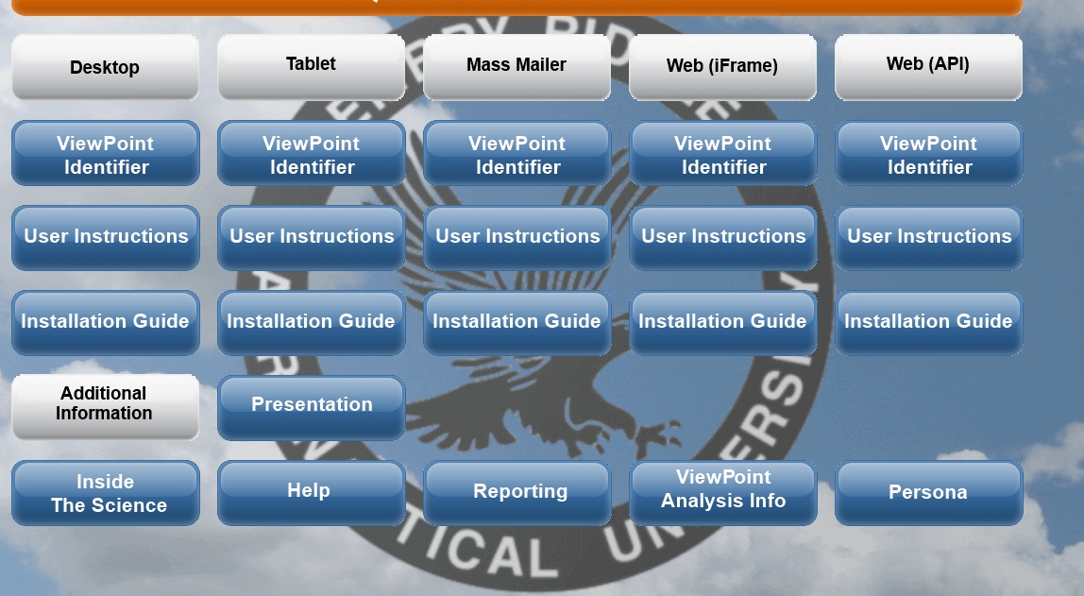
On-line Installation Dashboard
Accelerates Applied Use of the Science

Slide 46
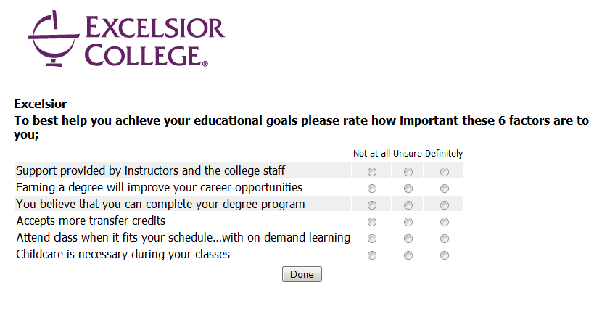
The ViewPoint Identifier:
Just A Few Simple Questions

Slide 47
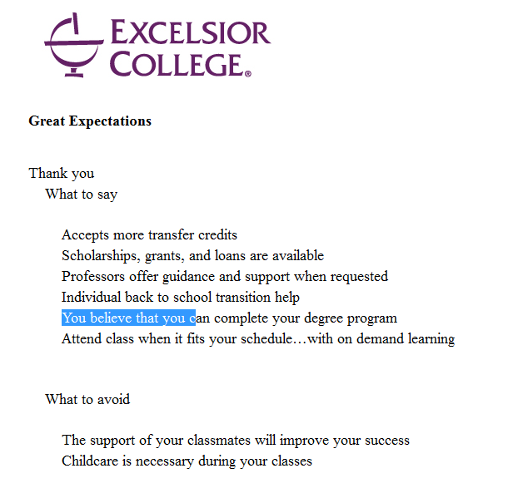

On The Spot: Know What To Say
And What NOT To Say with ViewPoint specific messages

Slide 48
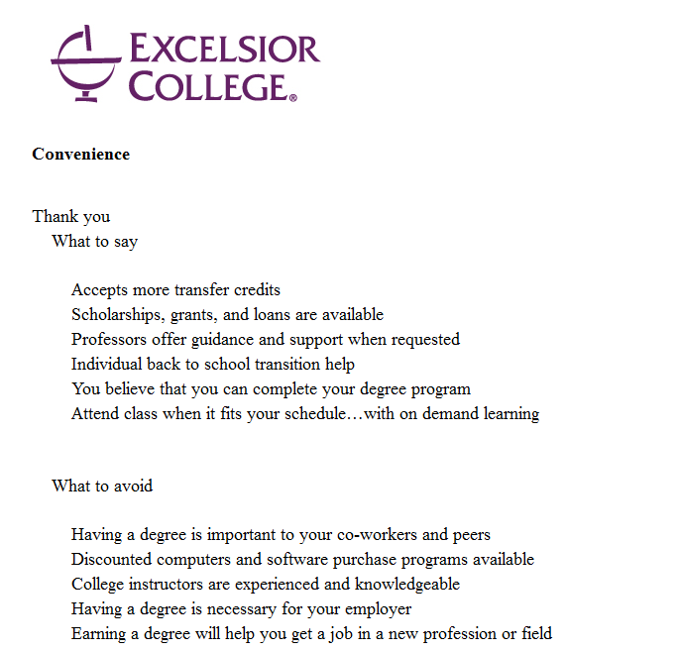
Immediately: Know What To Say
And What NOT To Say with ViewPoint specific messages

Slide 49
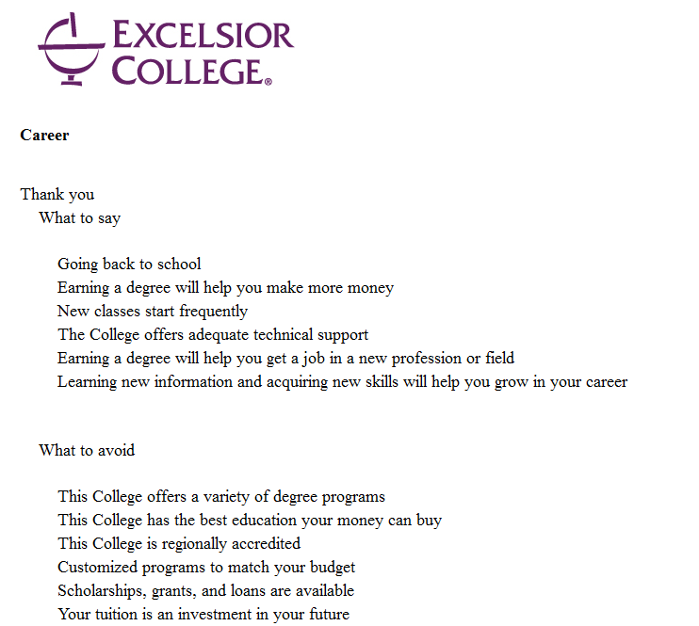

Immediately: Know What To Say
And What NOT To Say with ViewPoint specific messages

Slide 50
Results in Education -
Initial Returns show a 30 % increase in enrollments with the use of ViewPoint Messaging
Notes:
This graph shows the less than 30 day readmission rates for patients with congestive heart failure at a local hospital. The first column shows patients who were admitted for CHF during FY 2012 (262). The second column shows CHF patients who were readmitted in less than 30 days during FY 2012 (45) or 17.04%. Column three shows the number of CHF patients who we admitted between Feb 1 and July 31, 2013 (204) and typed. Column four shows the number of patients who were readmitted for CHF during the same period (6) or 2.94%.

Slide 51
iNovum Healthcare
Case Study

Slide 52
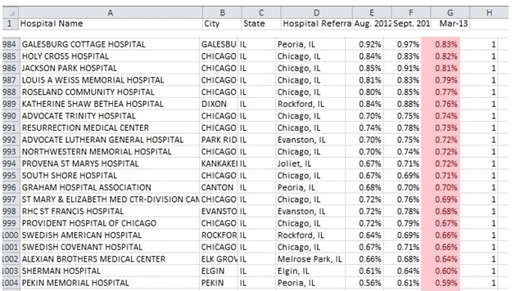
Under the Affordable Care Act, hospitals will be penalized on reimbursement if they are in the bottom of their peer hospital group with under 30 day readmissions - The Problem is Real Today…

Slide 53
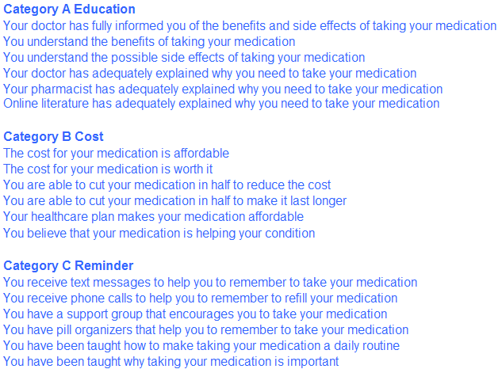

Compliance Messages – ‘raw material’ (1 of 2)

Slide 54
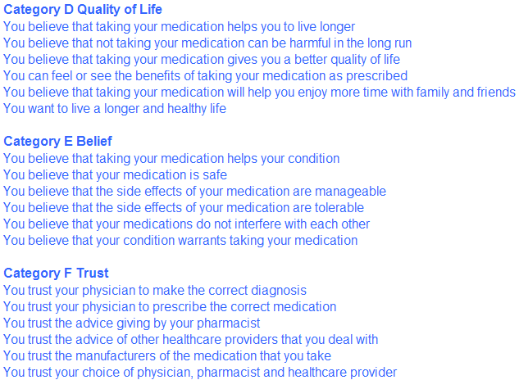
Compliance Messages – ‘raw material’ (2 of 2)

Slide 55
The survey uses “Rating Questions” which reveal
logic and emotions evoked by each message
  How likely are you to take your medication based on this information?
  1- Not at all likely 9 - Very likely
  Based on this screen ALONE…How do you feel when you read this screen?
  1 - Healthy 2 - Uncertain 3 - Confident 4 - Frightened
  5- Hopeful

Slide 56
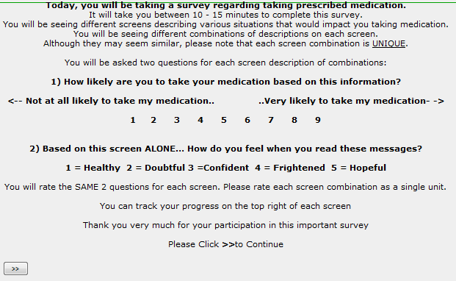
The Study begins with an orientation screen

Slide 57
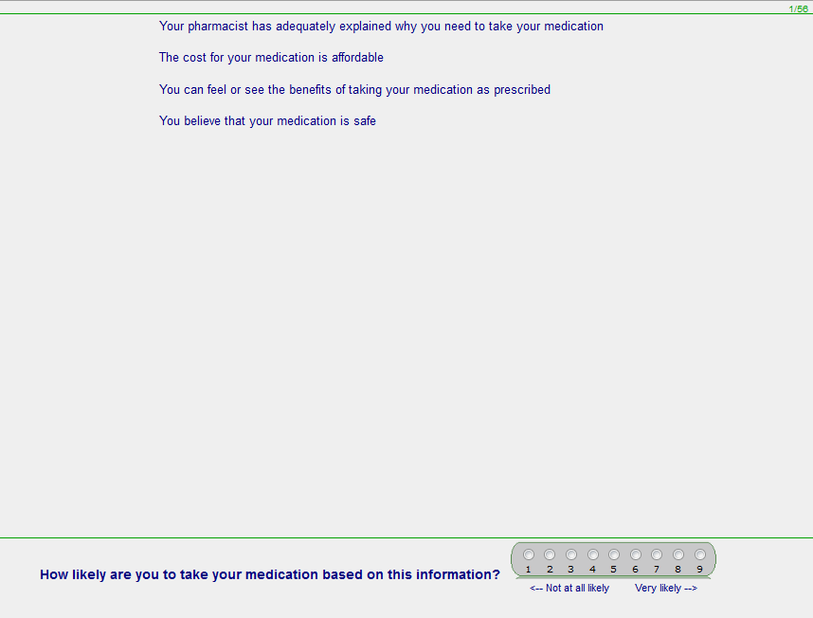
Each respondent evaluates 48 unique combinations of elements structured by design….the ‘idea’ recipes
First on overall likelihood to take prescribed medications…

Slide 58
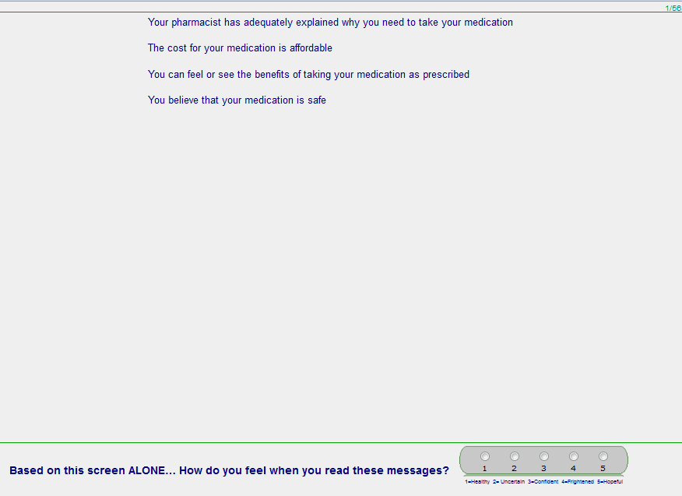
Then selects a single emotion…
Notes:
58

Slide 59
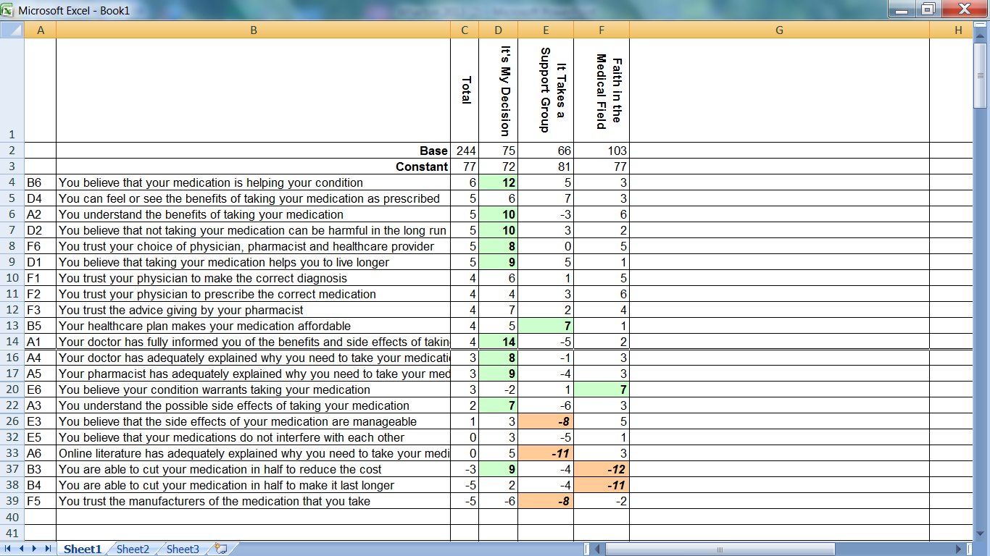
Performance of key elements

Slide 60


Patient Segmentation
It’s My Decision
31%
I Need Support
27%
Faith in Medicine
  42%
Messaging for one isn’t necessarily going to apply to the others
Notes:
Messages that are important to one segment are not necessarily important to another. In fact, what resonates positively with one segment could turn off another segment.
The three emergent mindset segments fell into: support, financial, and reputation.

Slide 61
Patient ViewPoint Segment Personas
It’s My Decision
I Need Support
Faith in Medicine
This person wants the facts, being fully informed of benefits and side effects by doctor and pharmacy. They believe medication will help and to not take it would cause long-term harm.
This person wants to live a longer life, is teachable, seeks tangible results, and needs encouragement from a support group. They have a healthcare plan which helps make medication affordable.
This person trusts their physician to prescribe the correct medication, and is strongly influenced by their pharmacy and healthcare providers. They believe they need the medication and the side effects of the medication are manageable.
Notes:
Once the mindset segments are identified and the statements are analyzed, we create a persona to help the admissions rep have a quick understanding of the potential student’s mindset.

Slide 62
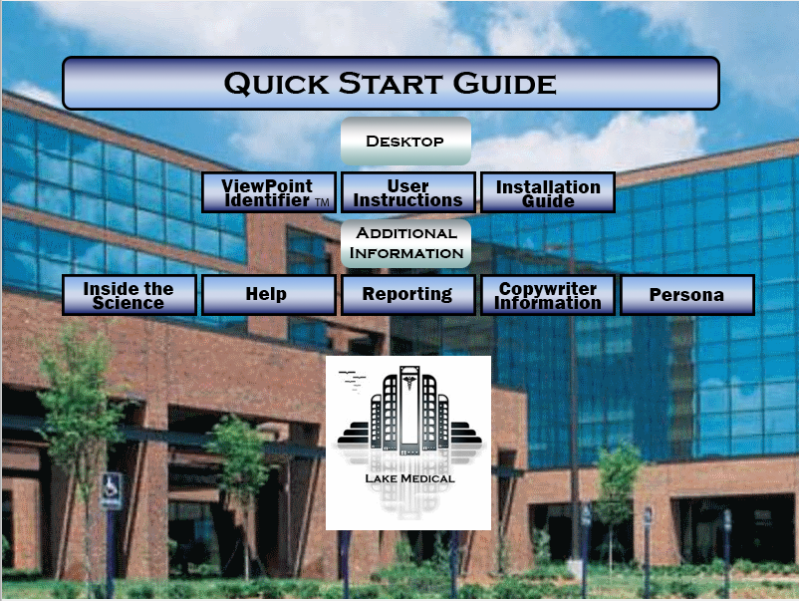

Slide 63
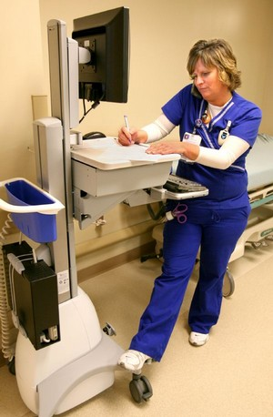
Nurse-Patient Communication and Follow-Up is Key

Slide 64
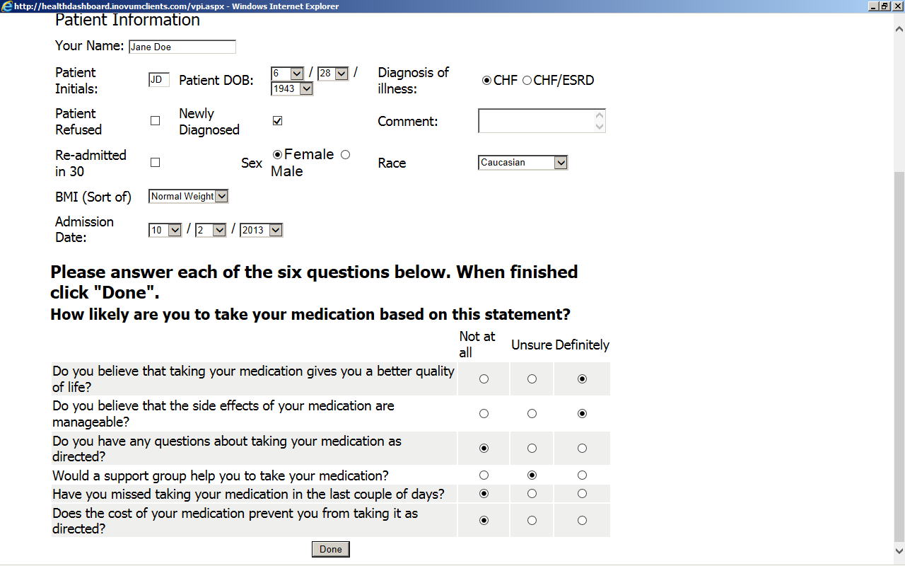
A patient admitted for Congestive Heart Failure is asked their Viewpoint about taking medication by the nurse…

Slide 65
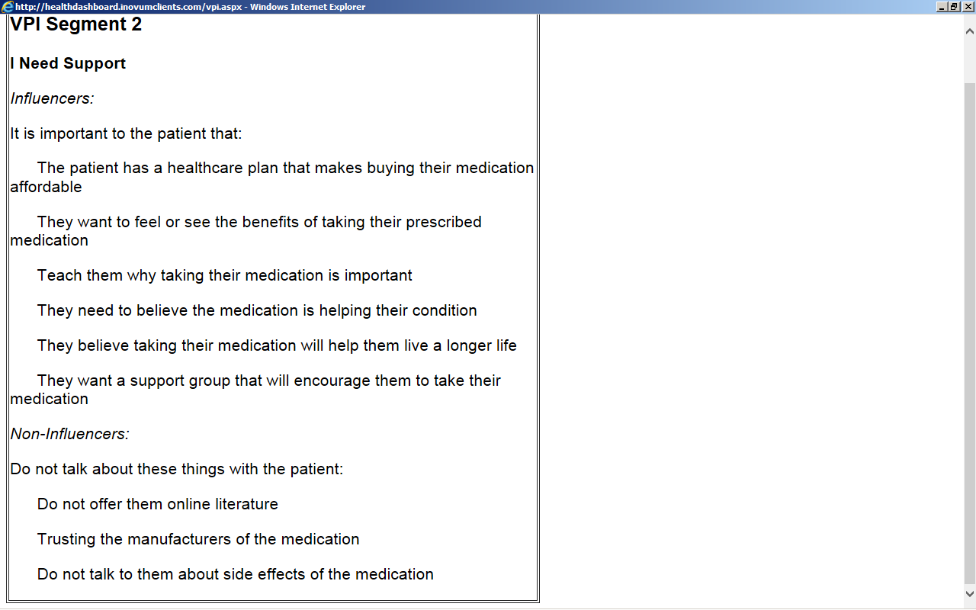
The system immediately gives the nurse their ViewPoint Segment with the motivating messages to encourage them to take their medication. These are reviewed with the patient throughout their stay and when discharged.

Slide 66
- Results -
CHF Under 30 Day Readmissions Reduced from 17% to 3 %
Notes:
This graph shows the less than 30 day readmission rates for patients with congestive heart failure at a local hospital. The first column shows patients who were admitted for CHF during FY 2012 (262). The second column shows CHF patients who were readmitted in less than 30 days during FY 2012 (45) or 17.04%. Column three shows the number of CHF patients who we admitted between Feb 1 and July 31, 2013 (204) and typed. Column four shows the number of patients who were readmitted for CHF during the same period (6) or 2.94%.

Slide 67
ViewPoint Messaging Speaks to People in terms to which they personally relate and delivers impactful measured results
Increased sales are reported from various industries with results showing increase in sales ranging from 11% to 128%.

Slide 68
What we will cover today
The Mind Genomics difference
  The Process
  Deliverables
  It is Actionable
Case Studies
  Education – How to drive application, enrollment, happier students
  Healthcare - St. Mary’s Hospital, & reducing < 30 day readmissions
The Institute for Competitive Excellence
  Education
Research
Consulting

Slide 69
The Institute for Competitive Excellence
Education: Students in Math 110 Class become interns to perform research and do billable consulting work
  - 5 Semesters
  - 150 Students in teams of 3 and 4
  - Performed 35 studies on topics of their choice
  - Final exam is presentation of survey results to faculty, family and friends
Research: Deep research with Columbia University Conflict Resolution Institute
  - !4 studies perform in Middle East conflict areas in Hebrew & Arabic
  - Focus is to get like minded ViewPoint Mind Segments on both side to engage in on-line business partnership
Billable Commercial Consulting
  Winthrop University Hospital

Slide 70

Thank you
хвала
hvala
Danke
Спасибі
hvala vam
спасибо

