Slide 1
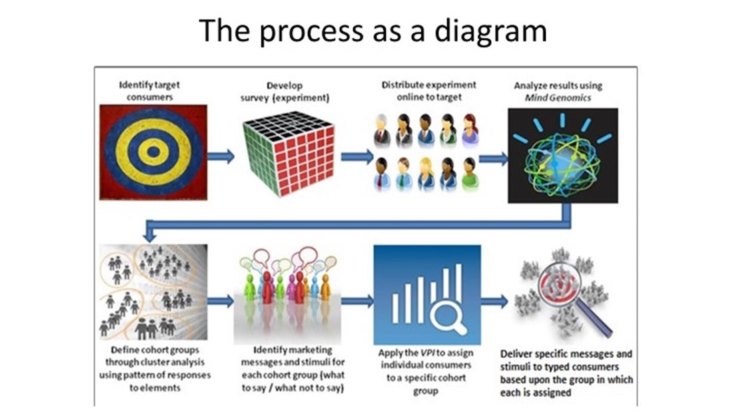

Slide 2
SILOS AND SLOGANS
The importance of nature
Conservation
Nature is the basis of everything
Nature renews itself
A completely insignificant topic
It should not be taken care of
It should be preserved
in order to enter the EU
Groceries
fruits and vegetables
Sweets
Snacks
Bottled water
Juices in a tetra pack
Milk in a tetrapack
Foods in glass packaging
Employment
Unemployed
Occasionally employed
Working from 8-12 am
Working from 7-3pm
Working from 9-5pm
Double working hours
Place of residence
Center of Podgorica
5km from the center
6km from the center
Around the school
The outskirts of Podgorica
Outside Podgorica
The importance of education
Knowledge is power
Very important
Significant
Education used to be of better quality
School should be abolished
It is better for students to study alone at home.
Number of family members
Singles
Married couple
Couple with one child
Couple with two children
Couple with 3 children
Family of 6 and more members

Slide 3

ANALYSIS: LINEAR REGRESSION

Slide 4
SLOGANS
Slogan #1
Lazy people
who don't like to carry garbage
Slogan #2
Residents of surrounding settlements
Slogan #3
Parents of students
who understand the importance of education
Slogans will increase the number of people who separate and bring waste.

Slide 5


CLASSIFY CLIENTS
EVERY TIME THEY CALL A TOLL-FREE NUMBER
?
48%
18%
21%
4%
2%
61%
22%
30%
94%

Slide 6

TARGETED ACTIONS
Separate and give us waste for recycling,
and we will provide better educational conditions for students!

Slide 7
PHASE#1
POLLERS 300 DAMAR DEFACTO MEDIA 30
6⁺36⁺300
RECYCLERS SCHOOL MGC/S PSYHO/AN

Slide 8
PHASE#2
POLLERS 300 DAMAR DEFACTO MEDIA 30
RECYCLERS SCHOOL MGC/S PSYHO/AN

