Slide 1
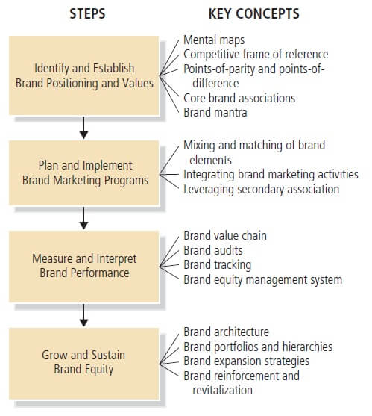
Strategic brand management process

Slide 2

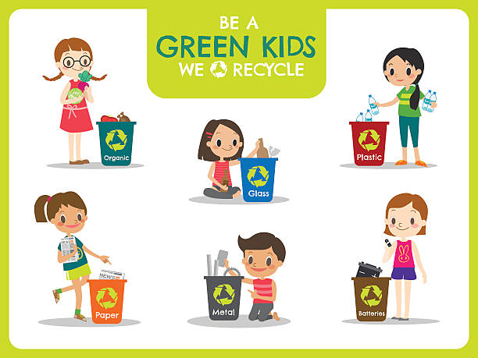
Identify and establish brand positioning and values
We are unique in the market. We work to provide better schooling conditions for children.
We are bringing Montenegro closer to the European Union
We come to your address by free call on 4444 and take away the waste,
all you have to do is separate it into 4 bags that we will give you.

Slide 3


Plan and implement Brand Marketing program
Our campaign will be supported by the Ministry of Education of Montenegro
and the Ministry of Sustainable Development and Tourism.
They will advertise our campaign in print and electronic media.
The NGO Green home and the company Deponija will support our action
through their website
Recycle, be our partner! Be cool, recycle for our school!

Slide 4
Measure and interprate brand performance
Measure the amount of collected waste on a daily basis.
Recalculate the number of participants on a daily, weekly and monthly basis
and follow the trend
Do an analysis of which part of the campaign gives the best results.
Conduct a survey of project participants in which we see where are places to improve work.

Slide 5
Grow and sustain of brand equity
Sign a multi-year contract with the company Deponija,
which provides us with the necessary infrastructure.
Sign a contract with Telekom, which will give us a free telephone line for several years.
Propose to the Ministry of Education that our brand be something
that can be implemented in all schools.

Slide 6

“A spider does not weave a web for a single fly.” folk saying

