Slide 1
Dataflow Computing
Milos Kotlar
School of Electrical Engineering, University of Belgrade
kotlar.milos@gmail.com

Slide 2
Big data
The big data applications are taking effort
to break the zetta-scale barrier (10²¹)
The main challenge is finding a way
to process such big quantities of data
The ratio of data volume increase is higher than
the ratio of processing power increase

Slide 3
Power dissipation
Most of the existing approaches are dissipating enormous amount
of electrical power, by solving big data problems
Conventional microprocessor technology
based on the control-flow paradigm
has been increasing the clock rate aligned with the Moore's Law,
and thus, the processing power has been improved

Slide 4
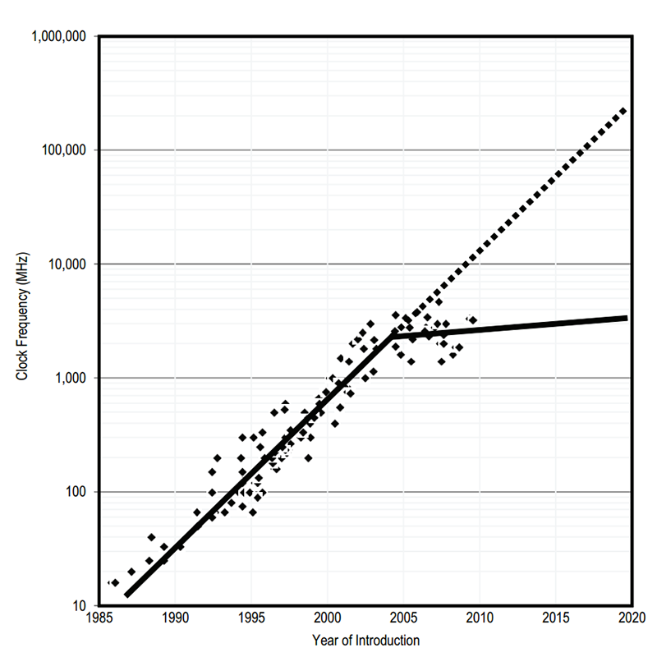
Moore’s Law
The silicon technology hit a wall, since power dissipation of silicon technology reached its technological limits
According to Moore’s Law,
the standard microprocessor technology
has hit the wall

Slide 5
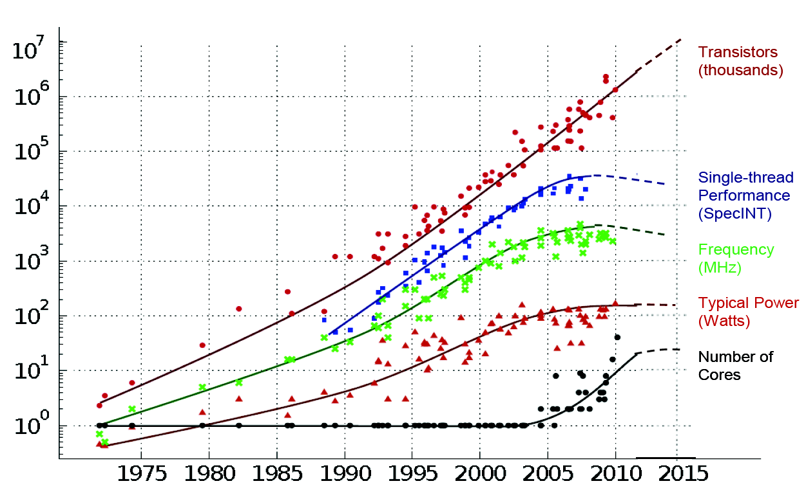
40 years of microprocessor trend data

Slide 6
High-performance computing
The end of Moore's Law leads to the several approaches
for solving this problem
The development of high-performance computing systems
utilizes other alternative architectural principles,
such as the dataflow paradigm

Slide 7
The dataflow paradigm
The dataflow paradigm introduces computing in space
where computations are placed dimensionally on a chip
Such an approach perfectly fits when
execution time is not a prime concern,
to save space and energy,
and with limited space and/or power resources
For big data algorithms, the dataflow paradigm can achieve acceleration consuming much less electrical power

Slide 8
Conditions for the dataflow paradigm
Over 95% of the algorithm run-time has to be in loops
Acceleration depends on level of data reusability inside the loops
Suitable for data streaming
Latency before the first result is computed
Presents a new programming model
Requires programming effort to accelerate an algorithm

Slide 9
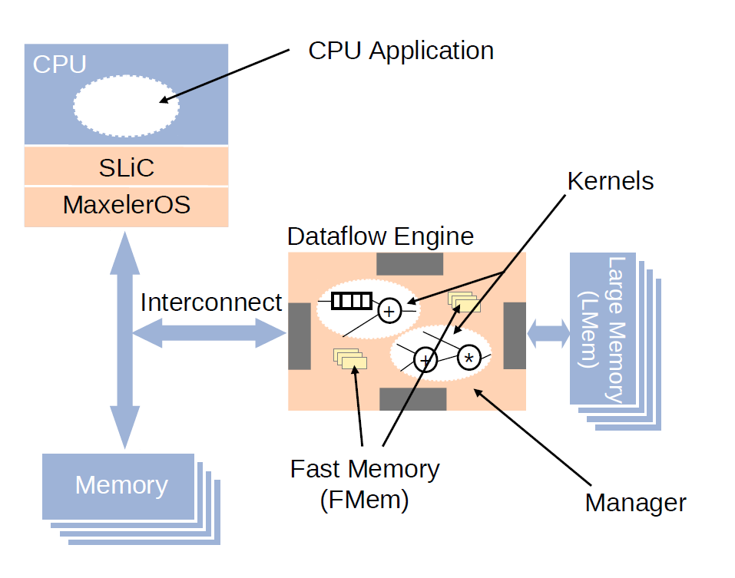
Maxeler dataflow architecture

Slide 10
Controlflow vs. dataflow
Controlfow:
  Computing in time
  Number of transistors: ~ 1B (1,000,000,000)
  Clock rate: ~4GHz
Dataflow:
  Computing in space
  Number of transistors: ~ 100M (100,000,000)
  Clock rate: ~200MHz

Slide 11
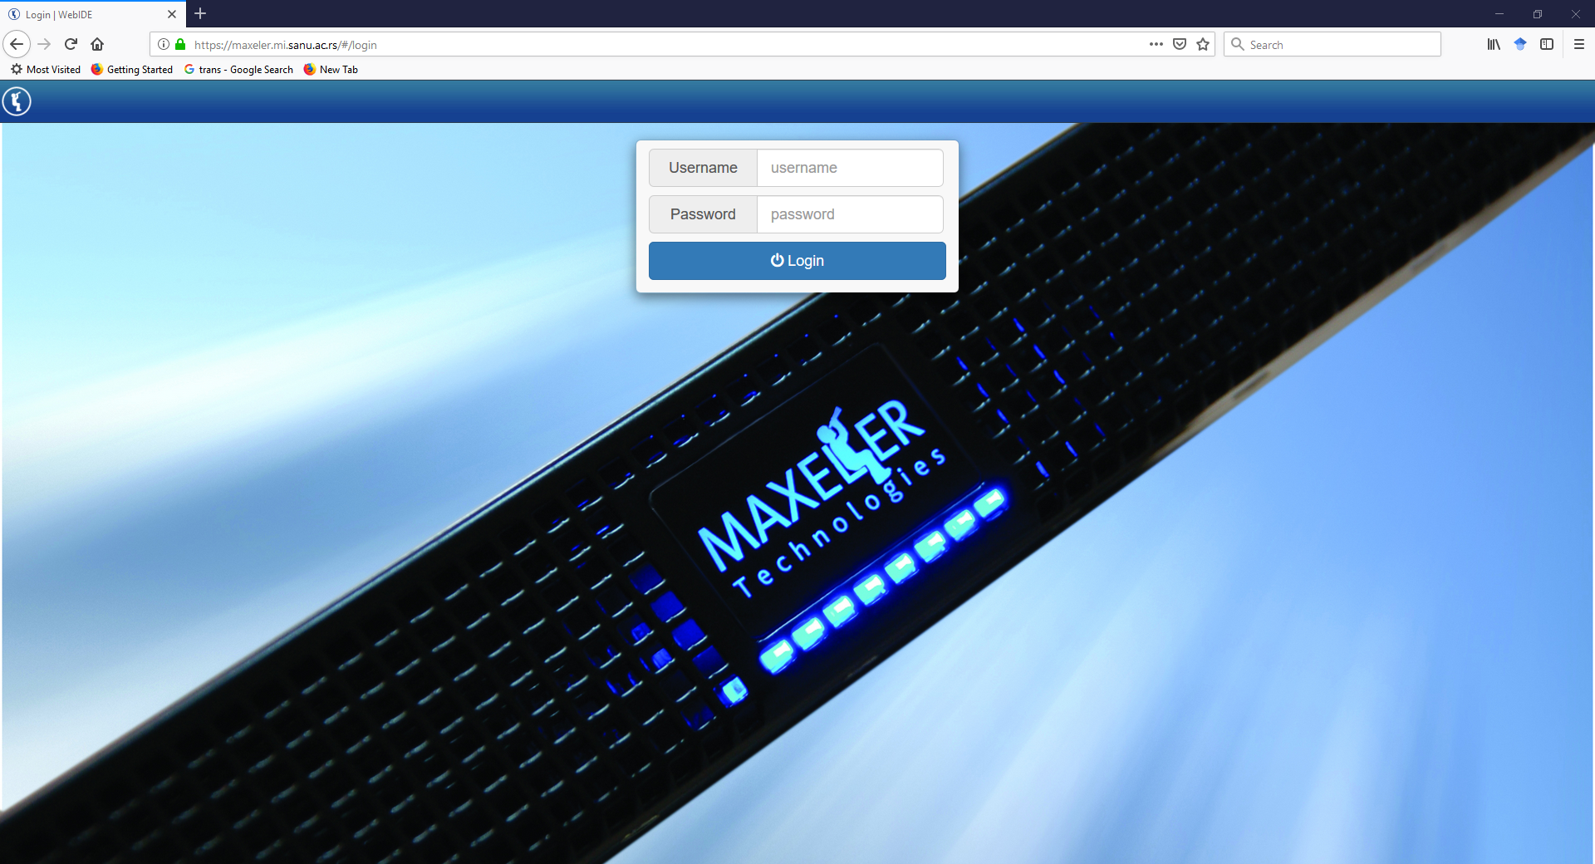
Maxeler WebIDE
Programming environment
Simulation

Slide 12

Exercise 1 - Hello World
Write a Kernel that takes a single input stream x
and applies a simple function:

Slide 13
Application
CPU code
Kernel is a graph of pipelined arithmetic units
Manager describes the data flow choreography
between Kernels, the DFE’s memory and the CPU
SLiC Skin enables communication between CPU and DFE
MaxCompiler uses an extended version of Java called MaxJ
Files have the .maxj file extension

Slide 14
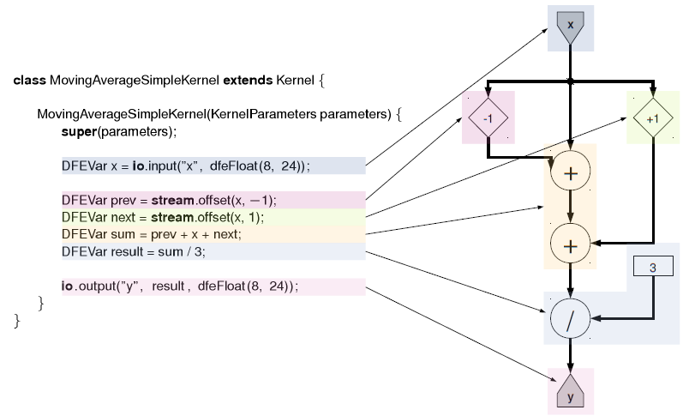
Kernel

Slide 15
Manager
The Standard Manager provided with MaxCompiler
is a general-purpose Manager which supports:
  a single Kernel
  external LMem interfaces
  linking between multiple dataflow engines
  links to the CPU

Slide 16
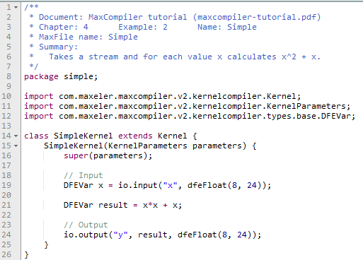
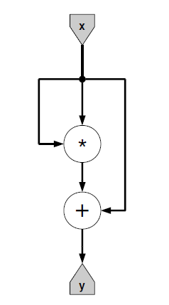
Hello World – Kernel code

Slide 17
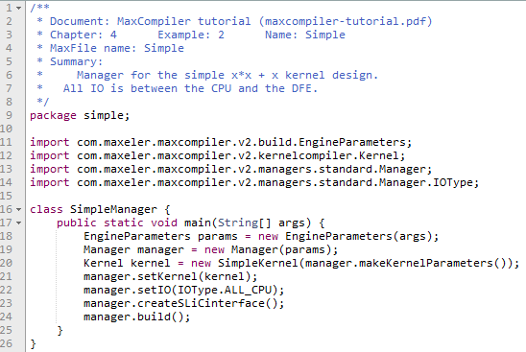
Hello World – Manager code

Slide 18
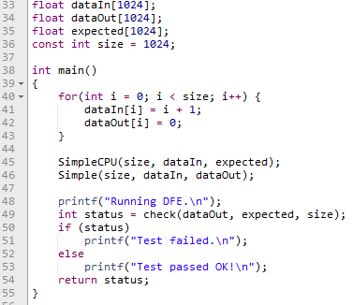
Hello World – CPU code

Slide 19
Debugging
simPrintf allow to print values explicitly from streams
within the Kernel on every tick
simPrintf behave similarly to printf in C
To print the message only when a certain condition is met,
a Boolean DFEVar stream can be supplied as a condition:
  void debug.simPrintf(DFEVar condition, String message, Object... args)
The arguments args can contain Java variables or DFEVar streams.

Slide 20
Exercise 1
Write a Kernel that takes two single input streams x and y
and produces a new output single stream as a summation
of the two input streams.
DFEVar io.input(String name, DFEType type)
DFEVar io.output(String name, DFEVar result, DFEType type)

Slide 21
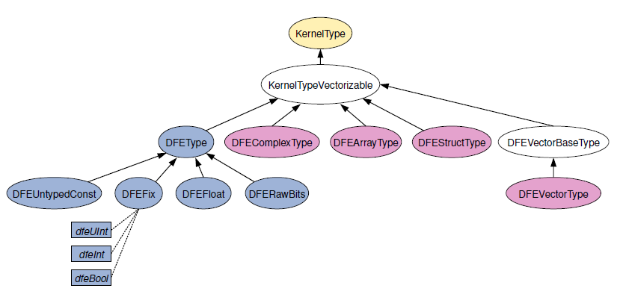
Software and hardware variables
Software variables exist during the compilation time
Hardware variables exist during the execution time

Slide 22
Hardware variables
A floating-point type parameterized
with mantissa and exponent bit-widths:
  dfeFloat(int exponent_bits, int mantissa_bits)
A fixed-point type
with parameterizable size and binary point offset:
  dfeFixOffset(int num_bits, int offset, SignMode sign_mode*)
*SignMode.UNSIGNED ,SignMode.TWOSCOMPLEMENT

Slide 23

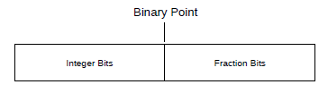
Floating-point vs fixed-point

Slide 24
Hardware variables
dfeUInt(int bits)
dfeInt(int bits)
dfeBool()
DFERawBits streams are used to prevent invalid operations:
  dfeRawBits()
DFEComplex/DFEVector variables allow multiple variables
to be grouped together

Slide 25
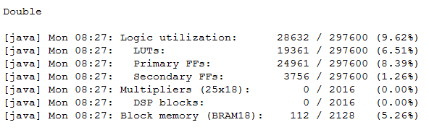
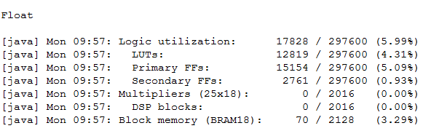
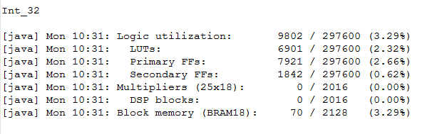
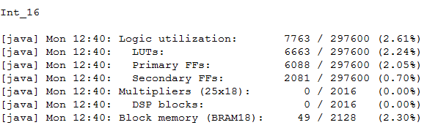
Resource allocation

Slide 26
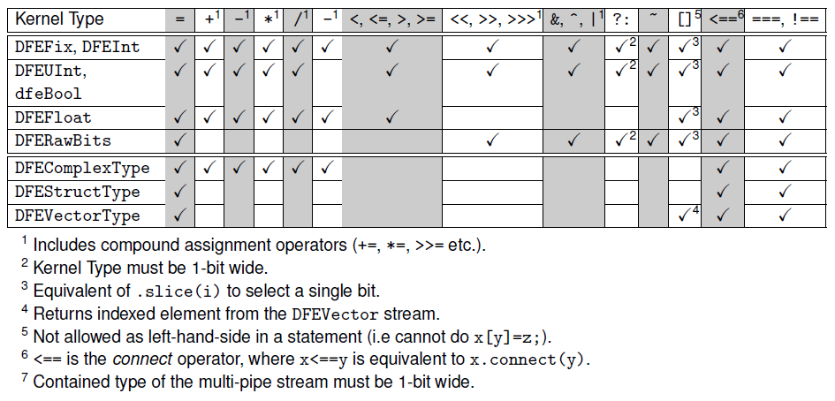
Available dataflow operators

Slide 27
Exercise 2
Write a Kernel that takes two vector input streams x and y
and produces a new output vector stream as a summation
of the two input streams.
DFEVectorType<DFEVar> vectorType =
new DFEVectorType<DFEVar>(DFEType type, int size);

Slide 28
Exercise 3
Design a Kernel that takes an input vector of four 32-bit unsigned integers, reverses the order of the elements in the vector and sends them back out again.
DFEVectorType<DFEVar> vectorType =
new DFEVectorType<DFEVar>(DFEType type, int size);

Slide 29
Scalar values
Transfer single values to and from the DFE at runtime
  io.scalarInput(name, dfe_type)
In contrast to a parameter passed to the constructor
of the Kernel class, which requires recompilation,
a scalar input can be set by the CPU application
dynamically at runtime

Slide 30
Exercise 4
Design a Kernel that takes an input vector of 32-bit unsigned integers, reverses the order of the elements in the vector and sends them back out again, using a scalar input for vector size.
DFEVar var = io.scalarInput(name, dfe_type);

Slide 31
Streams of data
A core concept of dataflow computing
is operating on windows into data streams
The data window is held in on-chip memory on the dataflow engine, minimizing off-chip data transfers
Stream offsetting allows us to access data elements within a stream relative to the current location

Slide 32
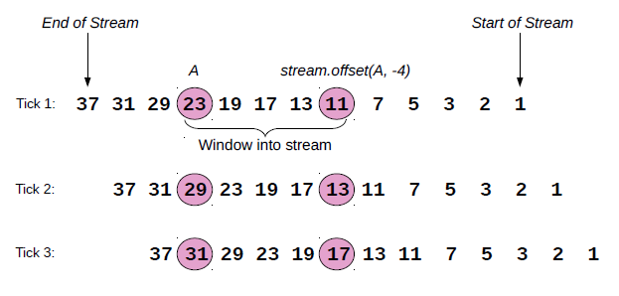
Streams of data

Slide 33
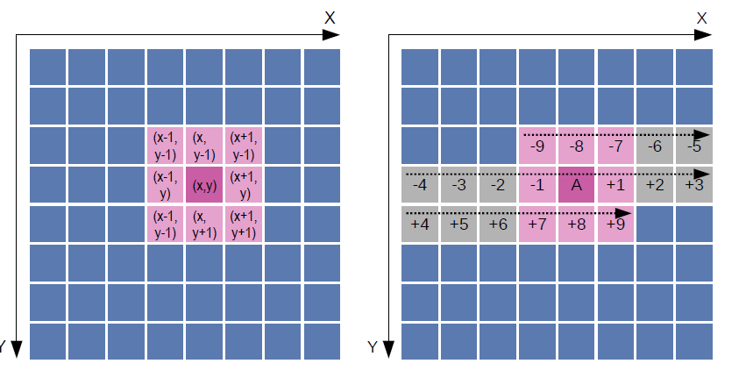
Streams of data

Slide 34
Streams of data
Maxeler supports three types of stream offsets:
  static offsets have a size fixed at compile-time
    stream.offset(DFEVar in_stream, int constant)
  variable offsets have size set at run time before a stream is processed
    stream.offset(DFEVar in_stream, int constant)
  dynamic offsets have sizes set at run time during stream processing
    stream.offset(KernelObject src, DFEVar offset, int min offset , int max offset)

Slide 35
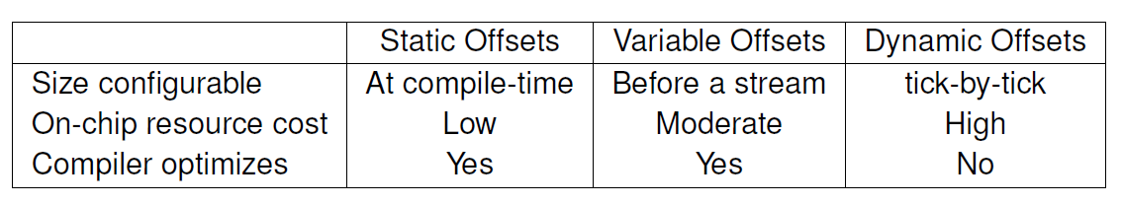
Characteristics stream offsets

Slide 36

Exercise 5
Write a Kernel that computes a 3-point moving average over a sequence of N data values. The moving average can be expressed as:
stream.offset(DFEVar in_stream, int constant)

Slide 37
Counters
Equivalents of loops in sequential programs
Counters allow Kernel designs to keep track of
where they are in the stream and keep track of
various levels of streaming and iteration
DFEVar control.count.simpleCounter(int bit_width)

Slide 38
Advanced counters
Count.Params control.count.makeParams(int bit_width)
Counter control.count.makeCounter(Count.Params params)
Options:
  bit width
  initial value
  increment
  count mode (NUMERIC INCREMENTING, SHIFT LEFT, SHIFT RIGHT)
  maximum value
  wrap mode
  wrap value
  enable

Slide 39
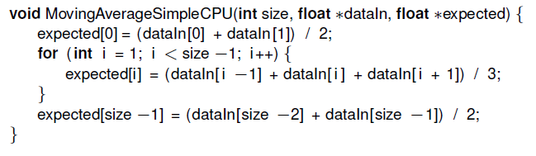
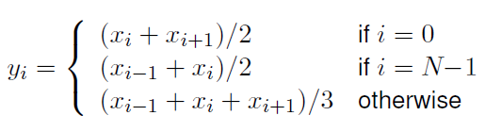
Exercise 6
Write a Kernel that computes a 3-point moving average over a sequence of N data values. At the boundaries (the beginning and the end of the data sequence), 2-point averages need to be applied.

Slide 40
Controlled inputs and outputs
Dataflow inputs and outputs could be controlled
using streams of Boolean values,
telling the gate to be open or closed during each tick
io. input(String name, KernelType type, DFEVar control)
io.output(String name, KernelObject output, KernelType type, DFEVar control)

Slide 41
DFE memory
Kernel memories are implemented using
a special on-chip memory resource.
The number of on-chip BRAM resources required for a particular kernel memory depends on:
The number of items in the memory
The type of the data held in the memory

Slide 42
DFE memory
DFEs provide two basic kinds of memory:
  FMem (Fast Memory)
  LMem (Large Memory)
On-chip static SRAM which can hold several MBs of data
Off-chip DRAM technology and can hold many GBs of data
All inputs and outputs to kernel memories are streams:
  Streams of addresses go in
  Streams of data come out
  Where data is being written, streams of data input go into the RAM

Slide 43
On-chip memory
The method alloc returns a Memory object,
which can then be used to access the memory:
  Memory<DFEVar> mem.alloc(DFEType type, int depth)
Data can be written into a RAM via the call:
  Memory.write(DFEVar address, DFEVar data, DFEVar enable)
Reading memory from specified addresses:
  Memory.read(DFEVar address)

Slide 44
Read-write memory
If you write to a memory address in a kernel tick
you can not call read with the same address in the same tick.
Attempting to do so will return undefined data.
As an optimization, it is also possible to create a single memory port which both reads and writes in the same tick using the same address:
  DFEVar Memory.port(DFEVar address, DFEVar data in, DFEVar enable, RamWriteMode portMode)

Slide 45
Mapped ROM memory
Memories can optionally be mapped,
which allows them to be changed by the CPU at runtime
For values that change slowly but sufficiently frequently
that it would be undesirable to recompile the .max file.
Example:
  Memory<DFEVar> mappedRom = mem.alloc(dfeFloat(8,24), dataSize);
  mappedRom.mapToCPU(”mappedRom”)

Slide 46
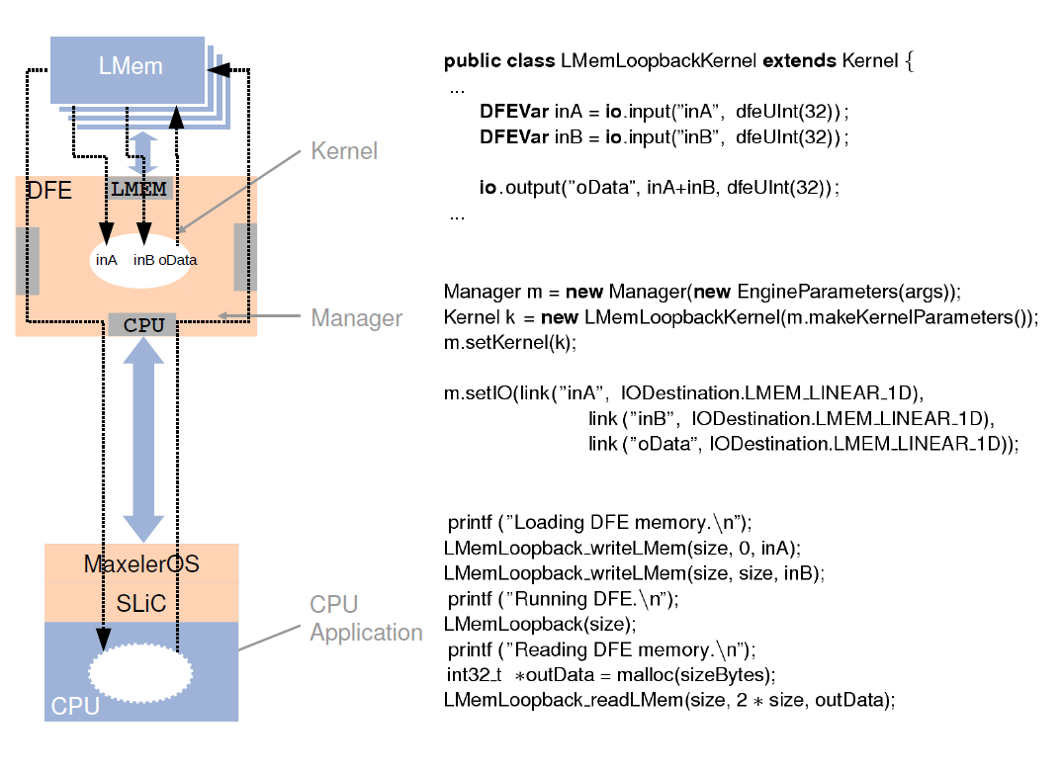
Off-chip memory
Allows large amounts of data to be kept local to the dataflow engine

Slide 47
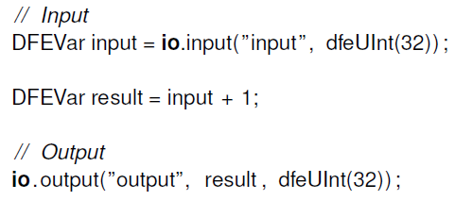
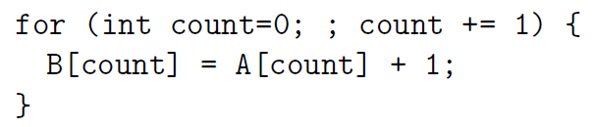
Loops in the dataflow engine
In a dataflow implementation, the data is streamed into the Kernel from the Manager, so there is no need for a loop in the Kernel itself: the loop is implicit in the stream.
The Manager controls the streaming of the data from its source, which can be from the CPU directly, from the LMem on the DFE or via MaxRing from another DFE.

Slide 48
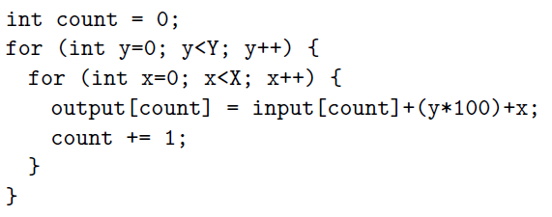
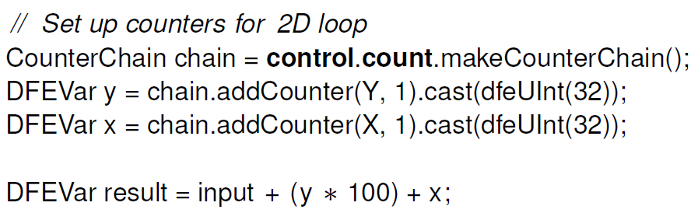
Nested & while loops in the dataflow engine
Counter chain
While loops?

Slide 49
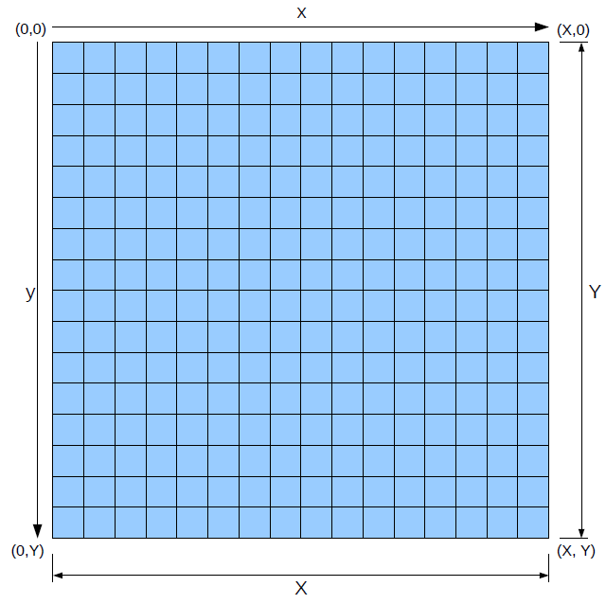
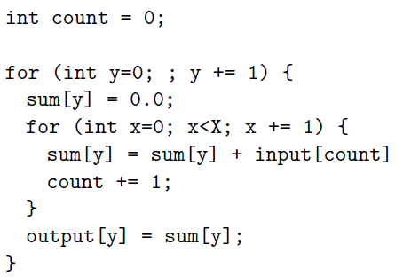
Cyclic dataflow graph
A cycle in the dataflow graph arises from a dependence
from one iteration to the next

Slide 50
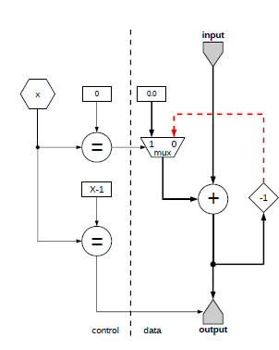
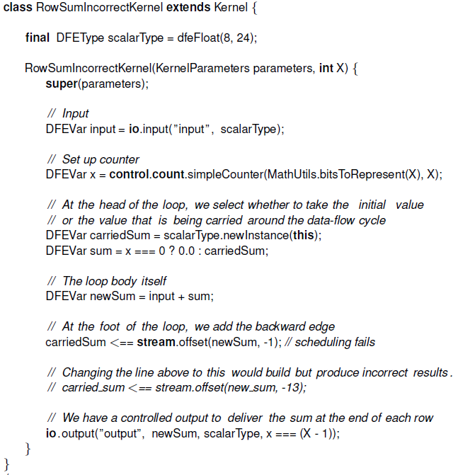
Cyclic dataflow graph

Slide 51
Autoloop offset
An Autoloop offset is a feature of MaxCompiler
that automatically calculates the lowest valid offset for a cycle
in the graph
  Stream.OffsetExpr makeOffsetAutoLoop(String name)
  Stream.OffsetExpr makeOffsetAutoLoop(String name, int min size, int max size)
  DFEVar Stream.OffsetExpr.getDFEVar(KernelLib design)

Slide 52
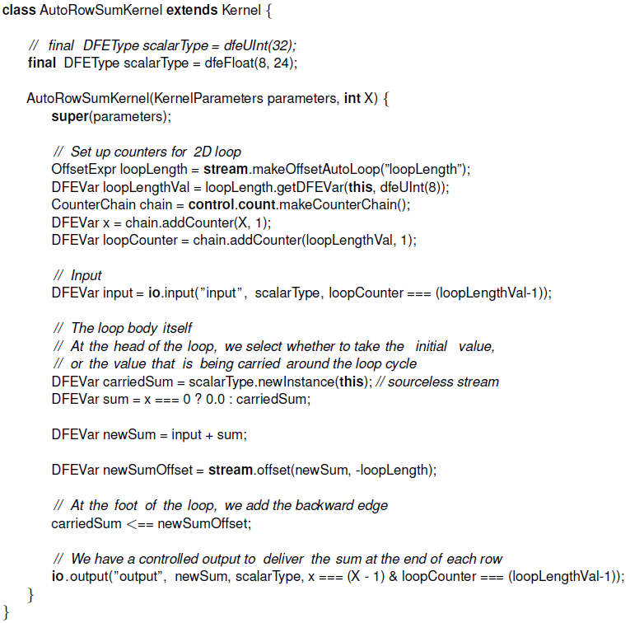
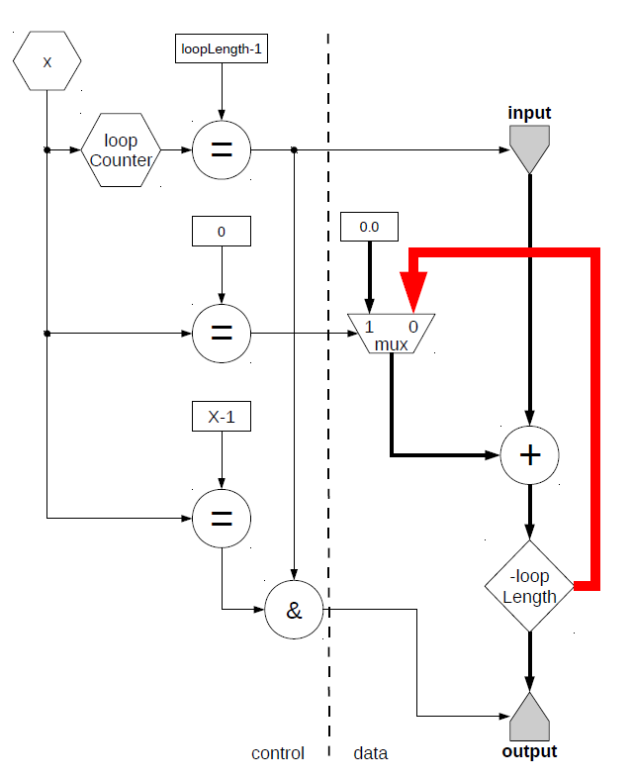
Autoloop offset

Slide 53
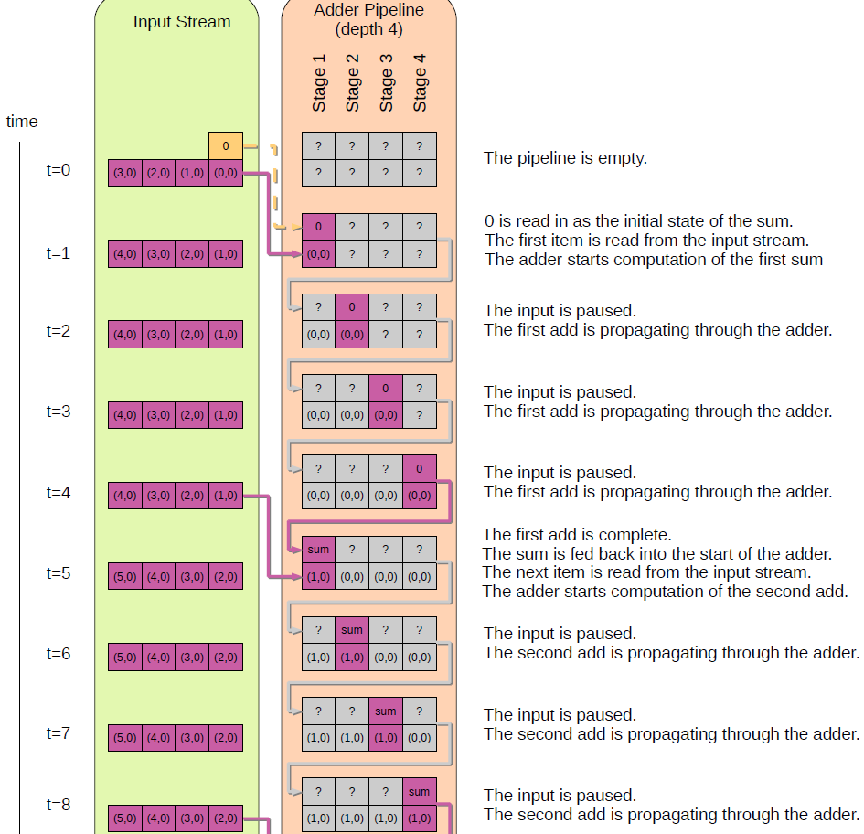
Multi-tick implementation of the row-sum

Slide 54
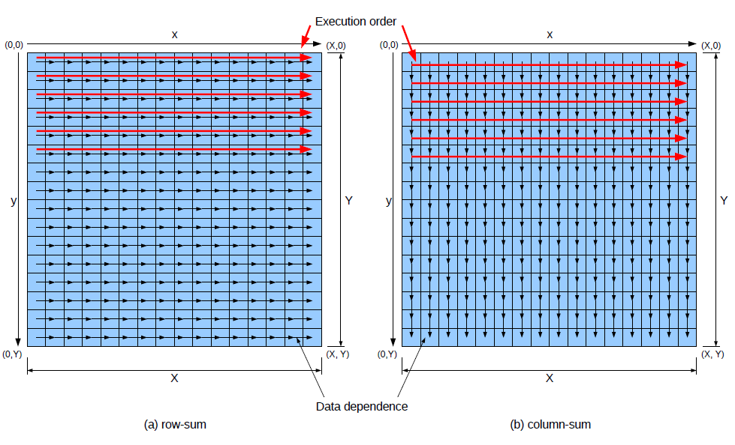
Data dependency

Slide 55
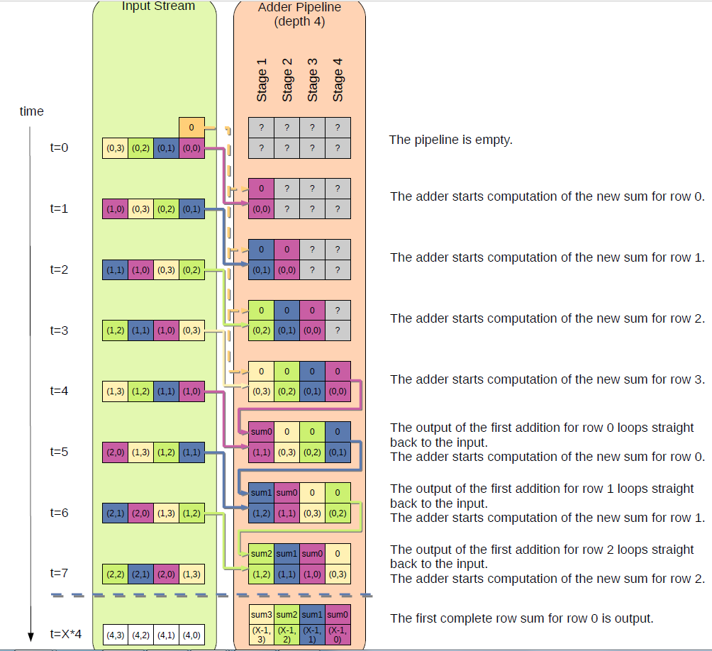
Multi-tick implementation of the column-sum

Slide 56
Homework assignments
For each homework assignment,
you should take one algorithm from the following sources:
Homework Assignment 1 (Math):
http://www.grad.hr/nastava/gs/prg/NumericalRecipesinC.pdf
without (Search, Sorting, Random Numbers, Less-Numerical Algorithms)
Homework Assignment 2 (Image Understanding):
http://homepages.inf.ed.ac.uk/rbf/BOOKS/PHILLIPS/cips2ed.pdf
Homework Assignment 3 (Machine Learning):
http://stanford.edu/~rezab/nips2014workshop/

Slide 57
Math examples
Homework assignment 1

Slide 58
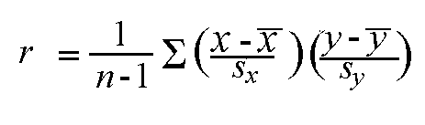
Linear correlation
Given a set of observations (x₁, y₁), (x₂,y₂),...(x_{n},y_{n}), the formula for computing the correlation coefficient is given by:

Slide 59
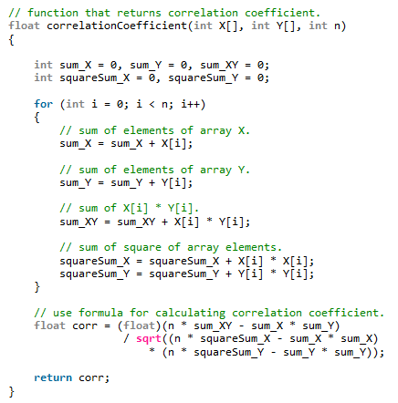
Linear correlation

Slide 60
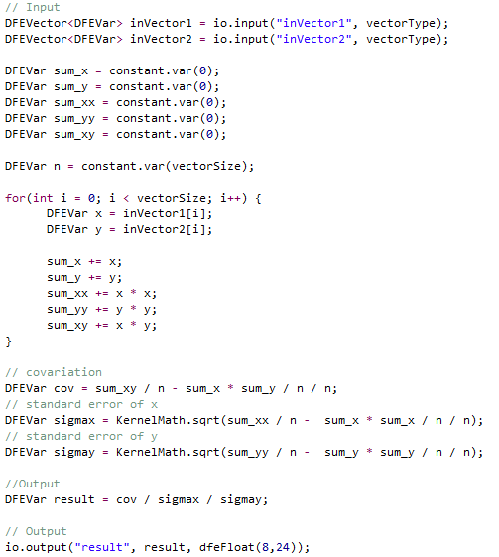
Linear correlation

Slide 61
Secant method
The secant method is a root-finding algorithm
that uses a succession of roots of secant lines
to better approximate a root of a function f.
The secant method is defined by the recurrence relation:

Slide 62
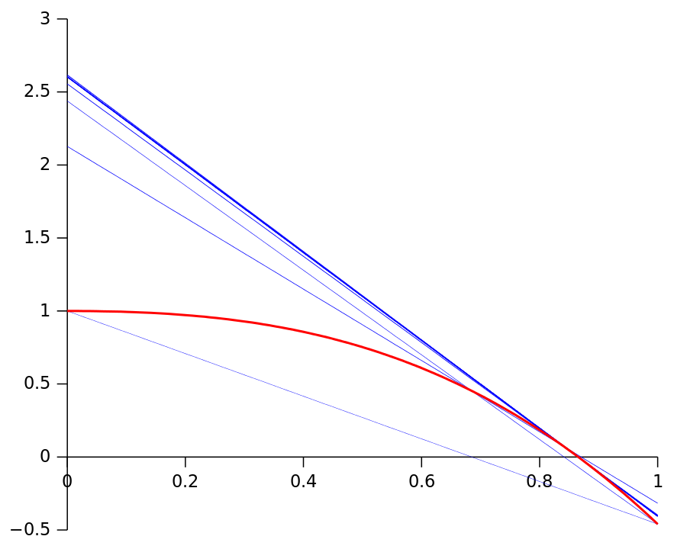
Secant method

Slide 63
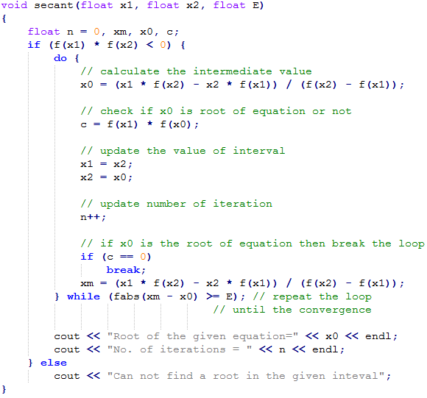
Secant method

Slide 64
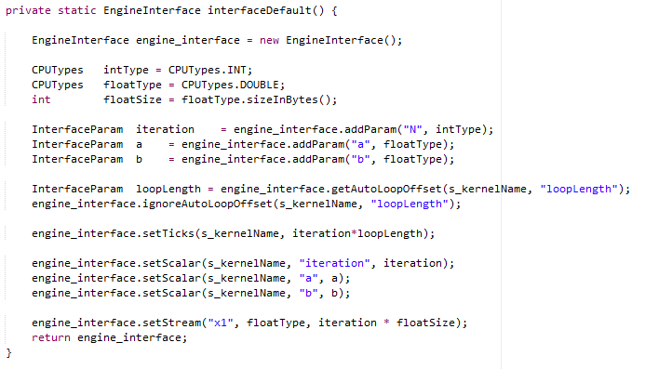
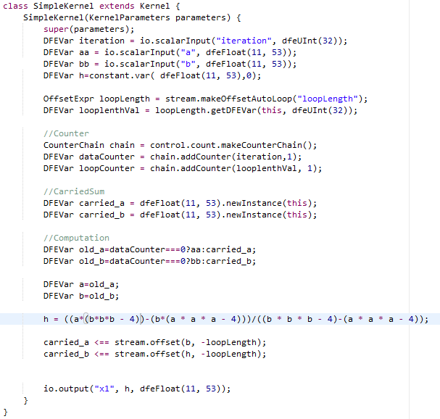
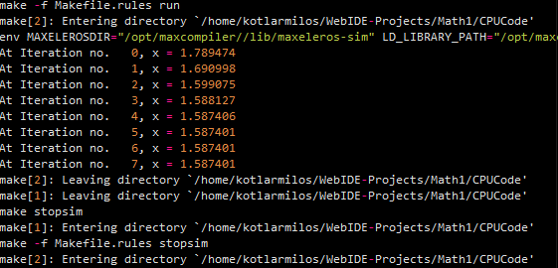
Secant method

Slide 65
Image understanding
Homework assignment 2

Slide 66
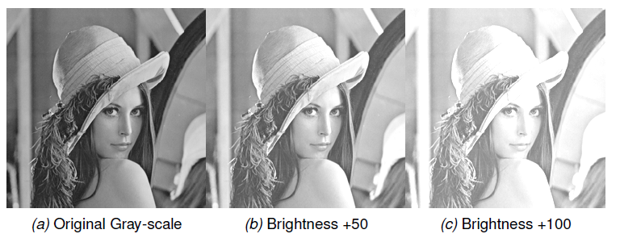
Brightness adjustment

Slide 67
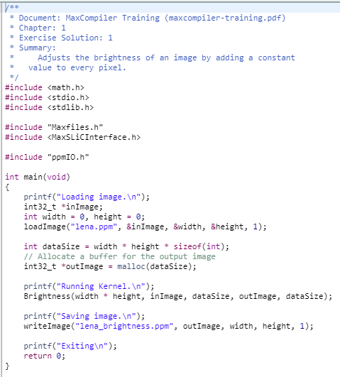
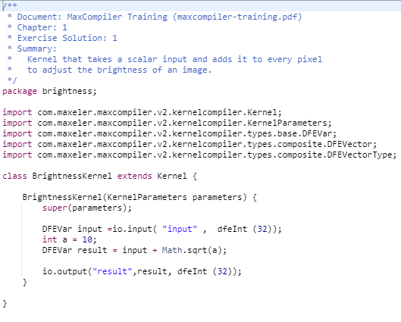
Brightness adjustment

Slide 68
Machine learning
Homework assignment 3

Slide 69
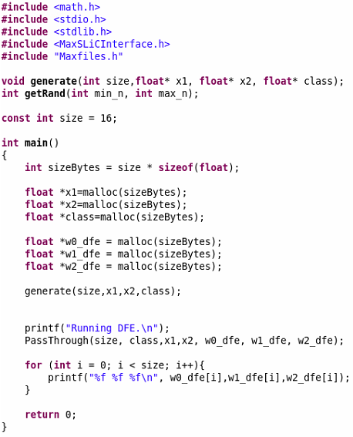
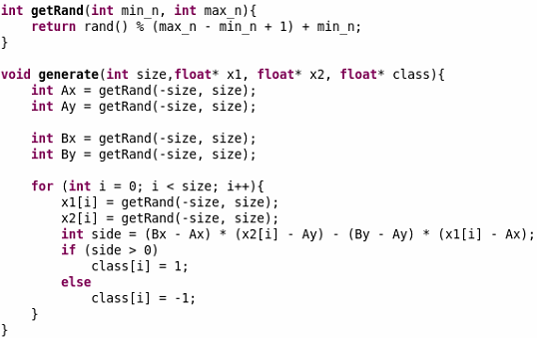
Perceptron

Slide 70
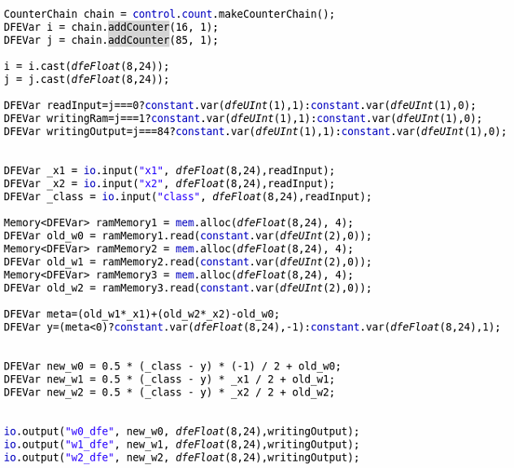
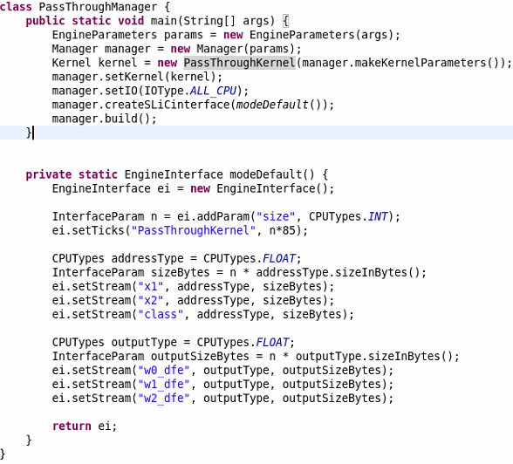

Perceptron

Slide 71

Tensor calculus

Slide 72
Q&A

