Slide 1
Smart Contracts
Milos Kotlar
kotlar.milos@gmail.com

Slide 2
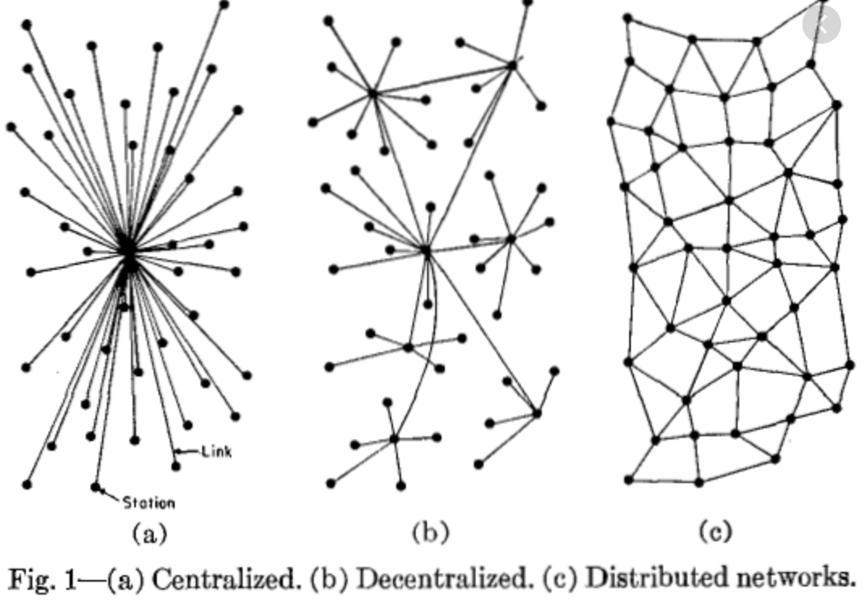
What is blockchain?
Decentralized ledger of all transactions across a peer to peer network
No need for central certifying authority

Slide 3
How it works?
Ne postoji jedan entitet koji je zadužen za održavanje i verifikaciju spiska transakcija
Svi učesnici su zaduženi za održavanje spiska i zajedno ga čuvaju
Mehanizam kojim se garantuje autentičnost i vrši provera transakcija održava više učesnika i zasniva se na kriptografskim algoritmima

Slide 4
Blockchain structure
Blockchain je linearna sekvenca blokova
Svaki blok ima prethodni I sledeci blok
Novi blok se dodaje na kraj blockchain niza
Svaki korisnik ima wallet koji ga identifikuje

Slide 5
Blockchain structure

Slide 6
Hash function

Slide 7
Hash function

Slide 8
Merkle tree
A merkle tree is a structure that allows for efficient and secure verification of content in a large body of data.

Slide 9
Adding transaction to the blockchain
If you are a miner, your job is to gather transactions from the transaction pool in to a “candidate block”, and to try and add this candidate block to the blockchain
To add a candidate block to the blockchain, you hash the data in the block header and hope that the result is below a certain target value
The target is calculated from the difficulty, which is a value set by the bitcoin network to regulate how difficult it is to add a block of transactions to the blockchain.

Slide 10
Adding transaction to the blockchain
Nonce is a dummy field that miners use to help them get a block hash below the target value
If the first nonce doesn’t work (starting at 0), keep incrementing it and hashing the block header. Eventually you’ll find a nonce that returns a block hash that is less than the target value
All miners will now head back to the transaction pool and start work on the next candidate block. They will use your successful block hash in their next block header, and the race to add a new block of transactions to the blockchain starts again
https://learnmeabitcoin.com/beginners/blocks

Slide 11
Etherium
Open source, public, blockchain-based distributed computing platform featuring smart contracts
Decentralized virtual machine (EVM) that can execute scripts using public an international network of public nodes
Smart contracts are self executing scripts hosted on EVM

Slide 12
Smart contracts

Slide 13
Solidity
Solidity is an object-oriented, high-level language for implementing smart contracts. Smart contracts are programs which govern the behaviour of accounts within the Ethereum state.
Solidity was influenced by C++, Python and JavaScript and is designed to target the Ethereum Virtual Machine (EVM).
Solidity is statically typed, supports inheritance, libraries and complex user-defined types among other features.
With Solidity you can create contracts for uses such as voting, crowdfunding, blind auctions, and multi-signature wallets.
https://solidity.readthedocs.io/en/v0.6.4/

Slide 14
Solidity example
https://solidity.readthedocs.io/en/v0.6.4/solidity-by-example.html

Slide 15
Voting example
The goal is to implement a voting contract. The main problems of electronic voting is how to assign voting rights to the correct persons and how to prevent manipulation.
https://solidity.readthedocs.io/en/v0.6.4/solidity-by-example.html
https://remix.ethereum.org/
https://gist.github.com/maheshmurthy/3da385a42678c3e36a8328cbe47cae5b
Notes:
Deploy contract:
["0x63616e6469646174653100000000000000000000000000000000000000000000","0x6332000000000000000000000000000000000000000000000000000000000000","0x6333000000000000000000000000000000000000000000000000000000000000"]

Slide 16
Voting example

Slide 17
Q&A

